Slide 1
CLASSIFIED
Classified is Jordi Beernink, Roel Bouman, Jeffrey Luppes, Gerdriaan Mulder and Thijs Werrij
Sberbank Russian Housing Market Competition
https://www.kaggle.com/c/sberbank-russian-housing-market

Slide 2
Introduction - The competition
Predict prices of realty in Moscow area
Data set consists of:
train.csv, 30473 entries with information about houses/apartments
macro.csv, data on Russia's macroeconomy and financial sector
Data is from 2011 to 2015, while the test set is from 2015 to 2016
Notes:
train.csv (build year, material, number of floors, etc.)
macro.csv (e.g. employment, salary, mortality)

Slide 3
Introduction - Data exploration

Slide 4
Approach - Pre-processing
Transform the data using one-hot encoding for categories, but preserving numerical data
[missing data?]

Slide 5
Approach - Testing different methods
Split the training data between entries before 2015 and in 2015, for internal validation
Tested several methods:
…
XGBoost
XGBoost outperformed all other methods, which later became even more notable…

Slide 6
Approach – XGBoost ensemble
Kernel published by Andy Harless
Widely used in the competition
Improved and outperformed the original
Train/Test Data
Macro-economic data
External Data
Set manual outliers to NaN
Correct for inflation on train prices
Remove possible fraud cases
Remove possible fraud cases
Correct for inflation on train prices
Add manual features
Add manual features
Correct for inflation
Add macro-economic data
XGBoost model: eta: 0.05, max depth: 6, subsample: 0.6, colsample per tree: 1 num rounds: 422
XGBoost model: eta: 0.05, max depth:5, subsample: 0.7, colsample per tree: 0.7 num rounds: 385
XGBoost model: eta: 0.05, max depth:5, subsample: 0.7, colsample per tree: 0.7 num rounds: 420
Prediction model 1
Prediction model 2
Prediction model 3
Weight: 0.3
Weight: 0.5
Weight: 0.2
Linearly combine predictions as ensemble
Final prediction

Slide 7
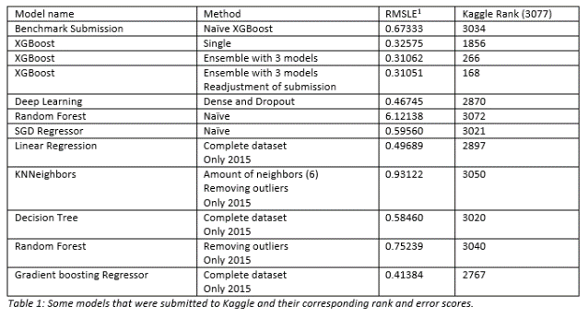
Results
Something something XGBoost

Slide 8
(discuss other things worth mentioning here)

Slide 9
Further work

Slide 10
Conclusion

Slide 11
Team Classified
Sberbank Russian Housing Market Competition
Maybe a short
Summary of stuff
Discussed
Thank you for your attention! Any questions?

