Slide 1
The TalkingData challenge
Team: Classified
Members:
Jordi Beernink – Coordination and pre-processing
Gerdriaan Mulder – Pre-processing
Thijs Werrij – Deep Learning
Jeffrey Luppes – classification
Roel Bouman – Pipeline and classification

Slide 2
The competition: Classify demographic based on mobile phone data
TalkingData is the largest Chinese third party mobile data platform
Predict user demographic per device:
Gender
Age
10 categories: M24-28, F55+, etc.
Possible predictors:
Every device has a series of events:
App used
Timestamp
App category
Location
Phone brand + model
Problem: Missing data, noise, differing #events per device

Slide 3
Our approach
Extensive pre-processing
Collect and join all data in a meaningful way
Many empty events
Classify each event -> determine probabilities per event
May work decent, but data is sparse
Feature extraction is needed!
Bag of Apps, Bag of categories, Phone brand, Distance travelled per day, Histogram of time activity
Subsets and the collection all have to be tested
Classification using Random Forests, XGBoost, Neural Networks and possibly an ensemble of these

Slide 4
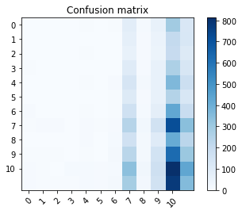
Preliminary results
Bag of apps features have been tested preliminary with Random Forests
Classifier is performing subpar
Severe class imbalance might hinder classification
This might be related to these specific features
There are still many meaningful things to be tested

