Slide 1
CLASSIFIED
Classified is Jordi Beernink, Roel Bouman, Jeffrey Luppes, Gerdriaan Mulder and Thijs Werrij
Sberbank Russian Housing Market Competition
https://www.kaggle.com/c/sberbank-russian-housing-market

Slide 2
The competition
Sberbank heavily relies on models to predict the value of property
Goal: Predict prices of realty in Moscow area
Data set consists of:
train.csv, data from Russian property market
macro.csv, data on Russia's macroeconomy and financial sector
Notes:
train.csv (build year, material, number of floors, etc.)
macro.csv (e.g. employment, salary, mortality)

Slide 3
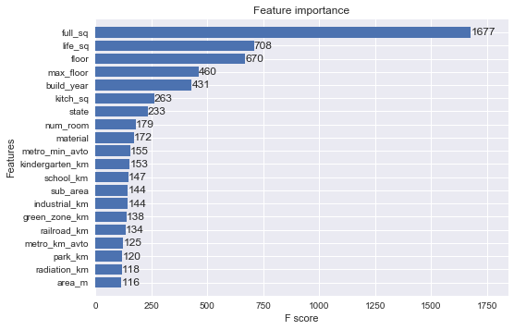
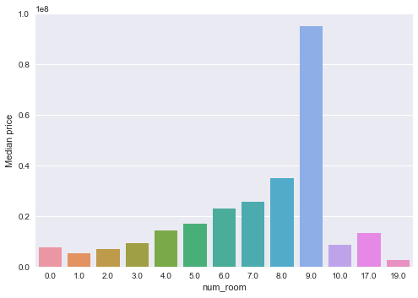
Data exploration
First two weeks we explored the data and discussed findings:
30471 entries with 291 features
Exploratory work: Python / Apache Spark / Leaflet.js
Good feel for the data, early identification of outliers/missing data
Most important features
Median price vs. number of rooms

Slide 4
Pre-processing
Training data was supplied as numerical and categorical data
To test methods, we transformed the data using one-hot encoding for categories, but preserving numerical data
To deal with missing data, imputing data has been tried (for example KNN and SVD-based methods), but were ultimately too costly to develop internally
Simpler methods like using mean, modus, median offered no improvement over not replacing NaN values
Not replacing NaN values means that some numerical data can not be used. Categorical treats NaN data as a separate category

Slide 5
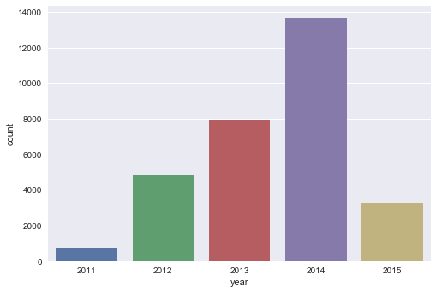
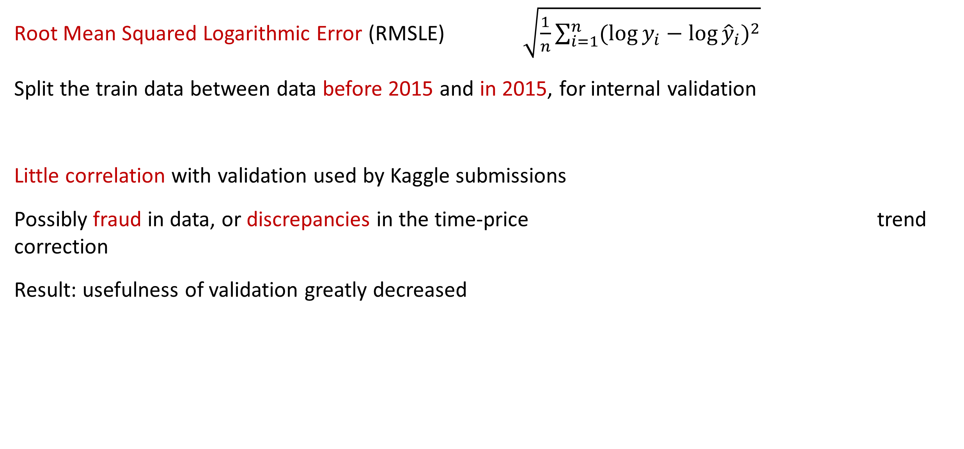
Evaluation
Root Mean Squared Logarithmic Error (RMSLE) $\sqrt{\frac{1}{n}\sum_{i=1}^{n}{{(\log{y_{i}}−\log{{\hat{y}}_{i}})}^{2}}}$
Split the train data between data before 2015 and in 2015, for internal validation
Little correlation with validation used by Kaggle submissions
Possibly fraud in data, or discrepancies in the time-price trend correction
Result: usefulness of validation greatly decreased

Slide 6
Testing different methods
Tested several methods:
Linear Regression
Random Forests
AdaBoost
k-nearest neighbors (KNN)
Stochastic gradient descent (SGD)
Deep Learning (Keras)
XGBoost (Extreme Gradient Boosting)
Methods are easy to use, readily available, and proven to work decently
XGBoost outperformed all other methods, which later became even more notable…
Notes:
It is hypothesized that XGBoost outperforms other methods by its inherent ensemble property, being able to robustly handle different categories of data. The boosting of weak learners might emphasize the variables that are useful for prediction, whilst de-emphasizing variables indicating fraud.

Slide 7
XGBoost ensemble
Kernel published by Andy Harless
Used 3 models from others.
Widely used in the competition
We improved it and outperformed the original significantly.
Original now somewhere around rank 600.
Train/Test Data
Macro-economic data
External Data
Set manual outliers to NaN
Correct for inflation on train prices
Remove possible fraud cases
Remove possible fraud cases
Correct for inflation on train prices
Add manual features
Add manual features
Correct for inflation
Add macro-economic data
XGBoost model: eta: 0.05, max depth: 6, subsample: 0.6, colsample per tree: 1 num rounds: 422
XGBoost model: eta: 0.05, max depth:5, subsample: 0.7, colsample per tree: 0.7 num rounds: 385
XGBoost model: eta: 0.05, max depth:5, subsample: 0.7, colsample per tree: 0.7 num rounds: 420
Prediction model 1
Prediction model 2
Prediction model 3
Weight: 0.3
Weight: 0.5
Weight: 0.2
Linearly combine predictions as ensemble
Final prediction

Slide 8
Results
Model | Extra info | RMSLE | Kaggle Rank
XGBoost | Ensemble with three models | 0.31038 | 134
XGBoost | Ensemble with three models | 0.31062 | 420
XGBoost | Single model | 0.32575 | 1856
Gradient Boosting Regressor | trained on 2015 | 0.41384 | 2767
DNN | 10-layer | 0.467445 | 2870
Linear Regression | trained on 2015 | 0.49689 | 2897
Decision Tree | trained on 2015 | 0.5846 | 3020
SGD Regressor | Naive | 0.5956 | 3021
XGBoost | Baseline Model | 0.67333 | 3034
Random Forest | trained on 2015 | 0.75239 | 3040
KNN Regressor | trained on 2015 | 0.93122 | 3050
Random Forest | Naive | 6.12138 | 3072
Best obtained score from each implementation is shown, if submitted.

Slide 9
Conclusion
Top scores very close together
Ensembles, Ensembles, Ensembles..
XGBoost outperformed other models
Pre-processing helped tremendously
Compensating for inflation

Slide 10
Conclusion
Felt “wrong” to take advantage of code posted in public
But at the same time it accelerated our progress, and it was standard practice
We were working as a community on the same ideas!

Slide 11
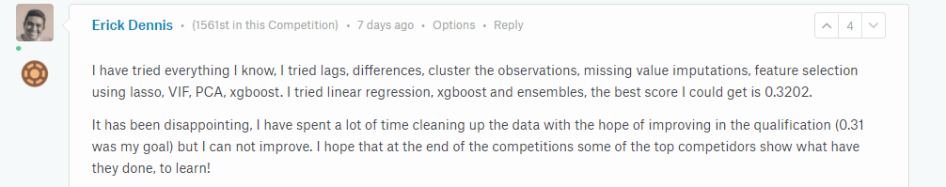
Words on Sberbank’s competition
Blatant fraud and tax evasion in data set (5% of data?!)
Wrong data (laziness) or errors
Data based on developers/investors/owner’s head office location instead of property itself.
Kaggle: new scores with new data set, old scores not recalc’d until 4 days ago
Fluctuating leaderboard

Slide 12

https://xkcd.com/1838/

Slide 13
Reflection
Ensembling, git, putting in more and more hours, letting people do their thing and report back
Yet, someone posts something which blows up. Do we follow suit?
Forming a team (restricting submissions) was premature
Using Kernels to code more interesting because of privacy (kernels set to non-public now)

Slide 14
Team Classified
Sberbank Russian Housing Market Competition
XGBoost ensemble
Current rank 130-ish, silver (top 4-5 percent)
Thank you for your attention!

