Slide 1
Sberbank Russian Housing Market
Team Classified
Jordi Beernink
Roel Bouman
Jeffrey Luppes
Gerdriaan Mulder
Thijs Werrij

Slide 2
Introduction - The competition
Predict prices of housing in Moscow area
Data set consists of:
train.csv, 30473 entries with information about houses/apartments
macro.csv, data on Russia's macroeconomy and financial sector
Notes:
train.csv (build year, material, number of floors, etc.)
macro.csv (e.g. employment, salary, mortality)

Slide 3
Introduction - Data exploration

Slide 4
Approach - Pre-processing
Transform the data using one-hot encoding for categories, but preserving numerical data
[missing data?]

Slide 5
Approach - Testing different methods
Split the training data between entries before 2015 and in 2015, for internal validation
Tested several methods:
…
XGBoost
XGBoost outperformed all other methods, which became even more obvious after a kernel was published…

Slide 6
Approach – XGBoost ensemble
Train/Test Data
Macro-economic data
External Data
Set manual outliers to NaN
Correct for inflation on train prices
Remove possible fraud cases
Remove possible fraud cases
Correct for inflation on train prices
Add manual features
Correct for inflation
Add manual features
Add macro-economic data
XGBoost model: eta: 0.05, max depth: 6, subsample: 0.6, colsample per tree: 1 num rounds: 422
XGBoost model: eta: 0.05, max depth:5, subsample: 0.7, colsample per tree: 0.7 num rounds: 385
XGBoost model: eta: 0.05, max depth:5, subsample: 0.7, colsample per tree: 0.7 num rounds: 420
Prediction model 1
Prediction model 2
Prediction model 3
Weight: 0.3
Weight: 0.5
Weight: 0.2
Linearly combine predictions as ensemble
Final prediction

Slide 7
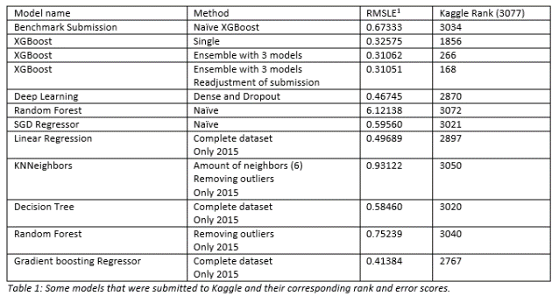
Results
Something something XGBoost

Slide 8
(discuss other things worth mentioning here)

Slide 9
Further work

Slide 10
Conclusion

Slide 11
Sberbank Russian Housing Market
Team Classified
Maybe a short
Summary of stuff
Discussed
Thanks for your attention!
Any questions?

