Slide 1
PR-DAD
Phase Retrieval using Deep Auto-Decoders
Guy Van-Dam | Roey Ydgar
MFOML 2023

Slide 2
Introduction
Phase Retrieval and classical techniques

Slide 3
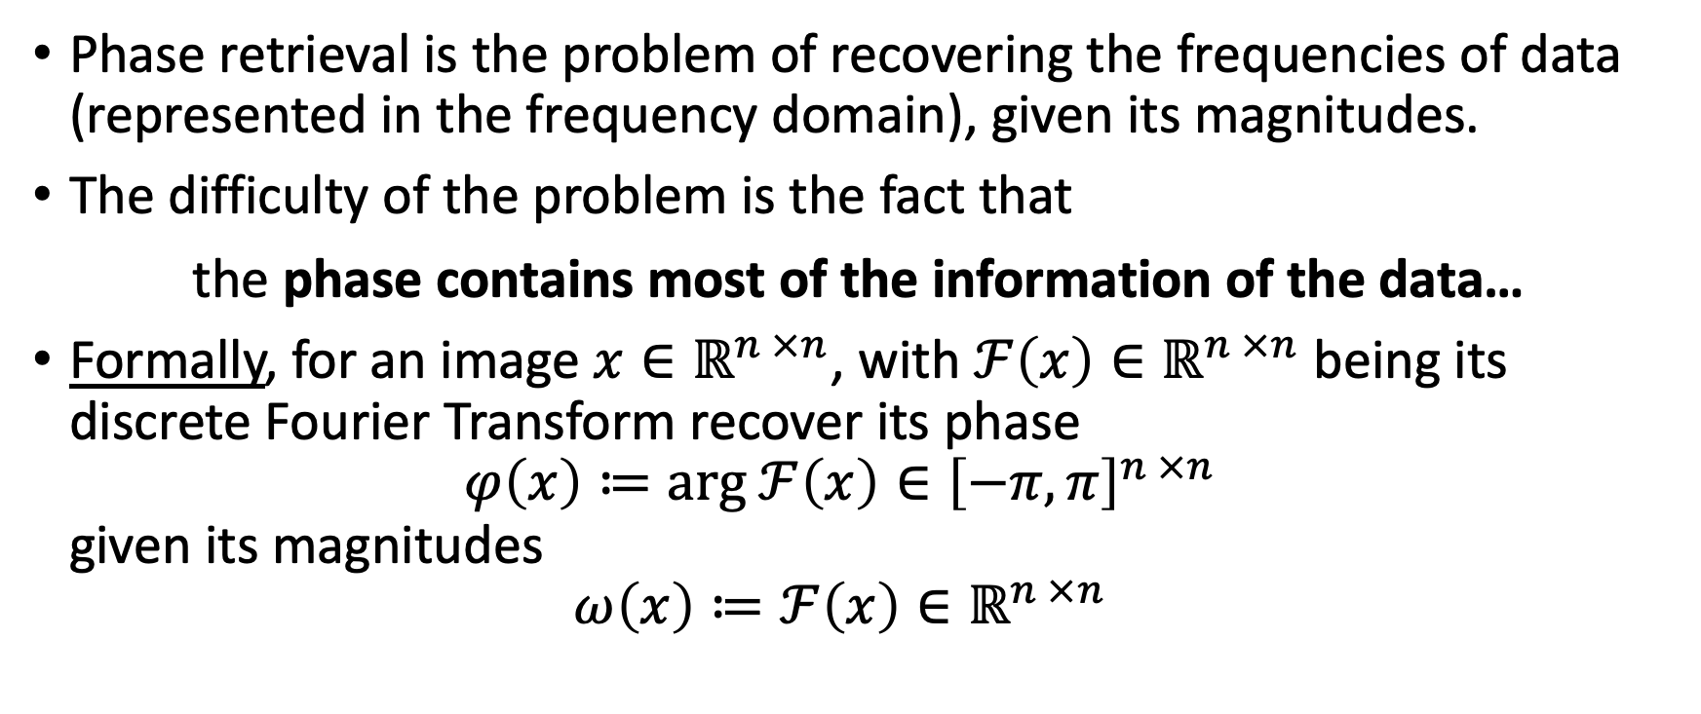
Phase Retrieval
Phase retrieval is the problem of recovering the frequencies of data (represented in the frequency domain), given its magnitudes.
The difficulty of the problem is the fact that
the phase contains most of the information of the data…
Formally, for an image $x∈ℝ^{n ×n}$, with $ℱ\left(x\right)∈ℝ^{n ×n}$ being its discrete Fourier Transform recover its phase $φ\left(x\right)≔arg ℱ\left(x\right)∈{\left[−π, π\right]}^{n ×n}$ given its magnitudes $ω\left(x\right)≔ℱ\left(x\right)∈ℝ^{n ×n}$

Slide 4
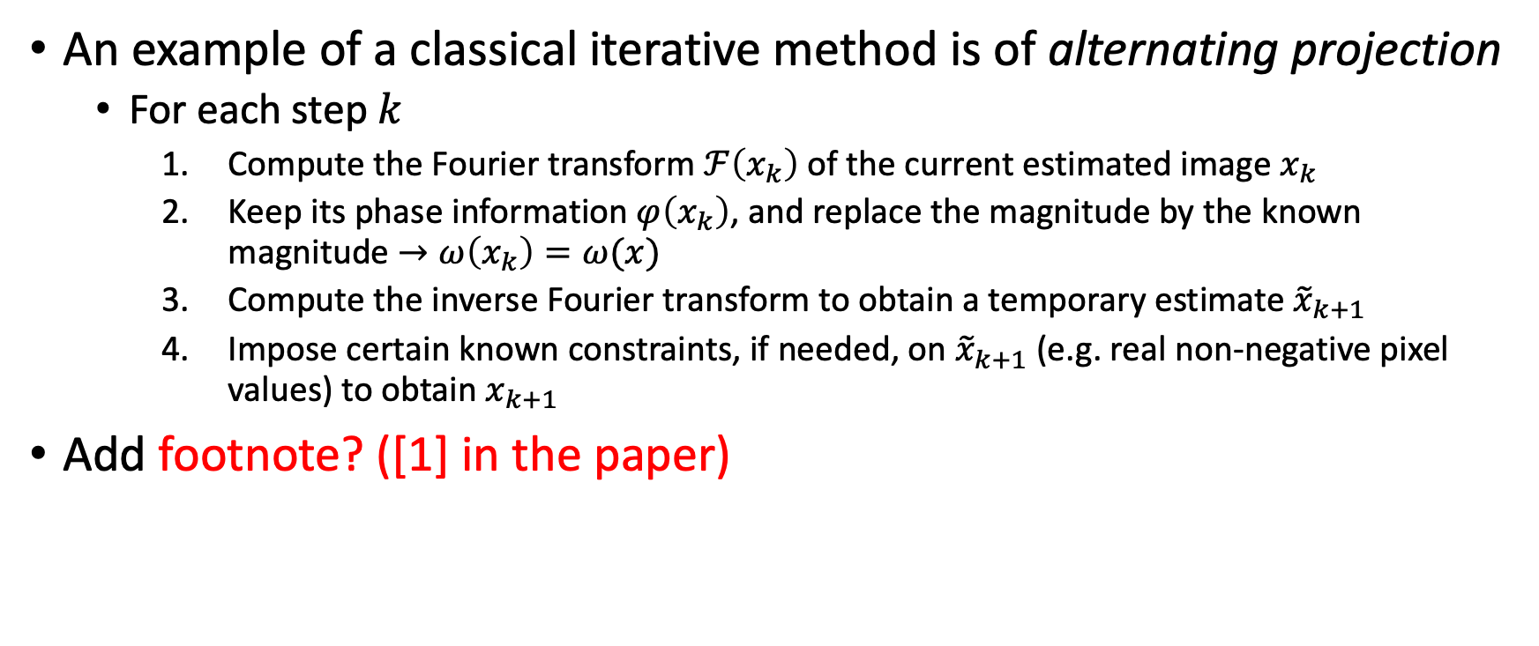
Classical Techniques
An example of a classical iterative method is of alternating projection
For each step $k$
Compute the Fourier transform $ℱ\left(x_{k}\right)$ of the current estimated image $x_{k}$
Keep its phase information $φ\left(x_{k}\right)$, and replace the magnitude by the known magnitude $→ω\left(x_{k}\right)=ω(x)$
Compute the inverse Fourier transform to obtain a temporary estimate ${\tilde{x}}_{k+1}$
Impose certain known constraints, if needed, on ${\tilde{x}}_{k+1}$ (e.g. real non-negative pixel values) to obtain $x_{k+1}$
Add footnote? ([1] in the paper)

Slide 5
PR-DAD
The learning setup and Architecture

Slide 6
The learning set-up
Supervised – providing access to pairs of Fourier magnitude inputs and their corresponding ground truth output (e.g. the actual image or ground truth phase) for a model to be trained
Semi-supervised – only a partial subset of the Fourier magnitude inputs has the corresponding ground truth images.
Un-supervised – dataset with the Fourier magnitude inputs only, no ground truth images (😕)
The PR-DAD framework resides in the supervised or semi-supervised domains – assuming a sufficient amount of training images

Slide 7
Architecture – need work
Assuming a semi-supervised setting, the labeled data is used for training a encoder-decoder pair to create a low-resolution, sparse, dictionary-like representation for the image class.
The second step involves training “conversion network” - a simple network (comprised of Fully-Connected and Convolutional layers) to map the magnitude input to the sparse representation that subsequently can be decoded back to image using the pre-trained decoder.
Despite the decoder being analytically defined / pre-trained, the output will remain novel as a closely represented linear combination of before seen data

Slide 8
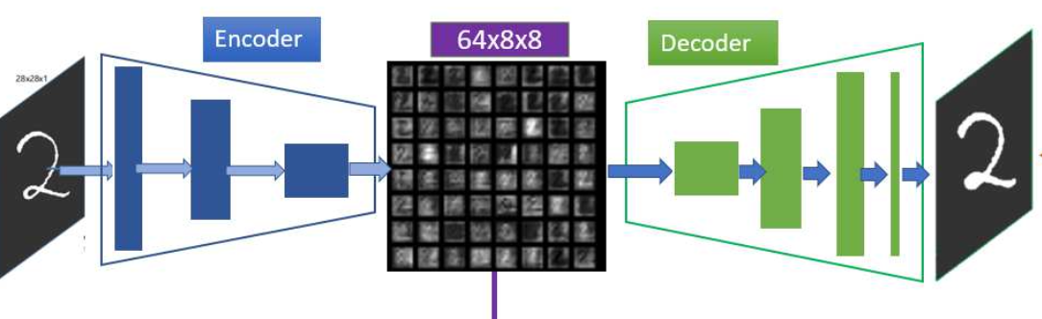
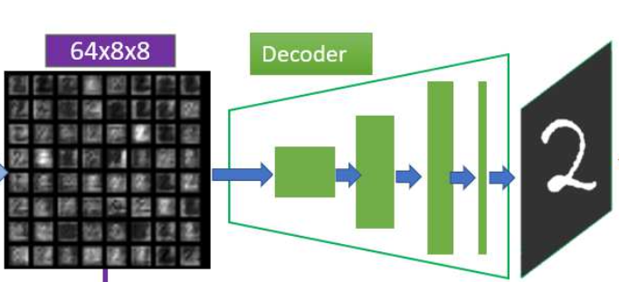
Encoder-Decoder
Training an encoder-decoder pair to obtain a sparse representation of the image-class.
Keep in mind! – the input and output is the original image

Slide 9
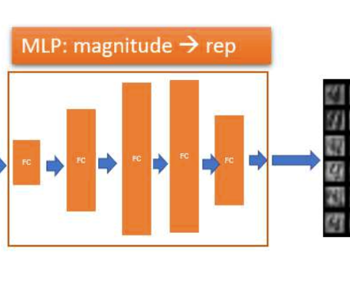
“conversion network”
The conversion network – magnitude $→$ sparse representation

Slide 10
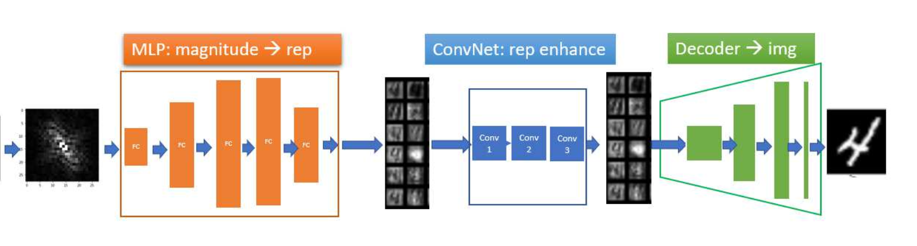
Complete Architecture

Slide 11
Cross-Correlation Loss

Slide 12
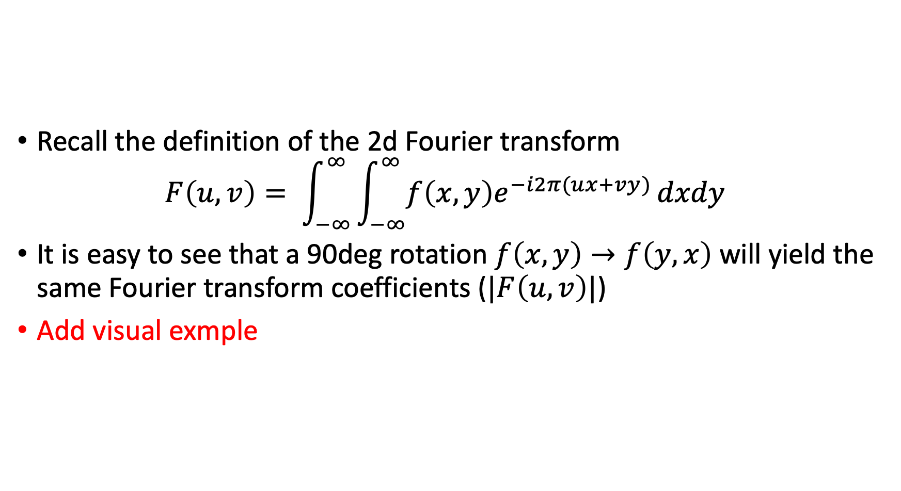
Rotation Invariance
Recall the definition of the 2d Fourier transform $F\left(u, v\right)= \int_{−∞}^{∞}{\int_{−∞}^{∞}{f\left(x,y\right)e^{−i2π(ux+vy)}}dxdy}$
It is easy to see that a 90deg rotation $f\left(x, y\right)→f\left(y, x\right)$ will yield the same Fourier transform coefficients ($|F\left(u, v\right)|$)
Add visual exmple

Slide 13
Cross-Correlation Loss
We define the cross-correlation loss as
[ ] add cross-correlation loss definition

Slide 14
Results Replication
Quantitative analysis of the different setups

