Slide 1
Data Engineering Project: Travel Agency Pipeline
Rofiat Abdulkareem
November, 2024

Slide 2
INTRODUCTION
This project demonstrates the development of an ETL pipeline using AWS services, Docker, Terraform, DBT, and Apache Airflow. The CI/CD pipeline was implemented using GitHub Actions for automation.
Technologies Used:
- Terraform
- Apache Airflow
- Docker
- DBT
- Amazon RDS
- S3
- CI/CD with GitHub Actions

Slide 3
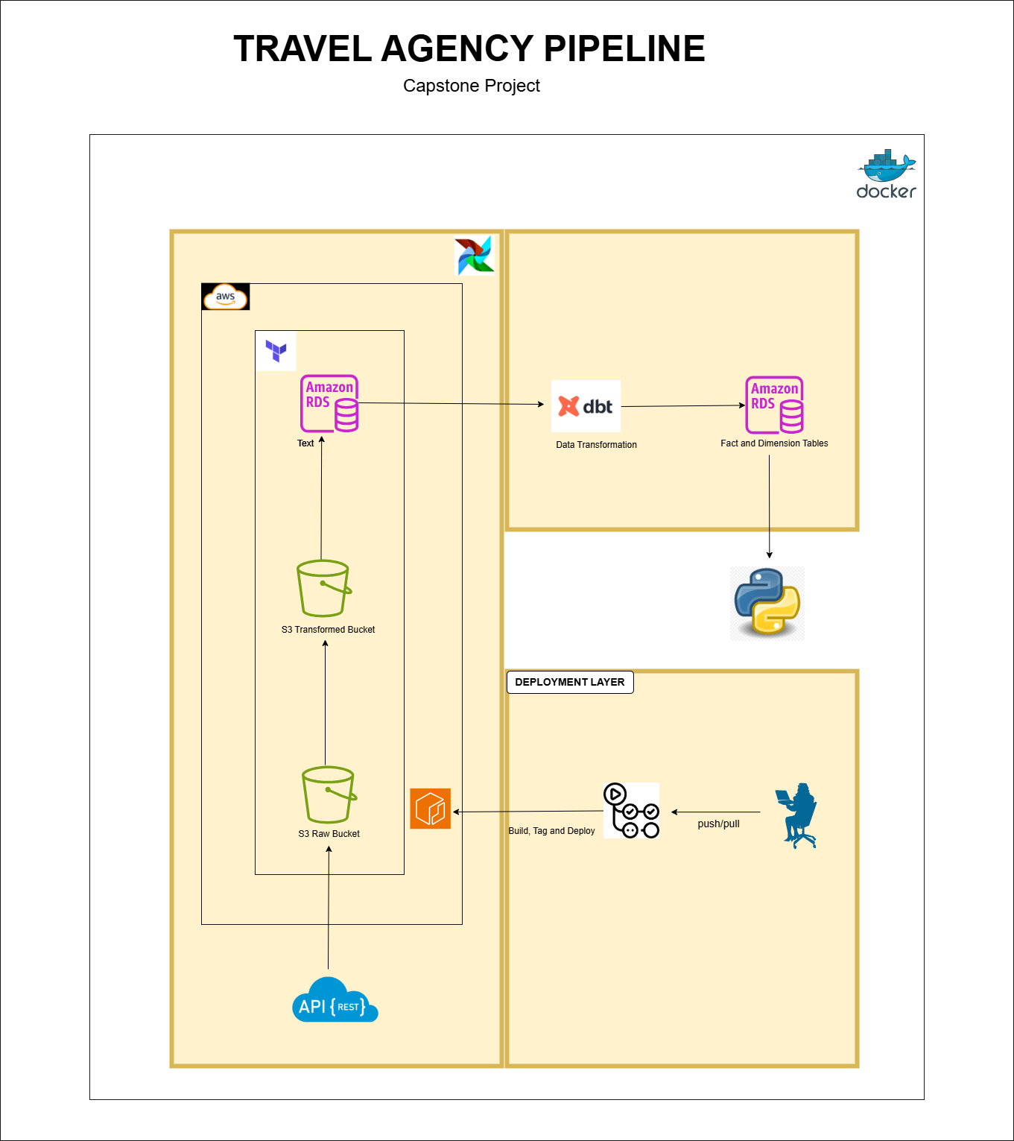
DATA ARCHITECHTURE

Slide 4
INFRASTRUCTURE PROVISIONING
- Used Terraform for provisioning infrastructure.
- Stored Terraform state in an S3 bucket.
- Provisioned AWS resources:
- RDS PostgreSQL for the database.
- S3 buckets for raw and transformed data.
- ECR for container images.
- IAM roles and policy

Slide 5
Data Pipeline: Extraction
- Extracted data from an external API.
- Stored raw data in S3 in Parquet format.
- Implemented error handling and logging in extraction code.
- Used Apache Airflow for managing extraction workflows.

Slide 6
Data Pipeline: Transformation
- Transformed raw data into processed data using Apache Airflow.
- Stored transformed data in a separate S3 bucket (Parquet format).
- Ensured data quality and consistency during transformations.

Slide 7
Data Pipeline: Loading
- Loaded transformed data from S3 into Amazon RDS PostgreSQL.
- Created three models:
- Fact Table
- Dimension Table
- Transform Table
- Used DBT for modeling and ensuring schema compliance.

Slide 8
Containerization
- Dockerized the ETL application for portability hosting Docker on Amazon EC2
- Pushed Docker images to Amazon ECR for deployment.
- Ensured reproducibility across environments.

Slide 9
CI/CD Pipeline
- Implemented CI/CD using GitHub Actions.
- Automated Docker image builds and pushed them to ECR.
- Streamlined deployment processes for efficiency.

Slide 10
Monitoring and Security
- Monitored data pipelines using Apache Airflow.
- Stored database credentials securely in AWS SSM Parameter Store.
- Implemented error handling and logging for robust operations.

Slide 11
Analysis Summary
Currency Distribution Africa has the highest number of currencies (58), followed by Europe (52).
Population Density: Bouvet Island and Heard Island have the lowest population densities, whilehighly populated regions like Asia dominate the global population share.

Slide 12
Analysis Summary
Start of the Week:
Most countries start their week on Monday (229 countries), while only a few start on Sunday or Saturday.
Top Regions: Asia has the largest population, while the Americas cover the most area.
Top Languages: English is the dominant language in the Americas, and French leads in Africa.

Slide 13
Conclusion
This project successfully demonstrates:
- Building a scalable ETL pipeline.
- Leveraging AWS services for storage, processing, and deployment.
- Automating workflows using CI/CD pipelines.

