Slide 1
Artificial Intelligence
3rd year, 1st semester
State based models for decision problems
Week 3: informed strategies and alternative problem spaces
“In any moment of decision, the best thing you can do is the right thing, the next best thing is the wrong thing, and the worst thing you can do is nothing.” Theodore Roosevelt

Slide 2
Let’s find a NP-complete problem and a computer able to solve it
Problem: finding a path in a graph
Describing a model - reducing a problem
describe a state
identify special states and the problem space
describe the transitions and validate them
specify a search strategy

Slide 3
Search strategies
Uninformed - no distinction between states
  Random
  BFS and Uniform Cost
  DFS and Iterative Deepening
  Backtracking
  Bidirectional
Informed - heuristics to help distinguish between states
  Greedy best-first
  Hillclimbing and Simulated Annealing
  Beam search
  A* and IDA*

Slide 4
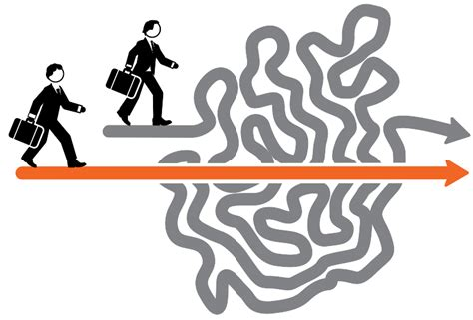
Heuristics?
Common sense is as good as a mathematical proof.
Statistical proofs are hard to get and largely irrelevant.
Brute force (search) is great, but intelligence is faster.

Slide 5
Finding a relevant heuristic
A heuristic should direct the search towards the goal.
Heuristic: function applied to any state, returns extreme and opposing values for all initial state(s) and for at least one final state(s).
h: S -> [min, max], h(IS) = min/max, h(FS) = max/min

Slide 6
Types of heuristics
If h(IS) = max, h(FS) = 0, h is a distance. Below, h is a distance.
If h(S) <= shortest_path(S,FS), h is admissible. An admissible heuristic never overestimates the shortest path in the problem space between a state and the goal.
If h(A) ≤ h(A,B) + h(B) if B is reachable from A, h is consistent. Requiring that a node is included in a path (solution) should estimate at least as lengthy paths.

Slide 7
Lets try finding a heuristic
For Hanoi Towers:
Number of pieces on the goal tower
If starting tower is 1 and goal is n, sum of all values in a state
?
For Sliding Puzzle:
Number of pieces placed correctly
For chess:
How many pieces I have - how many pieces has the opponent?
A maximal value - number of moves available to the opponent?
h should always be relatively easy to compute, good enough is enough

Slide 8
Three way of looking at solutions
path in a graph path in a space heuristic function graph
h(S)
solution

Slide 9
Greedy (best-first)
Evaluate all unexplored states accessible from the current state.
Select the unexplored state closer to the goal (best score according to a heuristic).

Slide 10
Greedy evaluation
Best case: gets you to the final state much quicker than DFS, doesn’t guarantee optimal solution.
Worst case: DFS with bad choices.
?

Slide 11
Hillclimbing
Select one accessible state which is at least as close to the final state as the current one.
h is not a distance! h(IS) = min, h(FS) = max
h(NewState) ≥ h(CurrentState)
h(S)
solution

Slide 12
Hillclimbing evaluation
Best case: fastest general strategy.
Worst case: fails to find a solution (local optimum).
https://www.youtube.com/watch?v=j1H3jAAGlEA&list=PLUl4u3cNGP63gFHB6xb-kVBiQHYe_4hSi&index=4
h(S)
?
solution

Slide 13
Hillclimbing Selection Algorithm
eligible_neighbors = {};
For each state n reachable from current_state applying one valid transition
If h(n)better than h(current_state) add n to eligible_neighbors;
Select next_state from eligible_neighbors;
Frequently used selections:
First one found - most common
Best one (greedy)
All, in the order they were found, choosing next state available if stuck (hillclimbing-backtracking)

Slide 14
Simulated annealing
Hillclimbing, but allows choosing a state further away from the goal, with an ever decreasing probability the closer you get to the goal state.
No more local optimum.
Slower than hillclimbing.
http://www.cse.iitm.ac.in/~vplab/courses/optimization/SA_SEL_SLIDES.pdf

Slide 15
Beam search
BFS but only keeps in a sorted list best k visited states. The list should be re-sorted and extra states removed after every new explored state.
Explores all states in the sorted list until the final state is found - should be first in the list.
Does not guarantee the optimum solution!

Slide 16
A* and IDA*
A* is mostly Dijkstra combined with Greedy, IDA* is informed IDDFS
IDDFS explores nodes by distance from initial state d(S)
A* explores nodes by d(S) + h(S), where h(S) is the estimated distance to the goal state (h has to be an admissible heuristic and a distance)
Always chooses the unexplored state which is closest to both the initial state and the goal state.
https://www.redblobgames.com/pathfinding/a-star/introduction.html
https://adrianstoll.com/post/a-star-pathfinding-algorithm-animation/

Slide 17
A* Algorithm
Current_state = Initial_state;
Best_score = maximum of h;
Sorted_queue = {All neighbours of Current_state, with computed h+1 scores, marked as unexplored};
While the score of the first unexplored state S in Sorted_queue is lower than Best_score
If S is a final state, Best_score = score of S;
Mark S as explored;
Add to Sorted_queue all its neighbours with computed h+d score and mark them unexplored;
If a duplicate state appears in Sorted_queue, keep only the occurrence with lowest score and transfer explored status;
Sort Sorted_queue;
The optimal path is recovered from the last state updating Best_score and looking for explored neighbours with lower score up to the initial state.

Slide 18
A*
Always finds the optimum solution.
Really?
A
h(A) = 1
5
3
h(B) = 4
B

Slide 19
A*
Always finds the optimum solution.
Don’t stop when you find the goal state! Keep looking until all states with better scores have been explored.
A
h(A) = 1
real = 4
5
3
h(B) = 4
real = 4
B

Slide 20
BFS/IDDFS
A*

Slide 21
Optimizing A*
Consistent heuristic: h(A) ≤ h(A,B) + h(B) if B is reachable from A
Simplified Memory Bounded A*
Prunes (removes) states for which the path was more costly than estimated, up to a set number of states (memory bounded)
Remembers costs of reaching pruned states from each explored state
If solution is not found, recovers pruned states and explores them

Slide 22
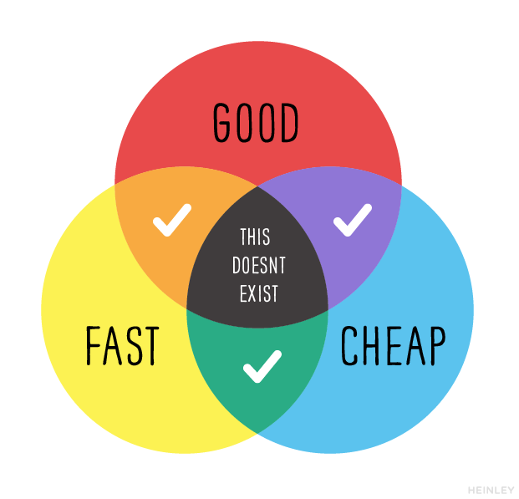
Choose a strategy
Do you want a solution quickly?
Do you want the best solution?
Do you want all solutions?
How much do you know about the problem?
Are you sure the state representation is good enough?

Slide 23
Non-deterministic problem space
Stochastic: known possibilities and probabilities
Non-deterministic: known possibilities
Each transition has multiple possible outcomes
AND-OR trees

Slide 24
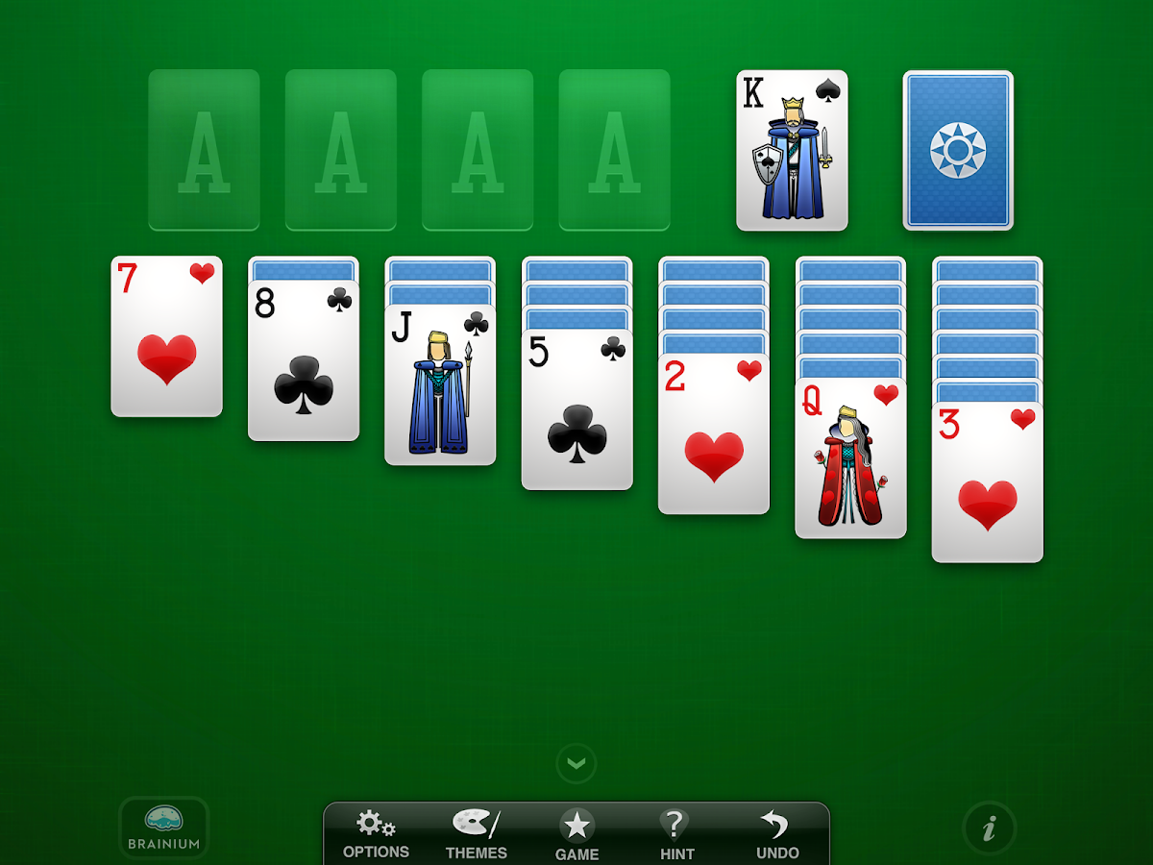
Partially observable problem space: you know what could happen after a transition, you don’t know what will happen after a transition.

Slide 25

Unknowable problem space: you don’t know what could happen after a transition

Slide 26
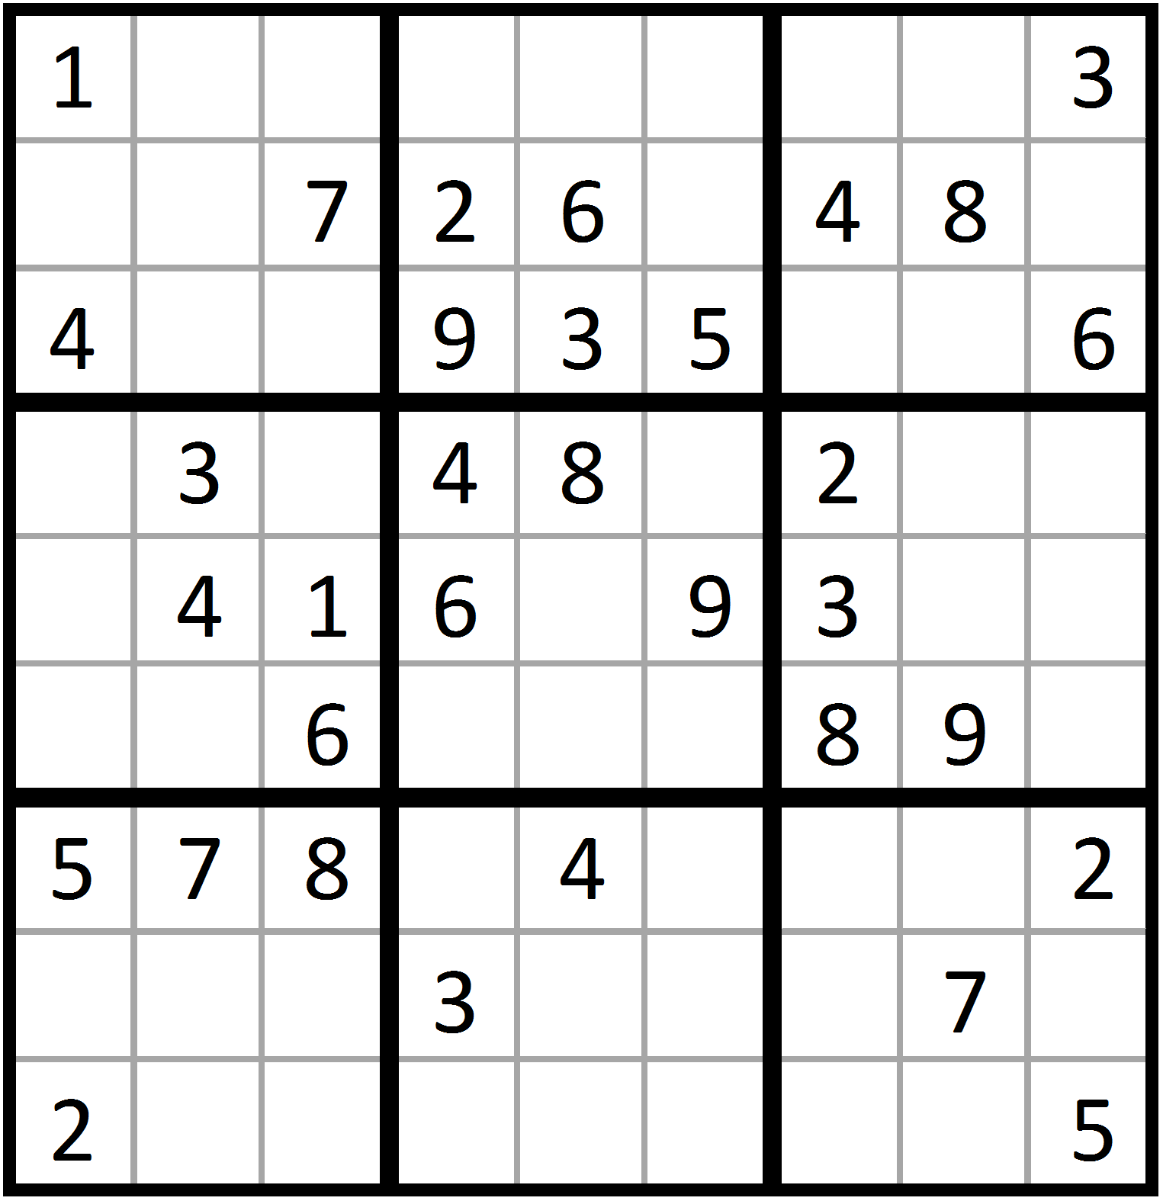
Next week: Constraint satisfaction problems (Variable based models)

Slide 27
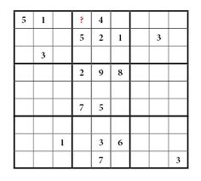
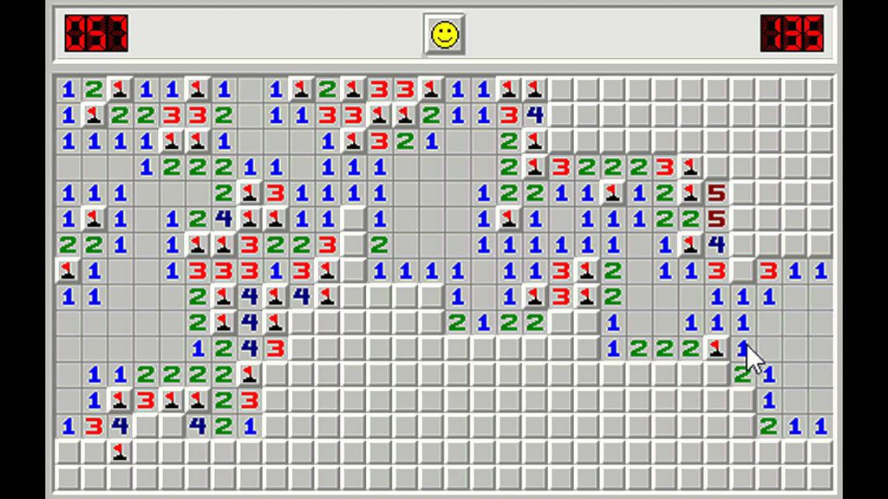
Week 5: Games
Interactive decision problems (games):
Solution is not built exclusively by your strategy
Not all final states are the same
Hardest solvable problems in AI.
NLP problems hardest potentially solvable.
?

