Slide 1

Candidate Invite portal Walkthrough
Visual Step By Step Representation for Submitting Case Details by the Candidate

Slide 2
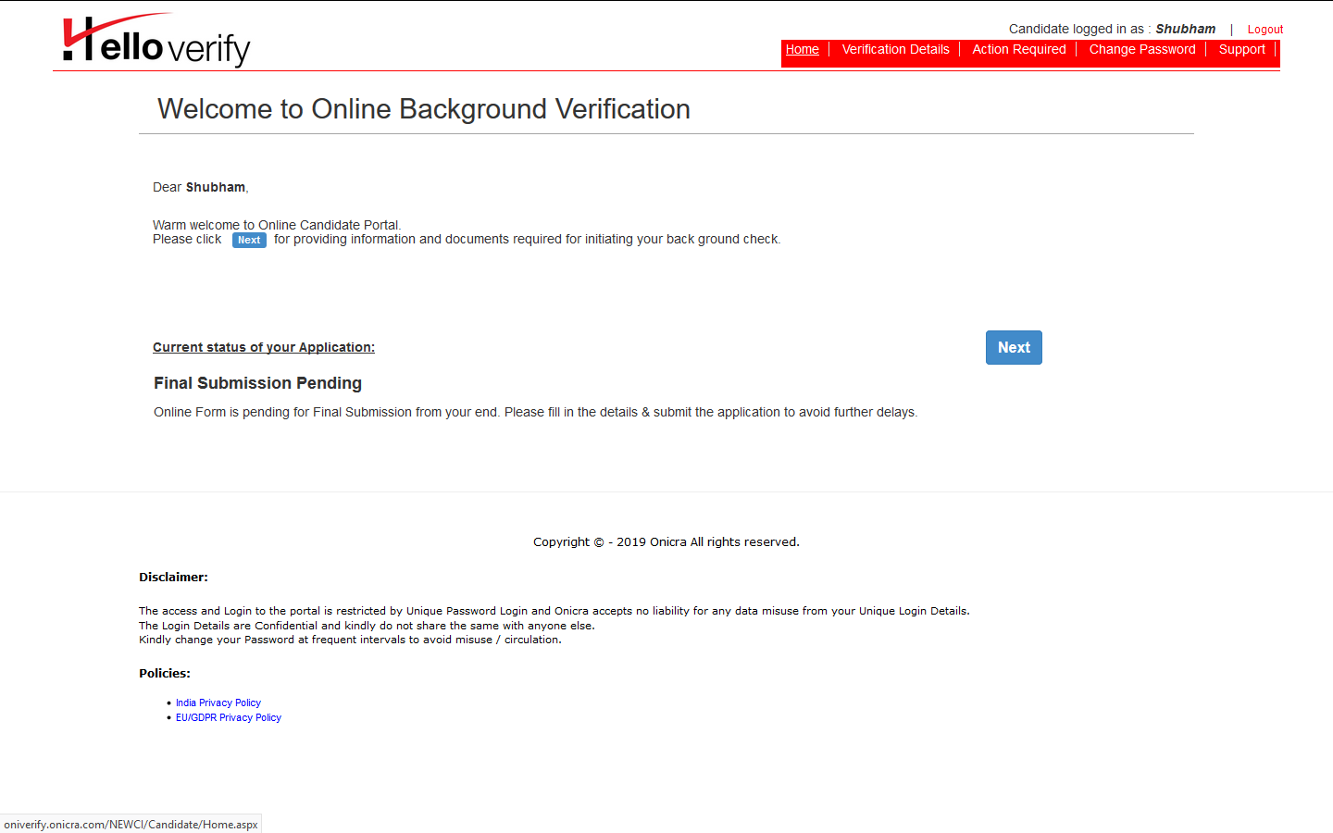
Displayed above is the home page of candidate invite window visible at the candidate’s end. Overall progress for submitting details will be reflected here. Please click on next to fill the details.

Slide 3
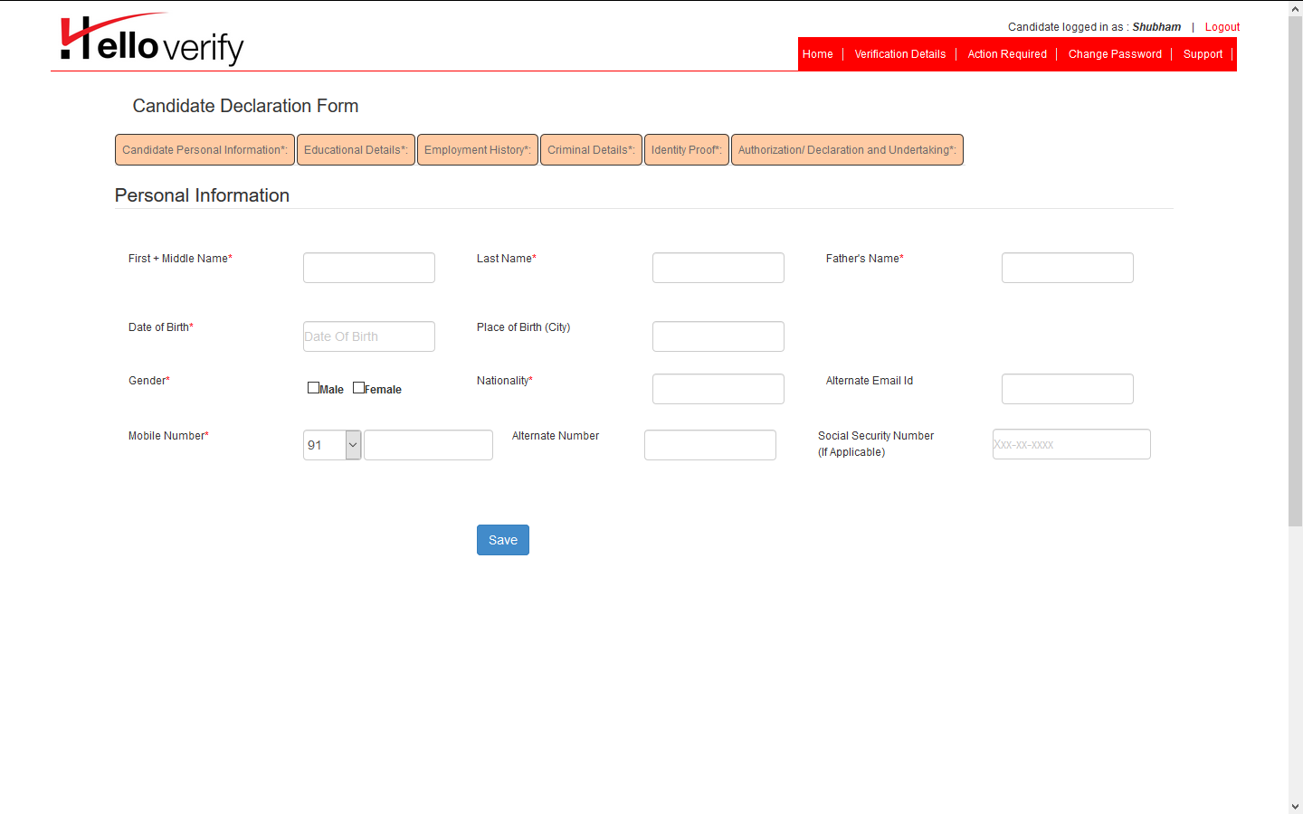
After clicking on verification details, attached screen will appear. Candidate’s personal information needs to be filled in the visible tabs. Mandatory tabs will be highlighted by the asterisk sign. Candidate can fill details accordingly as per requirement. After filling full PI details, candidate can click on save button to save PI details. Request candidate to click save after filling each TAB to avoid losing already filled details. Filling SSN details is mandatory for US based candidates.

Slide 4
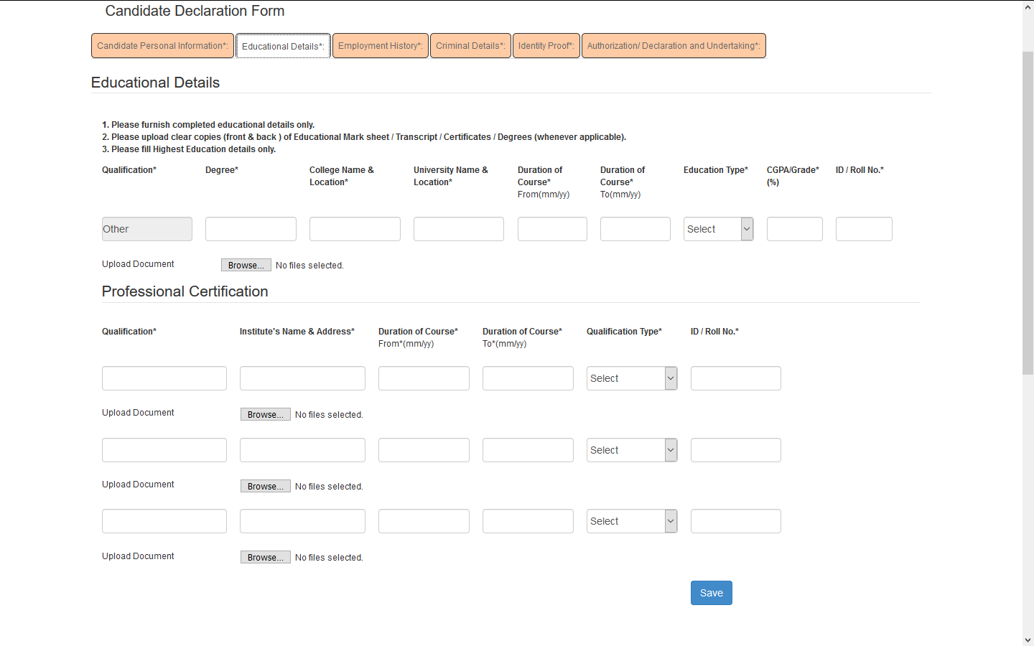
Education details needs to be filled in Education details tab. Candidate can fill highest education details or all education details as per BGV requirement. Final year mark sheet of the course or Degree certificate should be uploaded in upload document option. Uploading documents is mandatory for BGV.

Slide 5
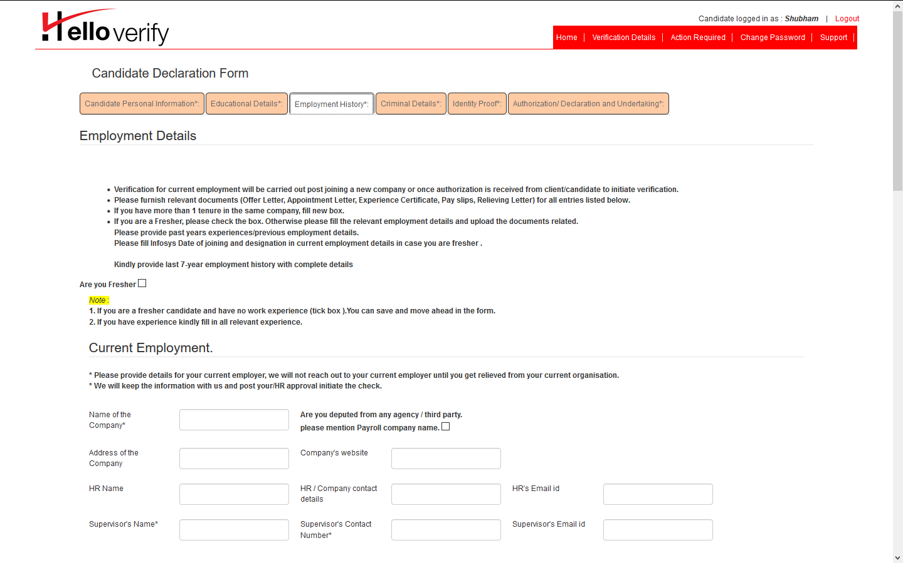
Employment details needs to be filled in this window. Fresher candidate can tick the box to not submit employment details. Current employment details needs to be filled in the given boxes.

Slide 6
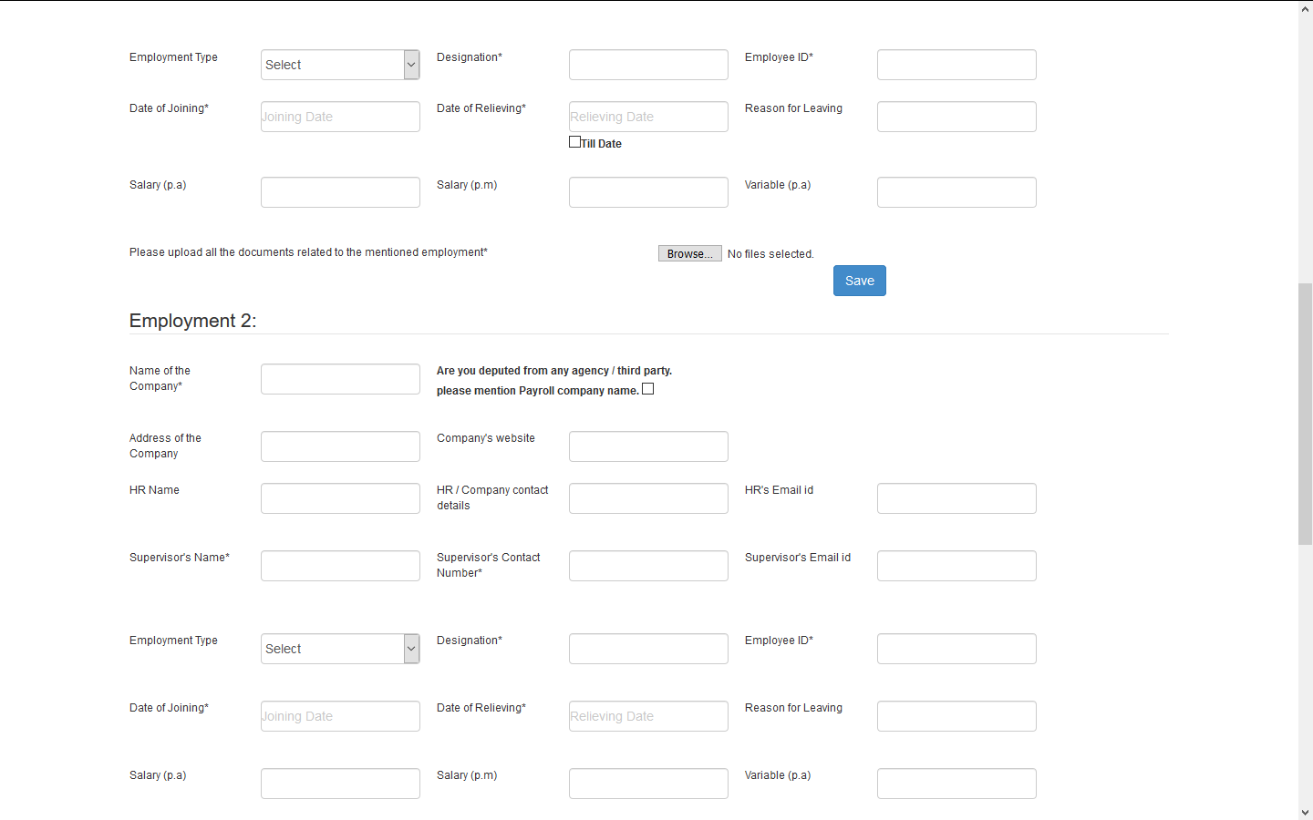
Rest of the employment details can be filled in the remaining boxes. Boxes with asterisk signs are compulsory to be filled. Please make sure to fill current employment tenure in till date format. For employment check relieving letter of the previous companies should be submitted in the portal.

Slide 7
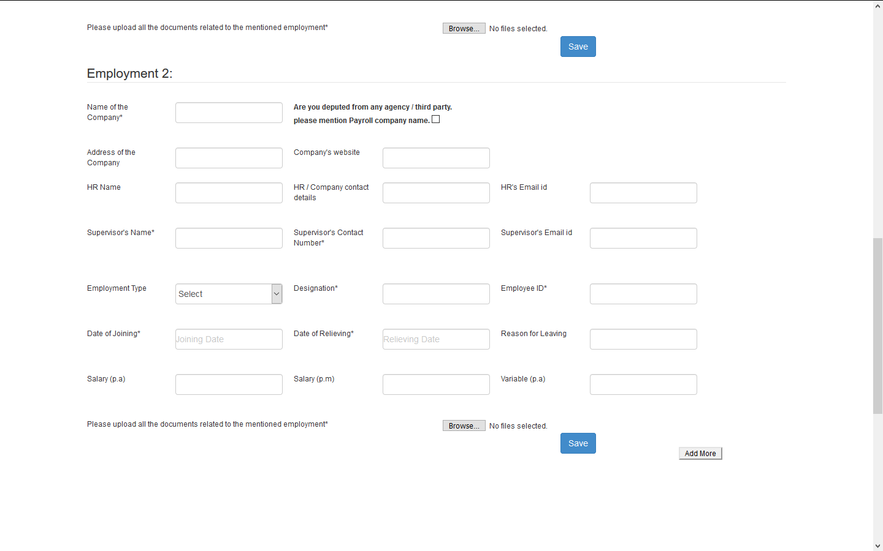
Fill remaining details employment as per BGV requirement.

Slide 8
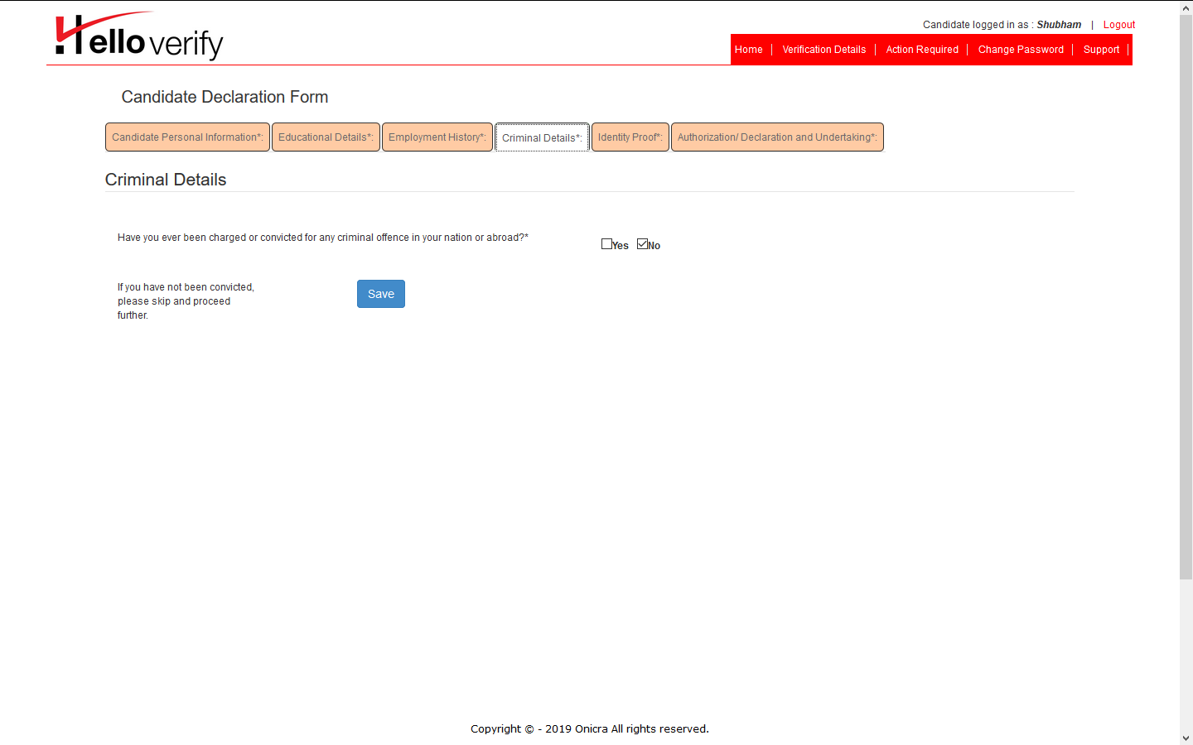
To fill criminal details, tick the box as per details. Click on save button to proceed with filling remaining criminal check details.

Slide 9
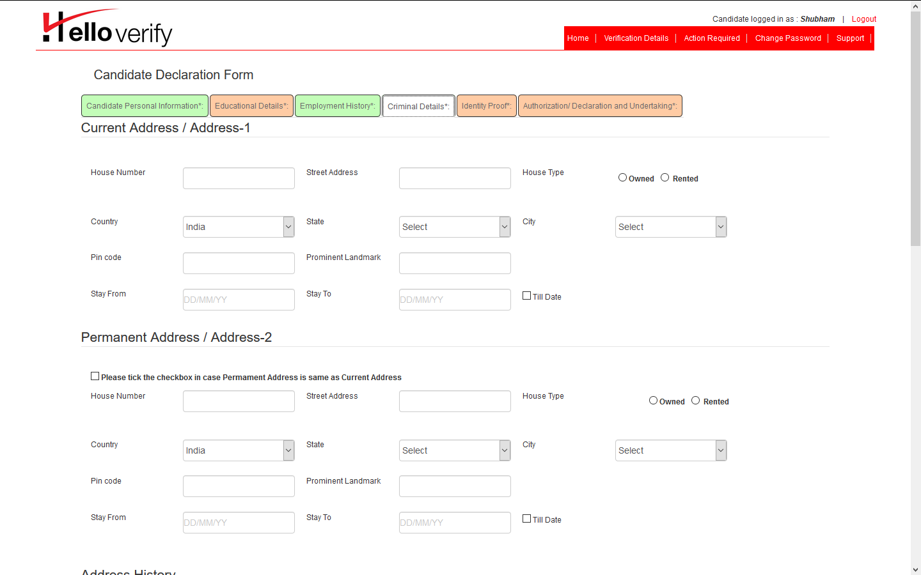
Proceed with filling criminal check details as per given fields. Make sure to fill landmark details with the criminal details. Criminal tenure should be filled in the form of e.g. 27th July to Till Date for current address.
Permanent details can be filled in the same way as current address details.

Slide 10
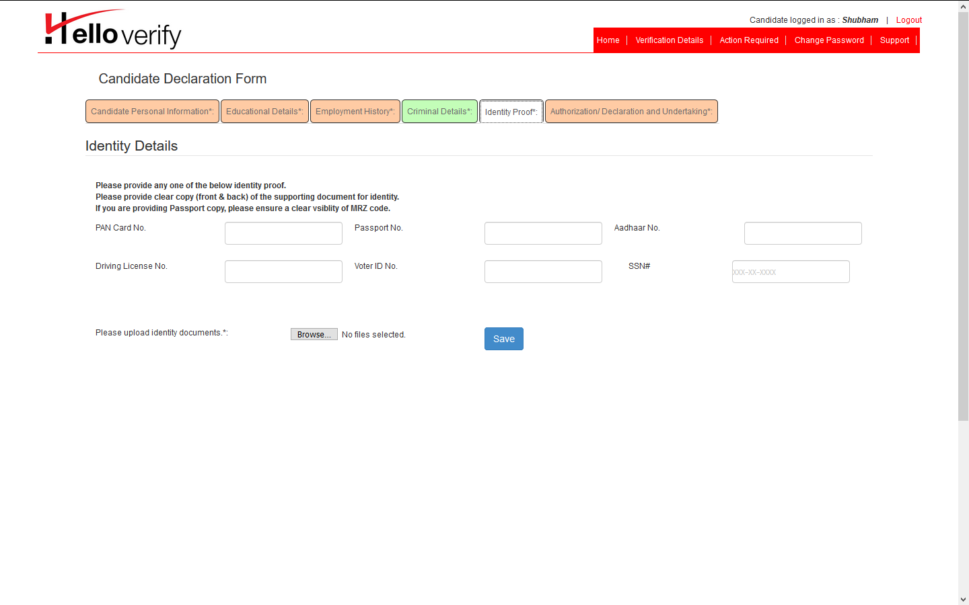
Candidate has to fill either PAN card or Passport details in given fields. Minor Pan cards and expired Passport documents won’t be acceptable for verification. Candidate has to submit scanned clear copy of either PAN or Passport document. Candidate can click on save button to move to the next page to submit details.

Slide 11
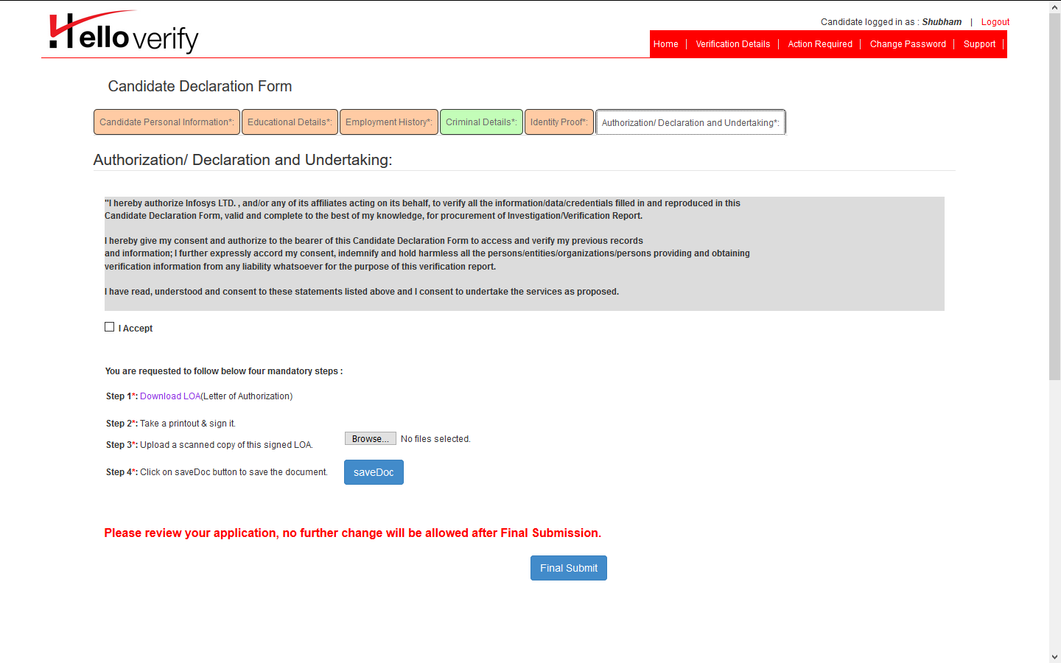
To complete the process of filling BGV details, candidate has to click on “I Accept” tick box. Submitting LOA is the last part of filling candidate details. First click on “Download LOA” to download LOA form. After taking printout of the LOA form, candidate needs to manually hand-fill LOA form and sign it with a recent date. Candidate needs to upload same signed copy again into the portal to complete BGV process. Candidate can click on “SAVEDOC” button to submit LOA form. At last, candidate can click on “Final Submit” button to fully submit the BGV details. Please make sure to fill case details in one go as after final submission, editing case details won’t be possible from candidate’s end.

Slide 12
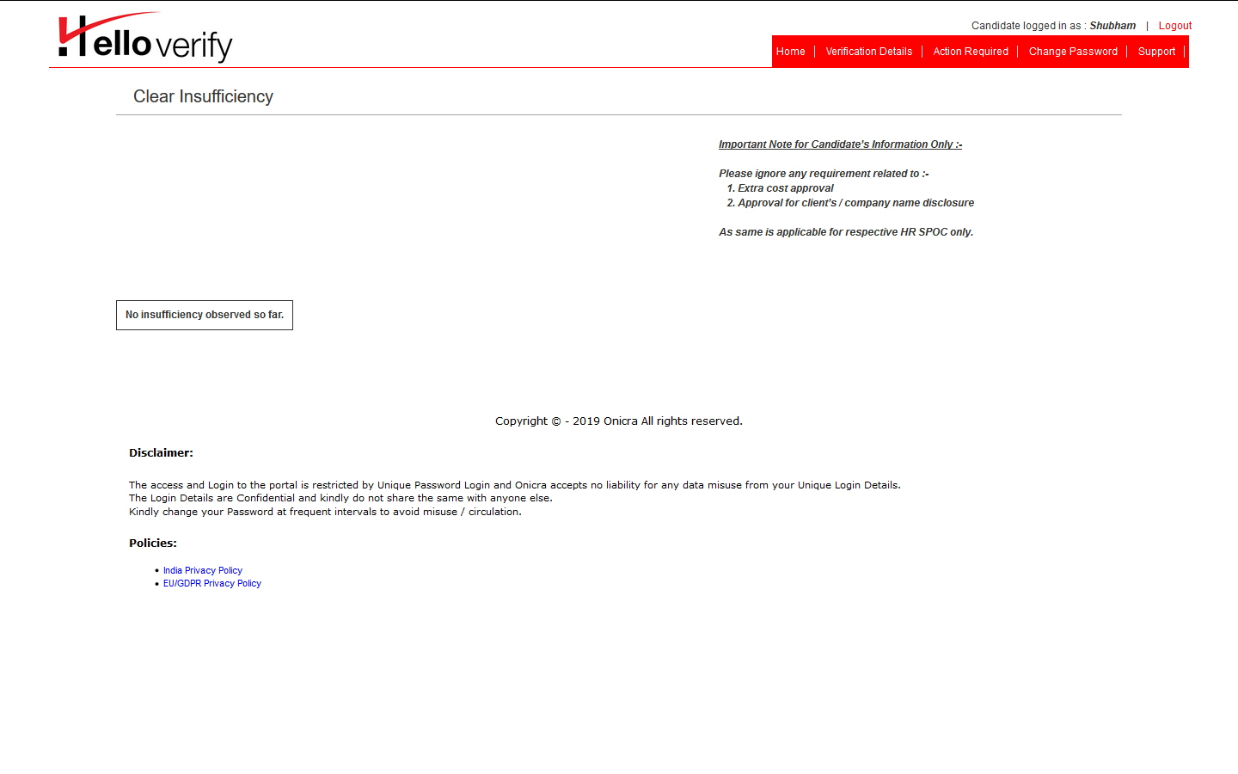
“Action Required” Window
After filling full BGV details and clicking on “Final Submit” details will be submitted to Infosys Team for further review. In case of any insufficiency or missing details candidate will get a reminder mail to his Infosys mailbox for “Insufficiency or Additional Details Required Alert”. Insufficiency details will be reflected in action required window. Candidate can further fill and submit insufficiency details for further review.

Slide 13
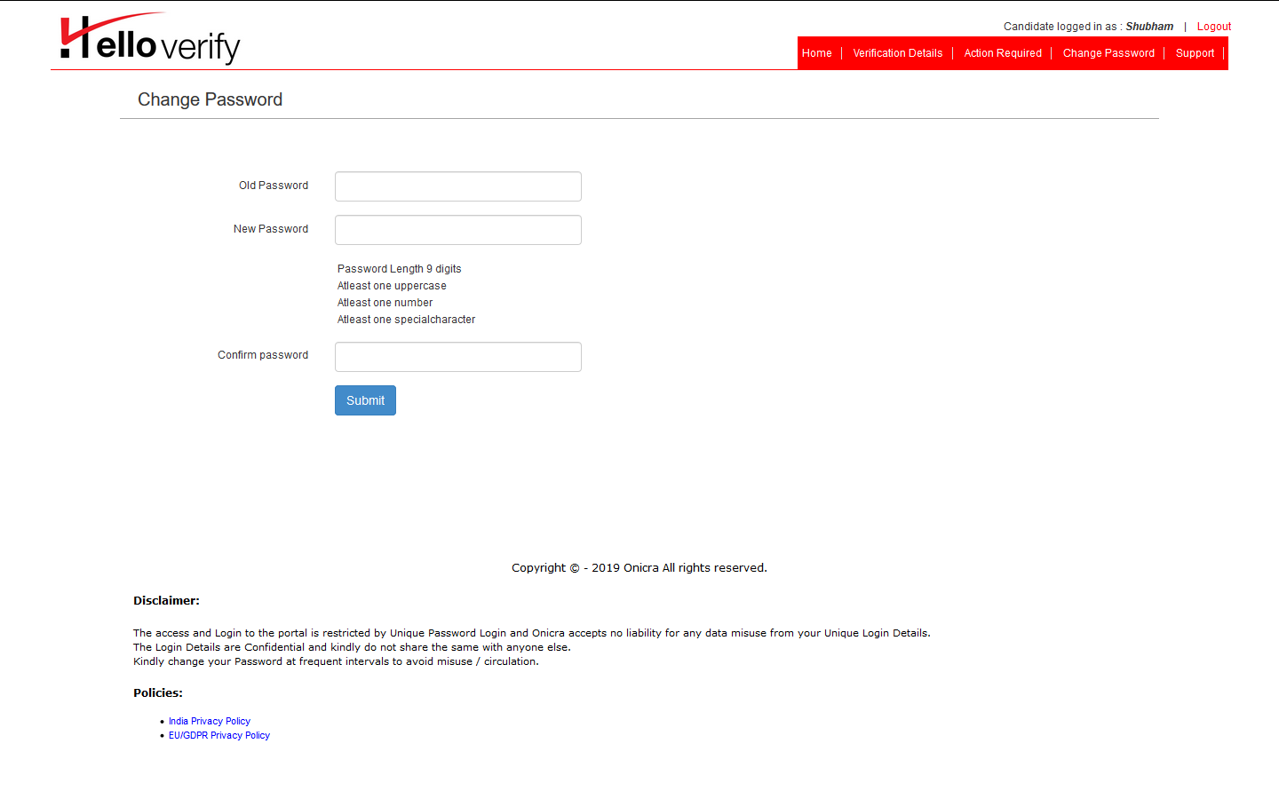
Candidate can change his login credentials using given fields. Given fields are self explanatory.

Slide 14
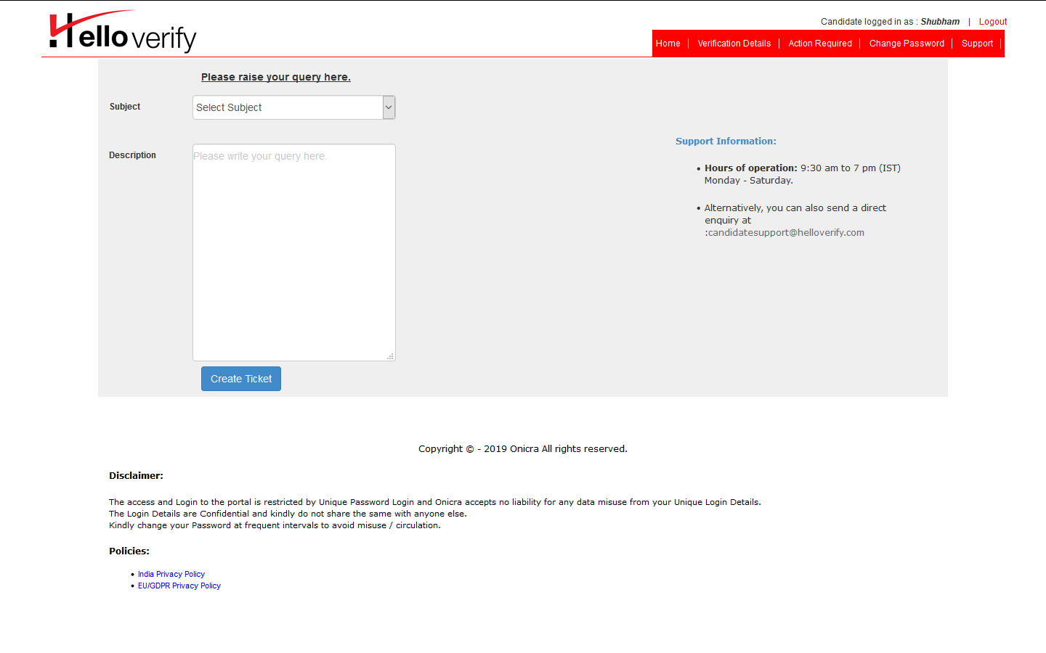
In case of further queries, candidate can submit his queries using given fields. Please select Subject as per your query and describe about it. After creating ticket, IT Support team will review query and resolution will be sent to the candidate.

Slide 15
The END

