Slide 1
Trace, Log, Cluster Info
Persistence Layer
LogVisualization UI
Trace Info
Log Info
Cluster Info
LogVisualization Backend
Tracing System
Log
Filter
Algorithm
Trace Info
Log Info
Traceapi
Infrastructure Layer
Service Mesh
Logapi
Container Orchestrator
Cluster Info
Clusterapi

Slide 2





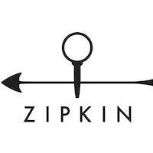

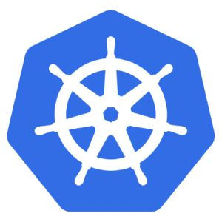

Node 1
Pod
Push(log)
Filebeat as DaemonSet
Pod
Logstash
Kubernetes Cluster
Envoy as sidecar
…
Log Info
Pod
Istio
Pilot
Push(Trace)
Trace Info
Envoy as sidecar
zipkin-server
…
Mixer
customized-ui
Pull
Node n
Pod
Customized Zipkin
Elasticsearch
Citadel
Envoy as sidecar
…
Pod
Pull
Pull(Node, Pod Info)
Envoy as sidecar
Push(Node, Pod Info)
Pod
LogVisualization
Filebeat as DaemonSet
Push(log)

Slide 3
Node 1
Pod
Push(log)
Filebeat as DaemonSet
Pod
Logstash
Kubernetes Cluster
Envoy as sidecar
…
Istio
Log Info
Pod
Pilot
Push(Trace)
Trace Info
Envoy as sidecar
zipkin-server
…
Mixer
customized-ui
Pull
Node n
Pod
Customized Zipkin
Elasticsearch
Citadel
Envoy as sidecar
…
Pod
Pull(Node, Pod Info)
Pull
Envoy as sidecar
Push(Node, Pod Info)
Pod
LogVisualization
Filebeat as DaemonSet
Push(log)

