Slide 1







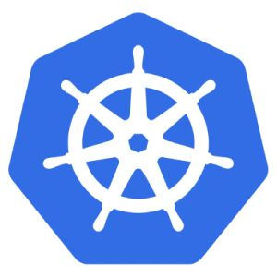

Node 1
Pod
Push(log)
Filebeat as DaemonSet
Pod
Logstash
Kubernetes Cluster
Envoy as sidecar
…
Istio
Log Info
Pod
Pilot
Push(Trace)
Trace Info
Envoy as sidecar
zipkin-server
…
Mixer
customized-ui
Pull
Node n
Pod
Customized Zipkin
Elasticsearch
Citadel
Envoy as sidecar
…
Pod
Pull(Node, Pod Info)
Pull
Envoy as sidecar
Push(Node, Pod Info)
Pod
LogVisualization
Filebeat as DaemonSet
Push(log)

Slide 2
Node 1
Pod
Push(log)
Filebeat as DaemonSet
Pod
Logstash
Kubernetes Cluster
Envoy as sidecar
…
Istio
Log Info
Pod
Pilot
Push(Trace)
Trace Info
Envoy as sidecar
zipkin-server
…
Mixer
customized-ui
Pull
Node n
Pod
Customized Zipkin
Elasticsearch
Citadel
Envoy as sidecar
…
Pod
Pull
Pull(Node, Pod Info)
Envoy as sidecar
Push(Node, Pod Info)
Pod
LogVisualization
Filebeat as DaemonSet
Push(log)

