Slide 1
Attendance App
FastTrac
DANG LA
ALEC BORMAN
MATTHEW
ROGER

Slide 2
Project Demo
Functionality
from basic to advanced

Slide 3
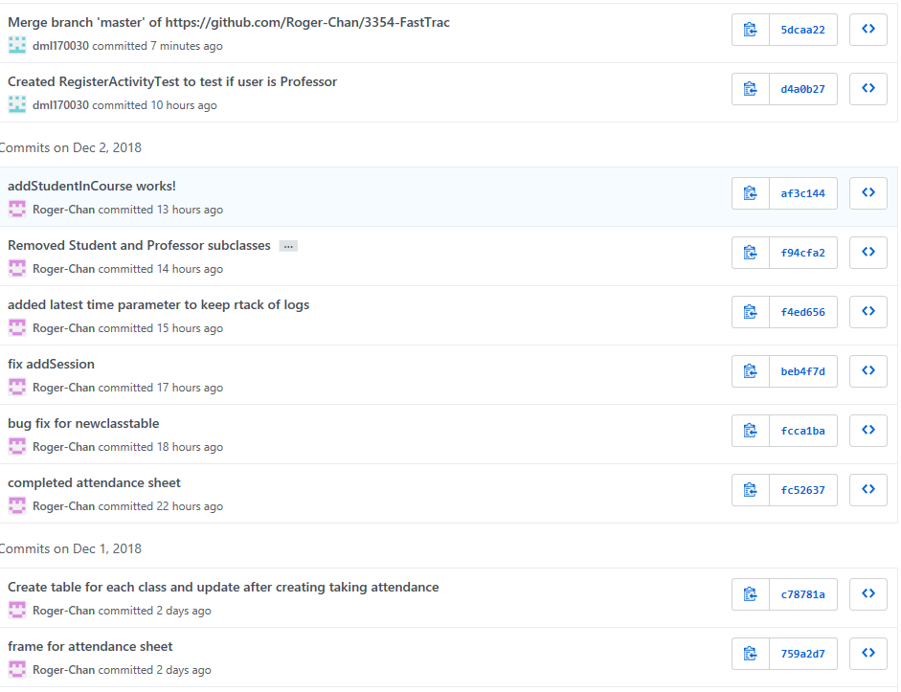
GitHub Demo

Slide 4
Team Organization
Team meetings
We meet once on the weekend.
We are using GroupMe to communicate with each other.
Task distribution
We are pair programming to support each other as this is our first time working with GitHub.

Slide 5
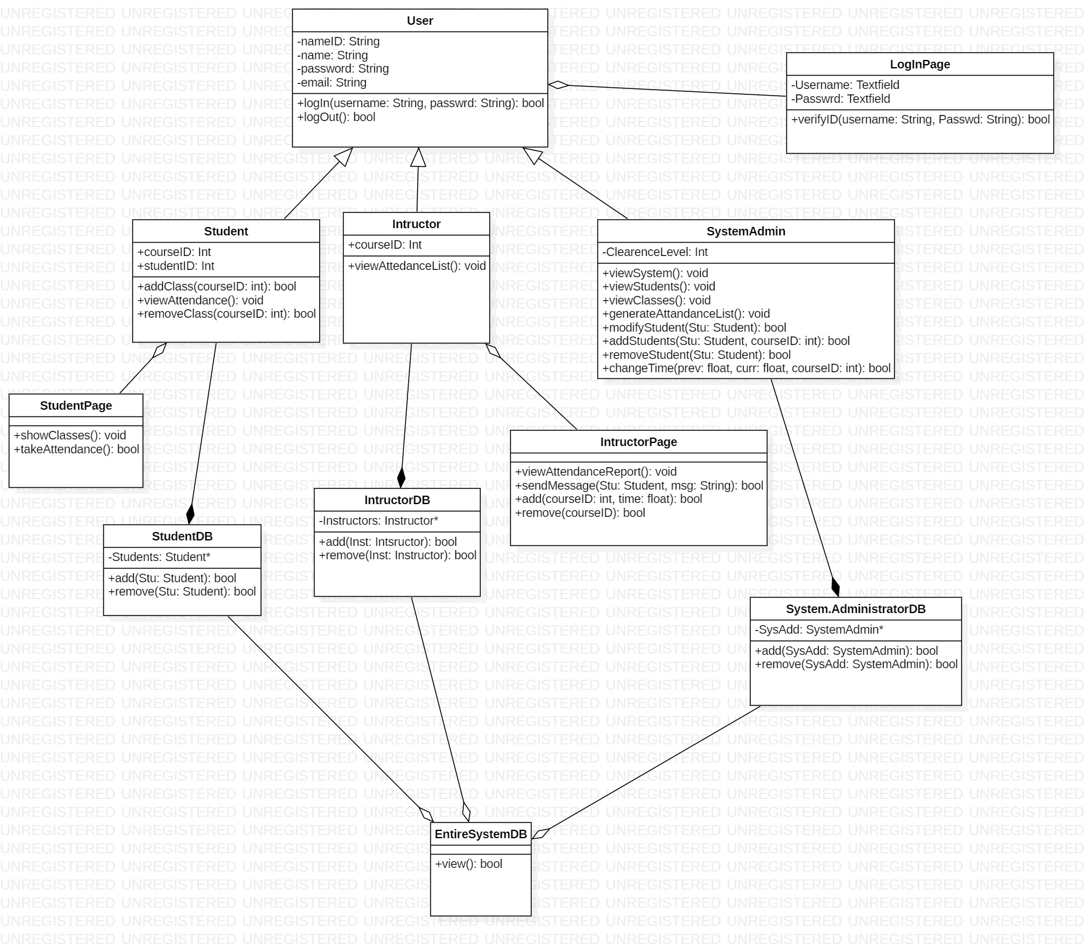
Coding Styles and Comments
In this project, we are using Proxy Coding Style to make the project run.
We are using
Camel code
Sqlite
Block comments
Junit testing

Slide 6
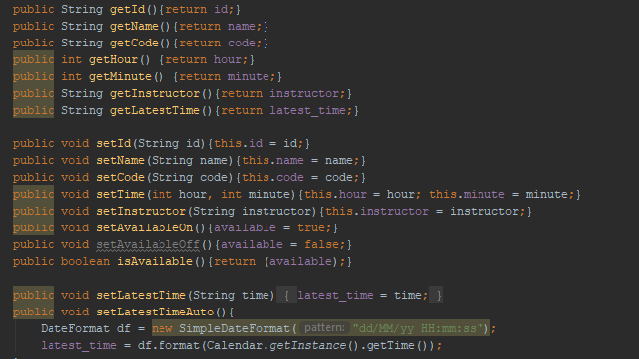
Design Pattern (proxy)

Slide 7
Refactoring

Slide 8
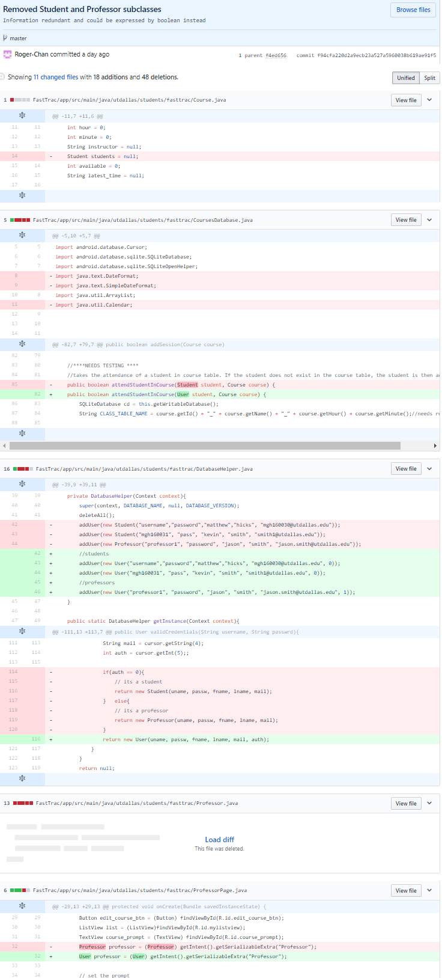

Slide 9
Testing

Slide 10
Questions?

