Slide 1
Attendance App
FastTrac
DANG LA
ALEC BORMAN
MATTHEW
ROGER

Slide 2
Project Demo
Functionality
from basic to advanced

Slide 3
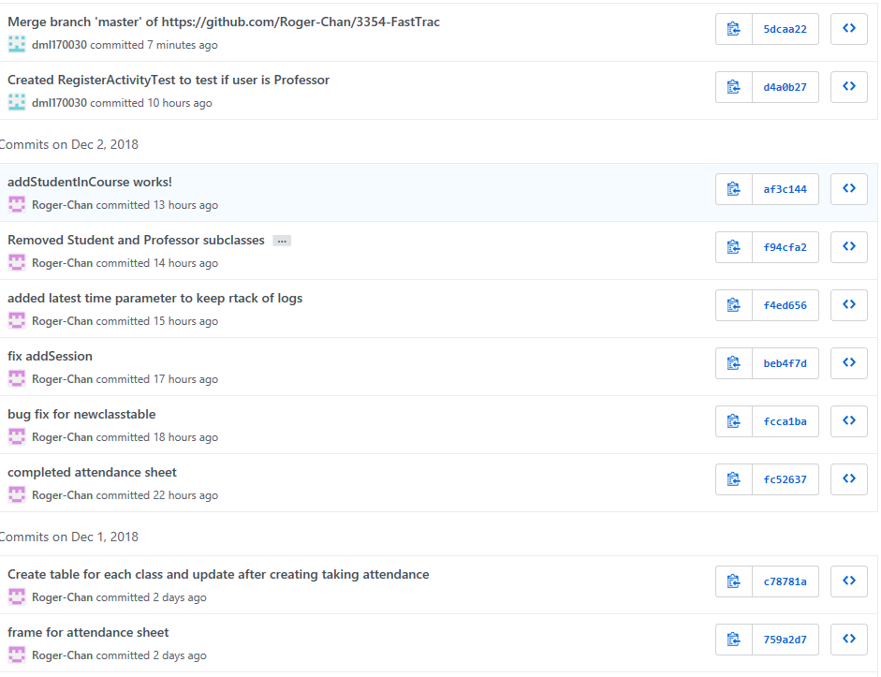
GitHub Demo

Slide 4
Team Organization (1 min)
Team meetings
We meet once on the weekend.
We are using Groupme to communicate with each other.
Task distribution
We are pair programming to support each other since this is our first time to work with github.

Slide 5
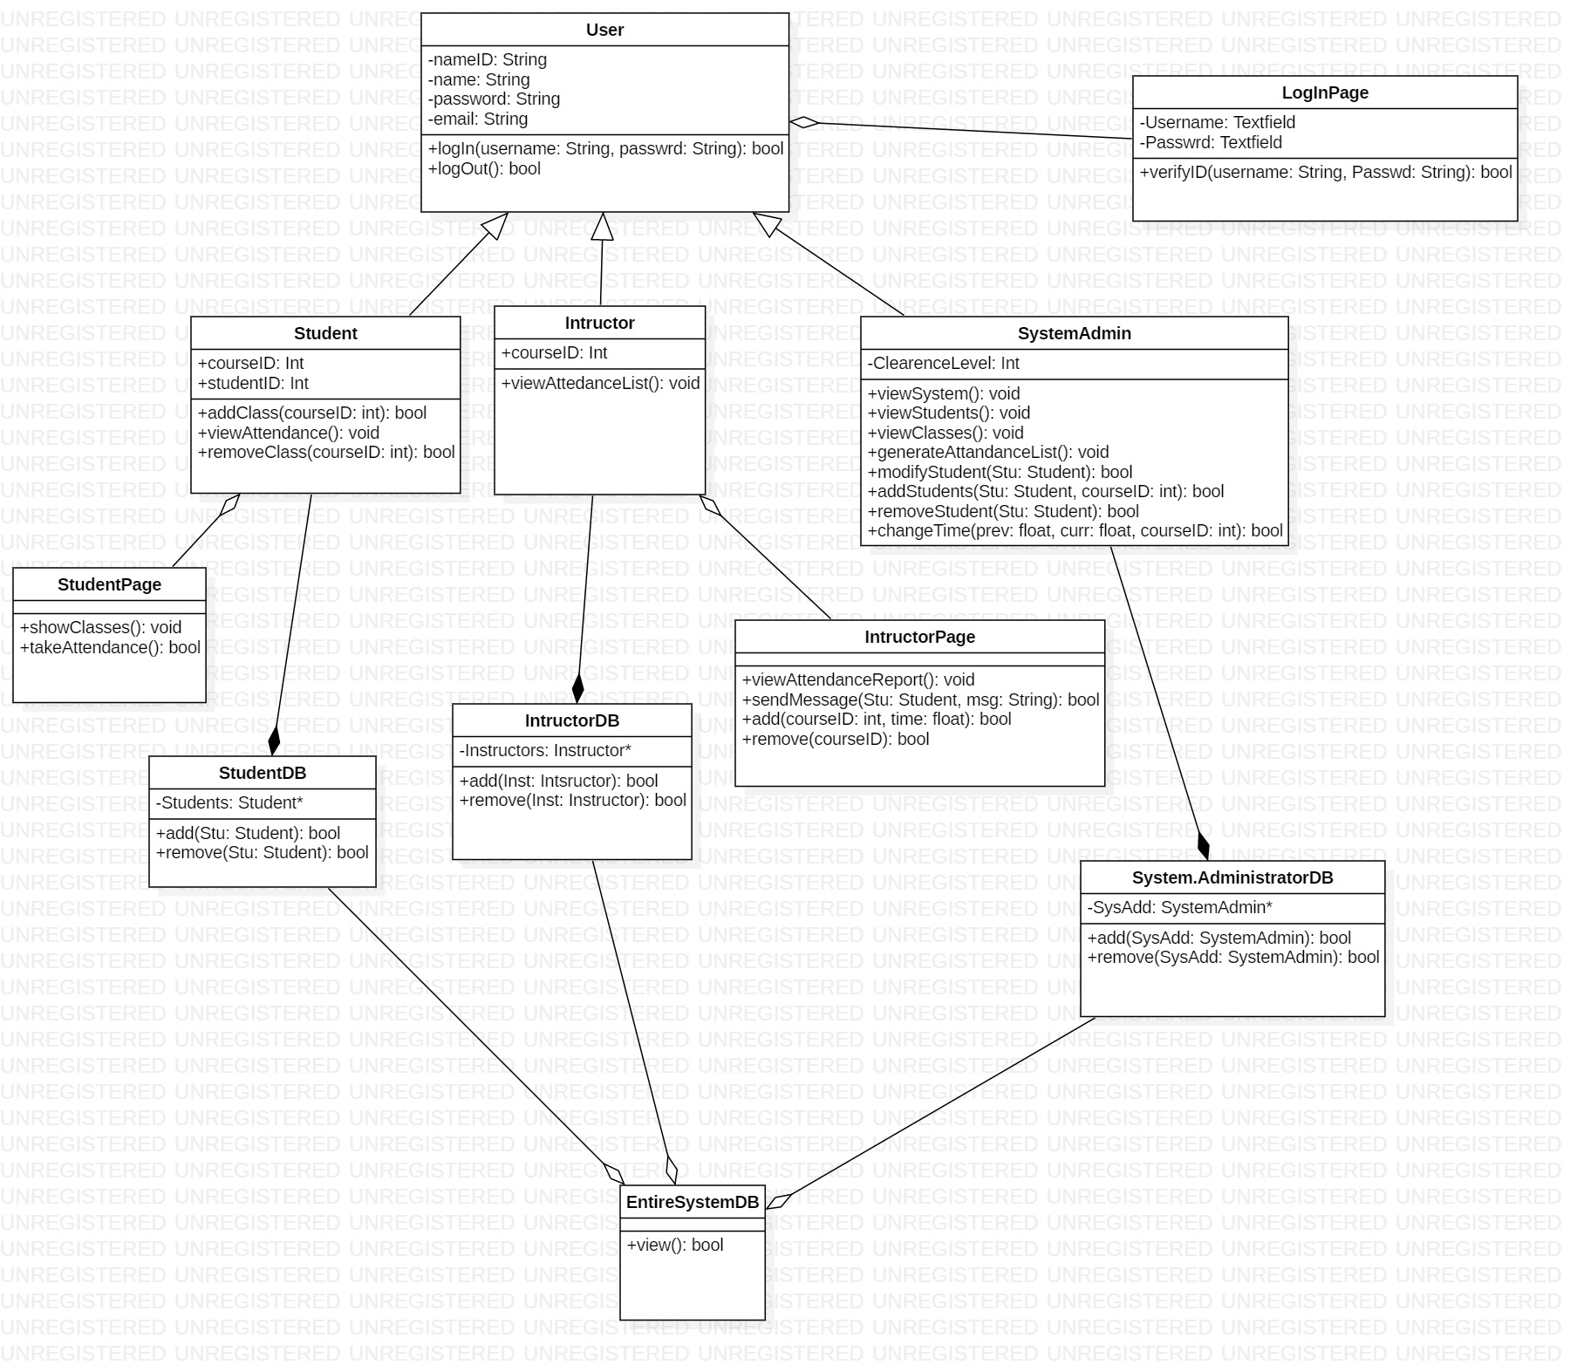
Coding Styles and Comments (1 min)
In this project, we are using Proxy Coding Style to make the project run.

Slide 6
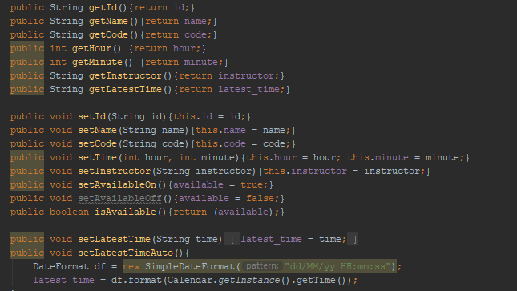
Design Pattern

Slide 7
Refactoring

Slide 8
Testing

