Slide 1
Attendance App
FastTrac
Dang La
Alec Borman
Matthew Hicks
Roger Chan

Slide 2
Project Demo
Functionality
from basic to advanced

Slide 3
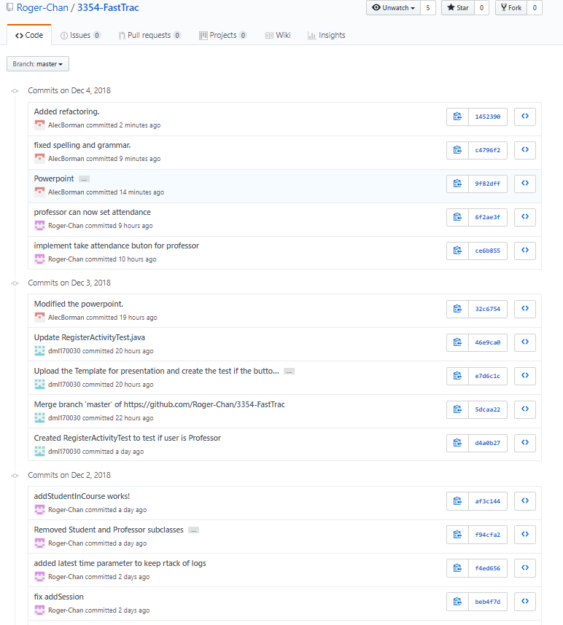
GitHub Demo

Slide 4
Team Organization
Team meetings
We meet per week.
We are using GroupMe to communicate with each other.
Task distribution
We are pair programming to support each other as this is our first time working with GitHub.
Tasks were distributed via GroupMe. with the highest priority tasks being worked on first.

Slide 5
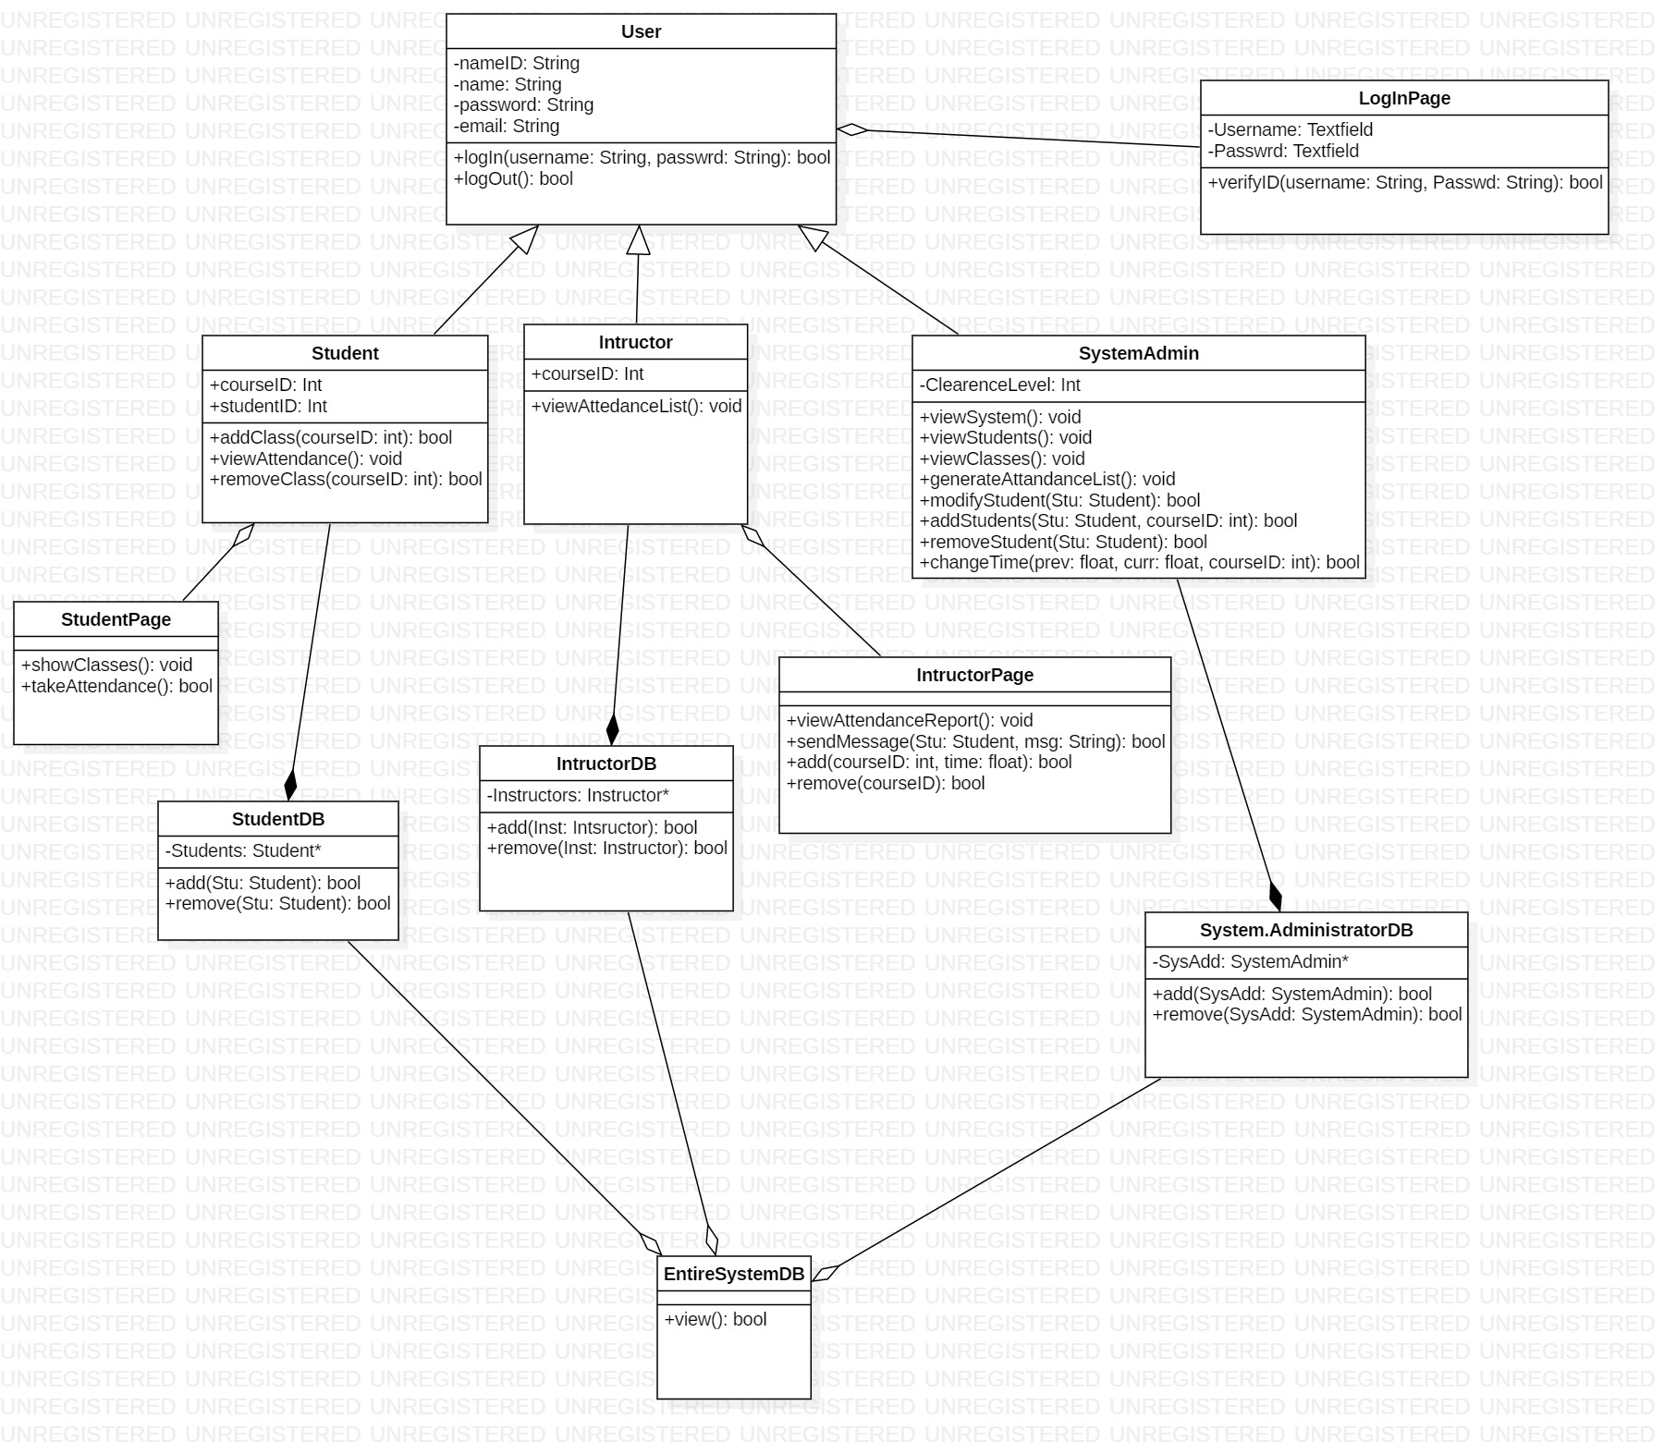
Coding Styles and Comments
In this project, we are using Proxy Coding Style to make the project run.
We are using
Camel code and underscore methods
Sqlite
Block comments
Junit testing
Manual testing
Paired Programming
Heavily utilized brainstorming in initial phase

Slide 6
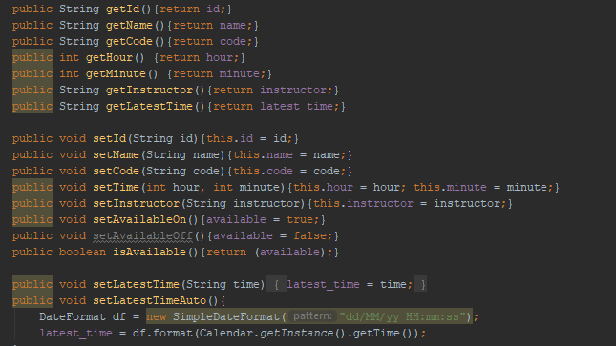
Design Pattern (proxy)

Slide 7
Refactoring https://github.com/Roger-Chan/3354-FastTrac/commits/master

Slide 8
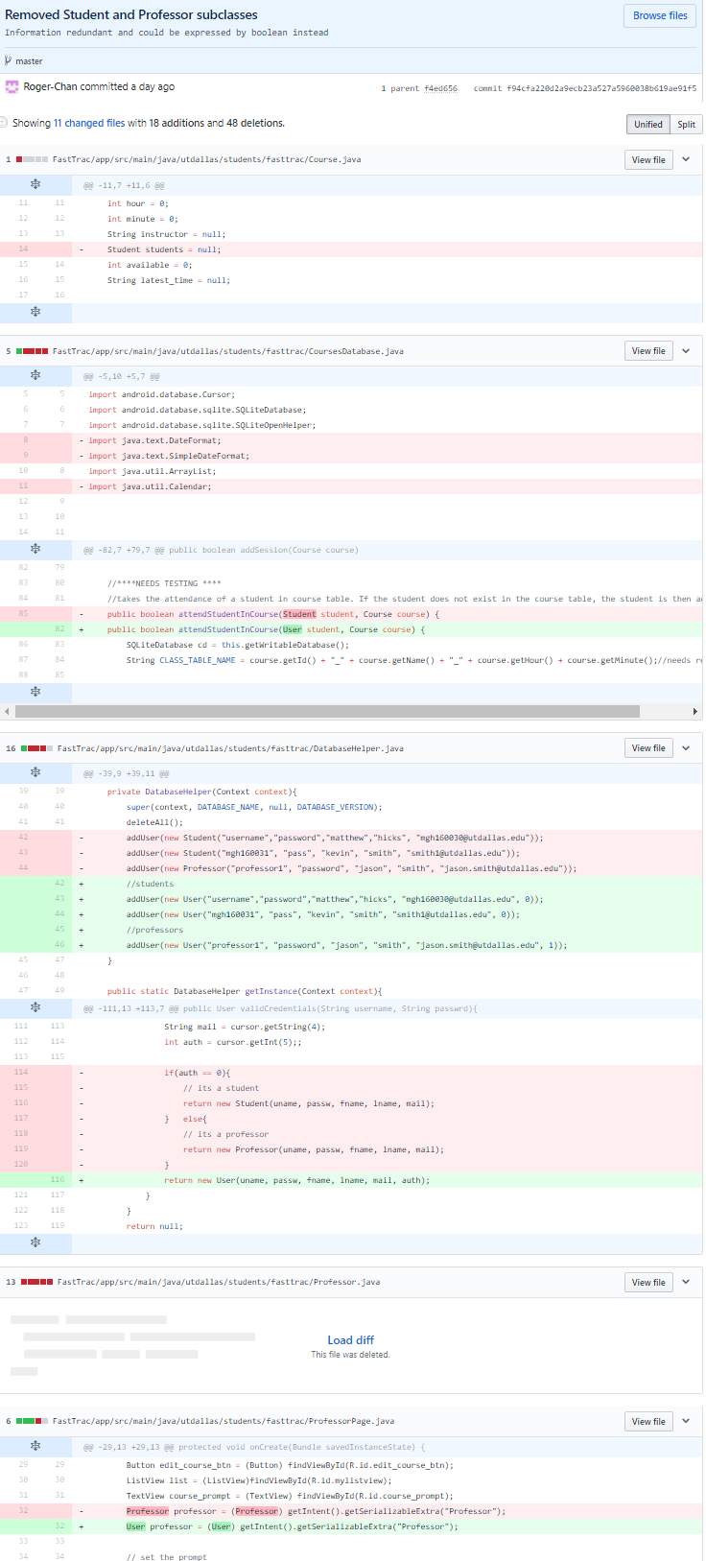

Slide 9
Testing
Our philosophy to testing has been to focus on getting working code first and test as much as possible during the coding process.
Because this is our first time using Junit we elected to test manually up until final debugging.
We have regularly used manual testing to fix collisions and other errors that have come up during the code writing phase of our project.
We are working diligently to have Junit testing completed before the final due date.

Slide 10
Questions?

