Slide 1
Car Rental Service
Group 404/2
Kuang Sheng
Shengtao Li
Xuejun Yao
Yanlin Song

Slide 2
Agile value
Communication: Weekly group meeting, share progress, ask for help
Feedback: Backend frontend corporation
Simplicity: Remove redundancy, focusing on requirement
Respect: Show opinion proper way
Courage: When facing challenge, help each other
Notes:
Simplicity: fullfill all the requiremnet, keep the necessary function. Make user easy to use.

Slide 3
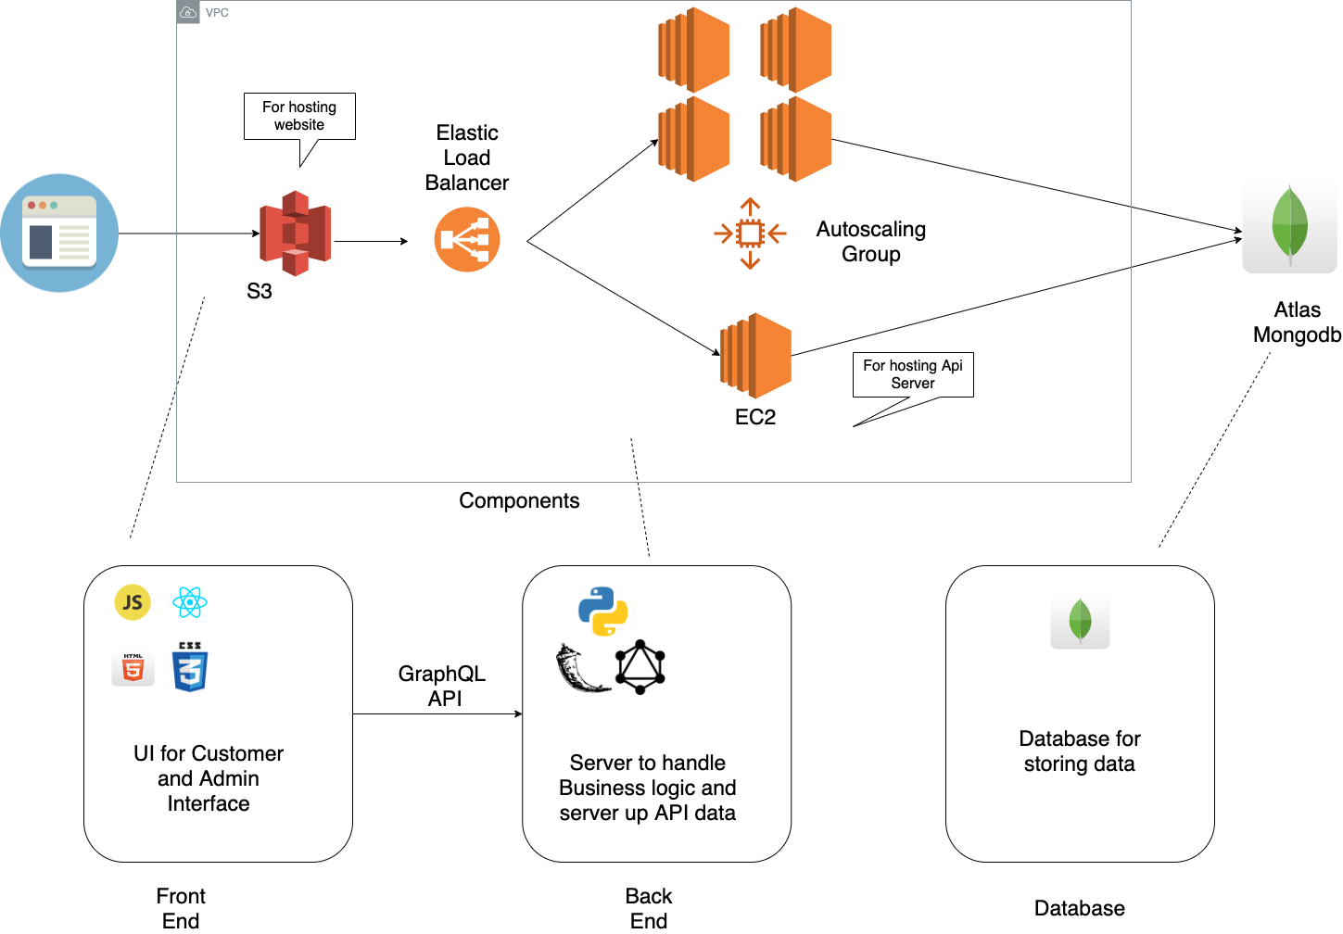
Structure
Notes:
实现 auto scaling. Load balancing. Use aws to achieve auto scaling.

Slide 4




Backend
Database: Mongodb
Document Mapper: MongoEngine
Backend server: Flask, ariadne graphql

Slide 5



Frontend
Frontend: React, Redux, JavaScript, HTML/CSS
UI: Ant Design, Bootstrap
Design: MockFlow Wireframe Pro

Slide 6
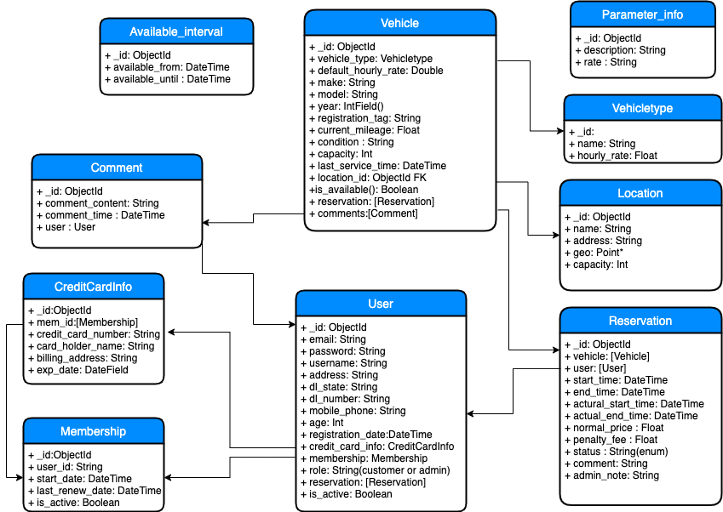
Model
Major classes:
Reservation
Location
Vehicle
Membership
Credit card info
User
Comment
Helper classes:
Vehicle type
Condition
Role
State list
Time interval
Parameter information

Slide 7
Demo List
User side
User register
User search car
User reserve car
User pay reservation
User pickup car
User return car
Show car status
User profile
Membership expired
Membership renew
Admin
Modify data
Manage user
Manage vehicle
Manage location
AWS Auto scaling

