Slide 1
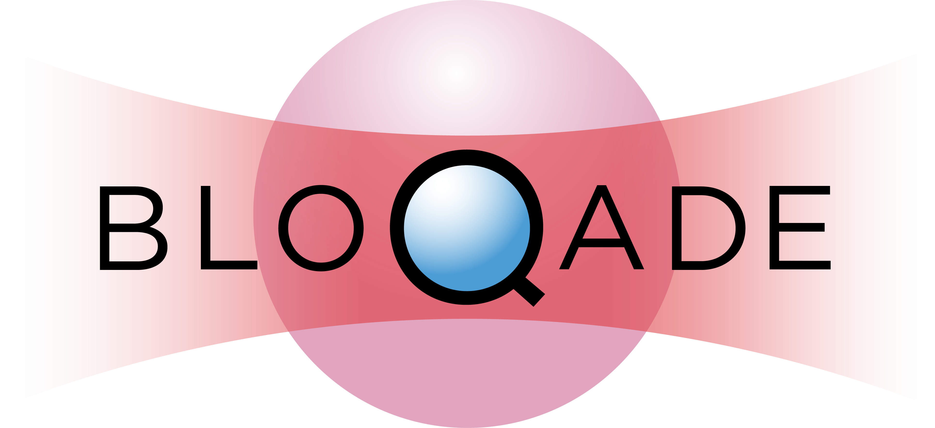
QCHS2022: The Bloqade package
Xiu-Zhe (Roger) Luo
University of Waterloo/Perimeter Institute/PIQuIL/QuEra Computing

Slide 2
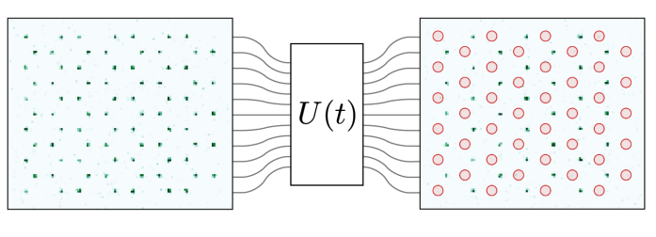

Emulating the Rydberg System
$$H=\sum_{\left\langle i,j\right\rangle }{\frac{C}{\left|r_{i}−r_{j}\right|}n_{i}n_{j}+}\sum_{i}{\frac{Ω_{i}}{2}∙σ_{i}^{x}}−\sum_{i}{Δ_{i}∙n_{i}}$$
Efficient and extensible emulation
Designed for QuEra Rydberg hardware
An open-source effort from QuEra software team
Written in Julia
Notes:
- Much faster than QuTiP
- Main goal is for QuEra hardware
- open source roughly at the end of Feb

Slide 3
Overview of functionalities
Summary & Roadmap
Live Demo: Adiabatic state preparation of Rydberg Atoms

Slide 4
Bloqade
Built-in Waveform
Flexible, intuitive waveform with various filters
Flexible Built-in Lattices
with fancy visualization
Unit Handling
Built-in support for auto-unit conversion for QuEra Rydberg device
Integrate with Yao
Rydberg Hamiltonian
Symbolic Expression Contains all system information
CUDA acceleration
80x speedup at most
ODE solvers
generic, fast, and highly configurable ODE solvers from DiffEq community
Krylov Solvers
fast and generic Krylov solver
enable easy access to common quantum information processing functions
Notes:
Rydberg Hamiltonian
Waveform
Lattice
Unit Handling
ODE/Krylov
CUDA
Yao
Introduce Yao

Slide 5
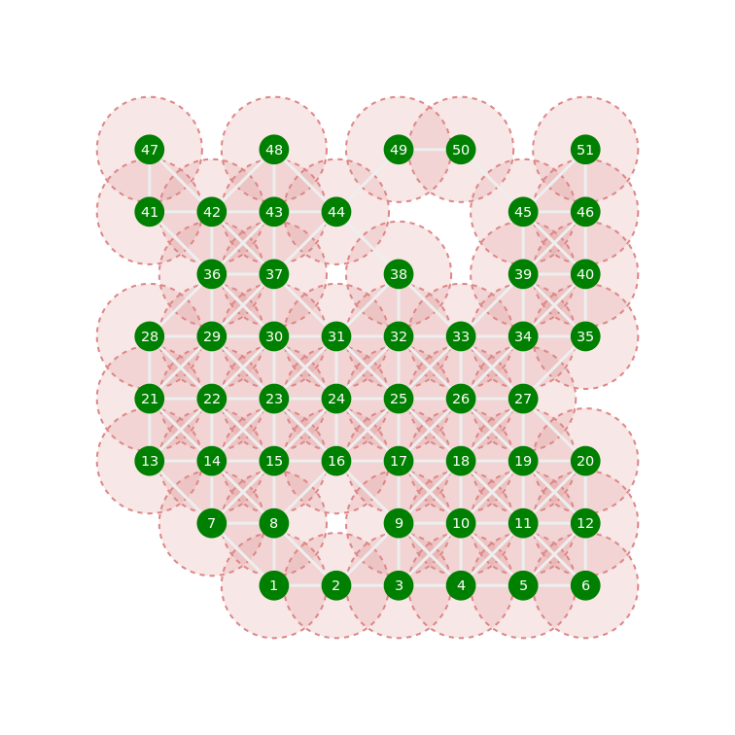
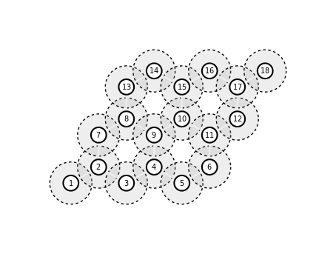
Component 1: Built-in Lattices
Generic Bravais lattice
Convenient constructors for common lattices
Fancy and flexible plots
Efficient neighboring querying

Slide 6
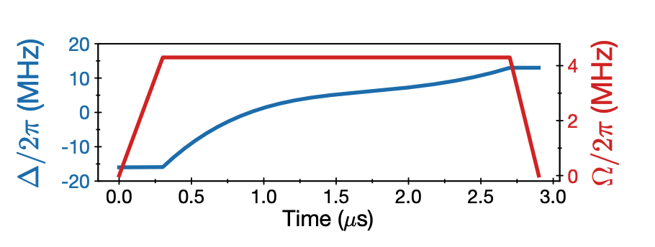
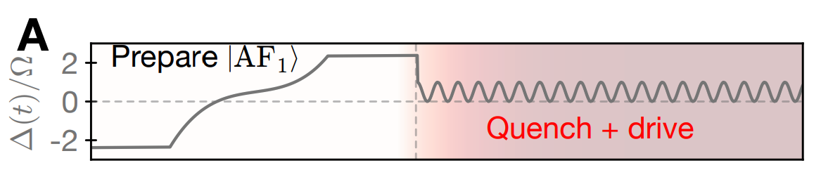
Component 2: Built-in Waveforms
Generic Waveform Object (function of time with a duration)
Convenient constructors for common waveforms
Waveform transforms (slicing, smoothing, …)
Notes:
Useful for simulating experiment, e.g variational quantum algorithm,

Slide 7
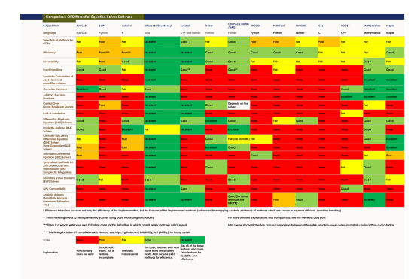
Component 3: ODE & Krylov Emulation
ODE solvers for continuous pulse simulation
Krylov solver for short-time QAOA-like simulation
SciPy
DiffEq.jl
MATLAB
Mathematica
Features
A Comparison Between Differential Equation Solver Suites In MATLAB, R, Julia, Python, C, Mathematica, Maple, and Fortran
On top of SciML/DiffEq, ExponentialUtilities
Notes:
Green mean better

Slide 8
Feature 1: Fast Emulation
Fast generic ODE-based solver for general pulse
Fast generic Krylov-based solver for QAOA-type evolution
Fast generic ODE/Krylov solver in subspace

Slide 9
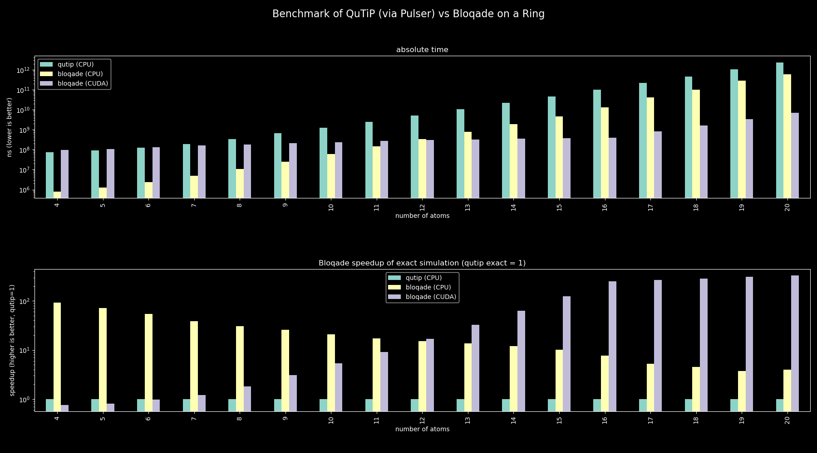
Notes:
Introduce the axis
Introduce the benchmark sets
TODO: re-plot, larger system size
TODO: add a sentence, how many times faster

Slide 10
Feature 2: More Choices of ODE Solvers
Efficiency
Precision
Memory
Incomplete list of solvers:
Adams-Moulton methods (`VCABM`, etc.)
Adams-Bashforth Explicit Methods (`AB3`, etc.)
Verner's "Most Efficient" Runge-Kutta methods (`Vern6`, `Vern7`, `Vern8`, etc.)
Full list of solvers is available at DiffEq documentation
Notes:
QuTiP and SciPy only have one fixed solver

Slide 11
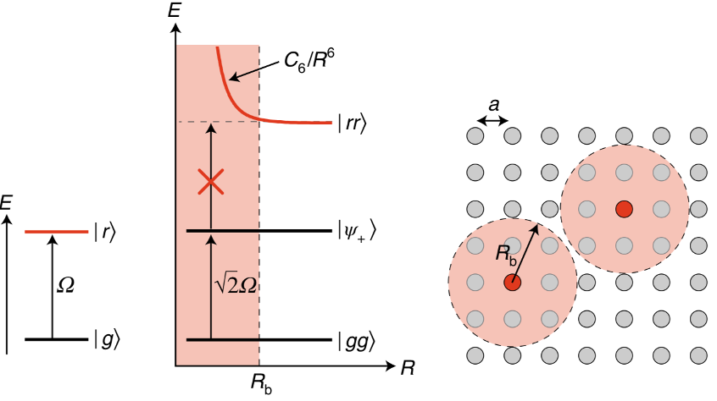
Feature 3: Rydberg Blockade Subspace
Notes:
Mentioned what is a blockade, cannot have Rydberg excitation within blockade radius

Slide 12
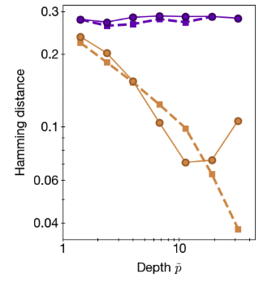

Feature 3: Rydberg Blockade Subspace
51-site simulation, $82384444≈2^{26}$ for blockade subspace, $2^{51}$for full space
Notes:
Mentioned what is a blockade, cannot have Rydberg excitation within blockade radius

Slide 13
Feature 4: Generic Implementation
Measurements.jl + Bloqade.jl = linear error propagation on Rydberg dynamics
ForwardDiff.jl + Bloqade.jl = forward mode automatic differentiation on Rydberg dynamics

Slide 14
Code Demo

Slide 15
Roadmap
Hardware integration through AWS braket (coming in summer)
3-level system
master equation and more complete noise modeling support
Reverse mode automatic differentiation
Rydberg Quantum Monte Carlo (SSE)

