Slide 1
(Quantum Lottery) Ticket to Ride:
Pruned VQE
The Day Trippers
QHACK 2019, Toronto, Canada
November 26, 2019

Slide 2
Lottery Ticket Hypothesis (idea):
Network size doesn’t matter
Initialization & architecture are important
Winning ticket: correct initialization and small network that performs comparably to a larger network
Start with big network → train it → prune insignificant parameters → train it → repeat
What about variational quantum circuits?
Flat landscapes make initialization hard
Many gates = lots of noise
Can we prune away gates that are insignificant?
Variational Quantum Eigensolvers
“Prune” gates that are doing nothing (very small rotations)
Retrain the circuit

Slide 3
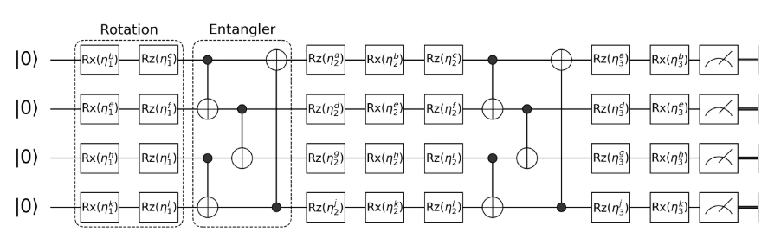
Variational Quantum Eigensolvers
“Prune” gates that are doing nothing (very small rotations)
Retrain the circuit

Slide 4
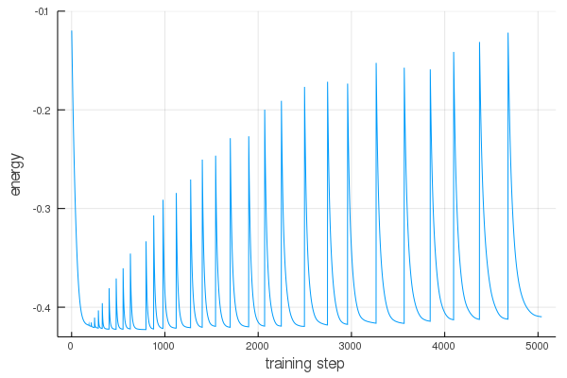
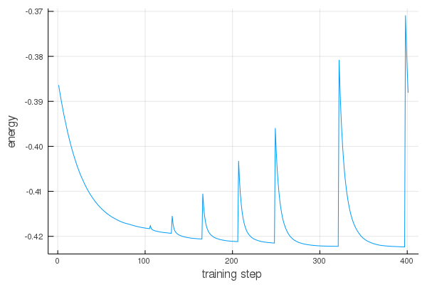

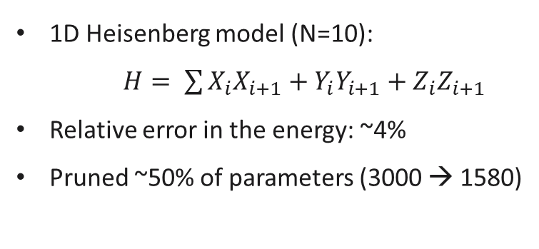
1D Heisenberg model (N=10):
$H= \sum{X_{i}X_{i+1}+Y_{i}Y_{i+1}+Z_{i}Z_{i+1}}$
Relative error in the energy: ~4%
Pruned ~50% of parameters (3000 → 1580)

