Slide 1
The Day Trippers
QHACK 2019
November 26, 2019
(Quantum Lottery) Ticket to Ride:
Pruned VQE
Lottery Ticket Hypothesis
“Winning ticket”: correct initialization and small network that performs comparably to a larger network

Slide 2
Quantum Lottery Ticket Hypothesis
Lottery Ticket Hypothesis:
Winning ticket: correct initialization and small network that performs comparably to a larger network
What about variational quantum circuits?
Flat landscapes make initialization hard
Many gates = lots of noise
Can we prune away gates that are insignificant?

Slide 3
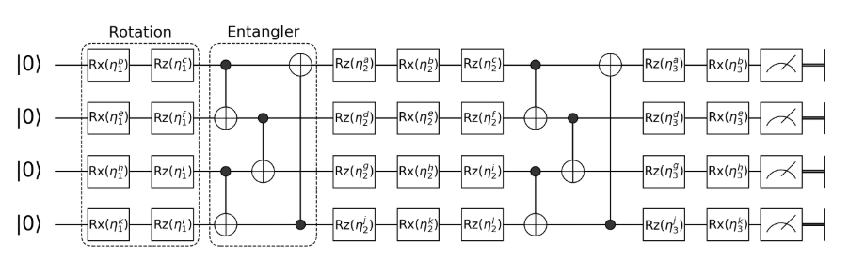
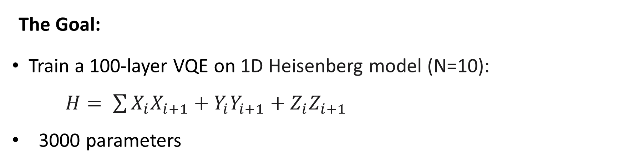
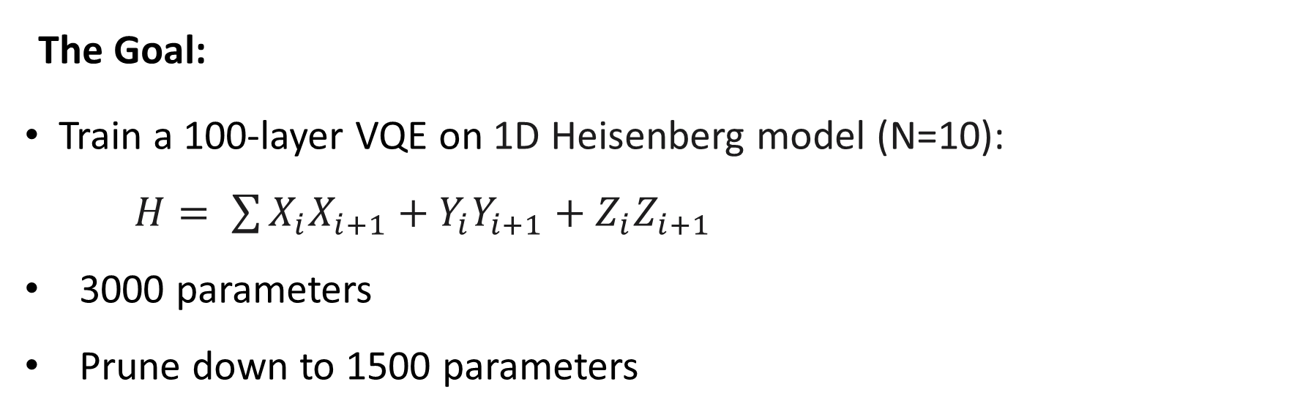
The Goal:
Train a 100-layer VQE on 1D Heisenberg model (N=10):
$H= \sum{X_{i}X_{i+1}+Y_{i}Y_{i+1}+Z_{i}Z_{i+1}}$
3000 parameters
The Goal:
Train a 100-layer VQE on 1D Heisenberg model (N=10):
$H= \sum{X_{i}X_{i+1}+Y_{i}Y_{i+1}+Z_{i}Z_{i+1}}$
3000 parameters
Prune down to 1500 parameters

Slide 4
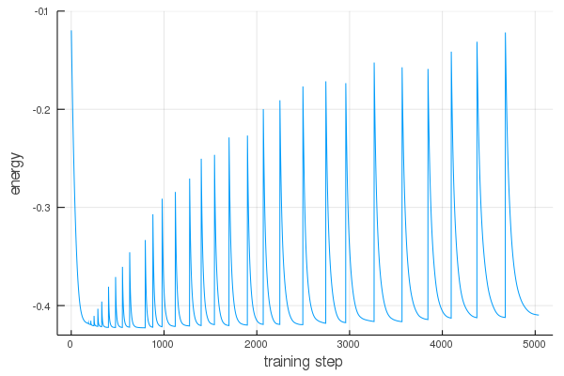
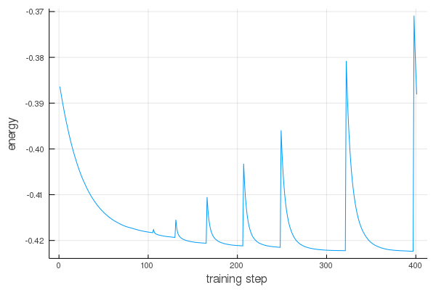
Results (Preliminary)
Small pruned ~50% of parameters (3000 → 1500) achieves 4% energy error

