Slide 1
Data analysis of ³He gas-filled neutron counters.
Roger González March
30 June 2022
Advisors: Ariel Tarifeño (UPC) and Volodomyr Magas (UB)
Notes:
Nuclear experimental physics and he put in in contact with Ariel. Proposed me a a final degree project about Data analysis of 3He gas-filled neutron counters at n_TOF a collaboration inside CERN. IFIT

Slide 2
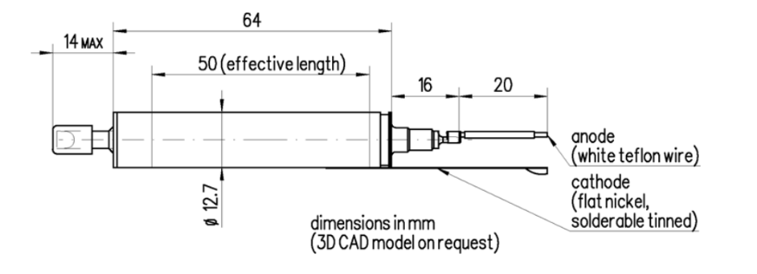

OUTLINE
UPC experiment
Scope of the work
Data Acquisition
Methods
Data Processing
Results
Conclusions
Vakutek V60 ³He Proportional Counter

Slide 3
n_TOF and experimental setup

Slide 4
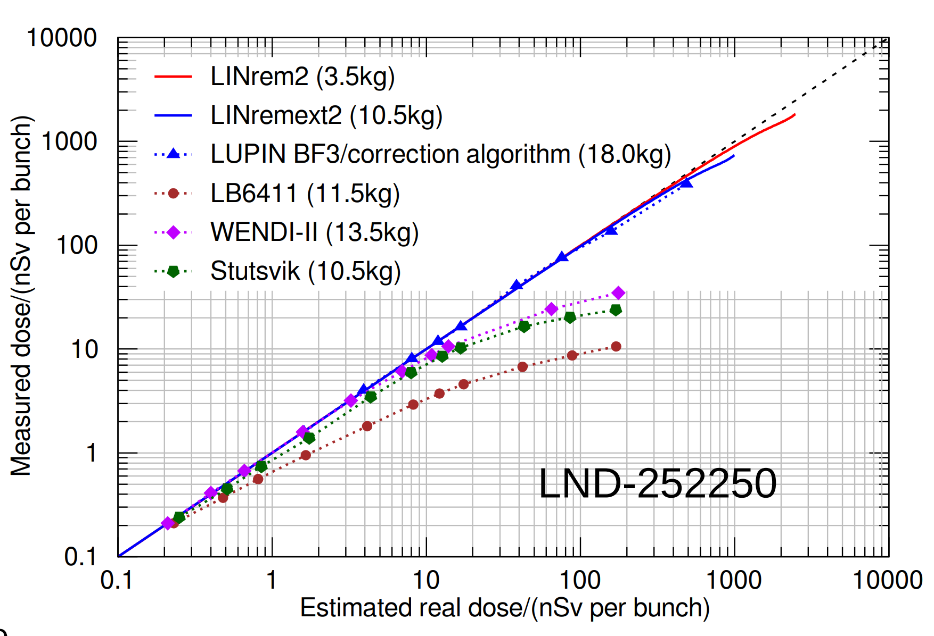
Characterization of ³He-filled neutron counters in pulsed fields
Motivation
Pulsed neutron fields are becoming more frequent in different facilities and applications.
Examples
Neutron dosimetry, hadron therapy, and Neutron background in pulsed neutron sources, among others.
System
³He-filled neutron counters provide high efficiency in handling large counting rates and pile-ups.
Source: Technical University of Catalonia (UPC) – Nuclear
Notes:
UPC is developing neutron dosimeters to enhanse performance in neutron pulsed beams wich can be foun in – Examples.

Slide 5
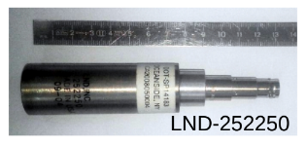
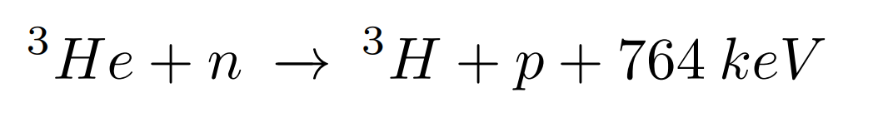
Gas-Filled Neutron Detectors
The reaction of ³He with a neutron breaks the nucleus into a tritium and a proton.
The proton and the tritium ionize the gas in their path until they have exhausted all their energy.
Choosing the right voltage, we can use ³He detectors as a proportional counter.
Notes:
The funny thing about neutrons is that they are neutral therefore detection is based in indirect methods.
One of the popular methods is to display an array of gas filled detectors and with the method os bonner spheres one can construct a neutron spectra playing with the geometry of the moderator (Slows neutrons to termal energy because it has more crossection with gas-filled detectors) (polyethylene).
This tubes have Helium 3 inside and when a thermal neutron comes breaks the nucleus into a tritium and a proton. Inside there is an electric field that collects the charge ionized by the reaction.
The reaction of 3He with a neutron breaks the nucleus into a tritium and a proton. This reaction is exothermic and release 764 keV that is shared between the tritium and the proton.

Slide 6
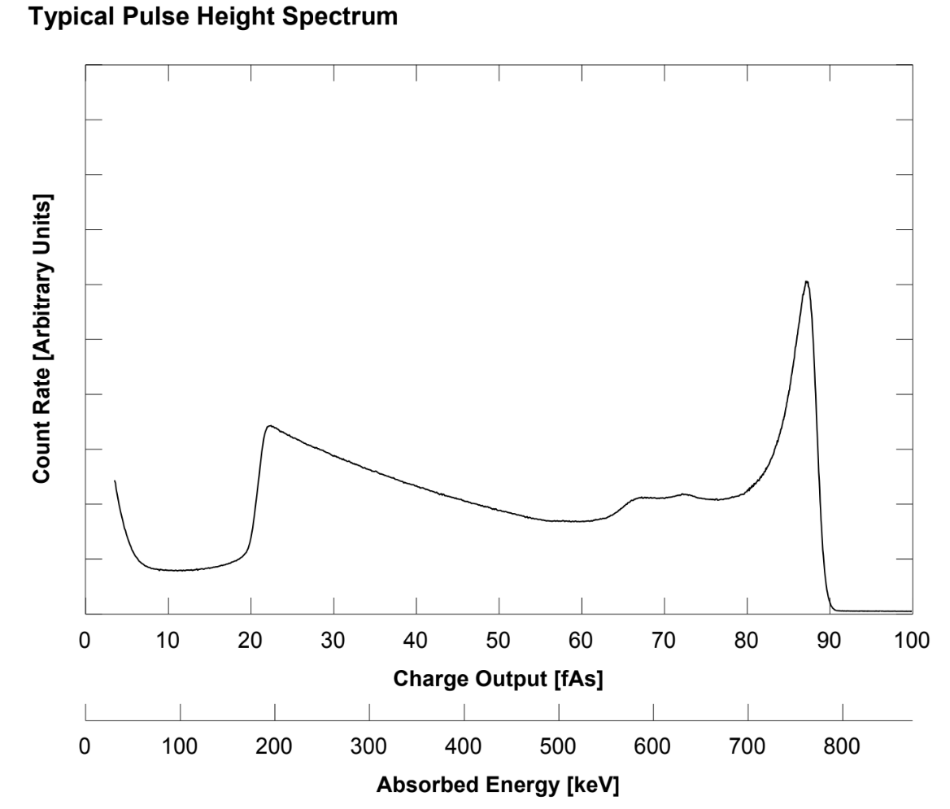
³He proportional counter spectra
These two particles are emitted at an angle of 180° to each other.
It often happens that one of them, strike the internal walls of the cathode and lose the residual energy there without causing ionization in the sensitive environment of the detector.
Proton and tritium are emitted with energy of 574 keV and 191 keV
Full energy peak
Gamma pule up background
Tritium edge
Proton edge
Source: Vacutek V60 datasheet
Notes:
Wall effect:
These two particles are emitted at an angle of 180 °C to each other. During their slowing down in the filling gas, it often happens that one of them, or perhaps, both at the same time, strike the internal walls of the cathode and lose the residual energy there without causing ionization in the sensitive environment of the detector. proton and the triton thus obtained, and which are, respectively, emitted with energy of 574 keV and 191 keV

Slide 7
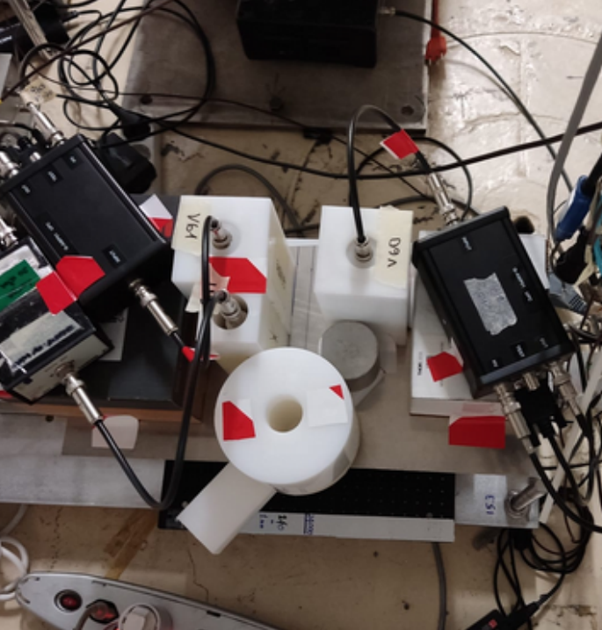
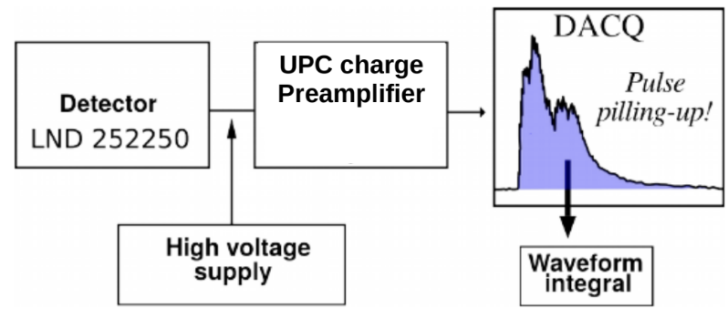
Calibration Setup
Three different 3He proportional detectors:
LND
Vacutek V60
Vacutek V61
V60, V61 new adicional tubes to be used in experiments at n_TOF for the UPC LINrem neutron dosimeters.
Notes:
So, what i’ve done?
I have been responsable of performing the calibration the tubes that have been used in the high pilled up. In other words to depelop a routine análisis to obtain the tubes spectra and exract some parameters that is needed when mesuring high pilled up recorded data.
COMENT PILE UP AND CHAIN ELECTRONICS
Americium-Berlium
This is the display of the calibration
->
New detectors to build an array of boles spheres or just more pile-up capacity?

Slide 8
Data Acquisition System
CERN n_TOF collaboration

Slide 9
Data Acquisition System
Digital Electronics
Difficulties
High volume of Data
Large storage capabilities
High data transfer rates
Computing power for pulse processing analysis.
n_TOF is fully digital with FADC
12-bit flash-ADCs (Amplitude Resolution)
Up to 1GHz of Sampling Rate.
Negligible dead times.
Offline digital processing methods adds flexiblity to extract maximum information.
We need to implement our own new Pulse Processing Algorithm
Notes:
We are on enviorment of high resolution. This typs of specpecta used to obtain with analog electronics. Analog to digital converters have replaced them.
- Talk about our Sample Rate 500MHz -> Only for the calibration 5TB and 9 runs.

Slide 10
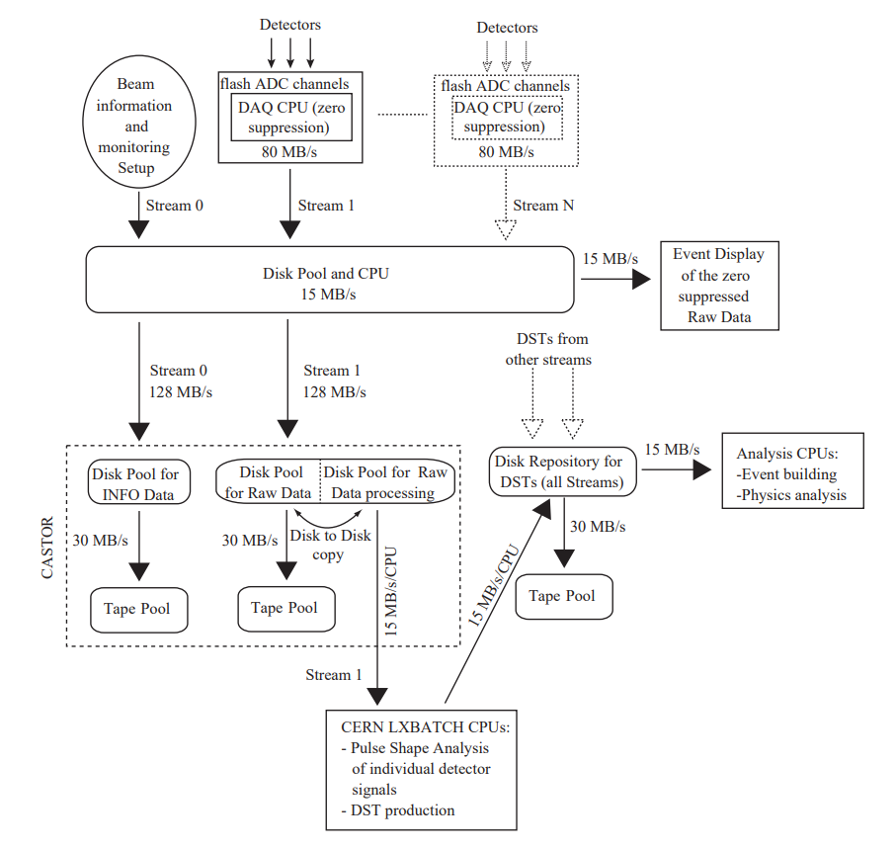
Data Acquisition System
After a raw data file is finished is tranfered to Cern Advanced STORage manager (Castor).
There data is migrated to tape.
n_TOF staff helped to extract and transform raw data into readable ROOT files for further analysis.
Run in Batch mode at CERN’s batch services (LXPLUS).
Notes:
We couldn’t done it with out the help of michi
Disk Pool is for improving transfer rate
Zero supression is a compresión algorithm
- Takes arround 5 days to process all data files

Slide 11
METHODS
Digital Pulse Analysis

Slide 12
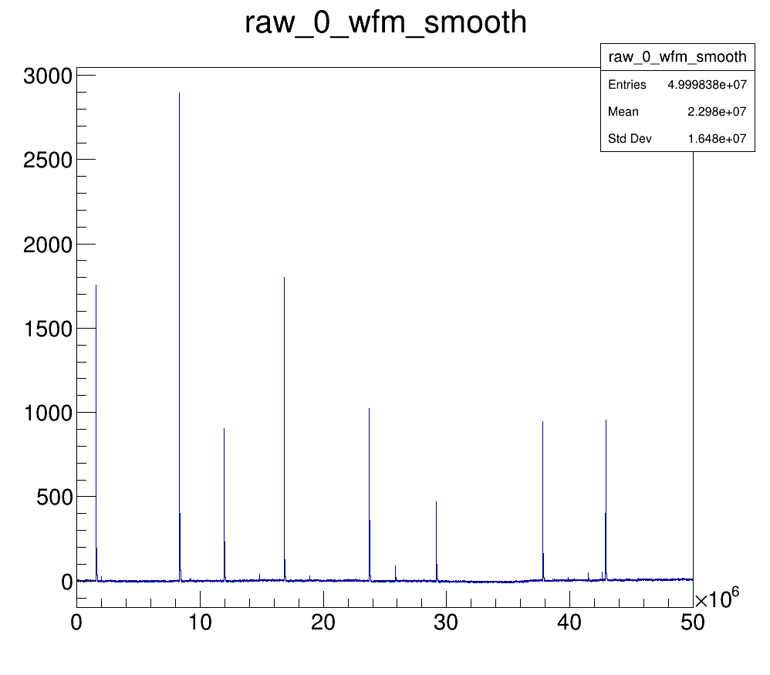
Signal
Mesured Amplitude [mV]
Sample Number [a.u]
Notes:
So when all the data is processed when can open a file and see what is like. See all the different signal shapes, with a first look we don’t see any pil ups, this is do our work esasier.
Raw Signal, coment that there are 14 singals ins a root file and 500 ROOT files in one detector

Slide 13
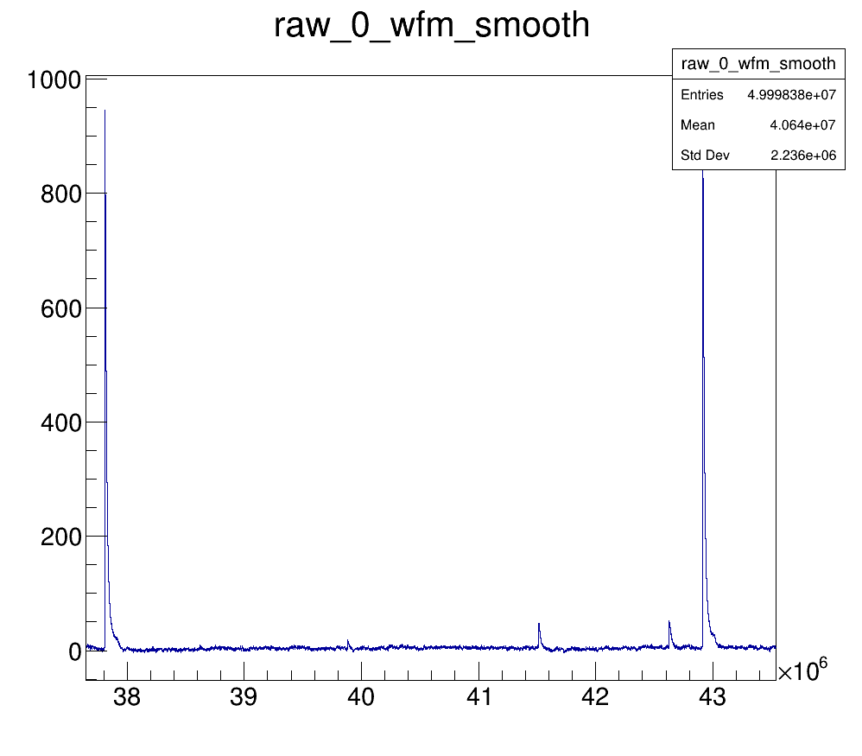
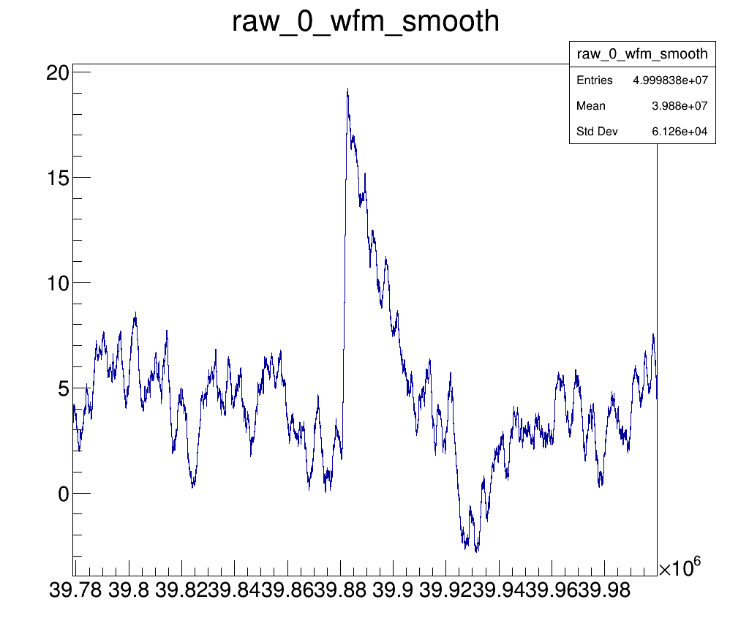
Small pulse
Mesured Amplitude [mV]
Mesured Amplitude [mV]
Sample Number [a.u]
Sample Number [a.u]
Notes:
On the other hand Small pulses at the same magnitude of background noise will create problems in the future. So we need to be carefull.

Slide 14
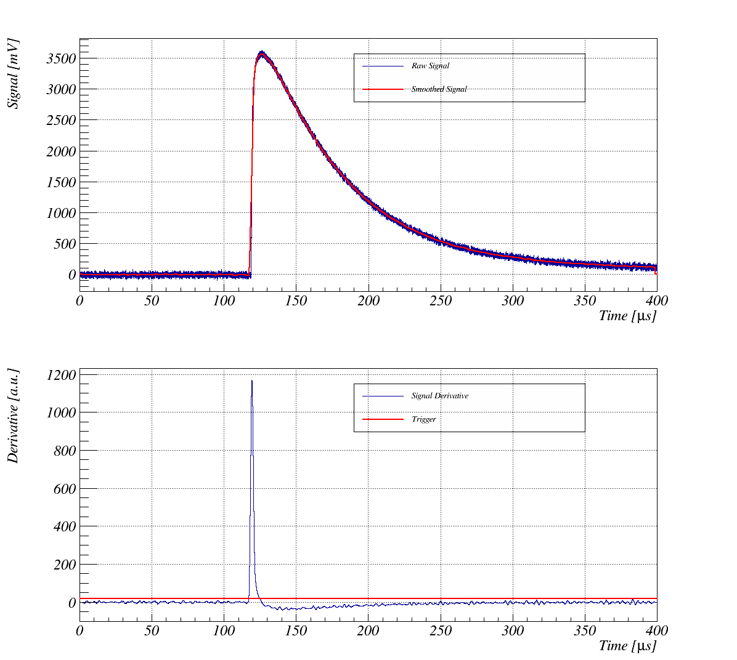
Pulse Analysis algorithm
Signal Derivative
Estimate Trigger Threshold
Smooth the signal between a range
Apply baseline correction
Calculate max amplitude
Integrate
Rebin histograms
Calibration 764 keV peak
Notes:
This is the Pulse Analysis algorithm that we have implemented. Is a very simple routine, the main work has been processing all the data and dessing a good system to run the algorithm to all files. Amplitude and Area

Slide 15
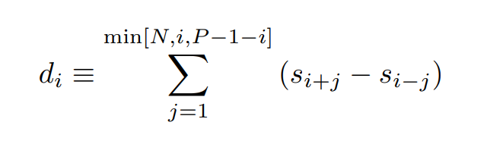
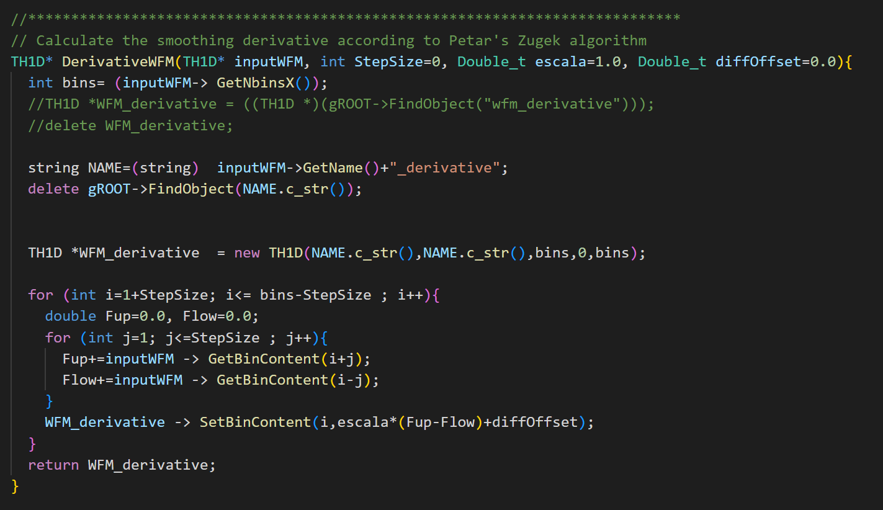
Signal Derivative
Notes:
The first this to creating pulse analysis is to develop some method to know where we can expect a pulse.
Coment here that we have used ROOT for the devepment of the code. Extracts files are already in ROOT and is design especially for managing huge amount of data like Alice or LHC

Slide 16
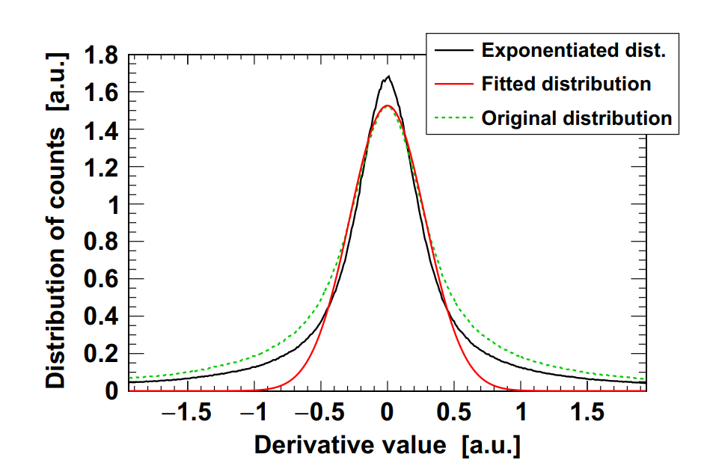
Signal derivative projection
Trigger
In a general approach, the election of the threshold can be fixed on the RMS (root mean squared) value from the signal. To find the RMS value of our signal, the derivate values are projected into a histogram. Values that correspond to the noise are expended to a group around 0 in a gaussian distribution and the RMS can be extracted with a fitting.
Meanwhile, signal derivative points from our pulses will be distributed outside the Gaussian shape in long tails.
Source: P. Žugec, Pulse processing routines for neutron time-of-flight data

Slide 17
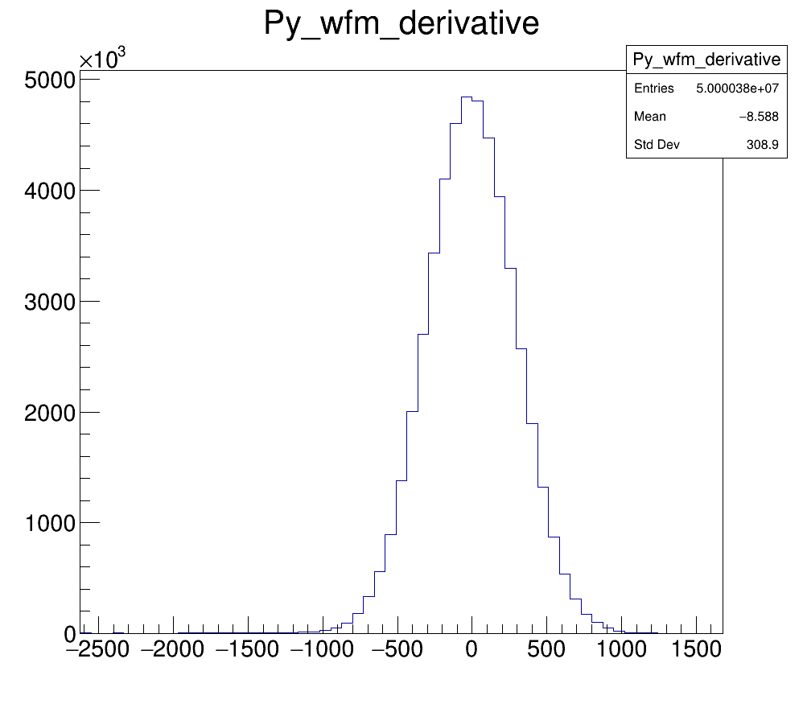
Trigger
Distribution of counts [a.u]
We can’t apply this procedure in our data. Need a manual trigger selection.
Derivative value [a.u]
Notes:
WE don’t find this long tails due to the low counts found in our files. Our trigger era un valor en nuestra distribucion

Slide 18
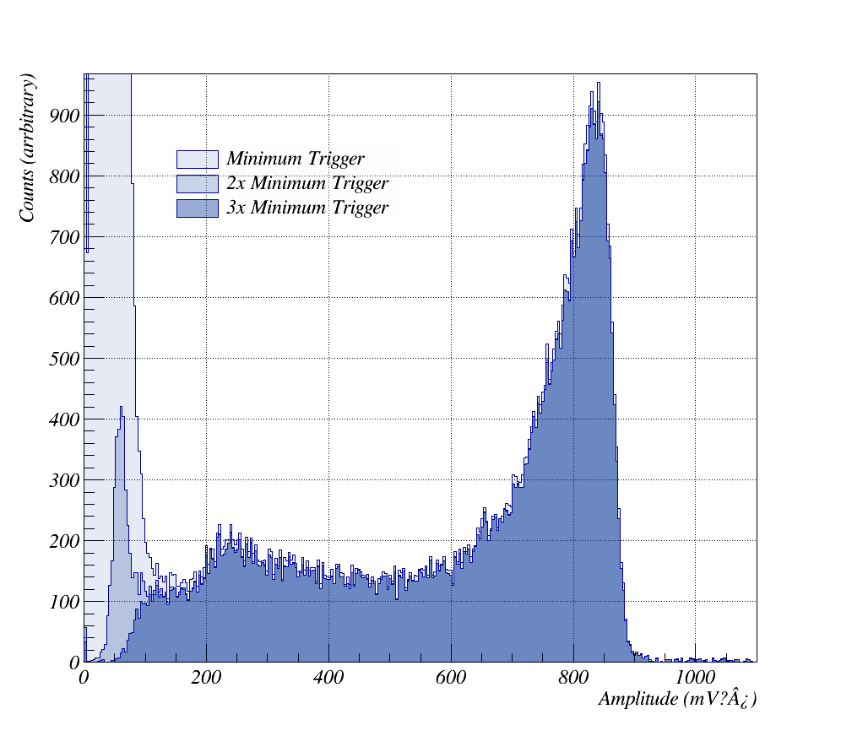
Trigger threshold
)
)
Notes:
Well really the development hasn’t been linear. This could be at the end. This

Slide 19
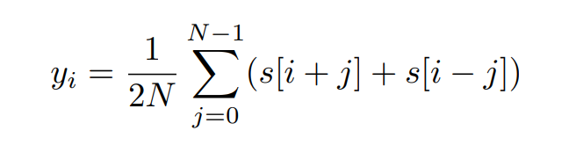
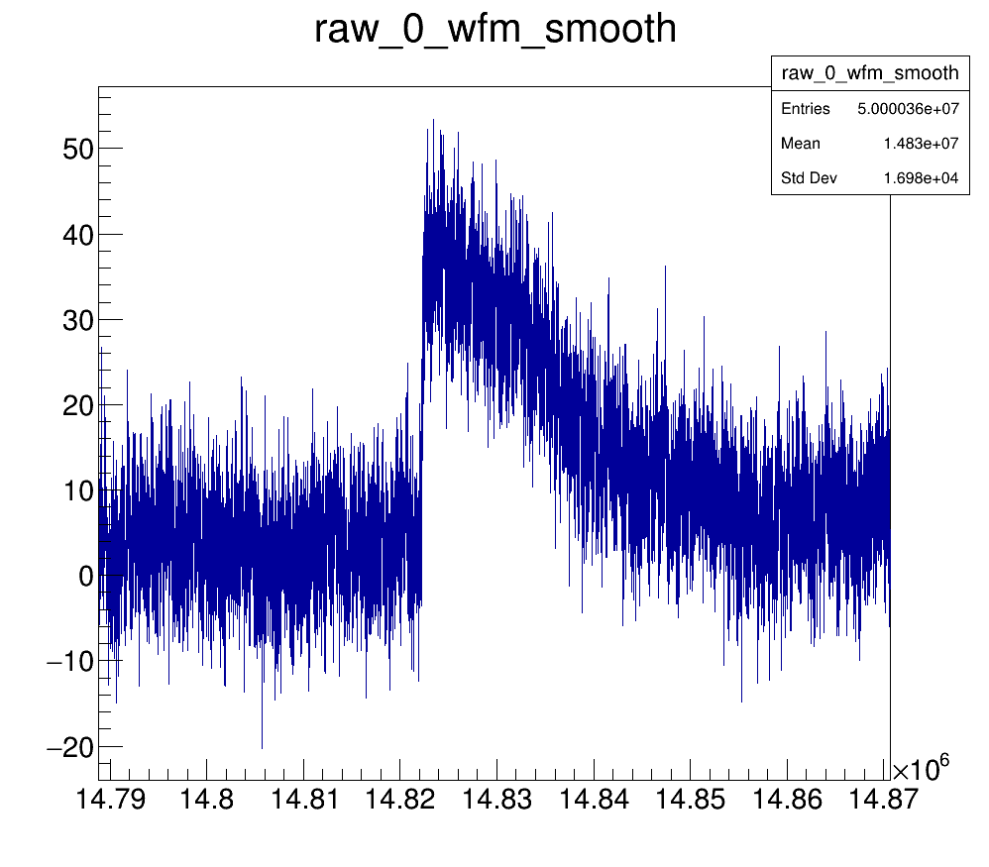
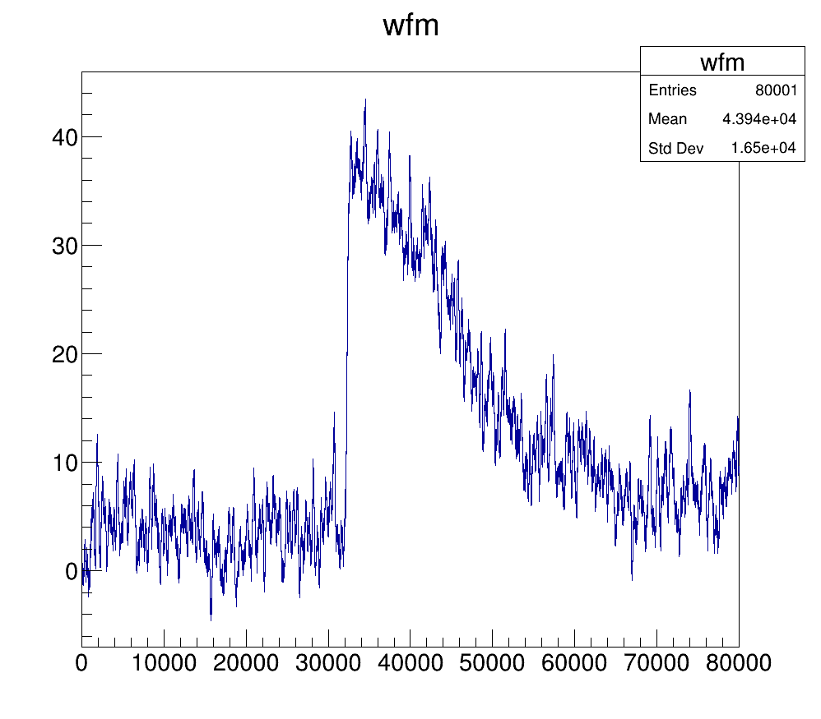
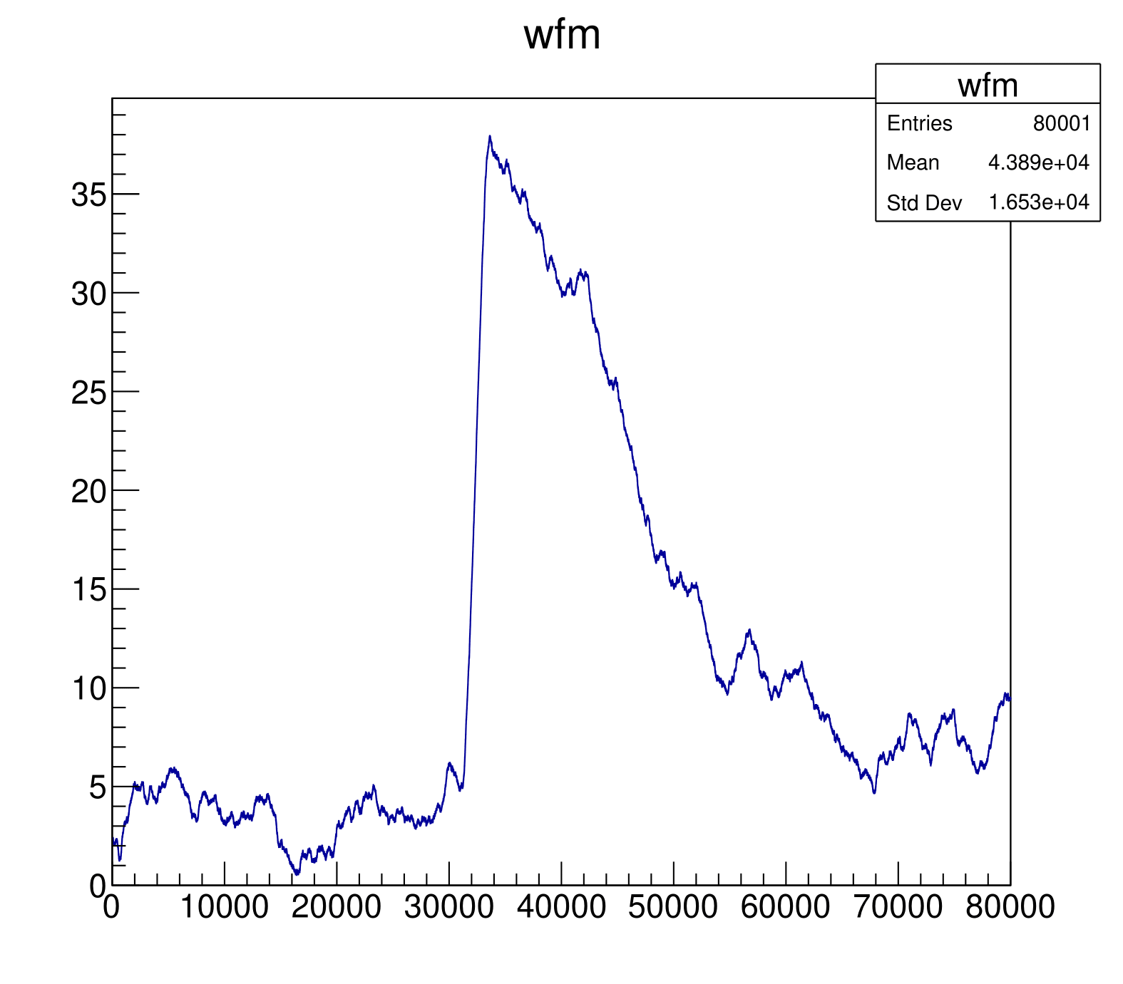
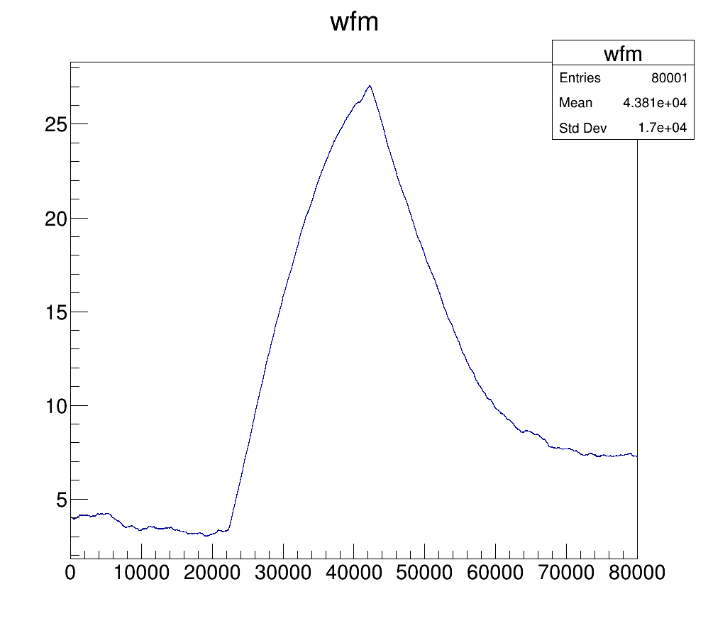
Moving Average
Reduce white random noise.
Distorts signal shape.
Step size
Step size selection will be set on a range that is enough to deal with the noise but maintain the shape and reduce the amplitude value to a minimum.

Slide 20
Recap

Slide 21
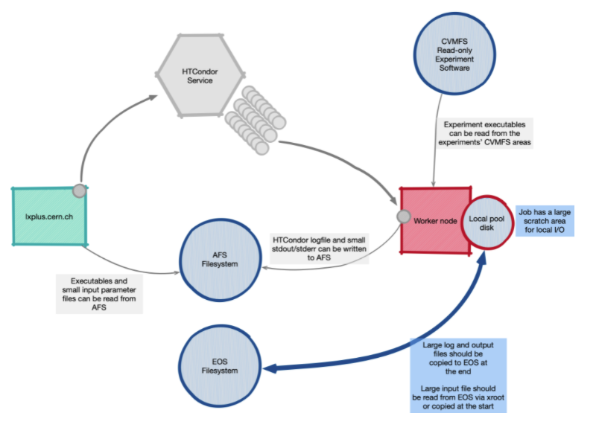
Processing time and Processing Power
For the calibration 5034 files have been analyzed.
Every file needs 1 CPU and 10 Gb of RAM
Every file needs 1h to extract all the information.
Thankfully we could get access to HTCondor. A batch farm (100k cores) to queue up all our files.

Slide 22
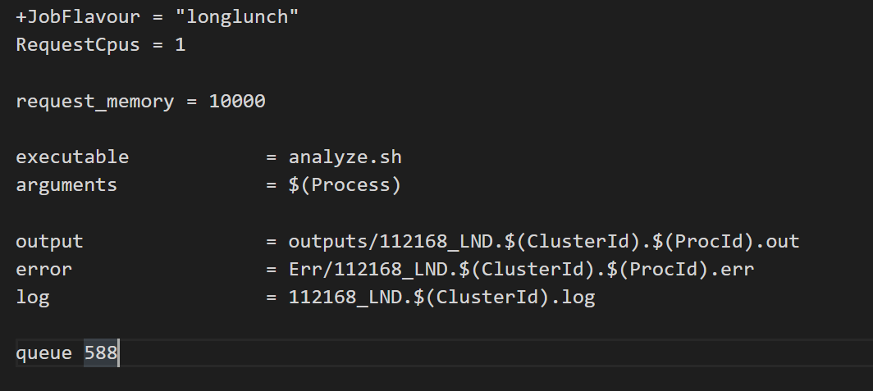
Simple job submission
Notes:
Enseñar ejemplo
dir que es cada cosa.

Slide 23
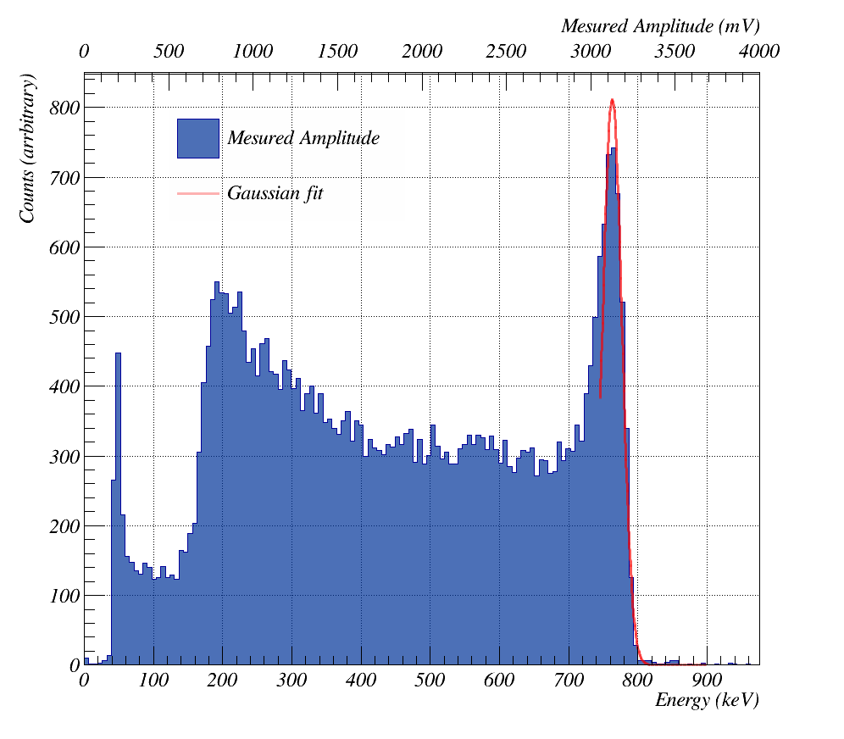
Calibration
Full Energy Peak
Proton + Tritium
Tritium edge (191 keV)
Resolution
Gamma background
Notes:
Amplitude and Area

Slide 24
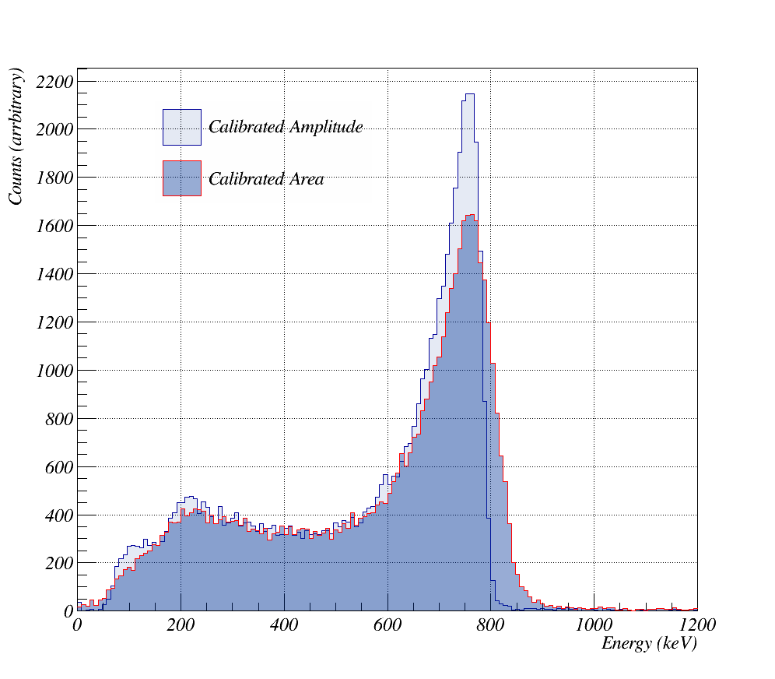
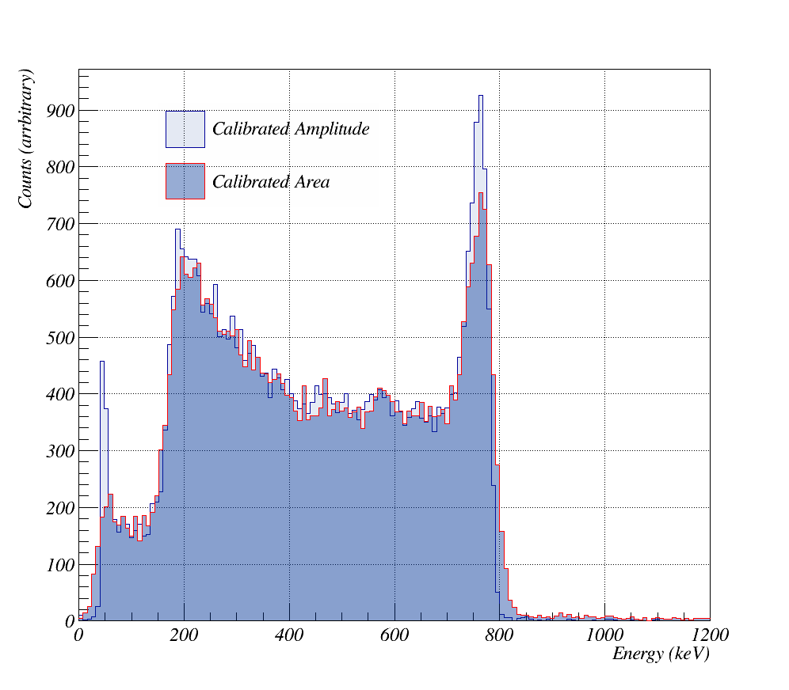
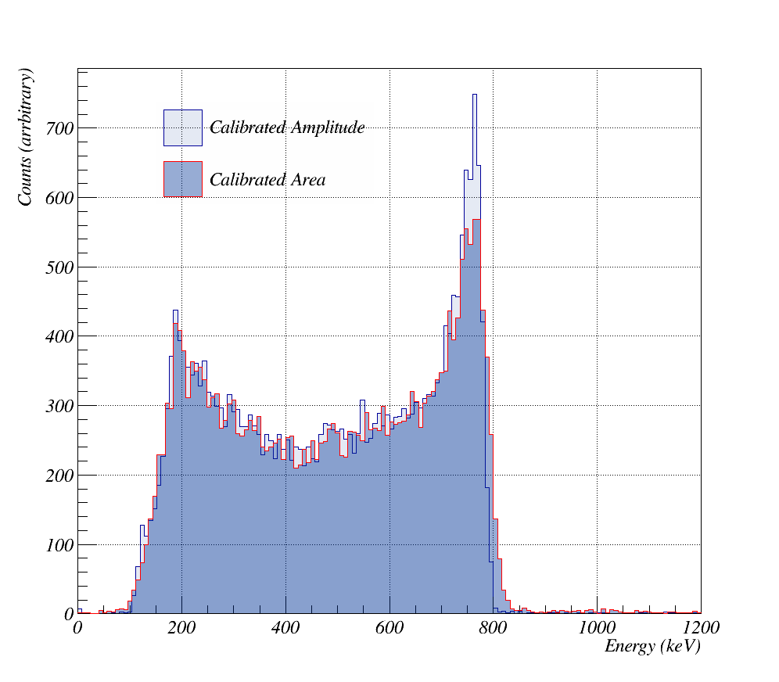
Threshold Selection – Run 112170
LND
V60
V61
Notes:
Talk about Trigger Selection with these examples good acceptable and bad.
Different voltage values attound 9 espectras and 500 files

Slide 25
Results and Conclusions

Slide 26
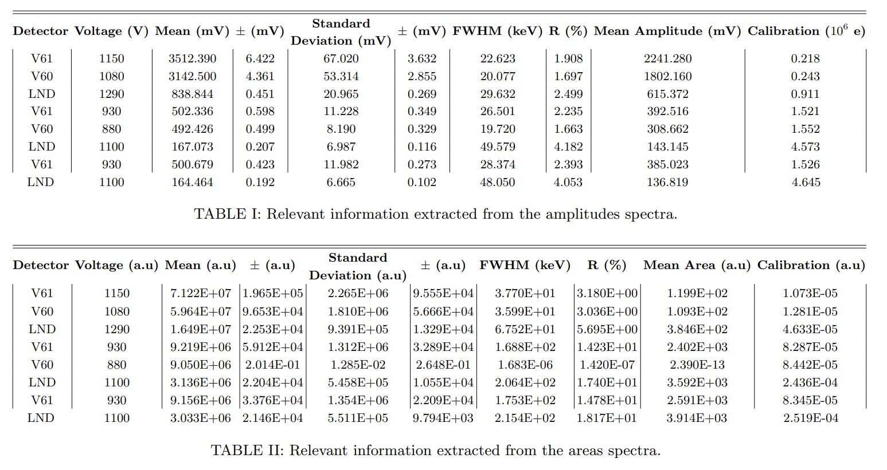
Results

Slide 27
Results
3
0.5
21.0
.3
0.6
.4
0.5
2
1
7.0
7
12.0
.3
5
.2
.7
2.014E+04
1.281E+06
2.654E+06
2.061E+02
1.680E+01
2.772E+06
8.537E+06

Slide 28
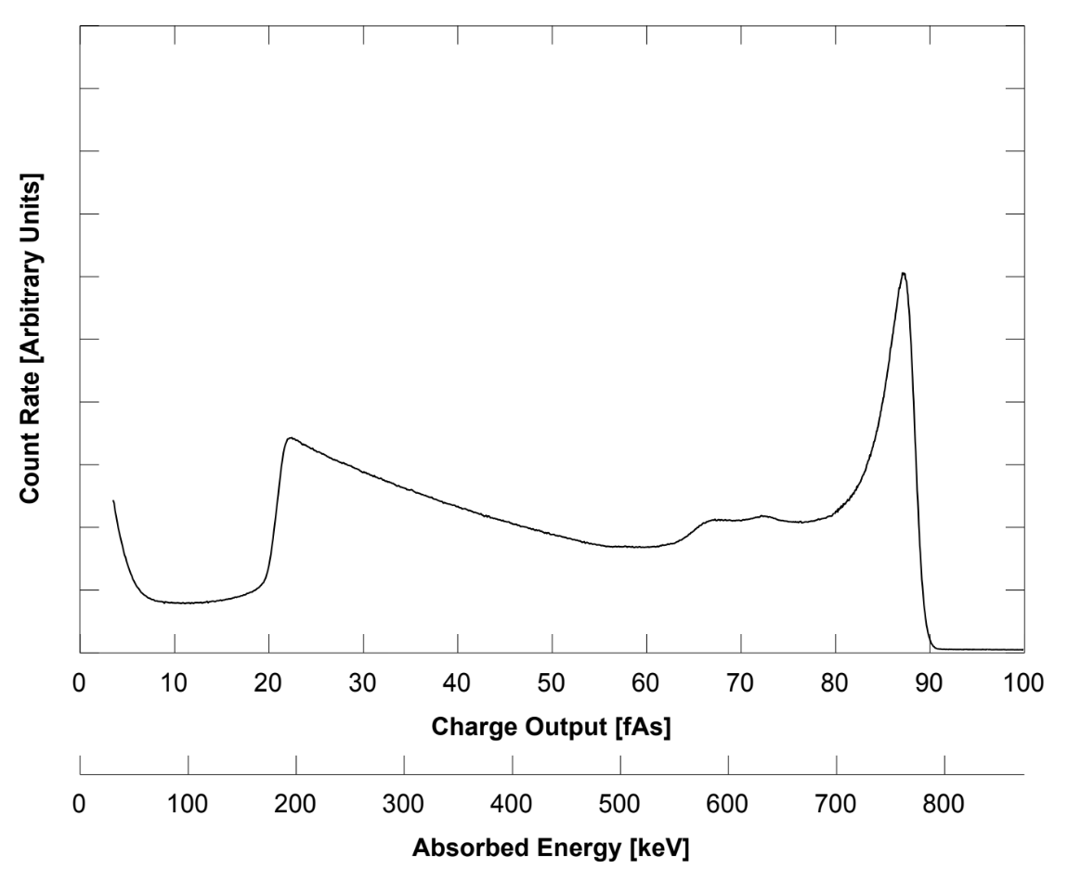
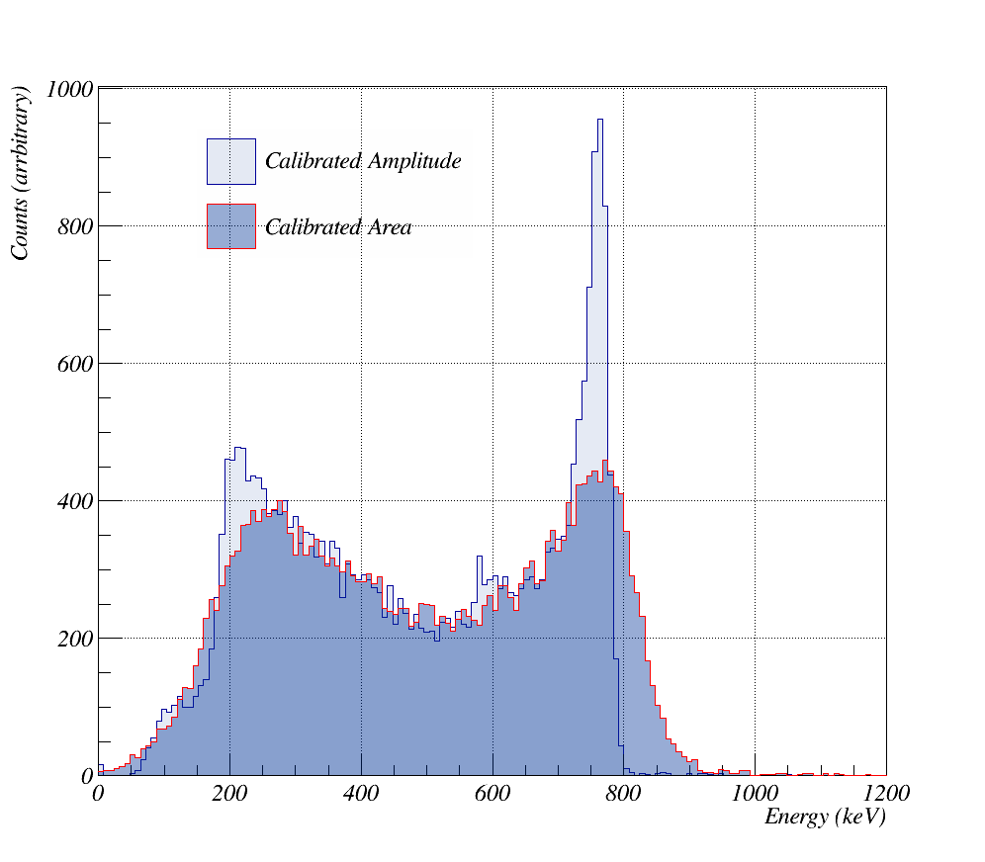
Conclusions
We have developed a viable digital pulse analysis and provided a good identification of events. Digital pulse analysis based on flash-ADCs has added flexibility to the signal processing methods.
Amplitude spectra also achieved a similar, and sometimes better, performance than analog 3He proportional spectra given in the detector’s datasheets.
Clear linearity between amplitude and area values has been found, yet for lower operating voltages, noise background has affected our analysis causing the divergence of area values.
Arreglar figuras
Notes:
I have learn a lot. Similar procedemnts in other experiments like alice of LHC. TALK ABOUT PILE UP

Slide 29
Thank you! Turn for Questions

