Slide 1
EE 5900: Introduction to Robotics Project 5 Working with the Jackal
1
Group 1: laughing-guacamole
Roger Gomes
Sabari Manohar
Deep Doshi

Slide 2
Presentation Overview
2
Objective of the Project
Communicating with Jackal
LIDAR Integration
Autonomous Navigation and rosbag
rosbag, playback and Map recreation using gmapping
Simulation Results for Maps generated
Problems and Challenges Faced
Credits and Distribution of Work

Slide 3
Project Objectives
3
Applying and leveraging the concepts learned from previous projects which heavily involved simulation of ClearPath Jackal in the Gazebo environment for exploring and mapping different worlds.
Apply these concepts learned on the real world robotic platform - Clear Path Jackal equipped with SICK LMS 291 LIDAR.
Specific Objectives:
Development of a URDF model for the LMS SICK 291 LIDAR and mounting bracket
The tf frame to be referenced for publishing the Laser scan data
Autonomous mapping routine and rosbag
Play back the recorded rosbag file and map reproduction using gmapping

Slide 4
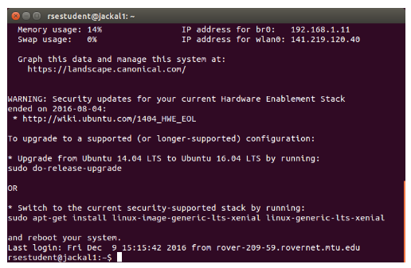
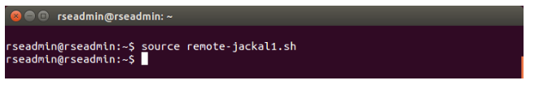
Communicating with the Jackal
4
Distributed Nature of ROS
The Michigan Tech Jackals are registered on the MichiganTechOpen wireless network
Editing the etc/hosts with Jackal 4 IP: jackal4 141.219.120.42
ssh to the jackal
ROS_MASTER_URI and the ROS_IP config connection details
Allows us to run ros desktop tools for visulaization

Slide 5
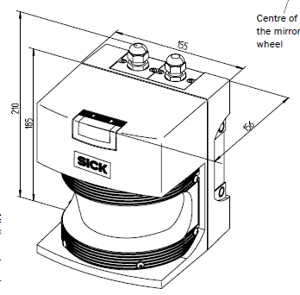
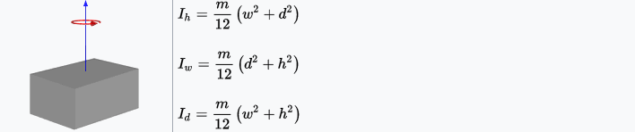
SICK LMS 291 LIDAR Integration
5
URDF file defined the geometry, size, mass, origin and inertial values.
Dimension: 0.156mm x 0.155mm x 0.210 mm
The mass of the LIDAR was assumed to be uniform at 4.5 kg
Inertia values were also defined by specifying ixx, iyy and izz
Laser mounting bracket geometry was defined with the help of an .stl file that was referenced in the URDF file.
Links and joints were also defined in this file which specified which component is mounted on what, relative to the front-mount on the jackal.

Slide 6
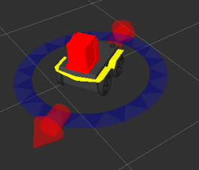
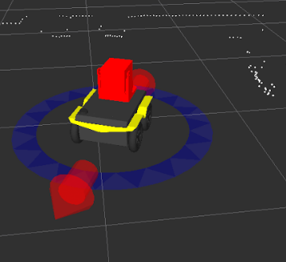
SICK LMS 291 LIDAR Integration
6
SICK Toolbox wrapper
Setting of Port and Baud Rate in the launch file
Jackal with the Laser and Laser Mount Integration as seen on RViz

Slide 7
Autonomous Navigation and Mapping
7
Autonomous Navigation and Mapping routine developed to map the 8th Floor of EERC
Leverage and heavily reused a lot of code and algorithm developed by Derek, James and Akhil as a part of the Project 3: Perception Map Building
Apart from the main algorithm, a lot of tweaking and modifications were performed on the constants for laser averaging, random bounds, and side thresholds
To eliminate the jerkiness in movement we implemented a velocity smoothing function for linear acceleration and deceleration

Slide 8
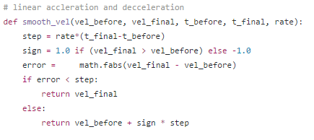
Autonomous Navigation and Mapping
8
Simultaneously Bags the /tf and /scan topics during mapping routine
Termination of program after 5 min 30 sec
Saves a bag file that is played back for gmapping

Slide 9
Rosbag, playback and Map recreation using gmapping
9
A parallel invocation of the rosbag recording is also initiated from the same launch file.
The recorded rosbag is saved once the autonomous mapping routine node's timer expires eventually killing the node.
The recorded rosbag is played back using another launch file that also launches an instance of gmapping to reproduce the map using the /scan and /tf topics previously logged by the rosbag file.
The process of map development can also be visualised in real-time using Rviz when the offline playback to recreate the map using gmapping is performed.

Slide 10
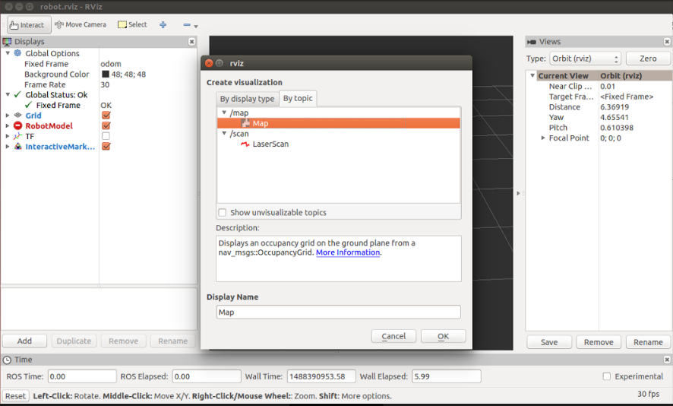
Visualizing Map Creation on RViz
10

Slide 11
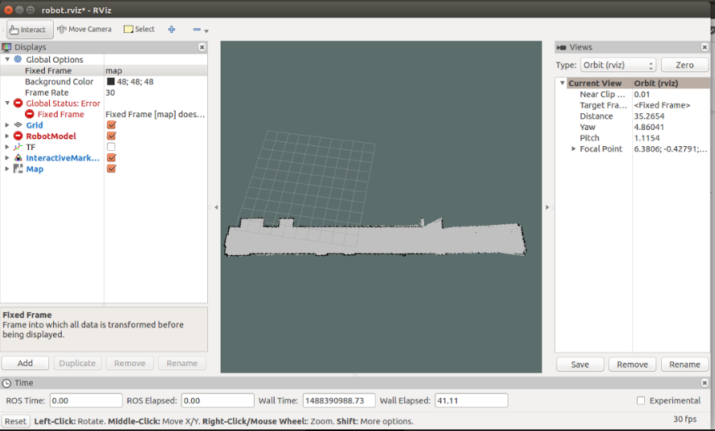
Visualizing Map Creation on RViz
11

Slide 12
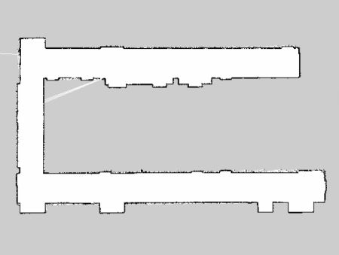
Simulation Results for Maps Generated
12
Best Map generated for the 8th floor out of all the runs

Slide 13
Problems and Challenges Faced
13
Controlling the Jackal via Rviz through Virtual Machine:
Needed to change ROS_IP from WAN to Ethernet to enable bridge connection from the host computer to the VM on which connection to the ROS_MASTER_URI was established.
Co-ordinate and scale adjustment of the Lidar, mounting bracket:
While incorporating the LIDAR definitions and the mounting bracket on the Jackal, problems with its orientation and scaling were faced which were eliminated by adjusting its coordinates relative to the robot.
Malformed/Invalid URDF:
Invalid xml definition for the URDF caused the rosmaster to crash and we were unable to connect to jackal's rosmaster instance. Used the URDF check utility available through the URDF tutorials before actually loading it on the jackal.
Loss of Wifi Connectivity:
At certain locations (near the elevator) the Michigan Tech wi-fi connections were spotty causing us to loose connections. In the cases where the launch file was launched through a normal terminal connection, there were problems with node terminations. Hence, screen command was used to launch a remote terminal in jackal itself for the node to run
Navigating of obstacles not in LOS:
Corridor with chairs situated above the height of LIDAR was problematic. Did not map that portion.

Slide 14
Credits and Distribution of Work
14
Sabari Manohar
Initial development, modification, tweaking and calibration of thresholds for the autonomous navigation and mapping routine
Development of velocity smoothing functionality to eliminate jerky movements
Testing and debugging
Deep Doshi
SICK Toolbox wrapper integration
Development of launch files for navigation and replay routines
Integration Testing for map reproduction, rosbag recording and replay
Roger Gomes
Development of the URDF File for LIDAR, LIDAR Mounting bracket definitions
Development of scripts and playback of recorded rosbag and gmapping to reproduce the map
Tweaking, modifications and calibration for mapping and navigation routine
Integration Testing, debugging, Team Management, Task Distribution and Documentation

Slide 15
Questions?
15

