Slide 1

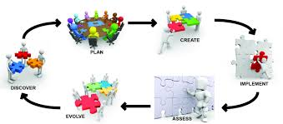

IT management progression
Maturation
Enterprise scale
Lifecycles
Portfolios
Complexity
Coordination
Teams of teams
Specialization
Process
Emergence & formalization are a function of scale
Collaboration
Teamwork
Communication
Experimentation & feedback
Inception
A person and their computer
Configuration, construction, operation
Pipeline

