Slide 1
Leveraging Regional Similarity in Deep Epidemic Forecasting
Atlanta, GA November 18th 2020
Alexander Rodriguez
Rogelio A. Rodriguez Gonzalez

Slide 2
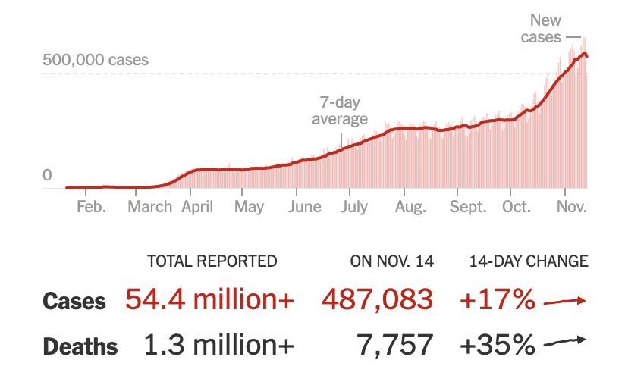
COVID-19 current state and modeling opportunities
SARS-CoV-2 the virus causing COVID-19 disease has infected 54,369,609 people and killed 1,317,131 as of Nov 16th 2020.
Epidemic parameters describing COVID-19 behavior have not been fully described yet.
Statistical models that rely on pattern recognition and correlations offer an opportunity to leverage available data to forecast COVID incidence (cases/deaths) in different regions.
Covid World Map: Tracking the Global Outbreak (NYT), https://www.nytimes.com/interactive/2020/world/coronavirus-maps.html

Slide 3
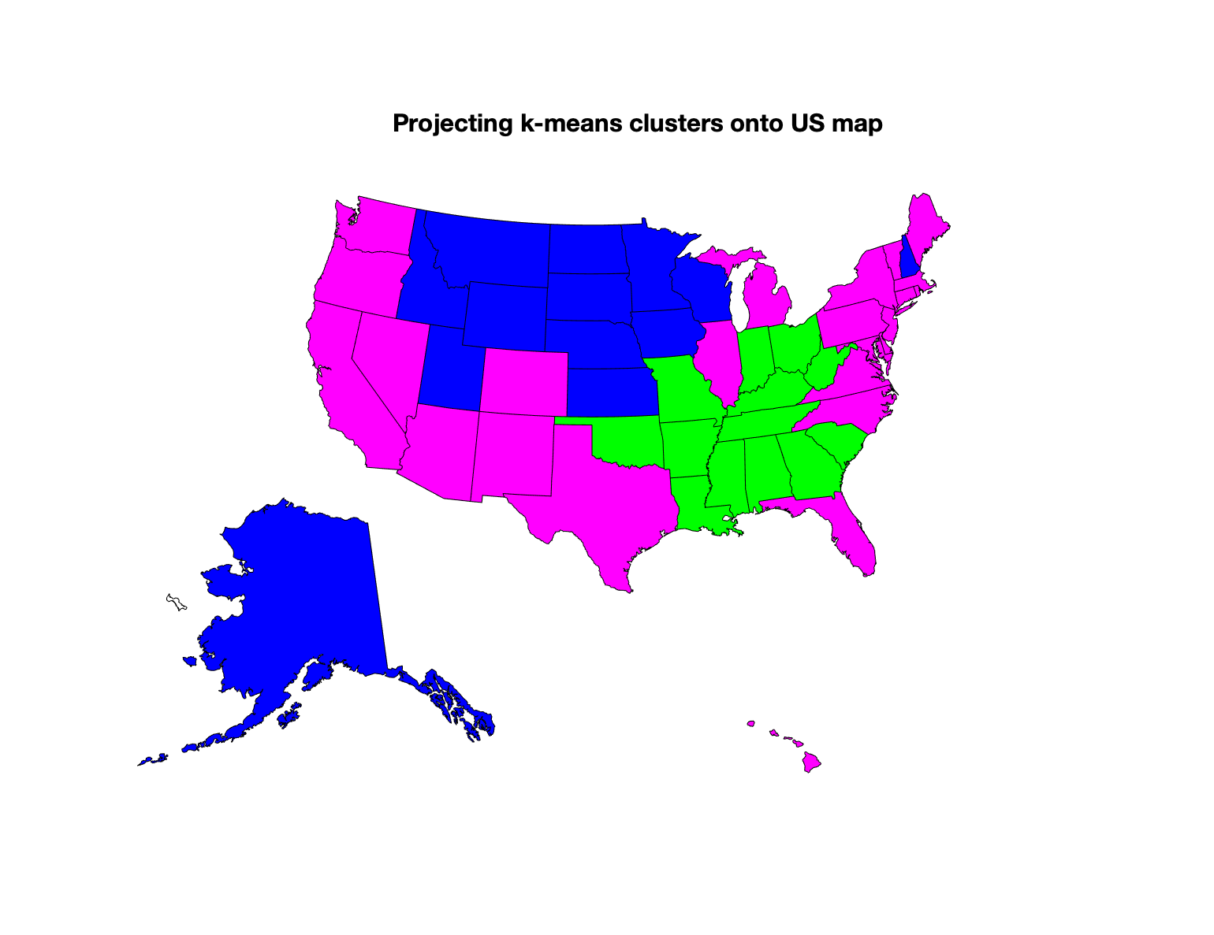
Leveraging regional similarity in Deep Epidemic Forecasting
Statistical models have used static (e.g. demographics, comorbidities) and dynamic features (e.g. mobility, cases, testing) to assess potential COVID risk in different regions¹⁻⁴
We propose an epidemic forecasting model that leverages regional static and dynamic similarity to improve accuracy of predictions of COVID incidence in US states.

Slide 4
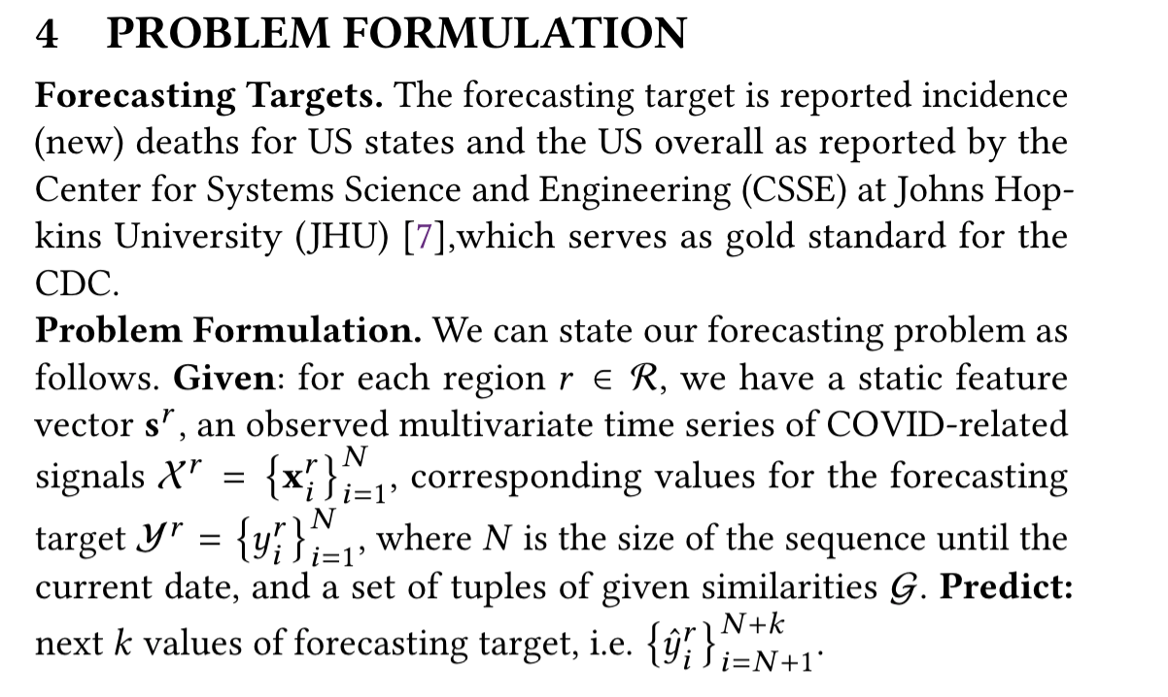
Problem definition (maybe just use problem definition section of PDF)
Hypothesis: Epidemic forecasting models that leverage on static and dynamic region similarity would produce more accurate covid mortality predictions.

Slide 5
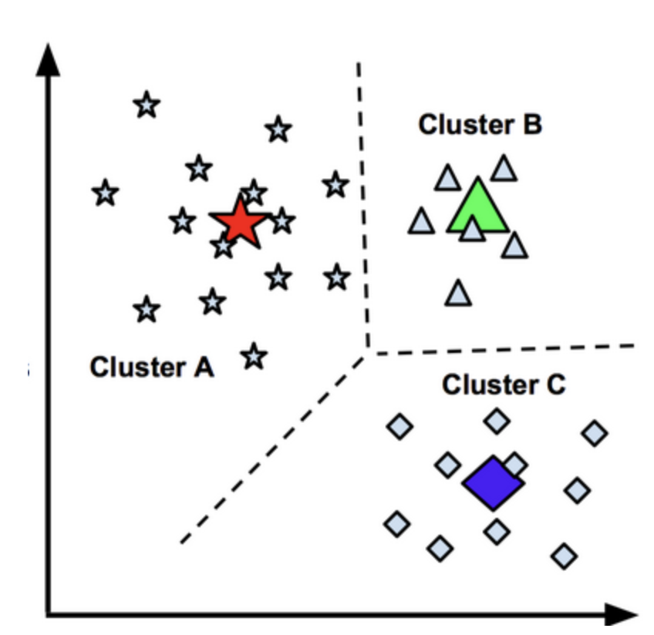
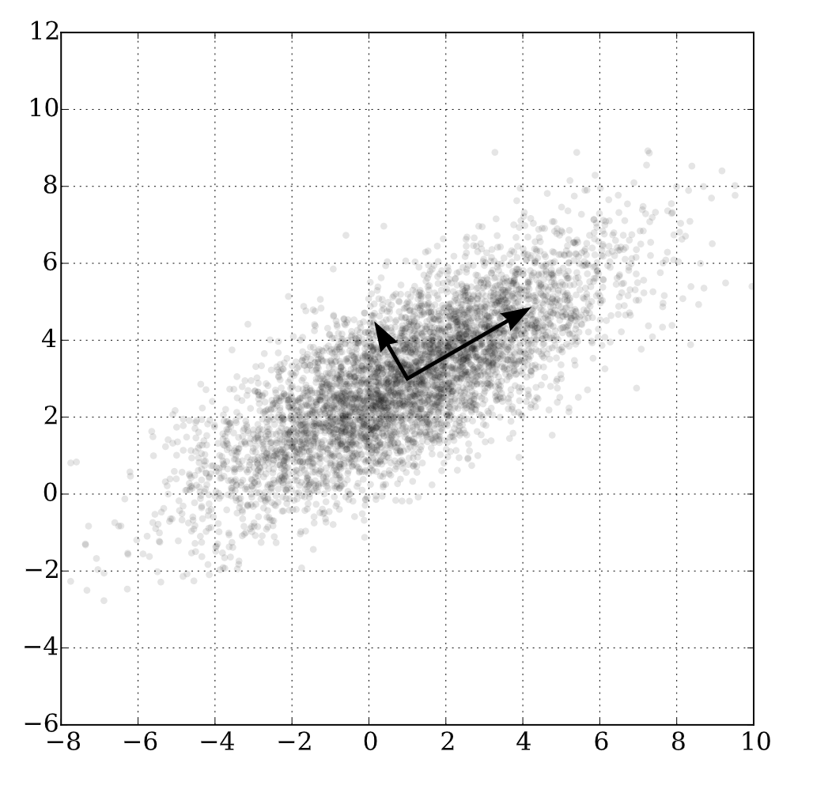
Analysis of static regional features using k-means clustering and PCA
We use k-means clustering analysis to group US states based on their static features. We use PCA to visualize the clusters.
PC2
PC1
K-means clustering partitions data into k clusters.
PCA is a dimensionality reduction method.

Slide 6
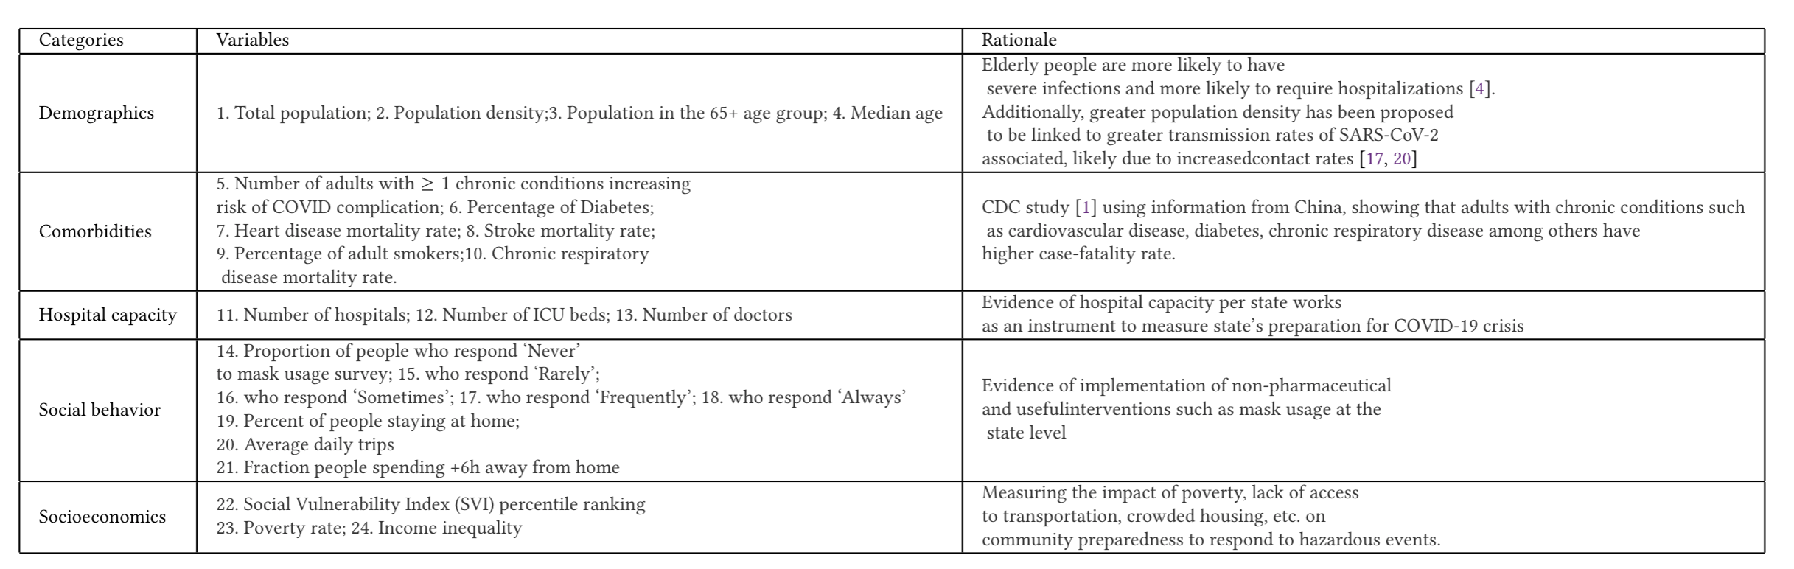
Static regional features (24 variables grouped in 5 categories)
Data sources include: US Census Bureau¹, CDC study on prevalence of comorbidities in US adults², GitHub repository of the Yu group at UC-Berkeley³, mask wearing surveys from the New York Times⁴ , social behavior data from COVIDcast site⁵, and mobility data from the United States Department of Transportation⁶.
1 .https://www.census.gov/programs-surveys/acs/data.html
2. Adams, M. L., Katz, D. L., & Grandpre, J. (2020). Population-based estimates of chronic conditions affecting risk for complications from coronavirus disease, United States. Emerging infectious diseases, 26(8), 1831.
3. https://github.com/Yu-Group/covid19-severity-prediction
4.https://github.com/nytimes/covid-19-data/tree/master/mask-use
6. https://www.bts.gov/daily-travel

Slide 7
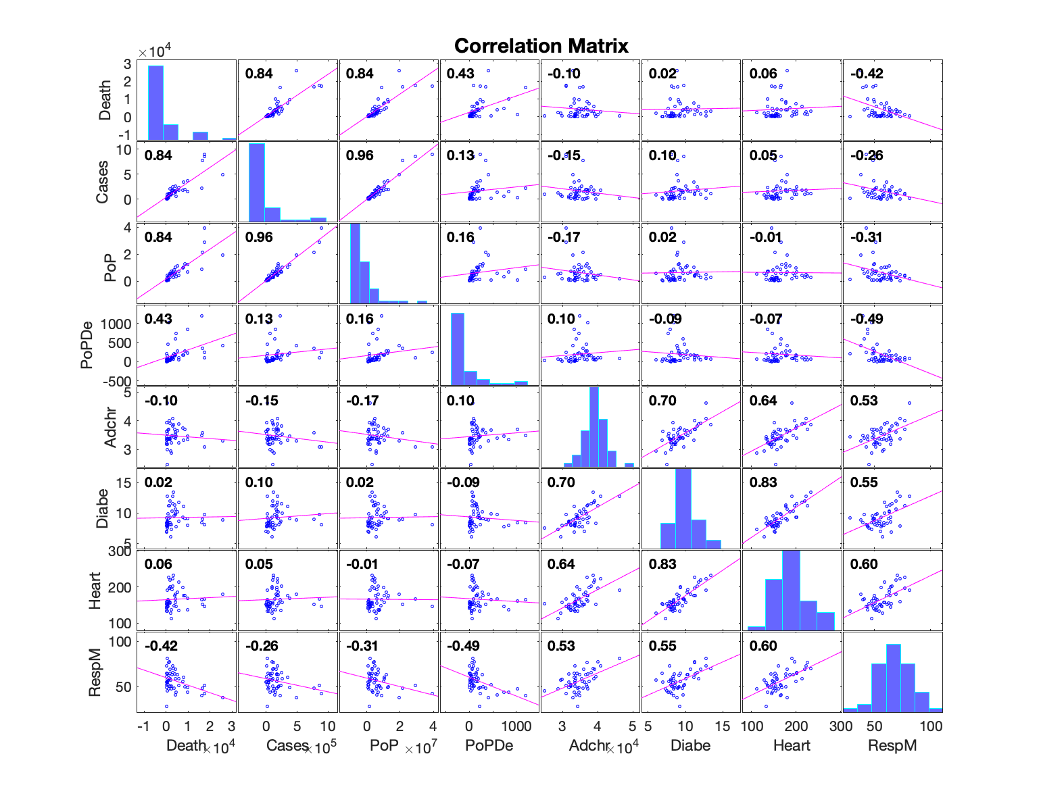
COVID cases and deaths correlate with demographics but not with comorbidities

Slide 8
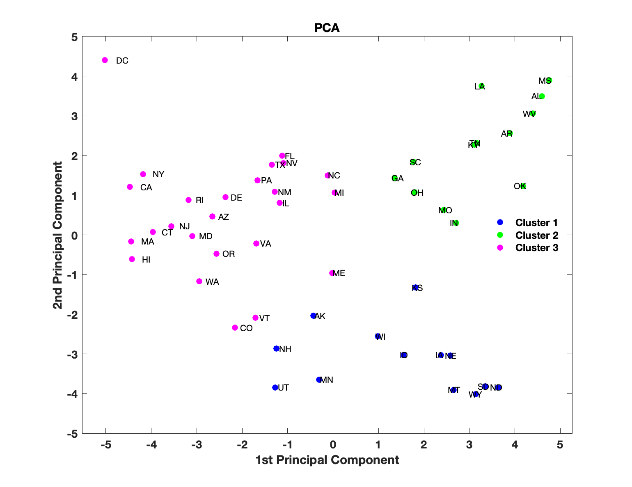
K-means clustering analysis recapitulates geographical patterns

Slide 9

K-means clustering analysis recapitulates geographical patterns

Slide 10
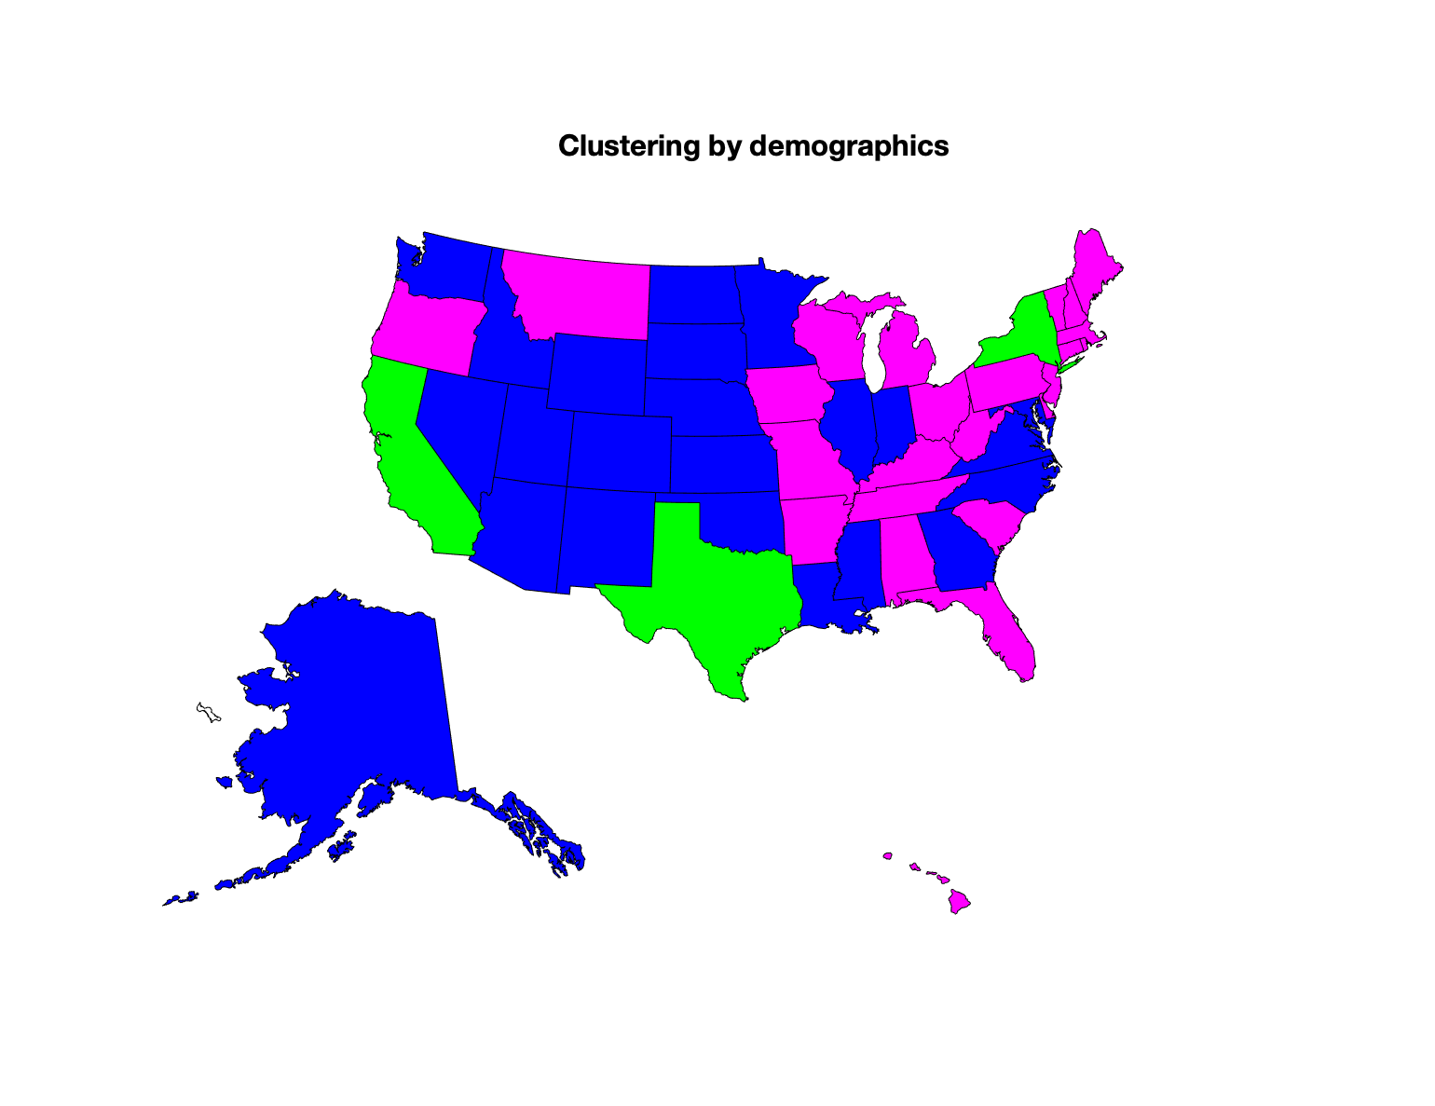
By using different static data categories we recapitulate different clusters
Clustering by demographics

Slide 11
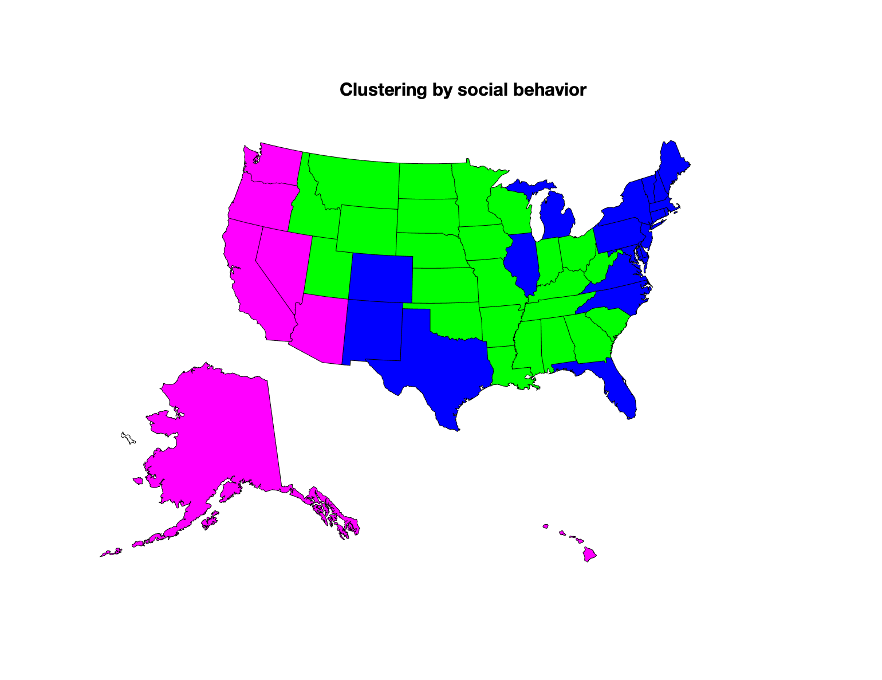
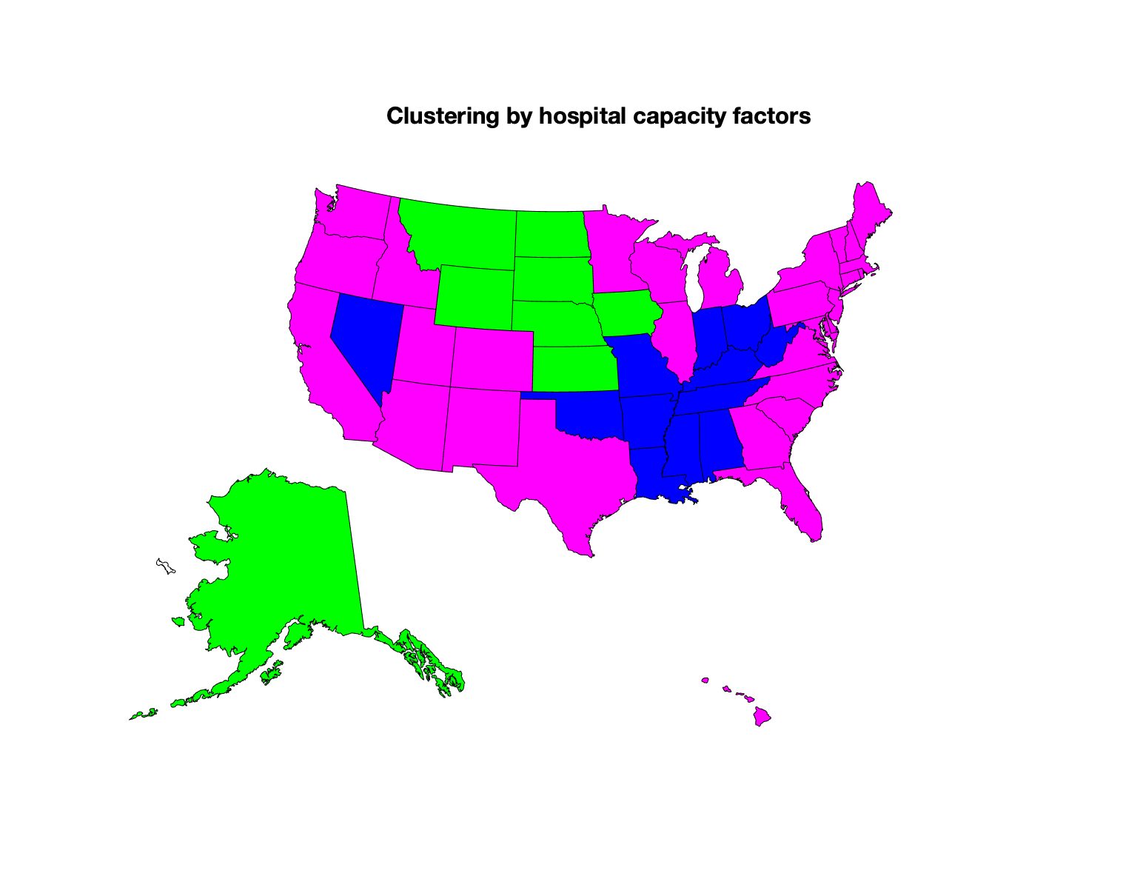
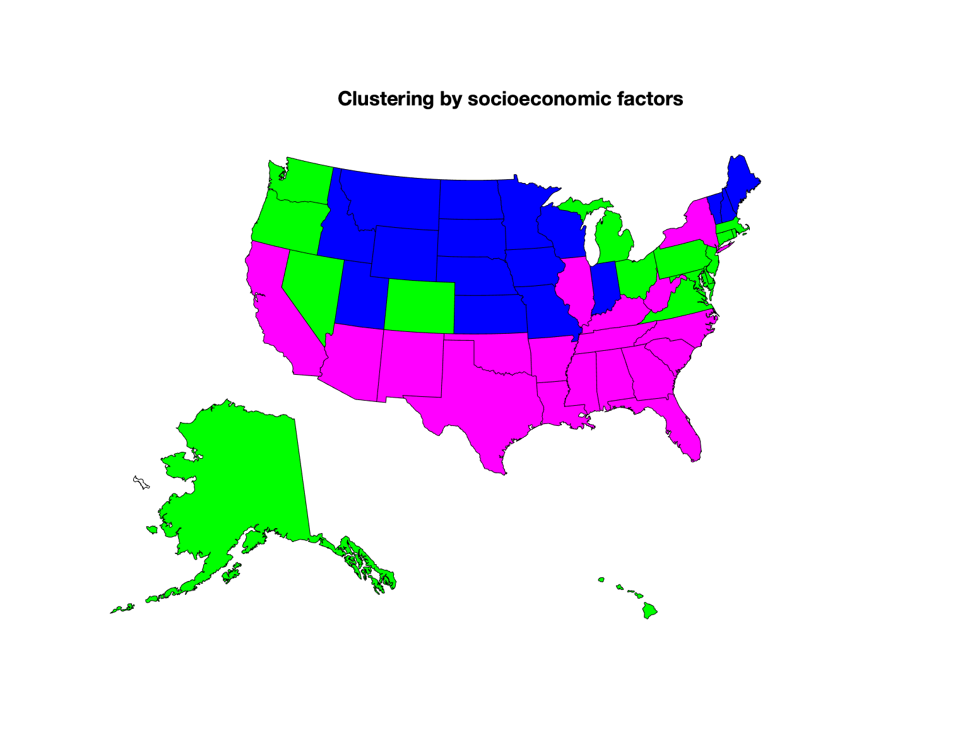
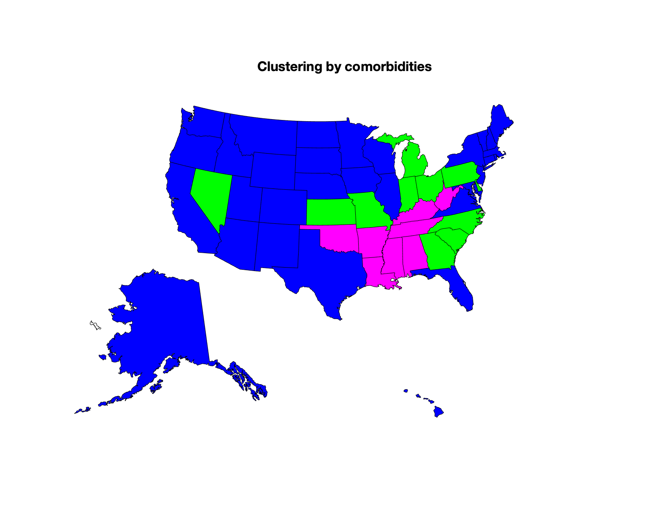
By using different data categories we recapitulate different clusters
Clustering by demographics
Clustering by social behavior
Clustering by hospital capacity
Clustering by socioeconomic factors
Clustering by comorbidities
Clustering using whole data set

Slide 12
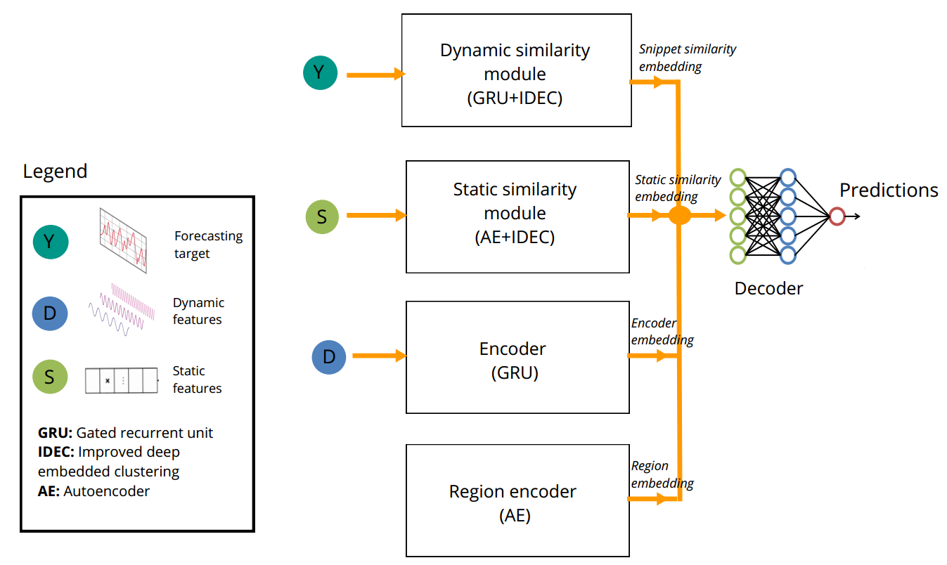
Proposed architecture

Slide 13
Experiment Setup
Research questions:
Q1: Does incorporating region similarity as proposed leads to better forecasting performance?
Q2: Can we beat DeepCOVID in short-term forecasting with this new neural architecture?
Note: DeepCOVID is a top performing model for short-term (1- and 2-weeks ahead)
Therefore, we compare against:
Subset of our model (encoder + region embedding + decoder)
DeepCOVID submissions located in the COVID-19 Forecast Hub
Measure with MAE (mean absolute error)

Slide 14
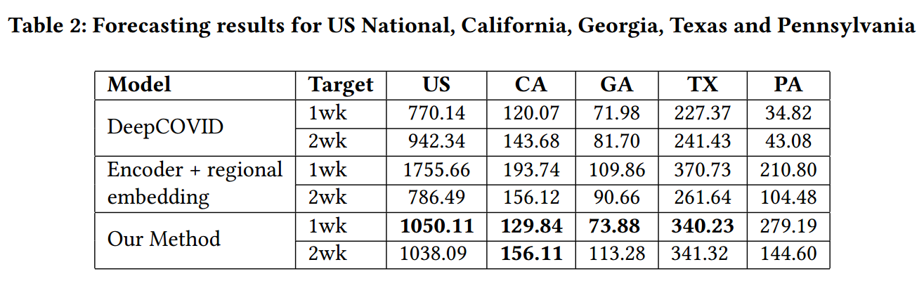
Results (dynamics module or everything combined)
1. Regional similarity is more effective for 1-week ahead
2. Unable to beat DeepCOVID, but close to it

Slide 15
Conclusions
The clustering analysis using state-level static features allowed the recapitulation of clear geographical patterns.

Slide 16
Conclusions
The clustering analysis using state-level static features allowed the recapitulation of clear geographical patterns.
Geographical closeness may be relevant in assessing potential COVID risk, especially for states in clusters 1 and 2. A regional rather than a state-level (authority) response might be more adequate for states in those clusters.

Slide 17
Conclusions
The clustering analysis using state-level static features allowed the recapitulation of clear geographical patterns.
Geographical closeness may be relevant in assessing potential COVID risk, especially for states in clusters 1 and 2. A regional rather than a state-level (authority) response might be more adequate for states in those clusters.
Incorporating regional similarity was proven to be helpful for short-term forecasting in most of the regions evaluated.

Slide 18
Future Work
Do extra experiments to understand the impact of regional similarity in short-term predictions.
Explore how to use bootstrap with our architecture so that ensemble it to have better point estimates.
This also enables uncertainty estimation.
Visualize regional similarity learned with the deep clustering losses.

Slide 19
References
Ramchandani, A., Fan, C., & Mostafavi, A. (2020). Deepcovidnet: An interpretable deep learning model for predictive surveillance of covid-19 using heterogeneous features and their interactions. IEEE Access, 8, 159915-159930.
Verhagen, M. D., Brazel, D. M., Dowd, J. B., Kashnitsky, I., & Mills, M. C. (2020). Forecasting spatial, socioeconomic and demographic variation in COVID-19 health care demand in England and Wales. BMC medicine, 18(1), 1-11.
Padilla-Raygoza, N., Sandoval-Salazar, C., Navarro-Olivos, E., de Jesús Gallardo-Luna, M., Magos-Vazquez, F. J., & Díaz-Martínez, D. A. (2020). Description of Confirmed Cases and Deaths from COVID-19 in Mexico, Until May 6, 2020: an Ecological Study. Biomedical and Pharmacology Journal, 13(3), 1471-1476.
Sannigrahi, S., Pilla, F., Basu, B., Basu, A. S., & Molter, A. (2020). Examining the association between socio-demographic composition and COVID-19 fatalities in the European region using spatial regression approach. Sustainable cities and society, 62, 102418.

