Slide 1
All Employees
Disgruntled Employees
new stages of the
the leaker funnel
Contacted Employees
Leakers

Slide 2
Overt
Activists
Environmental concerns relevant to the bottom line
Environmentally Relevant
Potential
Investors
Undercover
Activists
Questions & Concerns
Management
Team
Changes To
Possibly Smart Replies
Current and Future Business Plans

Slide 3
without social media
dark UX patterns
Reconciliation
Anger
Discussion
with social media
dark UX patterns
Dysfunction
$0.10 made from your
3am social media argument
Views
Ad Clicks

Slide 4
Without
social media
dark UX
patterns
With
social media
dark UX
patterns
Anger
Discussion
Views
Ad Clicks
Reconciliation
Dysfunction
$0.10 made from your 3am social media argument

Slide 5
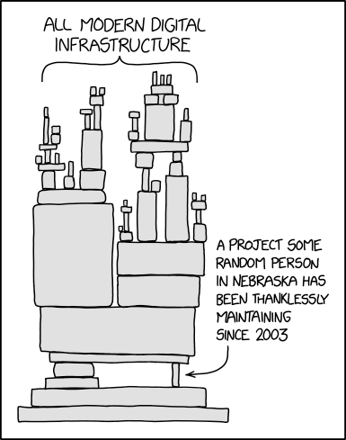
Fossil Fuel Corporate
Don’t amplify dissent here. Competition will make them come back.
Here are some good spots for discord.
That patent-owning company of the single random gasket that all deep water oil wells use
Creative Commons Attribution-NonCommercial 2.5 License.
Adapted from https://xkcd.com/2347/

