Slide 1
NFT Ethereum Data Pipeline

Slide 2
Outline
Exploratory Data Analysis
Pipeline Prototype
Pipeline Architecture
Pipeline Deployment
Pipeline Monitoring

Slide 3
Exploratory Data Analysis

Slide 4
Data Insights
API Data
  EtherScan
    Data types are all string
    The decimals places for different tokens need to be properly formatted in order to reflect the correct amount
  CryptoCompare
    Data types are all string
    In order to get USD Historical prices, the API requires a UNIX timestamp as a parameter
  OpenSea
    Data receive is in a heavily nested JSON format, with one key containing all information regarding NFT collection.
    Data types are not homogeneous and contain string, integer, and timestramp values
End_User Queries
  Query aggregated sale info of highest valued NFT’s (max price, number of sales,average price)
  Query individual token or aggregated token wallet balance of users
  Query average wallet balance of owners who own highest valued NFT’s
  Query number of high-value NFT’s owned by different users
  Query highest valued NFT collections
  Query most exchanged high-value NFT’s
Data Storage
  Since many queries will require aggregations of specific columns, files will be stored in parquet format
Data Wrangling
  Heavily nested data needs to be flattened, reformated, and desired columns need to be filtered before transforming into parquet file
  Cryptocurrency token data needs to be reformatted with the proper decimal places and flattened into individual columns
  Top selling NFT’s are based on nominal ETH amount without consideration of USD rate at time of sale. Therefore, timestamps need to be converted into UNIX to obtain current and Historical USD prices
Data Enrichment
  Create reference data in order to retrieve enriched data
  Add USD historical prices to find the USD value of transactions
  Add wallet balance information of NFT owner’s

Slide 5
Project Considerations
Given the below considerations as well as the ability to adapt to future changing requirements and needs of end-users, the current scope of the project utilizes cloud object storage in the form of parquet files. Parquet files are useful option for storing structured data and since it is columnar storage, the structured data is stored efficiently and increases speed of aggregation queries. By using cloud object storage, future changes requiring near-real time information can be implemented using a lambda architecture for fast ingestion and loading of different data formats.
Data Structure:
  Data ingested from source have a defined schema
  Data can be organized into rows and columns
  Data relationships can be created between data points (User & NFT info, User & Wallet info)
Data Processing:
  Since data from NFT collections and ETH balances are not constantly changing every moment, the data will be processed in batches
User-Queries:
  Aggregating columns (main/min/average)
  Groupby functions
  Window Functions

Slide 6
Pipeline Prototype

Slide 7
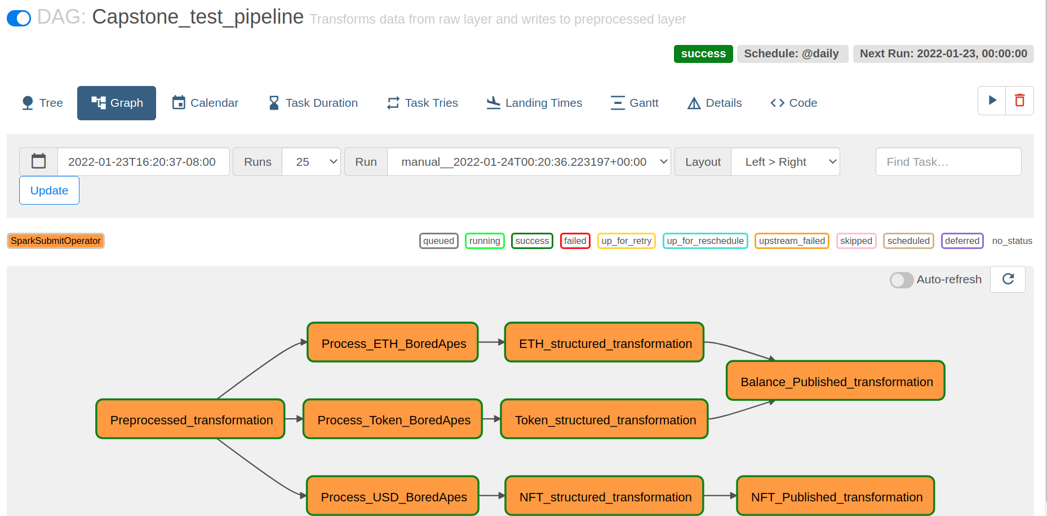
Pipeline Considerations
The prototype pipeline runs the entire end-to-end pipeline with a sample data containing one NFT collection
Airflow is used as the pipeline orchestrator due to its scheduling and logging features as well as its in-built operator to run Spark jobs
Since data sources are from API’s, creating smaller batch API call’s partitioned by NFT collection help separate Airflow tasks as well as stages of the pipeline. This enables clear identification of stages that breakdown and ensures previous data is persisted and not lost when jobs encounter issues.
Since this project requires data enrichment from an additional data sources, there will be a preprocessed layer to store reference data that will be needed in the next stage for data enrichment
The structured layer stores complete data for NFT information and Wallet information (Ethereum and Token balances). Therefore, even though the published layer includes the final data set tailored for current end-user queries, additional queries can be made or developed by fetching and transforming data directly from the structured layer.
Raw
Layer
Preprocessed
Layer
Processed
Layer
Structured
Layer
Published
Layer
NFT Data
USD,ETH.Token
Preprocessed Data
NFT,USD,ETH,Token
Processed Data
NFT,ETH, Token,
Structured Data
NFT, Balance
Published Data

Slide 8
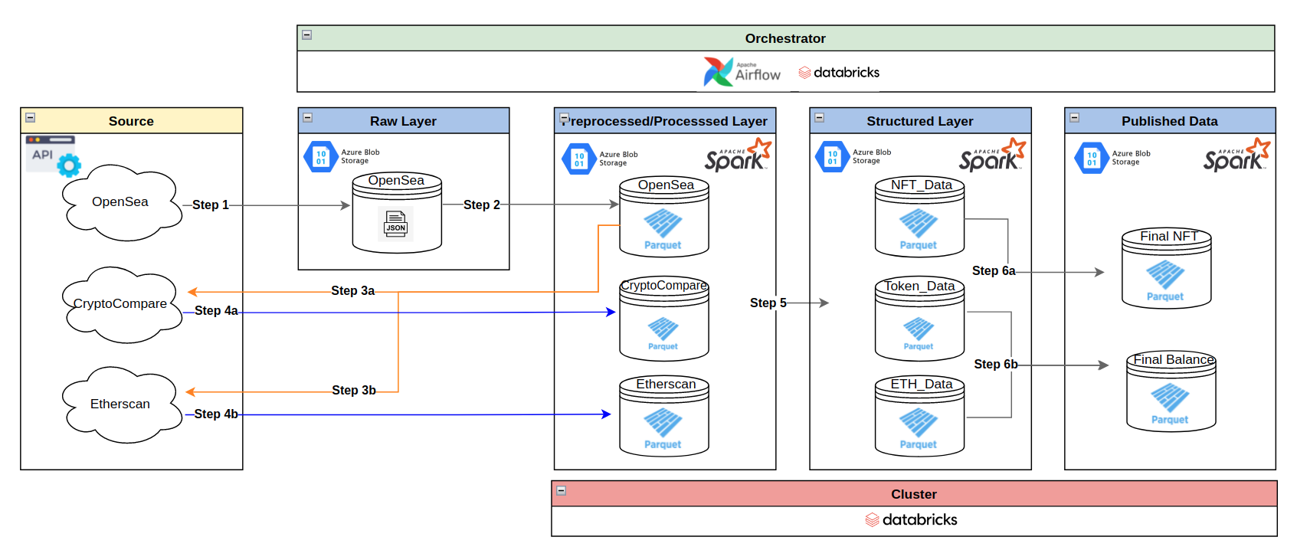
Pipeline Architecture

Slide 9
Pipeline Deployment

Slide 10
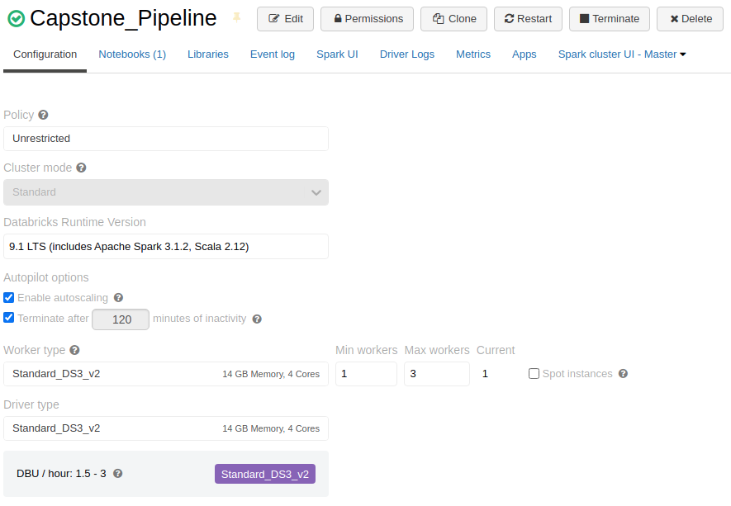
Cluster Configurations

Slide 11
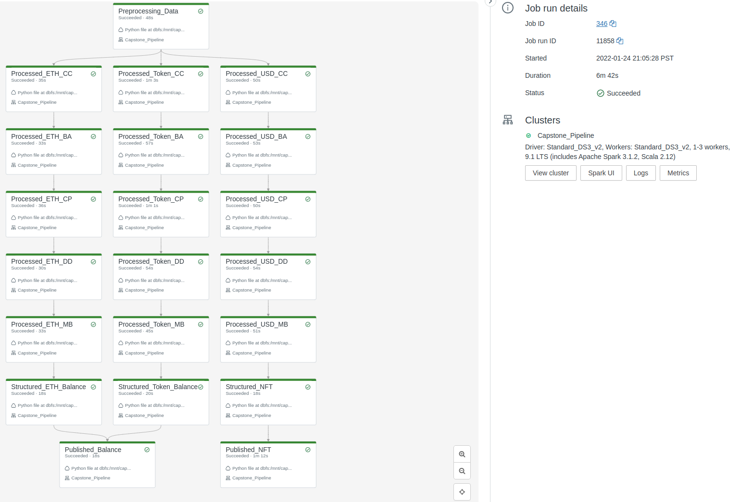
Pipeline
DataBricks built-in orchestrator was used to schedule python script tasks and dependencies
One benefit of using DataBricks Jobs as the orchestration tool is its ability to schedule notebooks as well. With this in mind, we can test existing stages or implement future changes to the pipeline interactively using notebooks before orchestrating multiple notebooks together for prototyping pipeline changes
The execution of the entire pipeline deployed on the cloud was 33% faster than the local execution

Slide 12
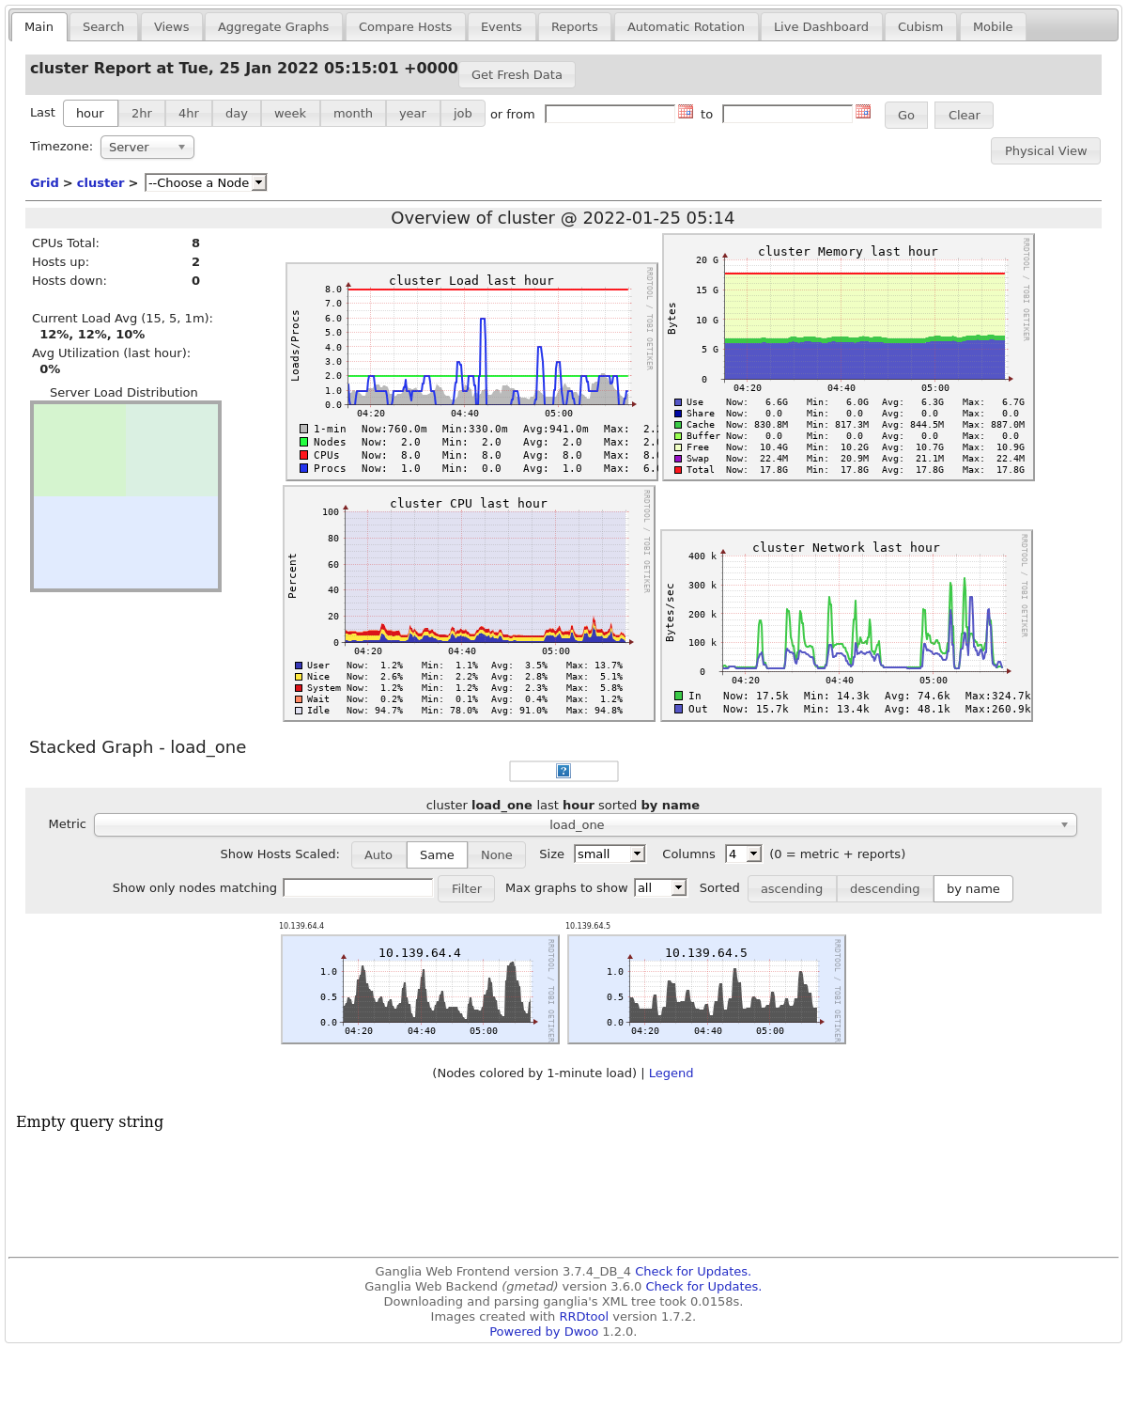
Pipeline Monitoring
Ganglia dashboard, a distributed monitoring system for high-performance computing systems was used for this pipeline
Dashboard consists of metrics relating to cluster CPU, memory usage, network

