Slide 1

Creating HDInsight Cluster

Slide 2
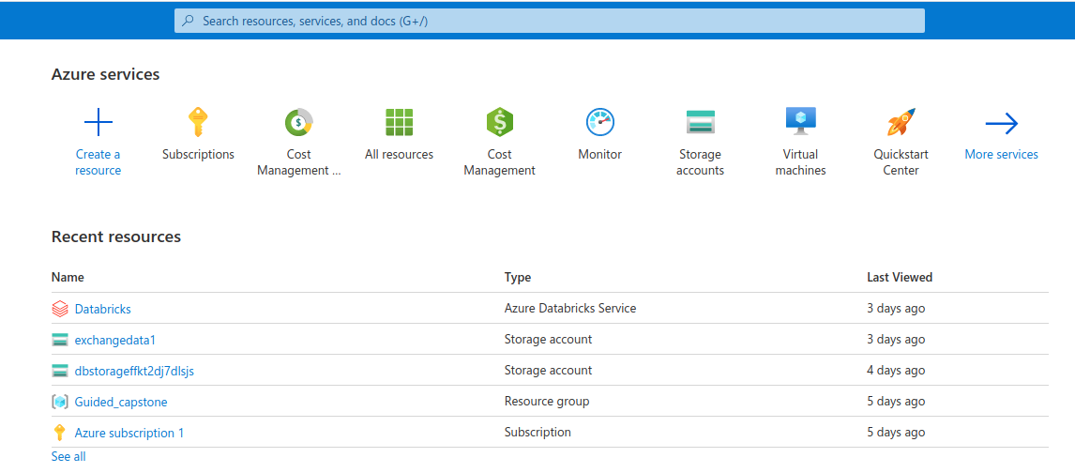
Create Resource
In Azure Portal homepage,
Select “Create a Resource”

Slide 3
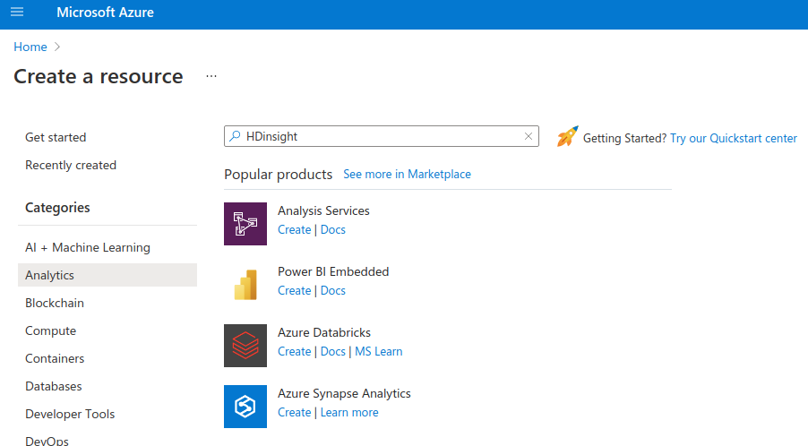
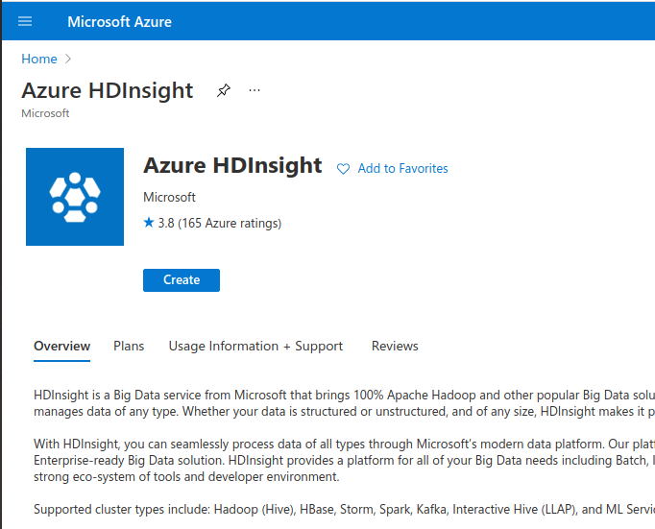
Create Azure HDInsight Resource
Under “Analytics”, search for HDInsight to locate “Azure HDInsight”

Slide 4
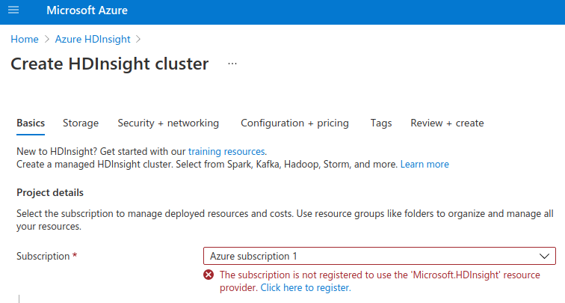
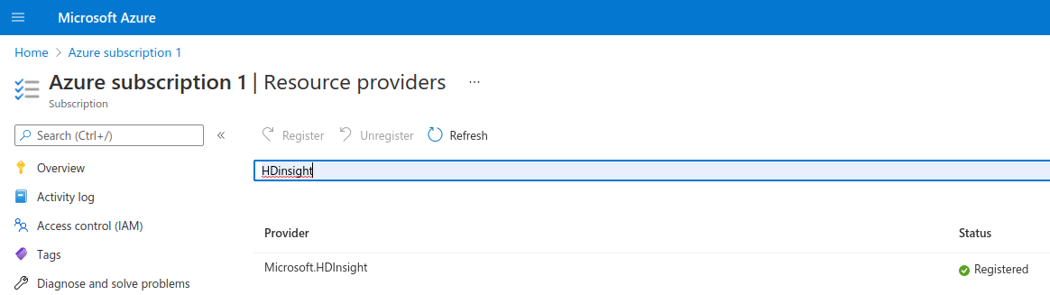
Registering Subscription
If subscription is not registered to use HDInsight, select “Click here to register.”
Search “HDInsight,” then select the register icon

Slide 5
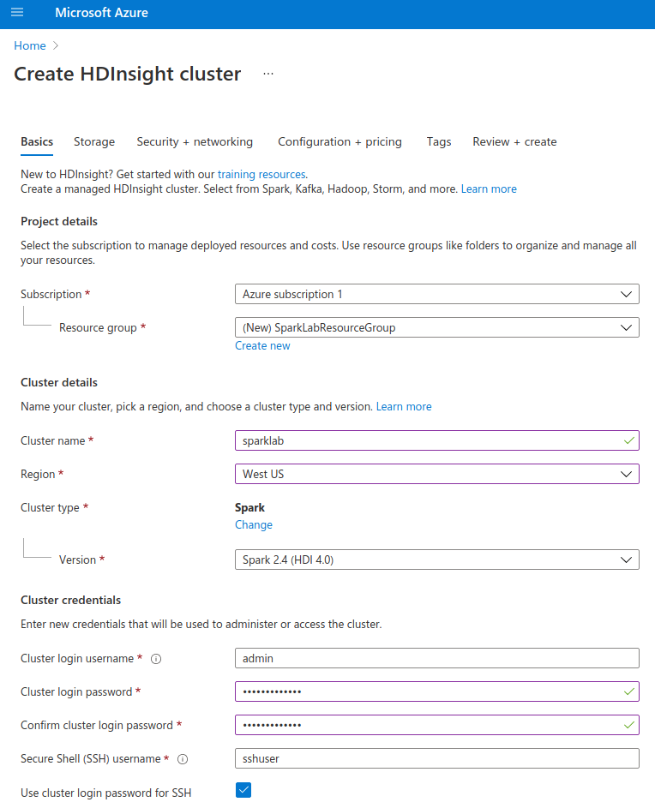
Credentials and Cluster Type
Enter Azure credentials. Select cluster type as Spark, choosing the latest supported version. For region, select the area with the most available cores.

Slide 6
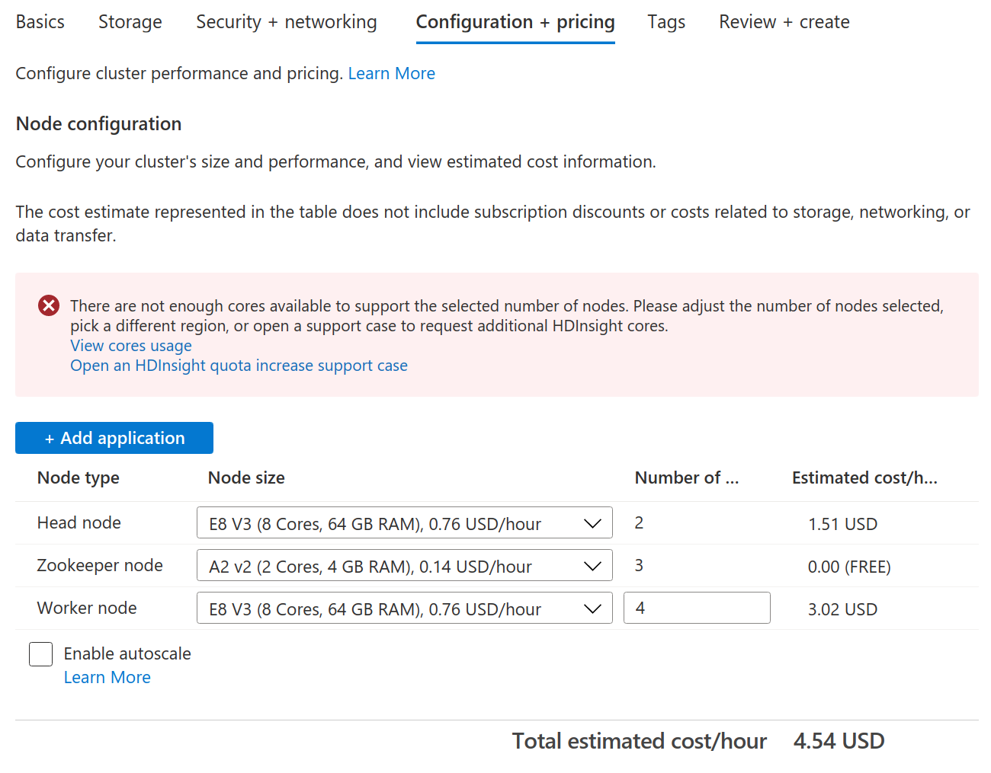
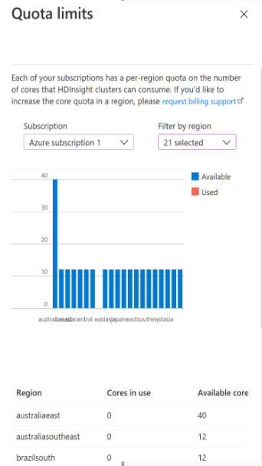
Quota Limit Error
If you encounter quota limits, there are 2 solutions.
1) create a Microsoft support ticket requesting additional quotas for your account
2) Select “view cores usage”, and locate regions with 20+ cores available. Update credentials with this region. In addition, for “Node Size,” update original core number to 2 cores for each Node Type.

Slide 7
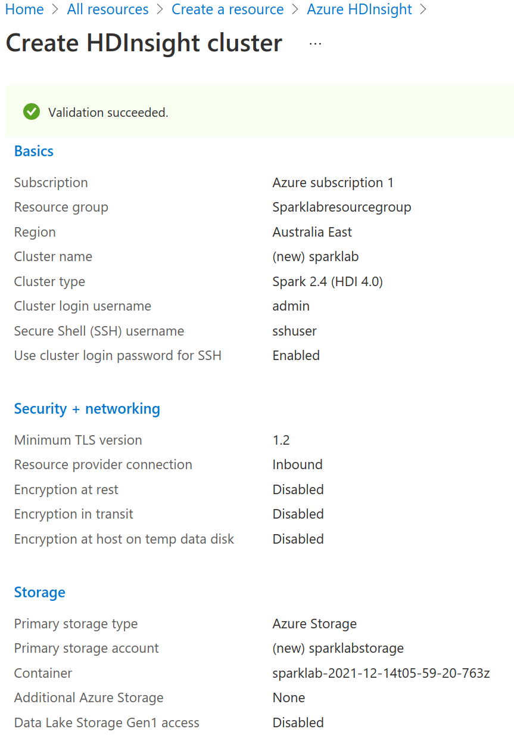
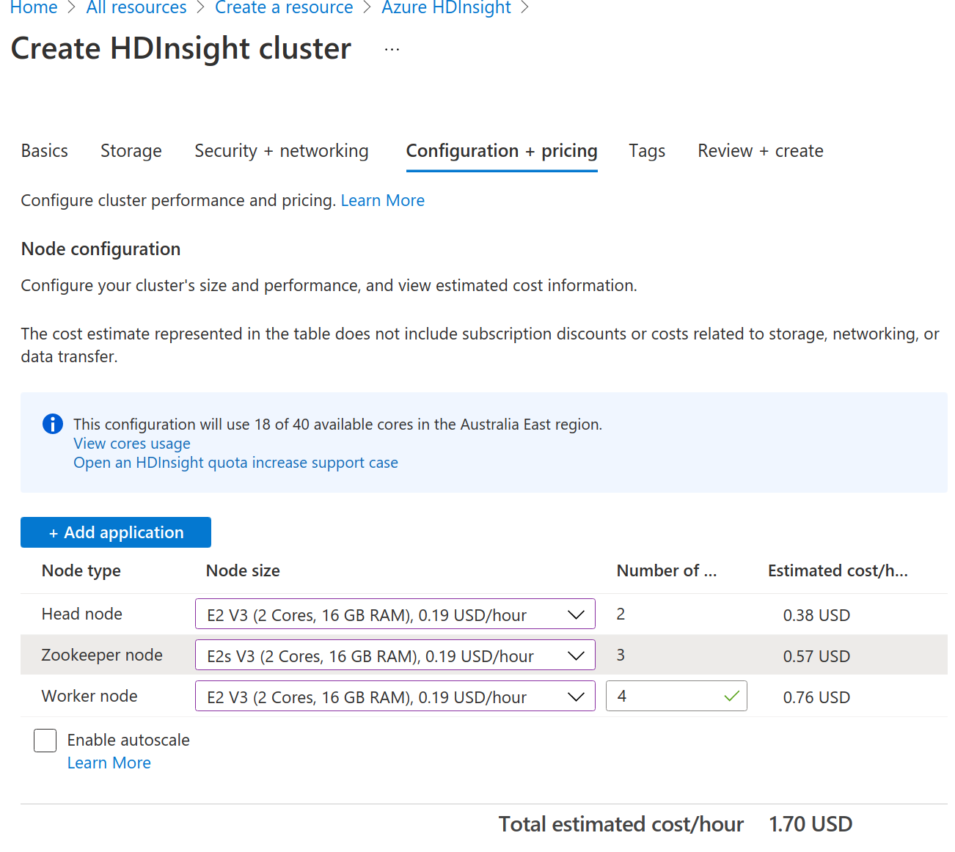
Review and Create Cluster
After updating region and core count to 2, select “Review+create”

