Slide 1

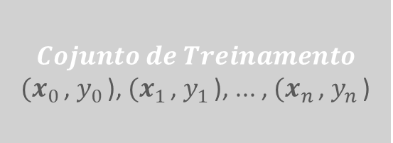
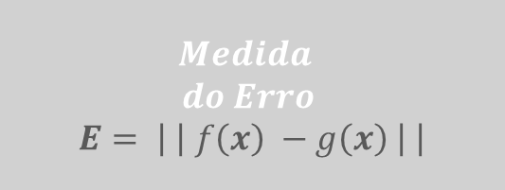




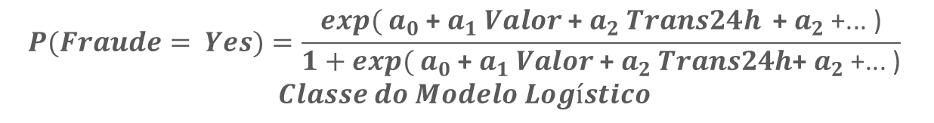



$$Uma Função Objetivo$$
$$Desconhecida$$
$$f:X →y$$
$$Medida$$
$$do Erro$$
$$E= \left| \right| f\left(x\right) −g\left(x\right) \left| \right|$$
$$Valor, Trans24h→Fraude Yes|No$$
$E=1 −$ $\frac{True Positives+true Negatives}{Total Examples}$
$$Cojunto de Treinamento$$
${(x}_{0 }$, $y_{0 }$), ${(x}_{1 }$, $y_{1 }$), ... , ${(x}_{n }$, $y_{n }$)
$$Algoritmo$$
$$de Aprendizado$$
$$A$$
$$Melhor Modelo$$
$$g\left(x\right)\sim f(x)$$
$$P\left(Fraude= Yes\right)=$$
$$\frac{{exp(}_{}1.23\text{ + }2.34 Valor \text{+ }4.5 Trans24h \text{+ }\text{... )}}{1+{exp(}_{}1.23\text{ + }2.34 Valor \text{+ }4.5 Trans24h \text{+ }\text{...)}}$$
$$\left[ \left[R\$ 2.000\right],\left[18\right],…\right], [ Yes]$$
$$OLS → min{ E}_{{ a}_{0}, { a}_{1},…, a_n }$$
$$\left[ \left[R\$ 10.000\right],\left[2\right],…\right], [No]$$
...
$$Uma Classe de Modelos$$
$$H$$
$$\left[ \left[R\$ 1.000\right],\left[24\right],…\right], [ Yes]$$
$$P(Fraude= Yes)=\frac{{exp( a}_{0}\text{ + }a_{1} Valor \text{+ }a_{2} Trans24h \text{+ }a_{2} \text{+... )}}{1+{exp( a}_{0}\text{ + }a_{1} Valor \text{+ }a_{2} Trans24h\text{+ }a_{2} \text{+... )}}$$
$$Classe do Modelo Logístico$$

