Slide 1


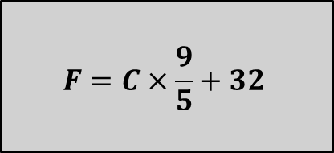
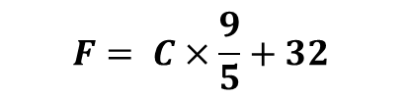



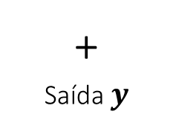
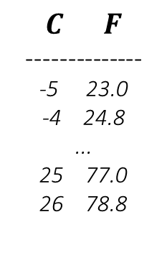


Entrada $X$
Programa
Saída $y$
Entrada $C$
$$F=C×\frac{9}{5}+32$$
Saída $F$
Modelo do
Programa
Modelo do
Programa
Entrada $X$
Aprendizado de
Máquina
Aprendizado
Linear Model
+
Saída $y$
$X→y$
$$C F$$
--------------
-5 23.0
-4 24.8
...
25 77.0
26 78.8
$C→F$
$$F= C×\frac{9}{5}+32$$

Slide 2
Artificial Intelligence
Robotics
Machine Learning
Computer
Vision
Planning
Reinforcement
Learning
Deep Learning
Formal Logic
Natural
Language
Automatic
Proof
Convolution
Nets
Recurrent
Neural Nets
Decision
Trees
SVM
Multi Layers
Perception
Association
Rules
Logistic
Regression
kNN
Text
Mining
Recommendation
Systems
Exploratory
Data Analysis
Visual Analytics
Time Series
Big Data
Eco Systems
Data Preparation
Data Science
Descritive Statistics

