Slide 1
MixUp Navigator
The current valid rule, with proof.
In Bahasa Melayu and English, even offline.
A validity-aware assistant that answers Malaysian civil servants only from circulars still in force, cites the clause and page, and flags what was cancelled.
Team: MixUp Navigator
NEVER CITE A CANCELLED
CIRCULAR AGAIN
University: ______________________
Members: ______________ | ______________ | ______________
Notes:
MixUp Navigator helps civil servants find the rule that applies today, with proof, in BM or English, even offline. 20 seconds.

Slide 2
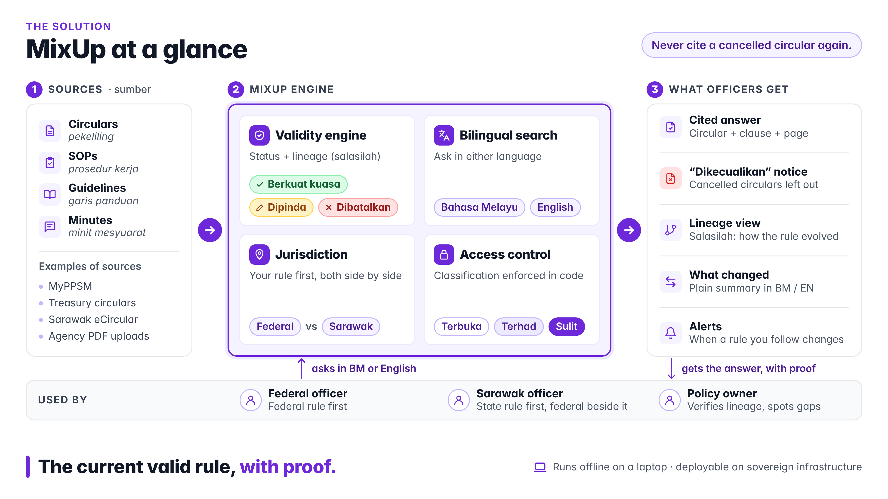
01 The Idea
One question. The current rule. With proof.
MixUp Navigator answers from circulars still in force, cites circular, clause and page, and says what was cancelled, instead of quoting it.
Validity engine
Cited answers
Right jurisdiction
Works offline
Knows which pekeliling is in force, amended or cancelled (berkuat kuasa / dipinda / dibatalkan).
Every rule ends with [S1]: circular, clause and page you can open.
Federal or Sarawak rule first, the other side by side.
Runs on the officer's PC. Documents and questions never leave it.
Sources in: circulars, SOPs, guidelines and minutes from MyPPSM, Treasury circulars, Sarawak eCircular and agency files.
Out: a cited answer, the excluded cancelled circulars, lineage, what changed and alerts.
MixUp Navigator
Notes:
The idea in one sentence: ask in BM or English and get the rule that applies today, with the clause and page as proof. Four parts: validity, citations, jurisdiction, offline. 20 seconds.

Slide 3
02 The Problem
Finding the current rule is the real problem.
Circulars are amended and cancelled all the time, but the old file stays in folders, portals and chatbots.
1.3 million
up to 445,000
395 agencies
federal civil servants follow these rules (ISEAS, 2026)
officers already have Gemini via AI at Work 2.0 (Feb 2025): a general tool that does not know which circular is valid
and 56,000+ users store records in DDMS 2.0 (JDN via GovInsider): it stores files, it does not answer questions
Existing systems work in silos
None of them answers: is this rule still valid, and what replaced it?
DDMS 2.0
(storage)
x
MyPPSM
(HR circulars)
x
Treasury
circulars
x
Sarawak
eCircular
x
AI at Work
(general AI)
Why it's urgent
JPA is reviewing circulars older than 20 years and Act 867 (2025) requires reviews every 3 years: rules will change more often. The MyGov chatbot was shut down in Aug 2025 after giving nonsense answers: ungrounded AI fails in government.
MixUp Navigator
Notes:
Government agencies hold thousands of circulars, SOPs and guidelines. The hard part is not finding a document but finding the current rule. 1.3 million federal civil servants follow these rules. Up to 445,000 already have Gemini, but a general chatbot does not know which circular is valid. DDMS stores files, portals list them, none answers whether a rule is still in force. And it is getting worse: JPA is reviewing rules older than 20 years and the new Act 867 requires a review every 3 years. When MyGov's chatbot gave nonsense answers it was shut down. Sources: ISEAS 2026, NST and FMT Feb 2025, GovInsider, RTM and Berita Harian 2026, Malay Mail Aug 2025. 50 seconds.

Slide 4
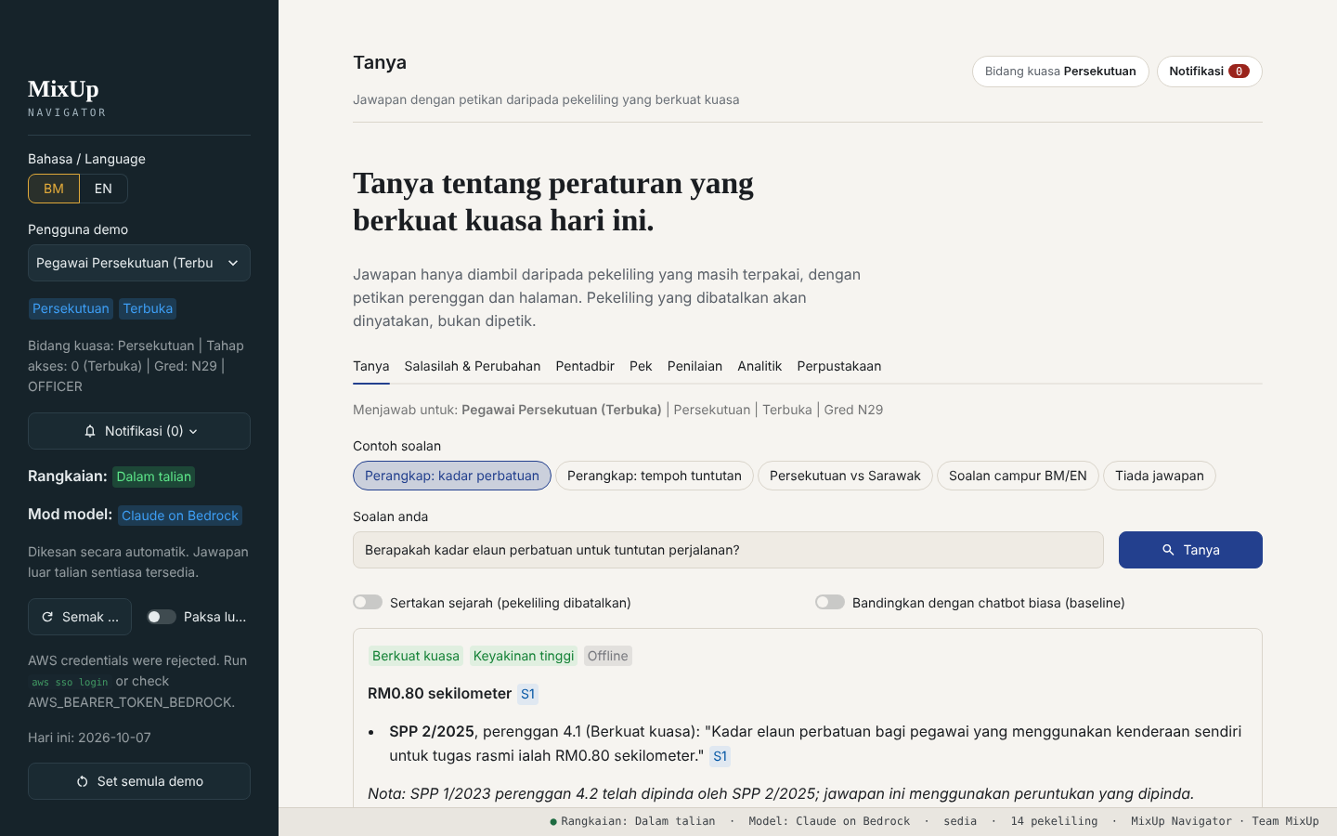
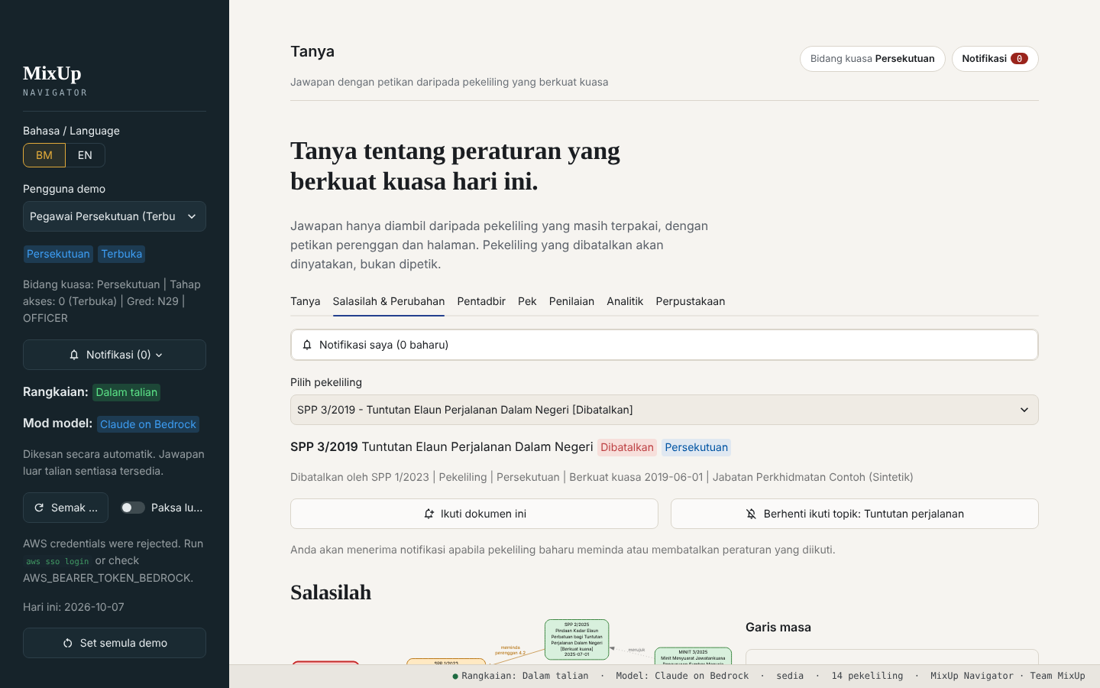
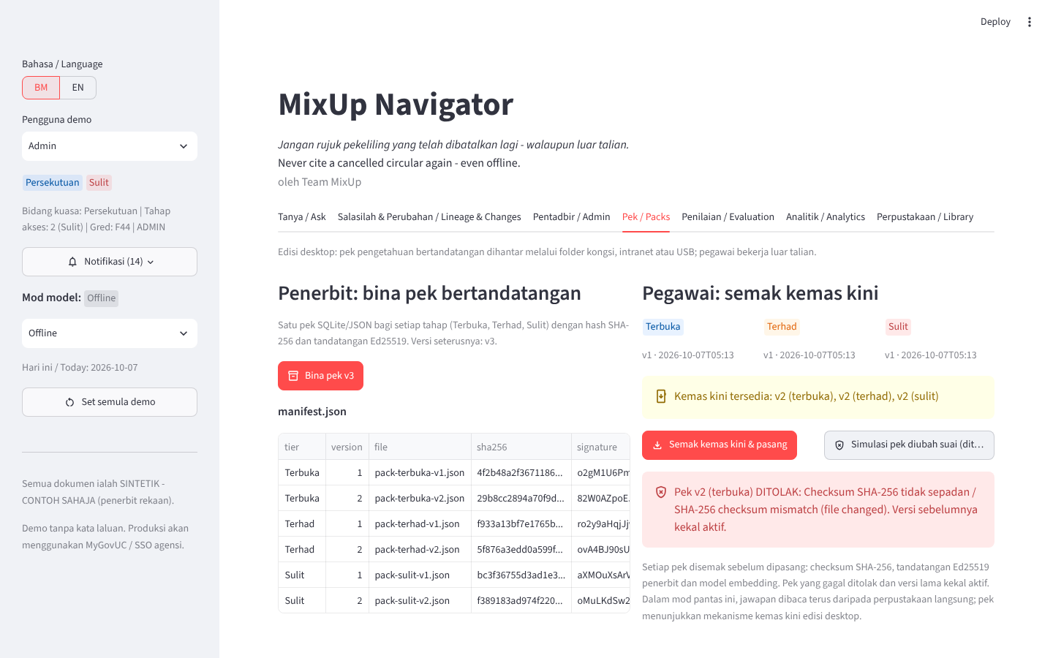
03 Our Solution
Ask. Check validity. Cite. Every screen is our working prototype.
One journey for every officer, in BM or English, fully offline.
1. Ask and check validity
The mileage question is answered from SPP 2/2025 [S1]. The cancelled SPP 3/2019 is listed under Dikecualikan, never quoted.
2. Lineage and what changed
Salasilah 2019 -> 2023 -> 2025 shows who cancelled or amended what, with a plain BM/EN summary of the changes.
3. Signed updates
The Publisher ships signed packs. A tampered pack fails the SHA-256 check and is rejected; the previous version stays active.
Officer app: ask, sources, lineage, updates. Publisher console: upload, verify relations, build packs. Validity engine underneath: statuses from verified relations only.
All screens: MixUp Navigator prototype, synthetic circulars (SINTETIK - CONTOH SAHAJA).
MixUp Navigator
Notes:
Here is the prototype. Step one: an officer asks about the mileage rate. MixUp Navigator answers RM0.80 per kilometre from SPP 2/2025, with the clause and page, and shows that SPP 3/2019 was excluded because it was cancelled. Step two: the lineage view shows how the rule evolved and what changed in plain language. Step three: new rules arrive as signed packs; a tampered pack is rejected and the old version stays active. Everything runs on the laptop, offline. 60 seconds.

Slide 5
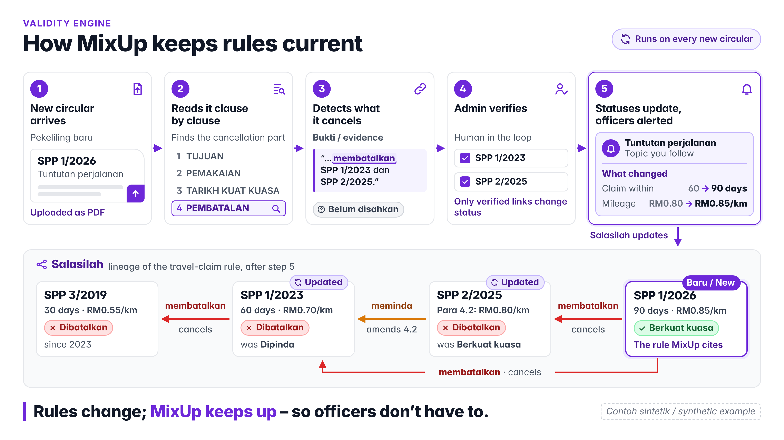
04 What Makes It Innovative?
Chatting with documents is table stakes. Validity is the gap.
Gemini, NotebookLM, Copilot and Sarawak's ADAM AI already chat with documents. None, as far as public sources show, tracks which circular is still valid.
Always-latest guard
Answers only from in-force rules; cancelled ones are named, not quoted.
Federal vs Sarawak
Your jurisdiction first, the other side by side.
What-changed alerts
Clause-level diff and a plain BM/EN summary when a rule you follow changes.
Offline, signed packs
Verified centrally, delivered signed, answered on the officer's PC.
91.7% -> 0% cancelled circulars cited as current: typical chatbot vs MixUp Navigator (30-question test, synthetic corpus)
MixUp Navigator
Notes:
Cited chat with PDFs is no longer innovative: Gemini, NotebookLM and Sarawak's ADAM AI do it. Our innovation is the validity layer: a new circular arrives, MixUp reads its cancellation section, detects what it cancels, a human verifies, and every answer and alert updates. On our 30-question test, a typical chatbot cited a cancelled circular as current 91.7% of the time; MixUp Navigator, zero. 50 seconds.

Slide 6
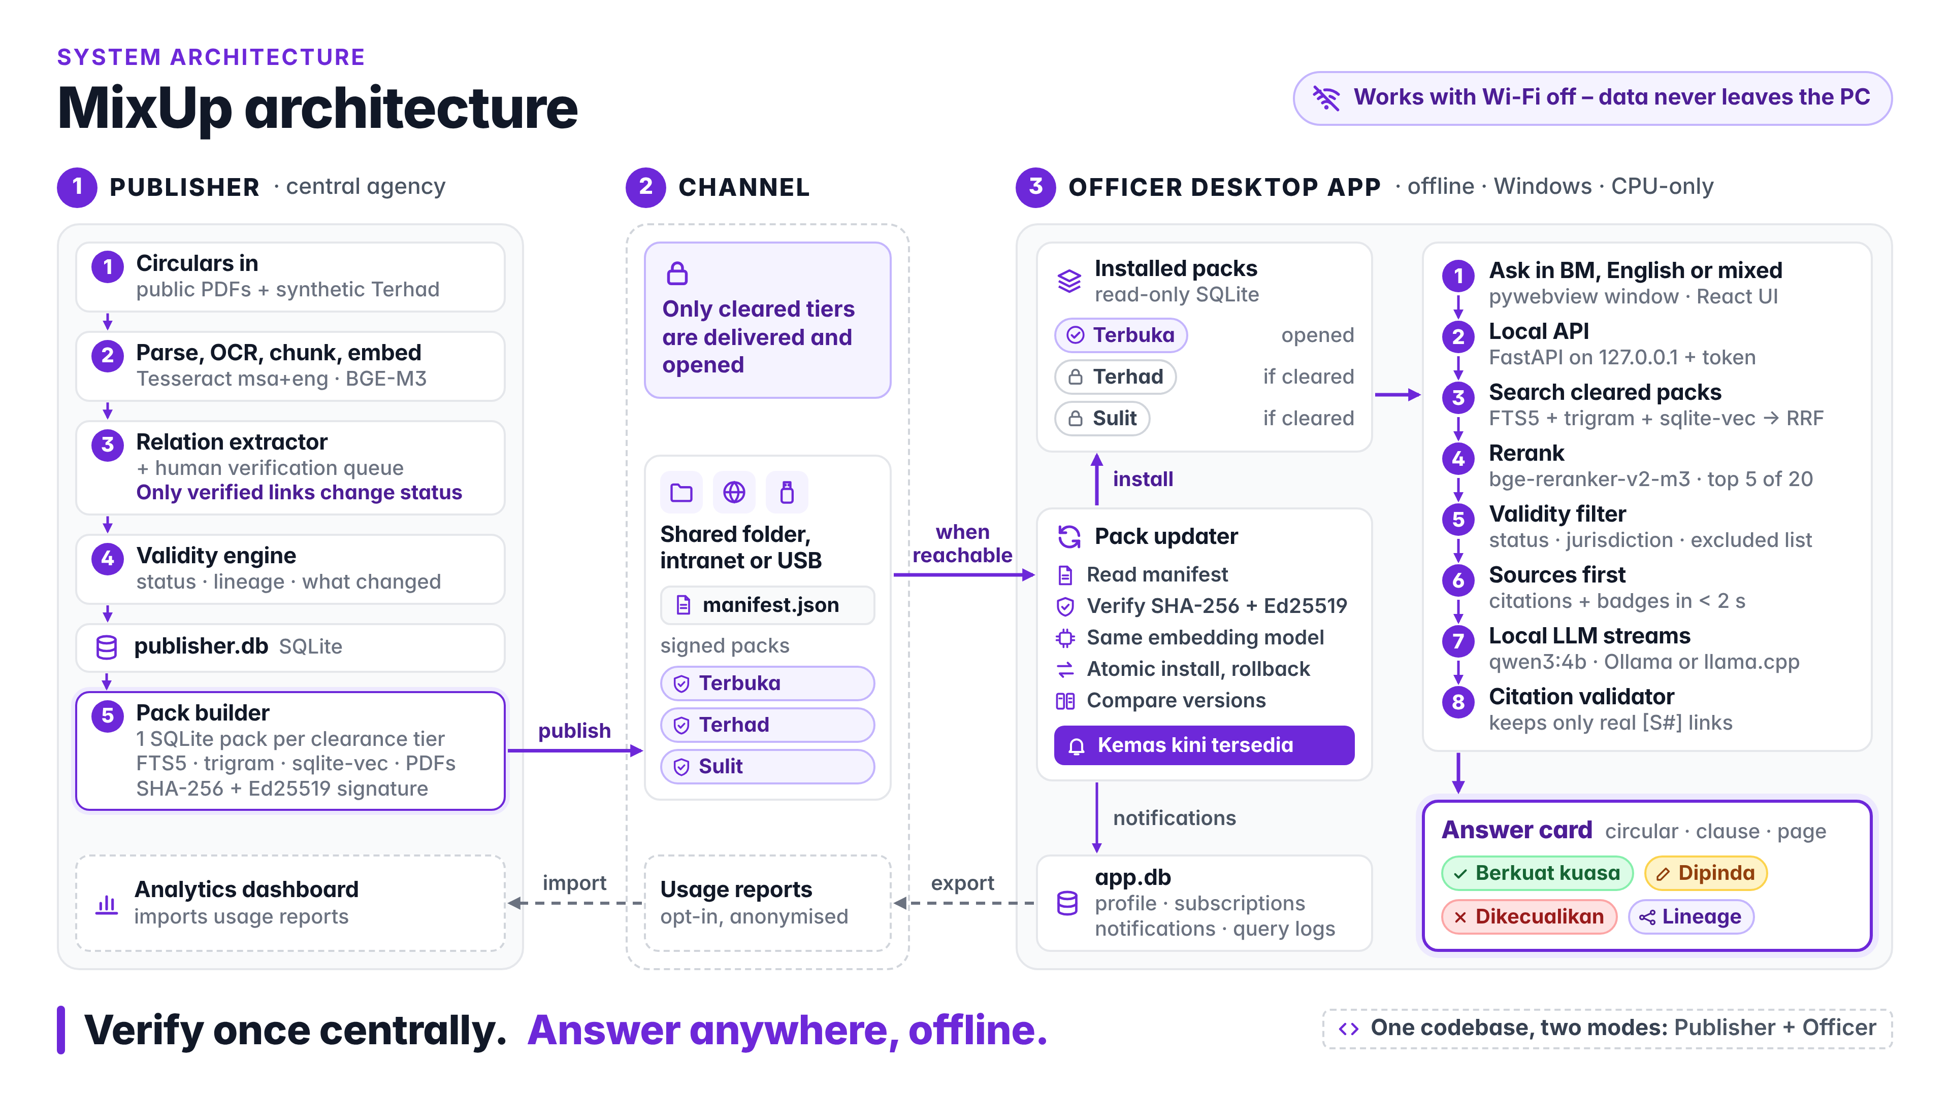
05 How It Works & Feasibility
Built in hours from parts that already exist.
Verify once centrally, deliver signed packs, answer anywhere offline. Public circulars can be curated in the AWS Malaysia Region; restricted tiers stay on-premise.
1 Pilot 0-6 months
One agency cluster, 50-150 real public circulars, a golden question set and a time-to-answer test.
2 Connect 6-18 months
Feeds from DDMS 2.0 and MyPPSM, integration with ADAM AI, Publisher on MyGovCloud or the SAINS platform (Terbuka only).
3 Scale 18+ months
Federal and Sarawak, then other states; Terhad and Sulit packs built on-premise, never on public cloud.
Pilot needs: one agency, a public circular corpus and feedback from JPA or the Sarawak civil service. The prototype runs today on a laptop.
MixUp Navigator
Notes:
How it works: a central Publisher ingests circulars, extracts which cancels which, a human verifies, and signed knowledge packs go out over a shared folder, intranet or USB. The officer app verifies the signature, installs, and answers offline. Feasible because the parts exist: MyPPSM and eCircular publish the circulars, DDMS stores them, and the AWS Malaysia Region can host the Publisher for public documents while restricted tiers stay on-premise. Roadmap: pilot in one agency, connect to DDMS and ADAM AI, then scale. 60 seconds.

Slide 7
06 Impact & Potential
Correct, current answers for every officer.
Success means fewer wrong answers and rejected claims, not more chat.
ON OUR 30-QUESTION TEST (SYNTHETIC CORPUS)
Officers
91.7% -> 0%
The right rule in under a minute, with the clause to quote.
Agencies
cancelled circulars cited as current
Fewer rejected claims, reworks and complaints; audit trail of every answer.
43% -> 83% correct and current answers
Citizens
Consistent, correct answers from government, federal and Sarawak.
How we measure success
Cancelled-citation rate
Time to answer
Adoption per agency
Unanswered-question rate
Scale: 1.3 million federal civil servants, the Sarawak civil service, other states and GLCs. Economic case: minutes saved x questions per week x officers x hourly cost, with conservative inputs agreed with the pilot agency.
MixUp Navigator
Notes:
Impact: on our test set the cancelled-citation rate drops from 91.7% to zero and correct, current answers rise from 43% to 83%. Officers get the right rule in under a minute; agencies get fewer rejected claims and an audit trail; citizens get consistent answers. We measure cancelled citations, time to answer, adoption and unanswered questions. The potential scale is 1.3 million federal officers plus the states, and the economic case is a simple formula we will fill with real numbers from the pilot. 60 seconds.

Slide 8
07 Why Us + Closing Vision
We diagnosed the real problem, built it, and measured it.
A working prototype, a fact-checked evidence base and a trust-first design.
01 Correct diagnosis
02 Built and evaluated
03 Trust-first design
Our research found the gap is validity, not search. We verified every claim and dropped the weak statistics.
A working prototype with a 30-question evaluation against a plain chatbot, not slides alone.
Human verification before any status changes, clearance enforced in code, offline by default.
Immediate next milestone
Support we need
Pilot MixUp Navigator with one agency cluster on 50-150 real public circulars, and publish the before/after numbers.
A pilot agency | access to a public circular corpus | feedback from JPA and the Sarawak civil service
Every officer, the current rule, with proof. Never a cancelled circular again.
MixUp Navigator
Notes:
Why us: we diagnosed the real gap, built a working prototype and measured it, and designed for trust. Next milestone: a pilot with one agency on real public circulars. We need a pilot agency, a corpus and feedback. Our vision: every officer, the current rule, with proof. Never a cancelled circular again. 40 seconds.

Slide 9
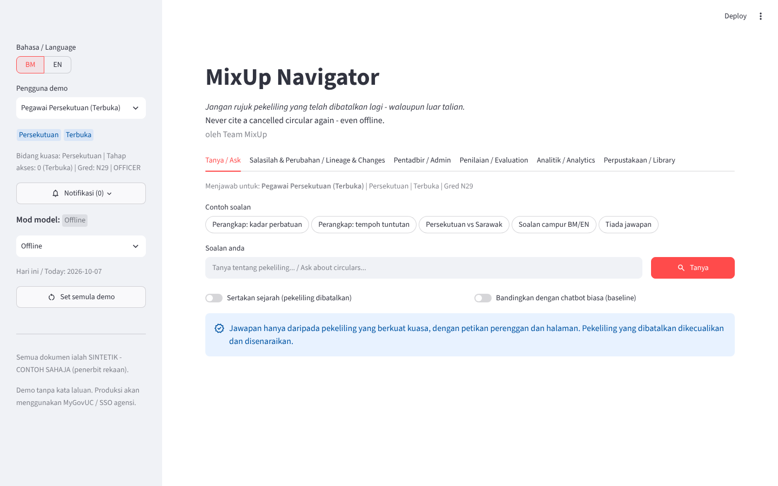
Thank you
MixUp Navigator prototype
Officer mode: ask, sources, lineage, updates
Publisher mode: upload, verify relations, build signed packs
Evaluation page: typical chatbot vs MixUp Navigator
Runs on a laptop, offline, with synthetic circulars
Repo: github.com/Rogerkkong/AWS-Kuching-Community-Day
Notes:
Thank you. The prototype is available in our repository; happy to take questions.

Slide 10
A Research and sources
What we checked, and where it comes from.
Two teammate research reports (problem space; competitive analysis) plus an independent fact-check of every statistic; weak or unverifiable claims were dropped.
ISEAS Perspective 2026/44: Malaysia's federal civil service of about 1.3 million.
NST, FMT, Google Cloud (Feb 2025): AI at Work 2.0, up to 445,000 officers; pilot of 270 officers, 97% self-reported ~3.25 h/week saved.
GovInsider / JDN: DDMS 2.0 used by 395 agencies and 56,000+ users.
RTM, Berita Harian (2026): JPA review of circulars older than 20 years; Government Service Efficiency Commitment Act 2025 (Act 867) reviews every 3 years.
Malay Mail, SoyaCincau (Aug 2025): MyGov beta AI chatbot shut down after nonsense answers.
UKAS Sarawak (Jul 2026): ADAM AI for the Sarawak civil service; Borneo Post (Aug 2026): SAINS Sovereign AI Infrastructure Platform.
Sarawak eCircular: Surat Pekeliling ICT Bil. 4 Tahun 2025 (AI guideline); AWS (2023): Malaysia Region, US$6 billion by 2037.
Evaluation: prototype/eval/results/summary.md, 30 golden questions, synthetic corpus (SINTETIK - CONTOH SAHAJA).
MixUp Navigator
Notes:
Backup slide: sources for every number in the deck. Links are in docs/problem-explainer.md and docs/research/teammate/README.md in the repository.

