Slide 1

Sorteer Algoritme
Content
InsertionSort
The Big O
Graph
Mark Zwiers &&
Rogier Velting

Slide 2
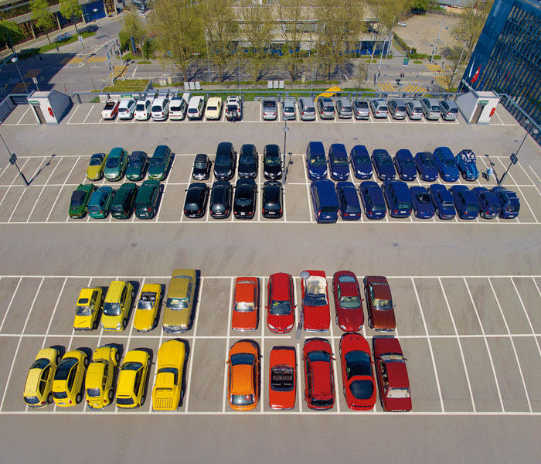
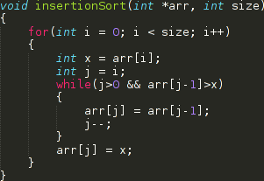
InsertionSort
Simple in nature.
Made for small lists.
Sorts by looking if the previous number in the list is smaller.
Will take serious time with long lists.

Slide 3
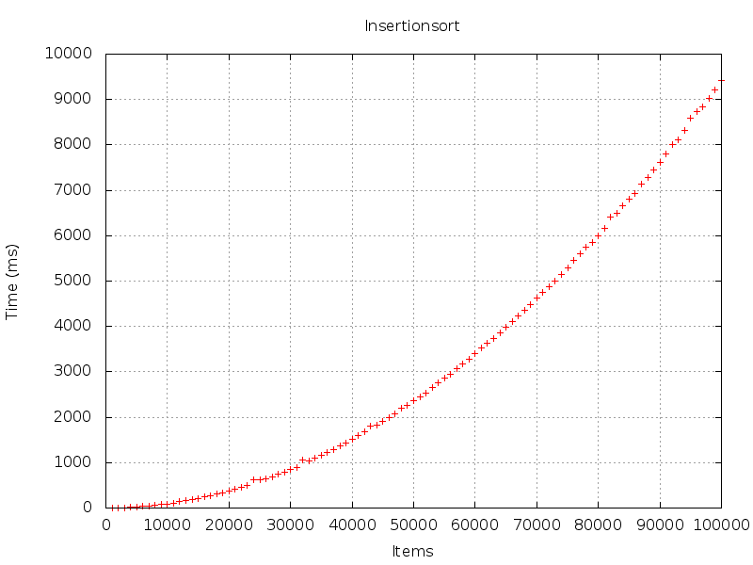
Big O
O(n²)

Slide 4
The End?
QUESTIONS???

