Slide 1
Hubble Expansion
Once upon a time, there were galaxies far, far away…

Slide 2
Edwin Hubble
Mt. Wilson Observatory, CA -- (about 1hr outside LA)
Astronomers at the time thought everything we saw in the sky was part of the Milky Way Galaxy
C. 1922:
Hubble used Cepheid variable stars to measure to distance to several spiral “nebulae”…showing that they were too far to be contained within the MW. In fact, these “nebulae” were entire galaxies far from us!
Notes:
Edwin Hubble worked at the Mt. Wilson Observatory in CA (about 1 hr outside of LA). This observatory still exists today, although LA has grown so large, that the light pollution from the city makes the observatory unusable for anything other than a museum. During Hubble’s time, however, LA was still a very small town.
Now, in the early 1900’s, astronomers debated about whether everything they saw in the night sky was part of our own galaxy. One side strongly argued that everything was inside the Milky Way, while the other camp argued that we were also seeing objects from other galaxies. But there was no definitive evidence one way or other until Hubble.
Hubble used Cepheid variables (which students have already done a lab on) to determine the distance to several cloud-like objects they called “nebulae.” He found that these objects were too far away to be within the Milky Way, and that, in fact, these “nebulae” were actually galaxies themselves!

Slide 3
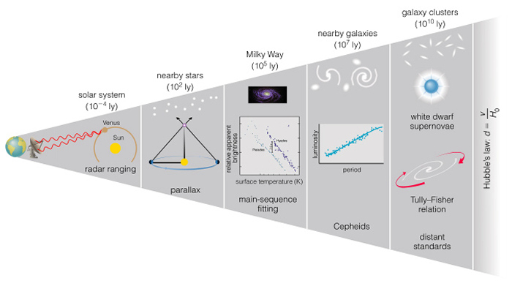
Cosmic Distance Ladder
Standard Candle:
An astronomical object with a known luminosity (absolute magnitude). E.g., Cepheid variable stars
Credit:
Encyclopedia
of
Science
Notes:
I want to take a moment to remind you of the Cosmic Distance Ladder. In astronomy, we use different methods of determining distances, each building on the other (like a ladder) to get us distances further and further away. Radar (which we use to determine the distance to the ocean floor) can also be used within the inner Solar System to get distances.
Once we know the spacing of our own solar system, then we can understand how star will appear to shift as we change our view of them over the course of our orbit around the sun. This is done with parallax, which we will learn about later in the semester.

Slide 4
Cosmic Distance Ladder
Distance Modulus:
m – M = 5*log₁₀( d/10pc)
m = apparent mag ; M = absolute mag
Credit:
Encyclopedia
of
Science
Notes:
With parallax, we can find the distance to a nearby star cluster. If we know the distance to the star cluster, and we know how bright it looks to us (apparent magnitude), then we can determine the true brightness (absolute magnitude) of the stars. Using an entire cluster at approximately the same distance, we can very well characterize the standard properties of different types of stars and create a color-magnitude diagram. You will learn more about color magnitude diagrams in the CMD lab. Once we have standard characteristics, then deviation in brightness of this standard can tell us about distances to even further objects, which we will do in the Open Clusters lab.
Looking at many clusters at different distances, we start to build a relationship for these special, bright, oscillating stars that we call Cepheid variables. Understanding the period-luminosity relationship of Cepheids along with the distance modulus allows us to find distances to even further objects.
Radar get us distances within the solar system. Parallax gets us distances to nearby stars. Star cluster fitting gets us distances within the Milky Way. But we really need those Cepheid variables to obtain distances outside the Milky Way and to nearby galaxies. This is why Hubble needed Cepheids to determine distances to these “nebulae,” which he showed to be outside galaxies.

Slide 5
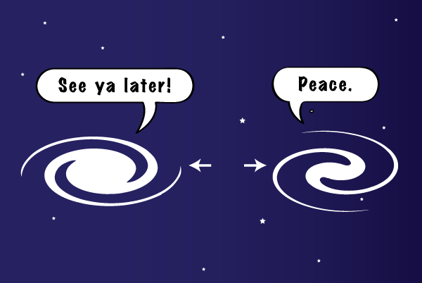
Edwin Hubble
C. 1929 -- About 7 years after Hubble discovered galaxies, he showed that these galaxies are moving away from each other. The more distant the galaxy, the FASTER it moves away!
How did he show this?
Credit: NASA SpacePlace
Notes:
So, Hubble used Cepheid variables to show that other galaxies were a thing. About 7 years later, he discovered that these galaxies are actually moving away from each other. In fact, the further away a galaxy is, the faster is moves away!

Slide 6
Basic Spectroscopy
A study of how light interacts with matter…
Notes:
Now, to talk about how he found how fast galaxies are moving, we first need to talk about basic spectroscopy, which we will cover in more detail later in the semester. At it’s core, spectroscopy is a study of how light interacts with matter.

Slide 7


A solid, hot object will emit a continuous spectrum of light. The sun (minus the atmosphere), gives out a continuous spectra…
It gives out light of all colors!
The Sun
Notes:
If you have a hot, solid object, it will give out light in every color of the rainbow. In actuality, it gives out light in every part of the electromagnetic spectrum, including UV, infrared, and beyond, but we will focus on the visible spectrum in our example because that we what we can see.
The sun (if we ignore the atmosphere) is a solid, hot object, and it gives out light in all colors.

Slide 8
*Not drawn to scale
An Electron
The Sun
An Atom
Notes:
An atom consists of a very dene nucleus filled with positively charged protons and neutral neutrons. Around the nucleus are the atom’s electrons. When light interacts with atoms, it primarily affects the electrons, so we will ignore the nucleus for the moment. Electrons can exist only in certain states – or orbitals – around the nucleus, and these orbitals represent the energy of the electron. An electron in a lower energy state will be closer to the nucleus (more toward the center), while an electron with a higher energy state will be further from the nucleus (more toward the outside). The spacing of these orbitals will depend on the atom. A hydrogen atom will have a different number of orbitals and with different spacing than a carbon atom, for example.

Slide 9
*Not drawn to scale
Notes:
Let’s say light is emitted from our hot, dense energy source. If the light has the right amount of energy, the atom can absorb the light and convert the energy from the light into a change in the energy state (or orbital) of the electron.

Slide 10
*Not drawn to scale
Notes:
Because the electron has gained that energy it must move up in energy levels. Because that wavelength of light has been absorbed, it gets removed from the continuum of light we see from the source! Blue light is more energetic than red light, so absorbing blue light means that electron must move a greater distance.
Keep in mind that it has the be the right color of light to make this happen. If the spacing between the orbitals is different, it will absorbed a different color. Any one atom will absorb several SPECIFIC wavelengths of light because that atom has specific energy levels allowed for the electron.

Slide 11
*Not drawn to scale
Notes:
Similarly, if the same atom were to absorb the lower-energy red light…

Slide 12
*Not drawn to scale
Notes:
Then the electron would not move as far, but the red light would still be removed from the continuum.

Slide 13
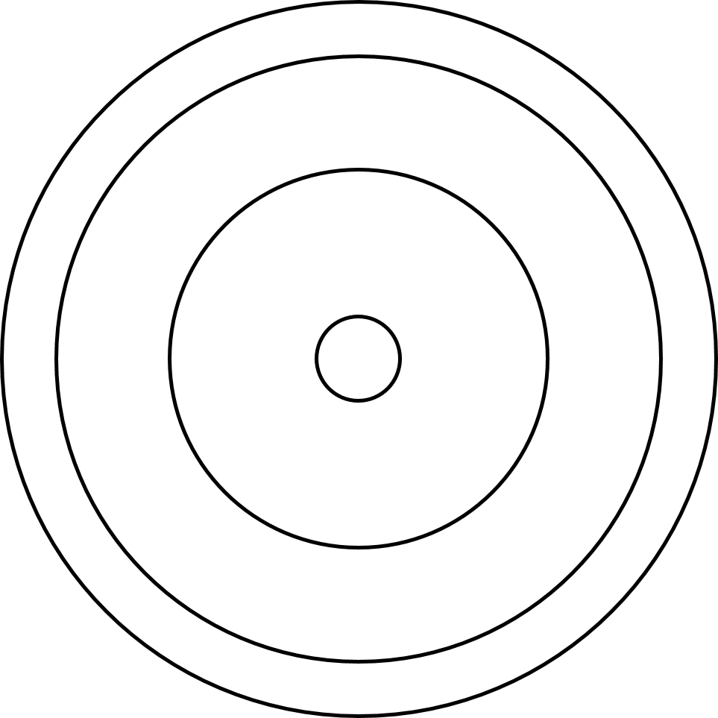
*Not drawn to scale
Notes:
If you had a cloud of the same type of atom between you and the energy source, then you would see every orbital transition possible. This pattern of missing light tells you what type of atom there is.

Slide 14




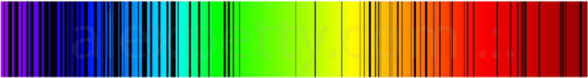
Hydrogen
Every element has
a UNIQUE
spectroscopic “fingerprint”
Helium
Carbon
Neon
Credit: Energy Research Journal
Argon
Notes:
Different atoms have different patterns of missing light. They each have their own unique spectroscopic fingerprint. Hydrogen looks different from helium, which looks different from argon.

Slide 15
One shift, two shift Redshift, blueshift
Movement in the spectroscopic fingerprint of an atom can tell us how fast something is going toward or away from us.
Notes:
Now, if we know what an element’s spectroscopic fingerprint should look like and what colors should be missing, then any shift in that patterns tells us that things are moving. An object is moving TOWARD you when a spectroscopic fingerprint that is spaced the way you would expect, but the pattern is shifted bluer than you would expect. Similarly, when an object is moving AWAY from you, the spectroscopic fingerprint appears shifted toward the red end.

Slide 16
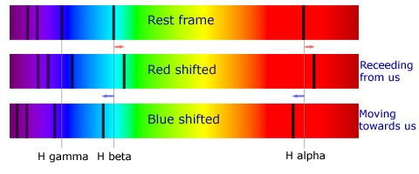
One shift, two shift Redshift, blueshift
Hydrogen Spectroscopic Fingerprint
Credit: Australia Telescope National Facility
Notes:
Here is an example of the redshift and blueshift of hydrogen. The top frame is how the spectra of hydrogen SHOULD look. Notice that the missing colors keep the same spacing, but shift toward the red end when an object is moving away from you. The patter keeps the spacing, but moves toward the blue end when the object is moving toward you.

Slide 17
One shift, two shift Redshift, blueshift
Movement in the spectroscopic fingerprint of an atom can tell us how fast something is going toward or away from us.
When the redshift (z) is small, then we can approximate the velocity (v) of the moving object as
v = c*z
Speed of Light: c = 3x10⁸ m/s or 670 million MPH
Notes:
The greater the shift in spectra (z), then the faster the object is moving toward or away from you!

Slide 18
Hubble measured the redshift of galaxies...they’re moving away!
Nearly all galaxies were redshifted (not blueshifted)
The further away the galaxy, the faster it moves away from us
This means that redshift can also tell us something about distance of the galaxy. The more the galaxy is redshifted, the further it is away from us.
OR… the faster speed (v) a galaxy has away from us, the more distant (D) it is!
Hubble’s Law: v = H₀*D
Notes:
Hubble used spectroscopy to determine that nearly all galaxies move AWAY from us – that is, they are all redshifted!
He then related the speed of recession to our distance from the galaxy (found with Cepheid variables), and he found a linear relationship. The further a galaxy was from us, the faster is moves away.
This is codified in Hubble’s law, which relates the speed of the galaxy (v) to its distance from us (D) by a constant that we call the Hubble Constant (H₀)

Slide 19
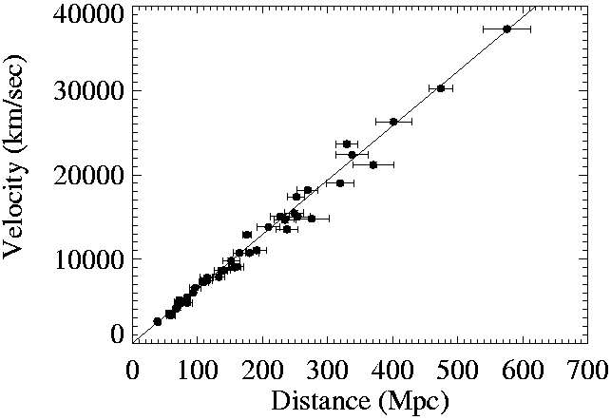
Hubble’s Law : v = h₀D
Credit: Caltech
Notes:
As a graph, Hubble’s Law looks like this. Velocity is on the y-axis, distance is on the x-axis, and the slope of the graph is the Hubble Constant (H₀), which has units of 1/s.
Now, this is all well and good, but what does Hubble’s Law tell us about the universe?
We now know that all galaxies are moving away from us, but why? There are 2 explanations.
We are the center of the universe, and everything is moving away from us. Astronomers and scientists have tried this whole “center of everything” before, and we’re always wrong. The Earth is not the center of the Solar System, and our Solar System is not the center of the Galaxy. So, we have no reason to suspect that we would be the center of the universe, unless there is no other explanation.
The other explanation is that space itself is expanding!

Slide 20
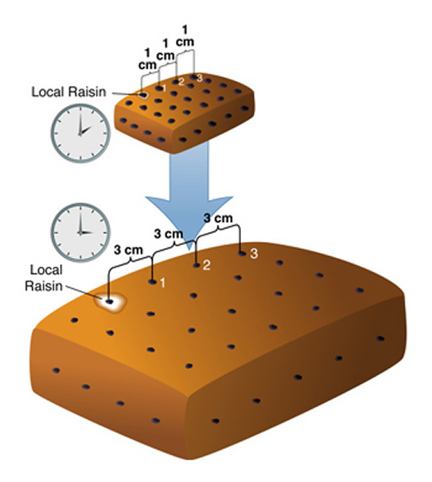
Space is expanding!
Notes:
Let’s make an analogy. Let’s pretend that our universe is like a loaf of raisin bread. And, because we are OCD about our raisin bread, we have carefully spaced each raisin exactly 1 cm apart. Our “local raisin” is us here in the Milky Way. Because every raisin is 1cm apart, the next nearest raisin (galaxy) is exactly 1 cm from us. The next one over is 2 cm from us, and the one after that is 3 cm from us.
Now, we bake our raisin bread and the bread expands. Notice that the raisins are not moving around in the raisin bread. You don’t have a raisin zipping here and there while the bread is cooking. But the raisins are still moving away from each other. Why? Because the bread in between the raisins is expanding! Now, let’s say that in the hour it took to bake the bread, the raisins have moved from 1 cm apart to 3 cm apart. That means that our nearest raisin is now 3 cm from us, the next nearest is 6 cm from us, and the one after that is a whole 9 cm from our position.
In terms of velocity, raisin 1 has moved 2 cm/hr (from 1 cm to 3 cm in the one hour of baking time). Raisin 2 has moved 4 cm/hr. And raisin 3 has moved 6 cm/hr. The further raisin moves away FASTER than the nearby raisin! This is exactly the result Hubble saw in our universe with the movement of galaxies! This means that, even if gelexies did not move through, then they would still move away from each other because space itself is expanding!

Slide 21
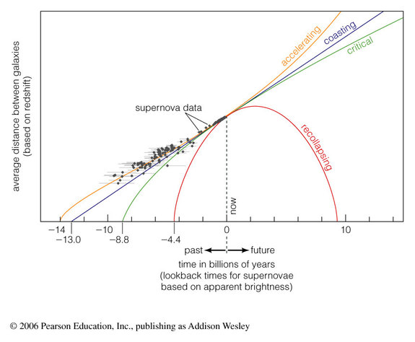
Credit:
Flat Universe Society
Notes:
If space is expanding outward, then if we were to rewind the clock, at some point in the past, everything was closer together. This is the origin of the Big Bang Theory, and the basis of how we think the universe began. But the rate of expansion can also tell us something about how the universe will end.
If enough matter existed in the universe, then gravity would pull in enough to counter-act the expansion outward. The universe would slow its expansion, momentarily stop, and then recollapse inward again, resulting in the “Big Crunch” where everything smashes back together. This recollapsing universe follows the red line in this graph, and current data shows that this will not happen.
If there is just enough matter to balance the expansion of space, then it will coast along in its expansion, slowing down over time, but never reversing the expansion. This is the blue line in the graph. The result would be the “Big Chill” because eventually, nothing will be close enough to produce new stars. The same material will be recycled through until nothing is left…and the universe goes cold. Although the data is not definitive enough to completely rule this model out, it is less likely than the accelerating universe.
If there isn’t enough matter, then space will accelerate its expansion over time. Eventually, every galaxy will be so far away and moving so fast that we will never see the light from those galaxies again. For the most part, gravity in local space is strong enough that we only see the expansion of the space between galaxies. However, space may eventually accelerate fast enough to overcome even local gravity. “Clusters of galaxies will disband and separate. Then galaxies themselves will be torn apart. The solar system, stars, planets, and even molecules and atoms could be shredded by the ever-faster expansion. The universe that was born in a violent expansion could end with an even more violent expansion called the Big Rip.” My chemistry teacher in high school called this “Entropic Doom,” which I think sounds so much cooler.

Slide 22
Today’s Lab
“Appreciating Hubble at Hyper Speed”
Determine v and D of galaxies in the Hubble Deep Field
Plot v vs D to determine the Hubble Constant.
H₀ – the Hubble Constant – describes the expansion of the universe.
Large H₀ means the universe is expanding faster.
Small H₀ means the universe is expanding slower.
Inverting the Hubble Constant gives us the age of the universe
Large H₀ means the universe is younger.
Small H₀ means the universe is older.
Notes:
To summarize, Hubble used Cepheid variables to find the distances to other galaxies. He used spectroscopy and redshift to determine how fast those galaxies were moving away from us. Hubble discovered that, not only are galaxies moving away from us, but the further the galaxy is, the faster it moves away!
You will use “Appreciating Hubble at Hyperspeed” or AHAH to look up the velocity and distance of several galaxies in the Hubble Deep Field image. The AHAH icon is under the astronomy account on the lab computer, and it looks like a steaming coffee cup. You will plot velocity and distance to determine the Hubble Constant, and from this constant, you can determine the age of the universe. To help you out, I have provided an Excel spreadsheet under the “Labs” folder on Blackboard. It should be titled something like “Hubble Table.”

Slide 23
Bibliography
http://map.gsfc.nasa.gov/universe/bb_concepts_exp.html
http://www.daviddarling.info/encyclopedia/C/cosmic_distance_ladder.html
https://en.wikipedia.org/wiki/Edwin_Hubble
http://alexpetty.com/2014/09/21/the-periodic-table-of-light/
http://www.atnf.csiro.au/outreach/education/senior/astrophysics/spectra_info.html
http://spaceplace.nasa.gov/review/moon/big-bang/
http://hubblesite.org/hubble_discoveries/dark_energy/de-fate_of_the_universe.php
http://www.flatuniversesociety.com/accelerating-expansion.html
https://ned.ipac.caltech.edu/level5/Tyson/Tyson2.html

