Slide 1
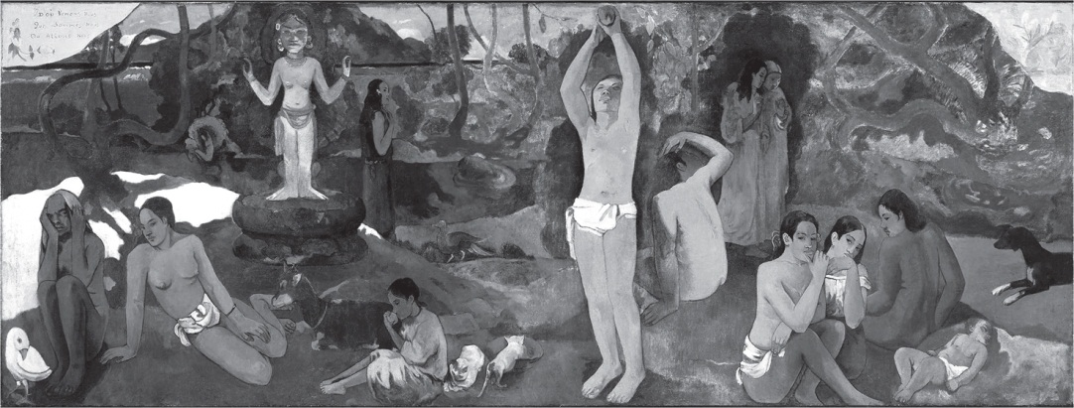
Ryden_Fig1-1
© Cambridge University Press 2016

Slide 2
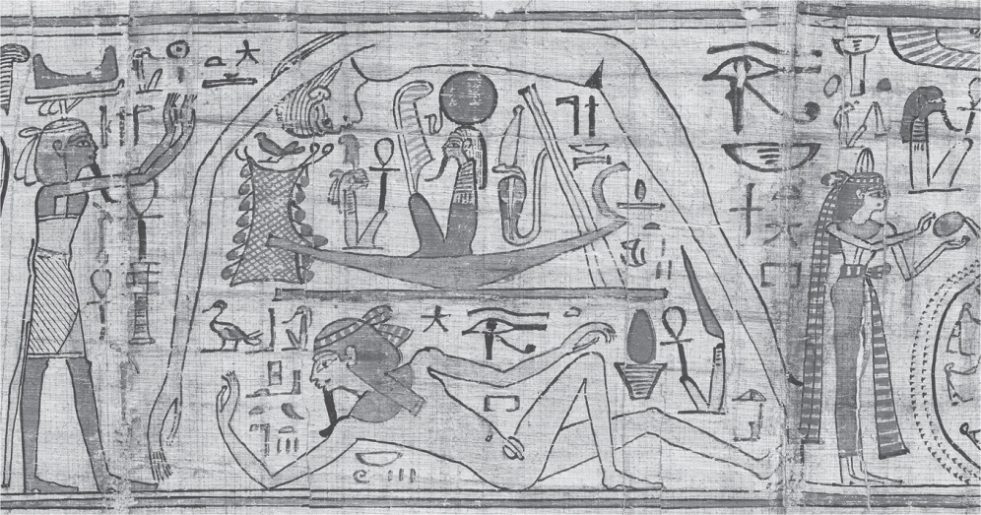
Ryden_Fig1-2
© Cambridge University Press 2016

