Slide 1
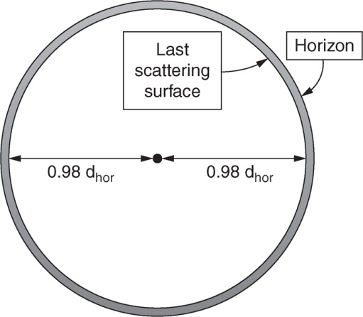
Ryden_Fig10-1
© Cambridge University Press 2016

Slide 2
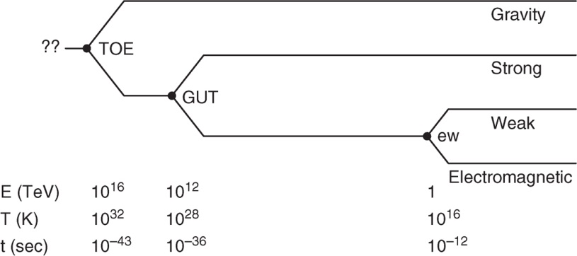
Ryden_Fig10-2
© Cambridge University Press 2016

Slide 3
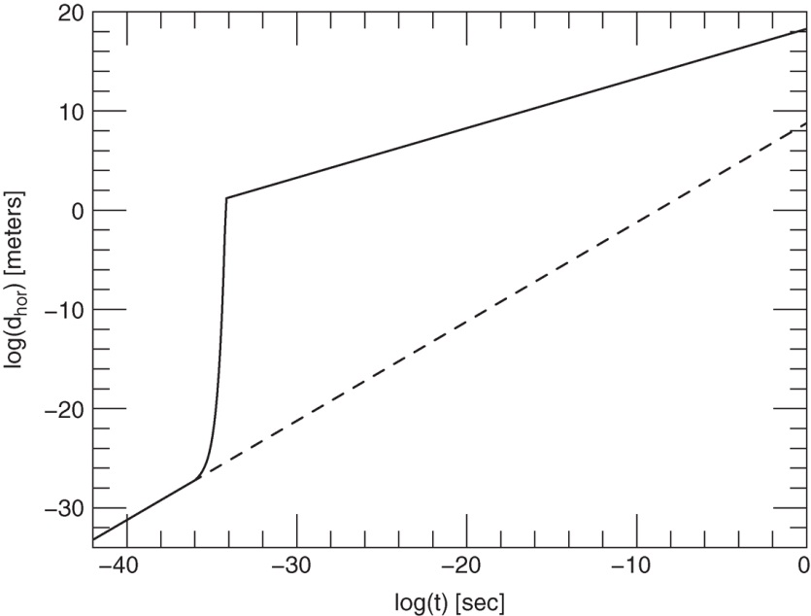
Ryden_Fig10-3
© Cambridge University Press 2016

Slide 4
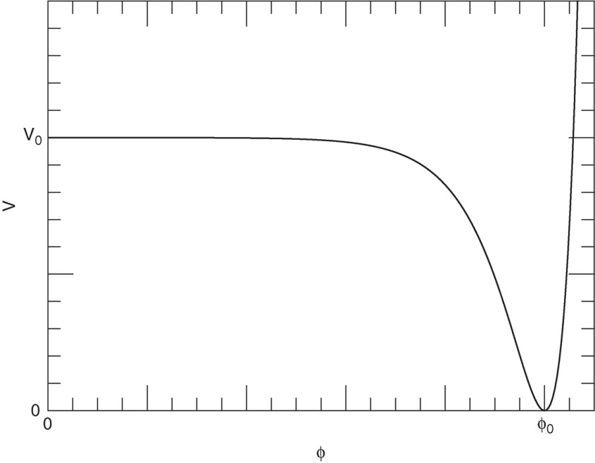
Ryden_Fig10-4
© Cambridge University Press 2016

