Slide 1
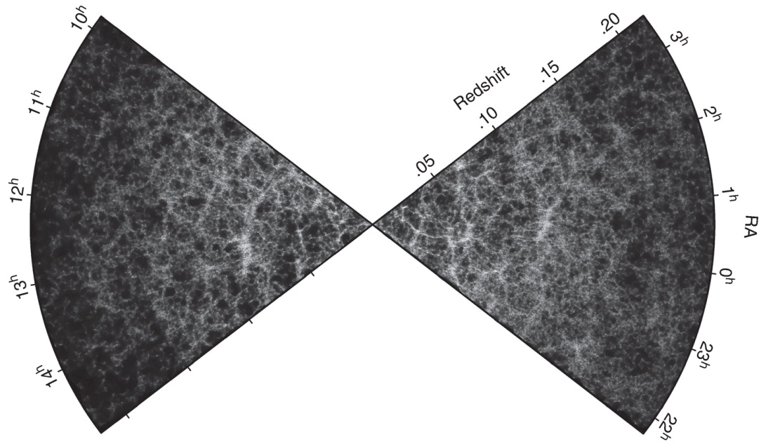
Ryden_Fig11-1
© Cambridge University Press 2016

Slide 2
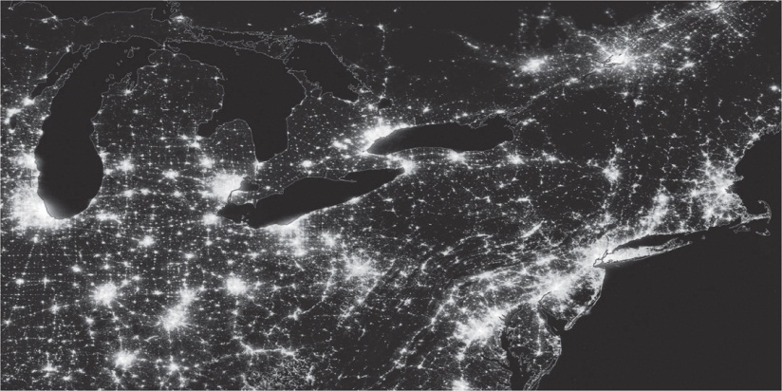
Ryden_Fig11-2
© Cambridge University Press 2016

Slide 3
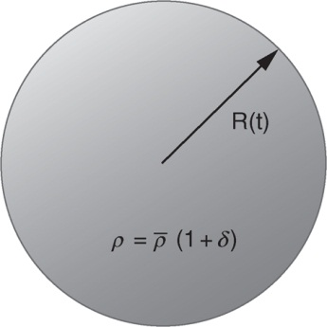
Ryden_Fig11-3
© Cambridge University Press 2016

Slide 4
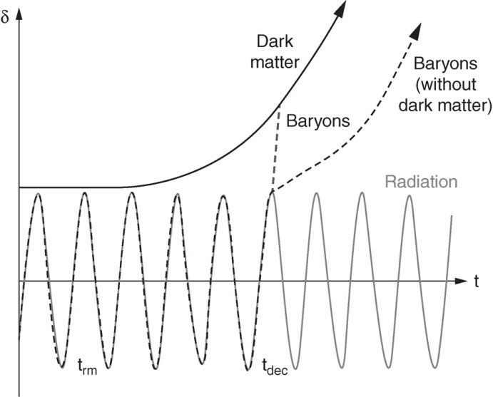
Ryden_Fig11-4
© Cambridge University Press 2016

Slide 5
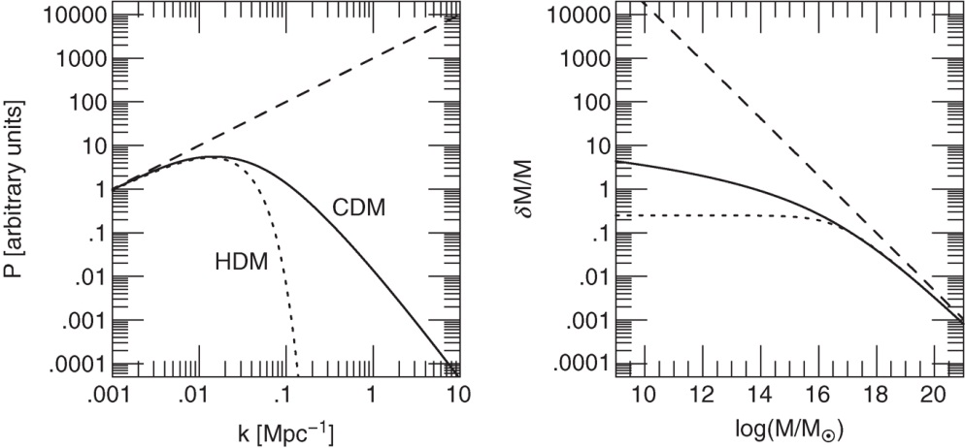
Ryden_Fig11-5
© Cambridge University Press 2016

Slide 6
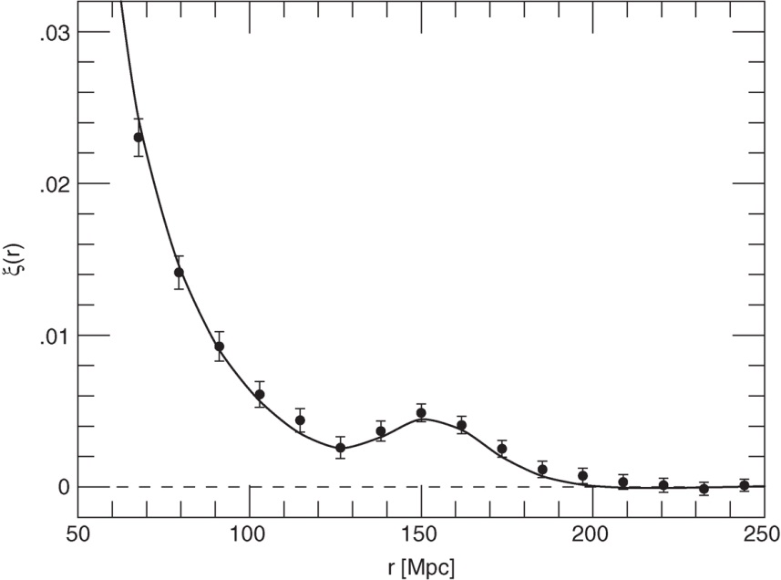
Ryden_Fig11-6
© Cambridge University Press 2016

Slide 7
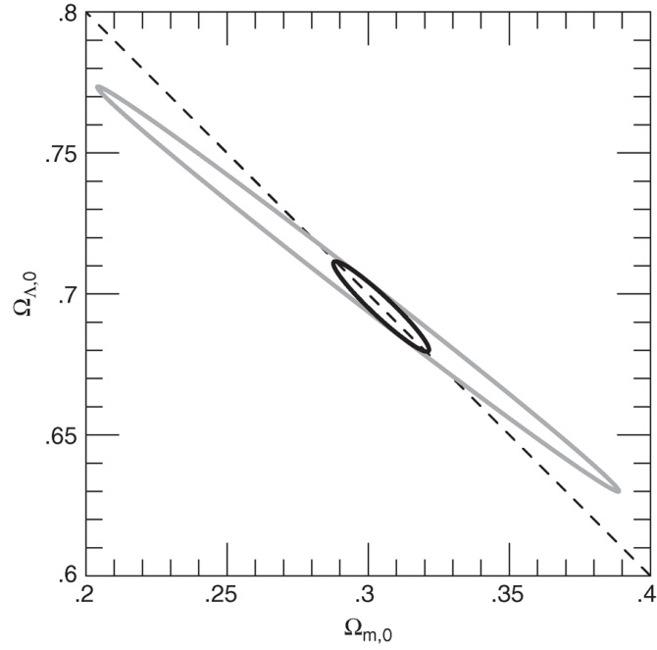
Ryden_Fig11-7
© Cambridge University Press 2016

