Slide 1
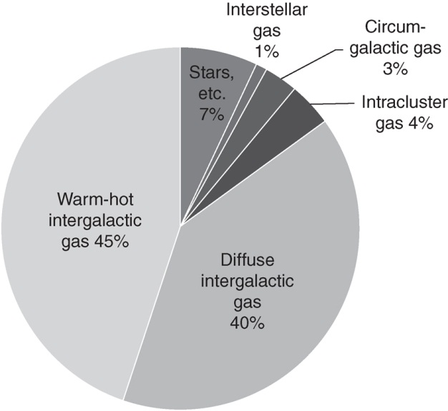
Ryden_Fig12-1
© Cambridge University Press 2016

Slide 2
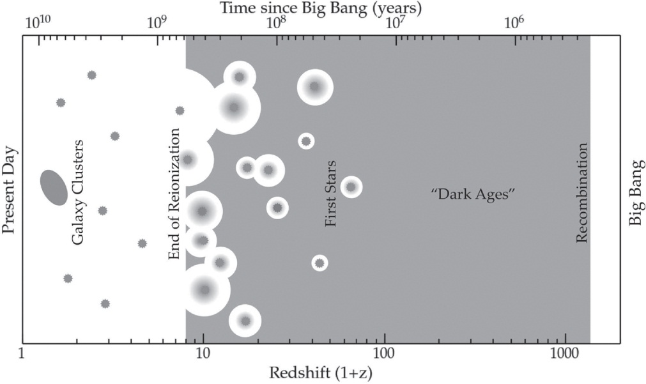
Ryden_Fig12-2
© Cambridge University Press 2016

Slide 3
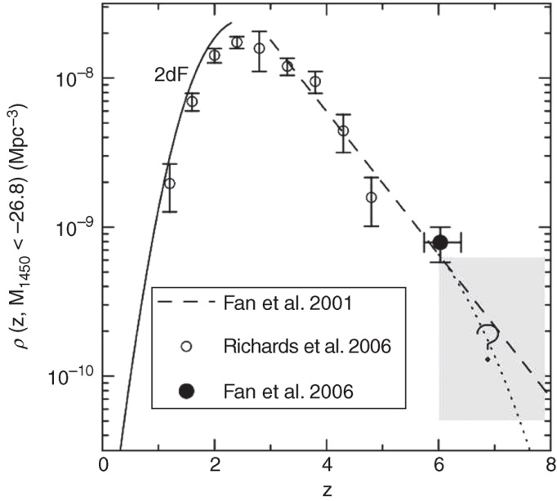
Ryden_Fig12-3
© Cambridge University Press 2016

Slide 4
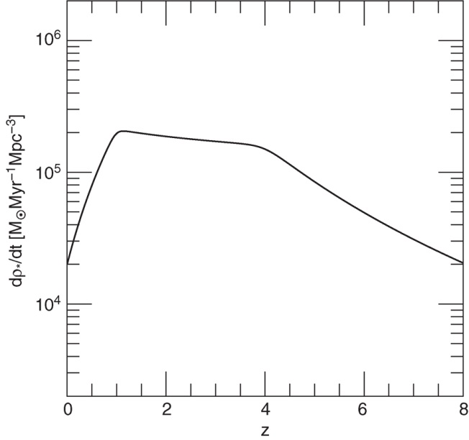
Ryden_Fig12-4
© Cambridge University Press 2016

Slide 5
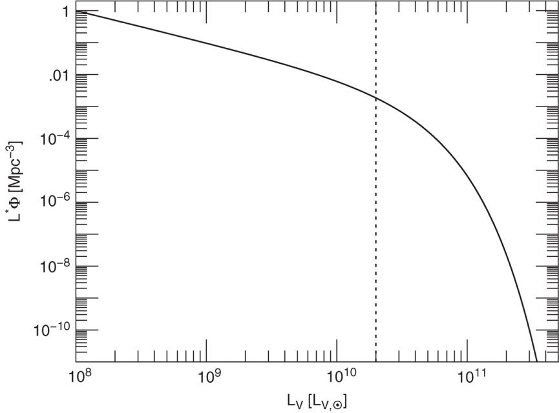
Ryden_Fig12-5
© Cambridge University Press 2016

Slide 6
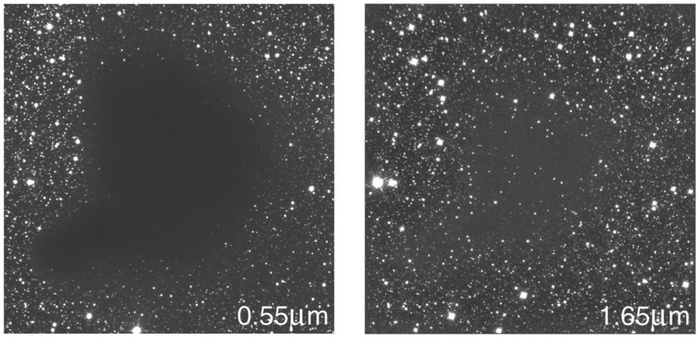
Ryden_Fig12-6
© Cambridge University Press 2016

