Slide 1
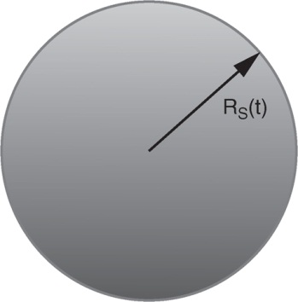
Ryden_Fig4-1
© Cambridge University Press 2016

