Slide 1
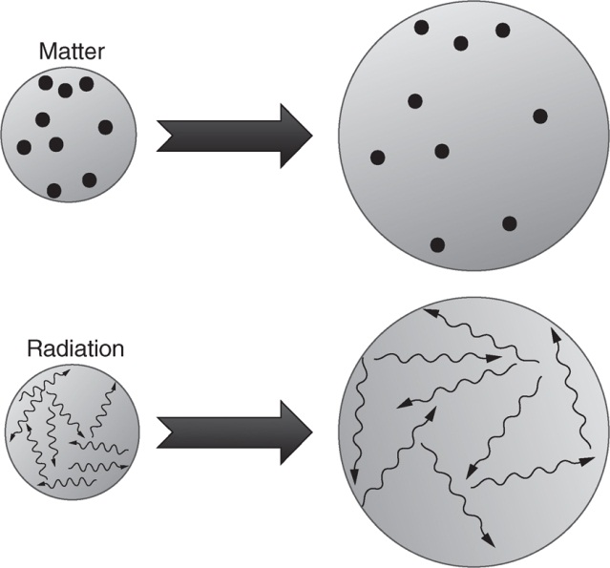
Ryden_Fig5-1
© Cambridge University Press 2016

Slide 2
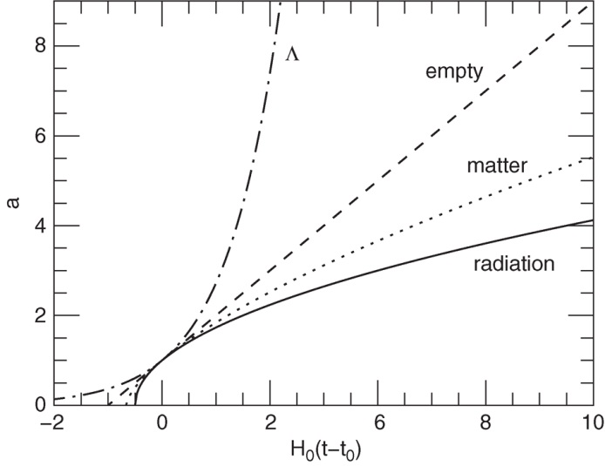
Ryden_Fig5-2
© Cambridge University Press 2016

Slide 3
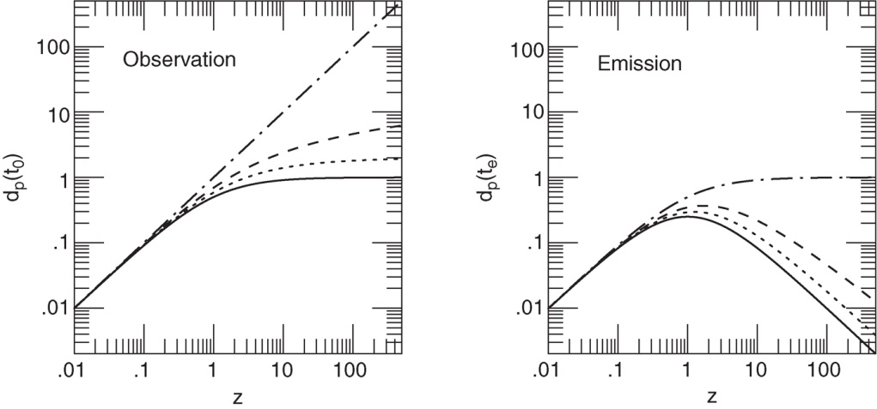
Ryden_Fig5-3
© Cambridge University Press 2016

Slide 4
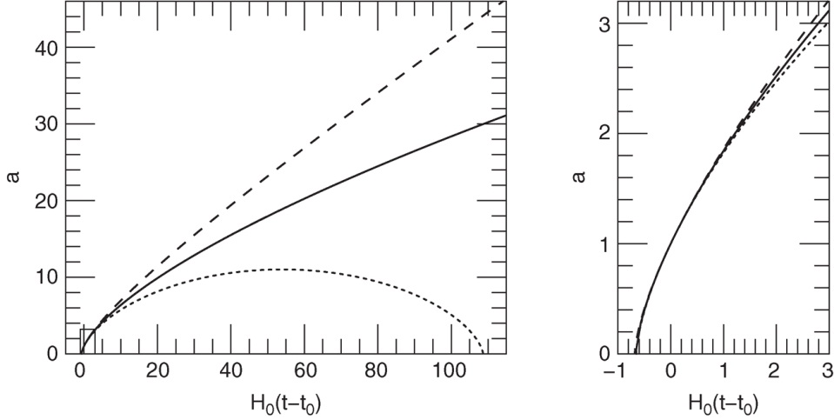
Ryden_Fig5-4
© Cambridge University Press 2016

Slide 5
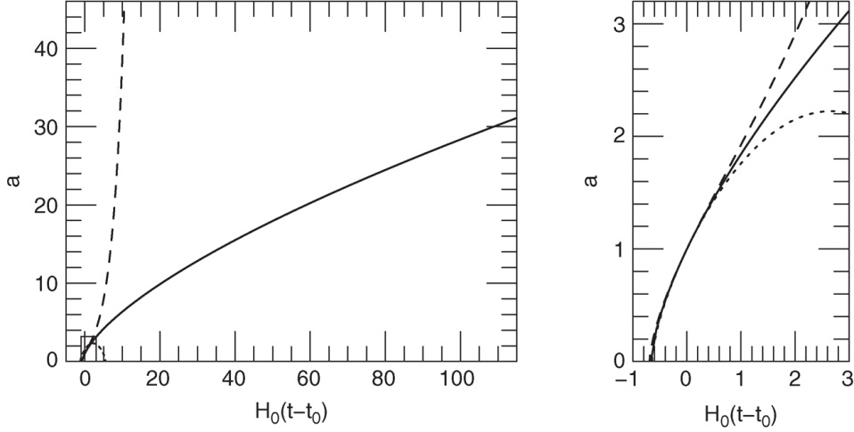
Ryden_Fig5-5
© Cambridge University Press 2016

Slide 6
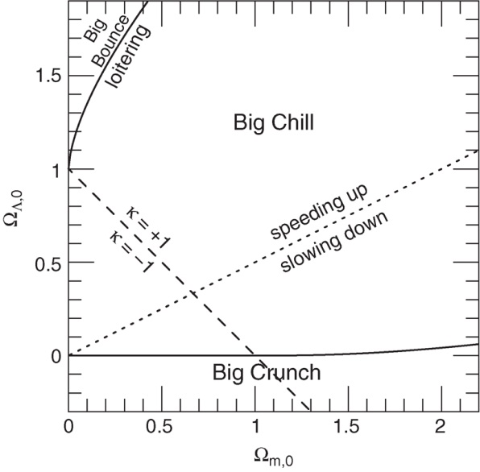
Ryden_Fig5-6
© Cambridge University Press 2016

Slide 7
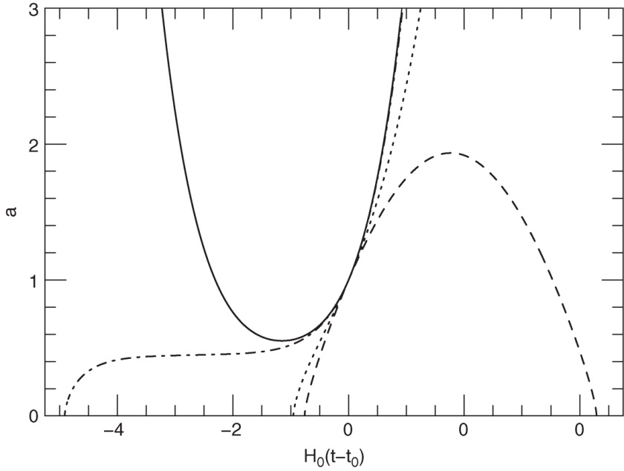
Ryden_Fig5-7
© Cambridge University Press 2016

Slide 8
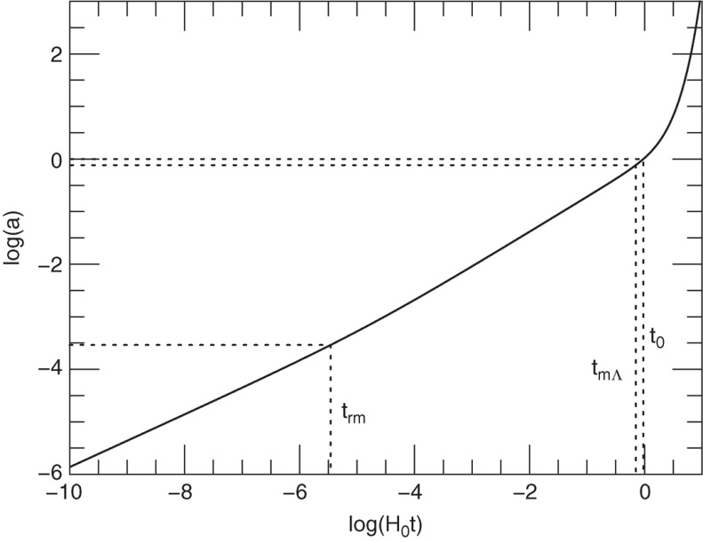
Ryden_Fig5-8
© Cambridge University Press 2016

Slide 9
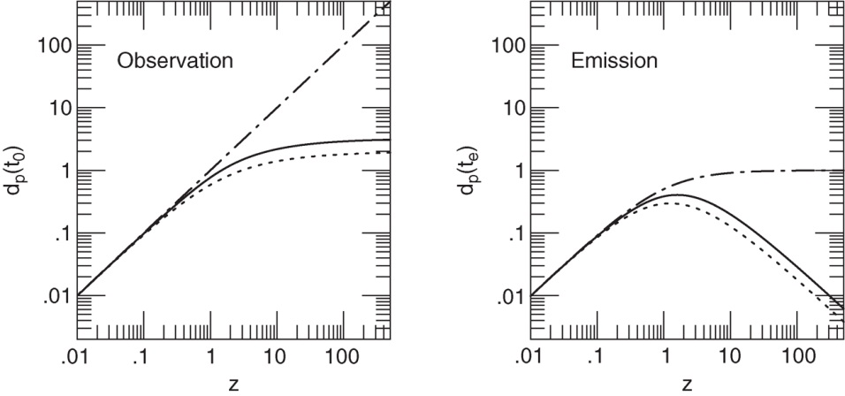
Ryden_Fig5-9
© Cambridge University Press 2016

Slide 10
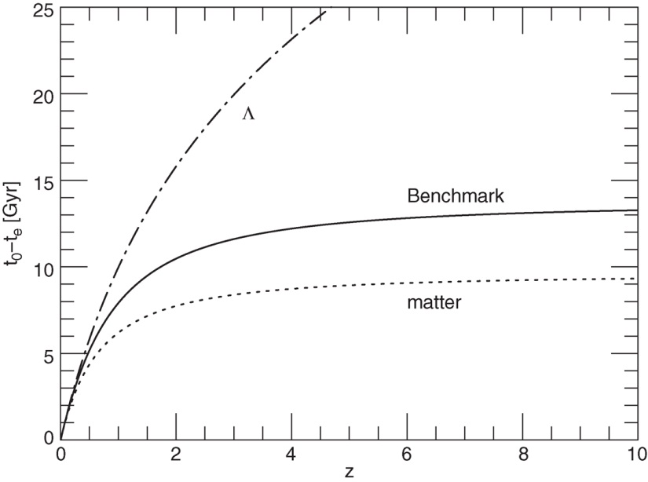
Ryden_Fig5-10
© Cambridge University Press 2016

