Slide 1
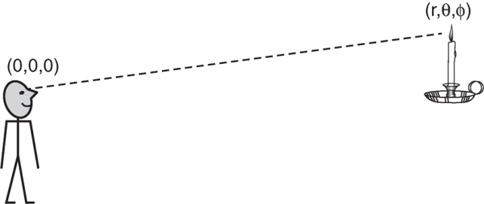
Ryden_Fig6-1
© Cambridge University Press 2016

Slide 2
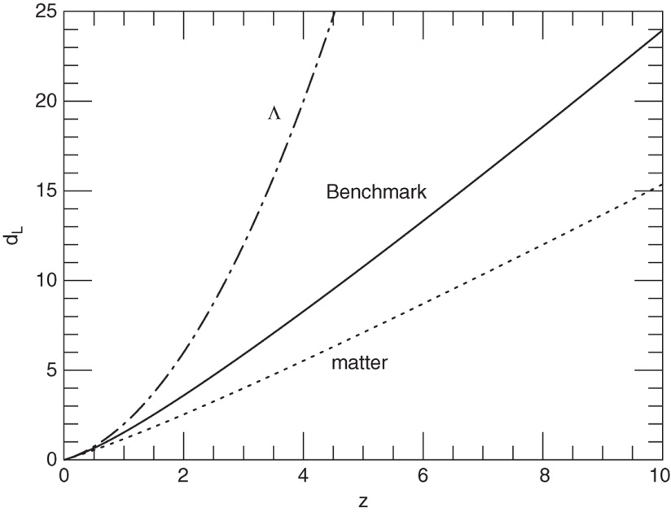
Ryden_Fig6-2
© Cambridge University Press 2016

Slide 3
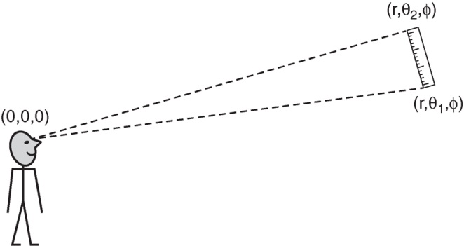
Ryden_Fig6-3
© Cambridge University Press 2016

Slide 4
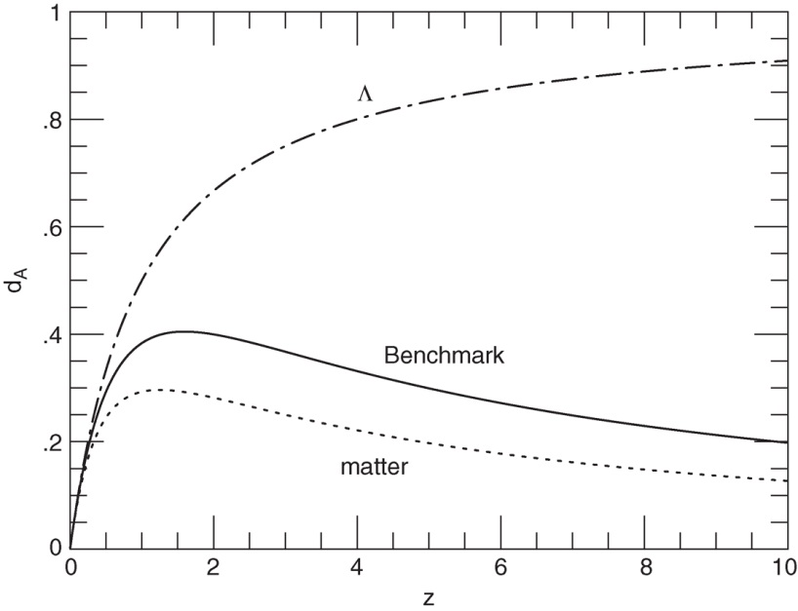
Ryden_Fig6-4
© Cambridge University Press 2016

Slide 5
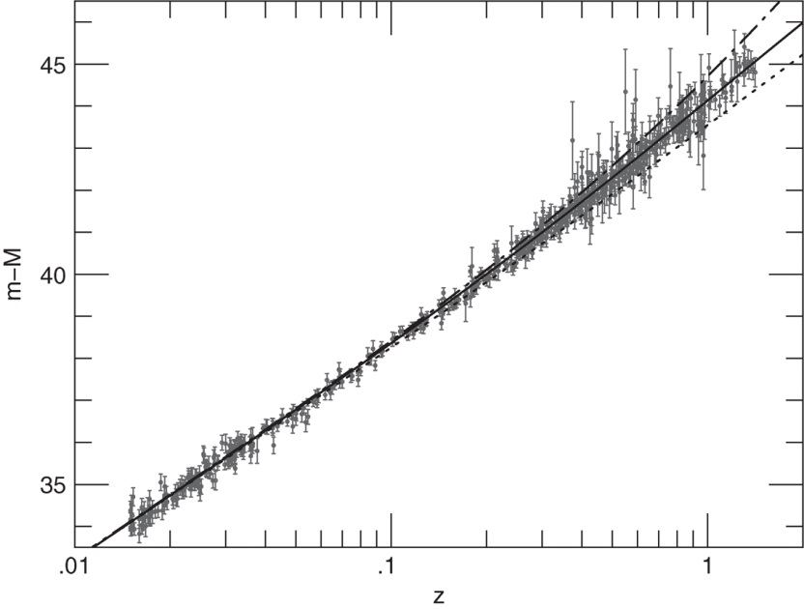
Ryden_Fig6-5
© Cambridge University Press 2016

Slide 6
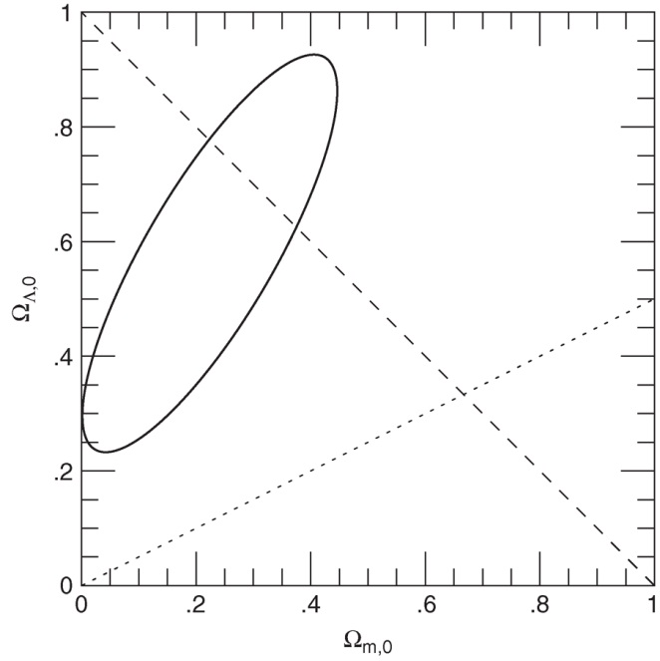
Ryden_Fig6-6
© Cambridge University Press 2016

