Slide 1
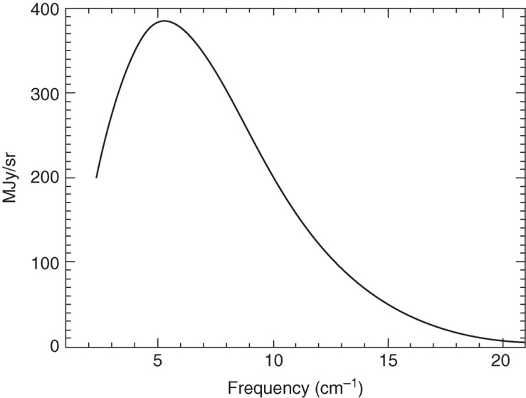
Ryden_Fig8-1
© Cambridge University Press 2016

Slide 2
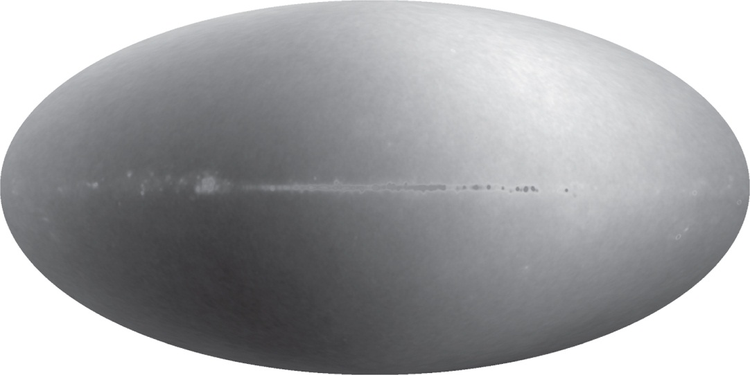
Ryden_Fig8-2
© Cambridge University Press 2016

Slide 3
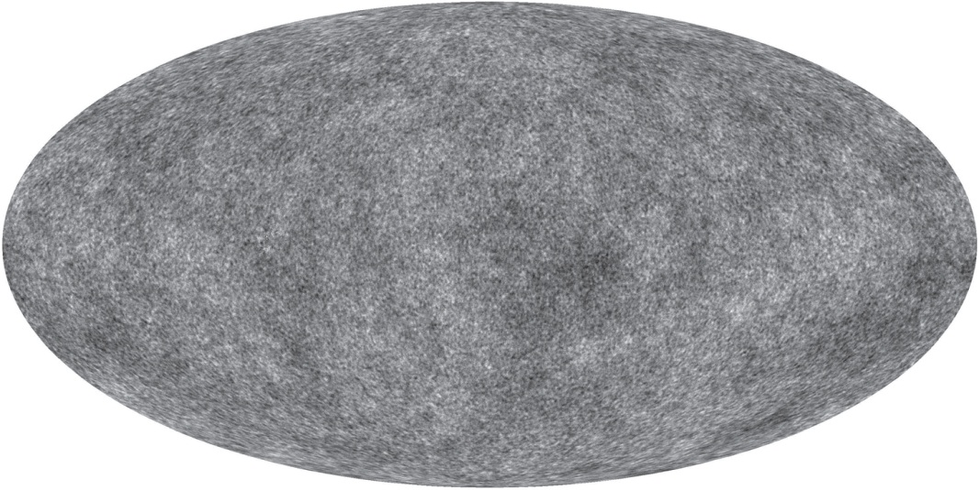
Ryden_Fig8-3
© Cambridge University Press 2016

Slide 4
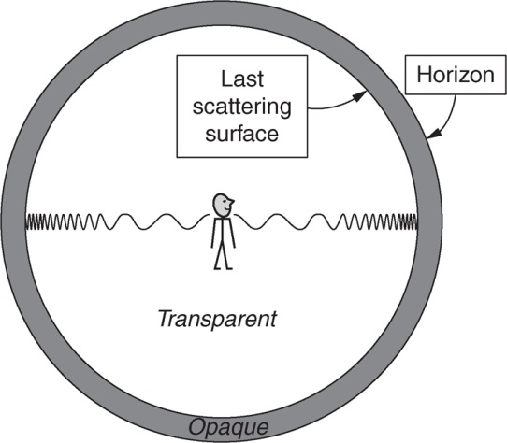
Ryden_Fig8-4
© Cambridge University Press 2016

Slide 5
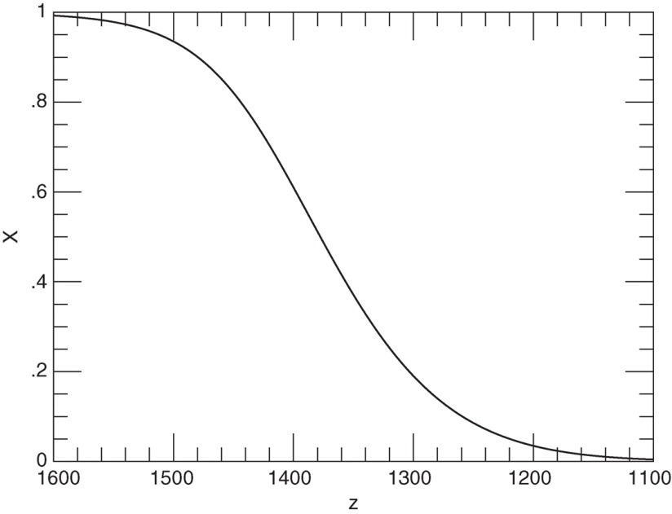
Ryden_Fig8-5
© Cambridge University Press 2016

Slide 6
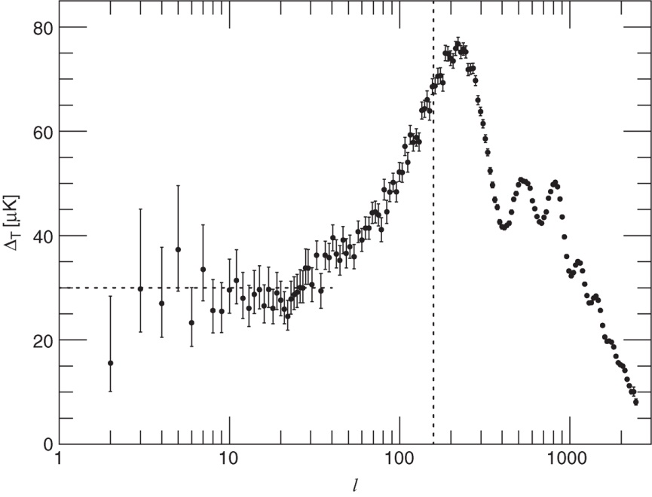
Ryden_Fig8-6
© Cambridge University Press 2016

Slide 7
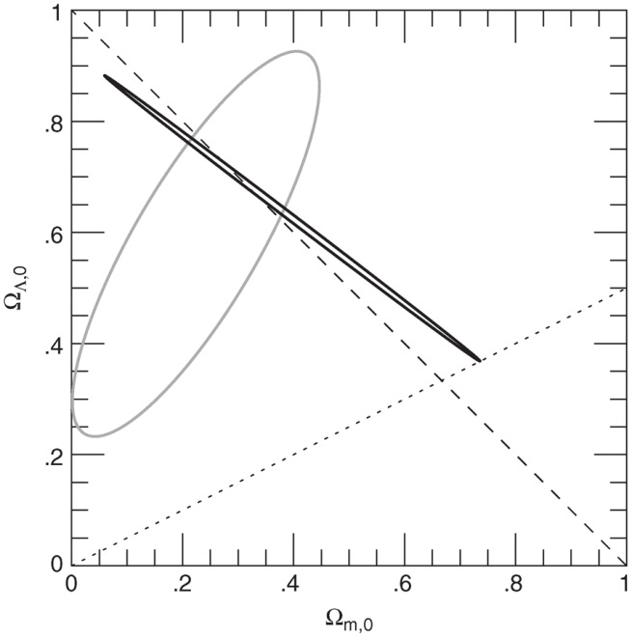
Ryden_Fig8-7
© Cambridge University Press 2016

