Slide 1
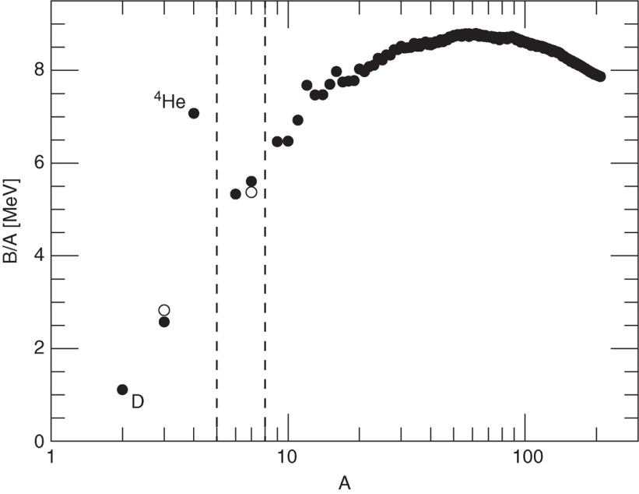
Ryden_Fig9-1
© Cambridge University Press 2016

Slide 2
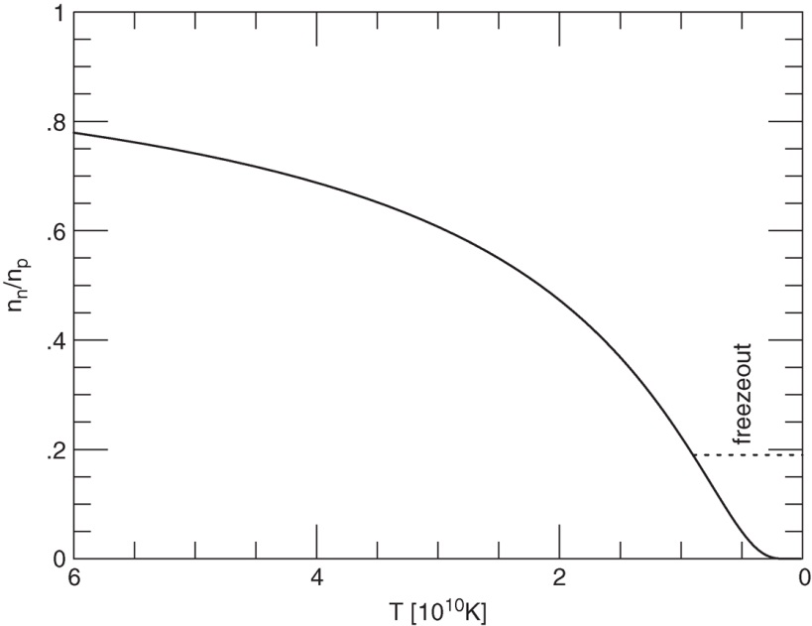
Ryden_Fig9-2
© Cambridge University Press 2016

Slide 3
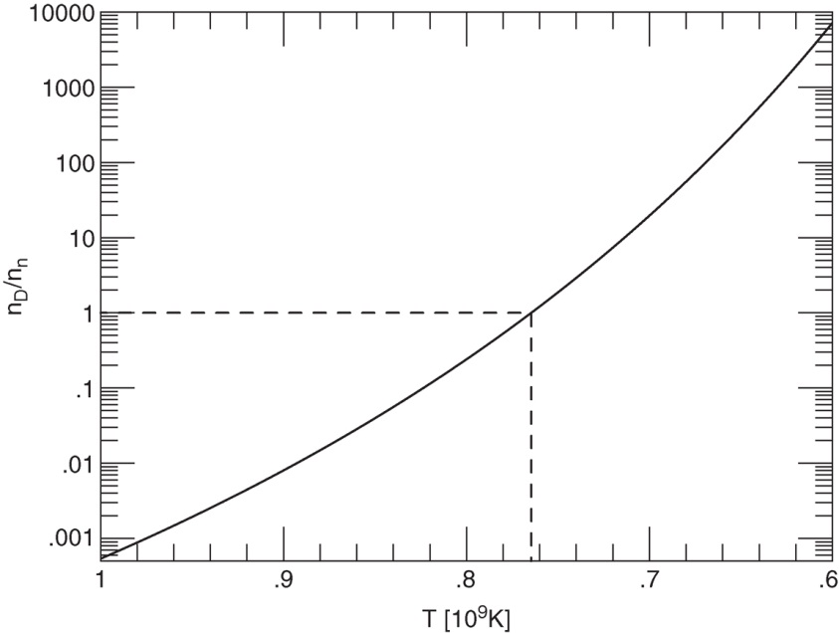
Ryden_Fig9-3
© Cambridge University Press 2016

Slide 4
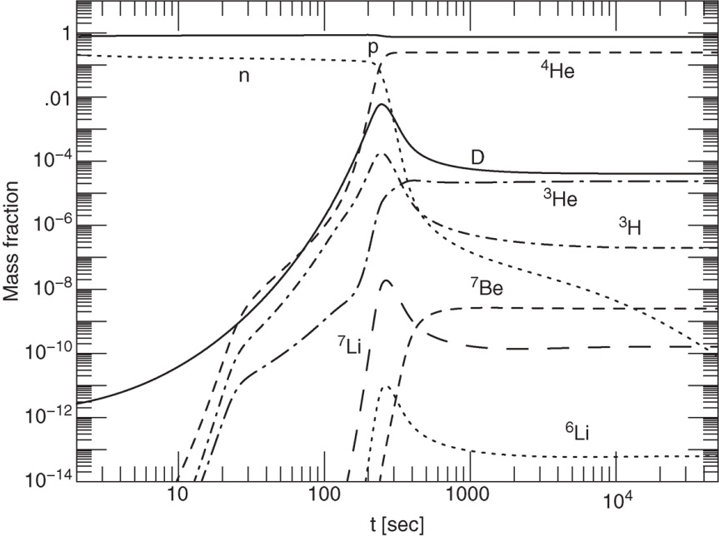
Ryden_Fig9-4
© Cambridge University Press 2016

Slide 5
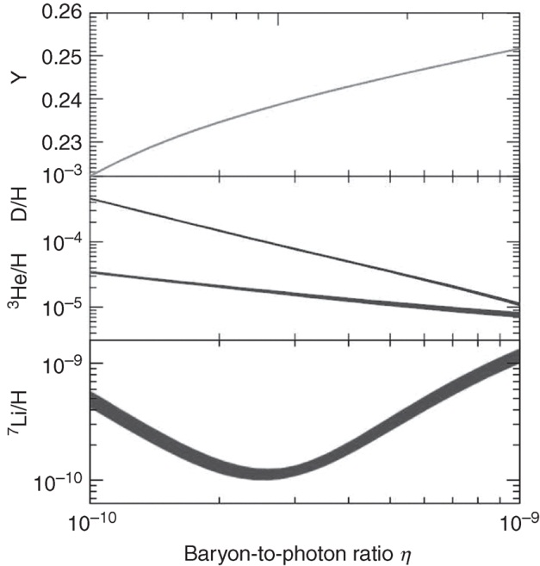
Ryden_Fig9-5
© Cambridge University Press 2016

