Slide 1
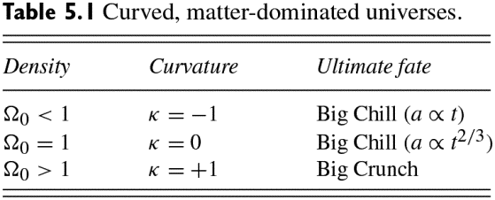
Ryden_Tab5-1
© Cambridge University Press 2016

Slide 2
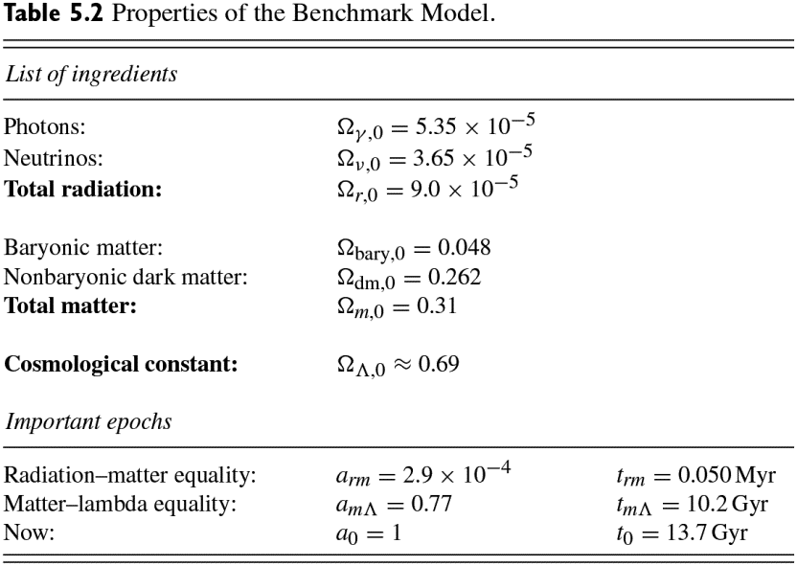
Ryden_Tab5-2
© Cambridge University Press 2016

