Slide 1
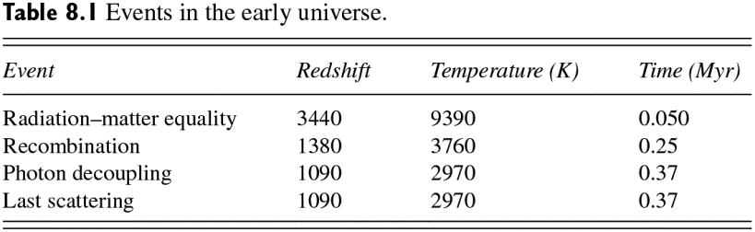
Ryden_Tab8-1
© Cambridge University Press 2016

