Slide 1
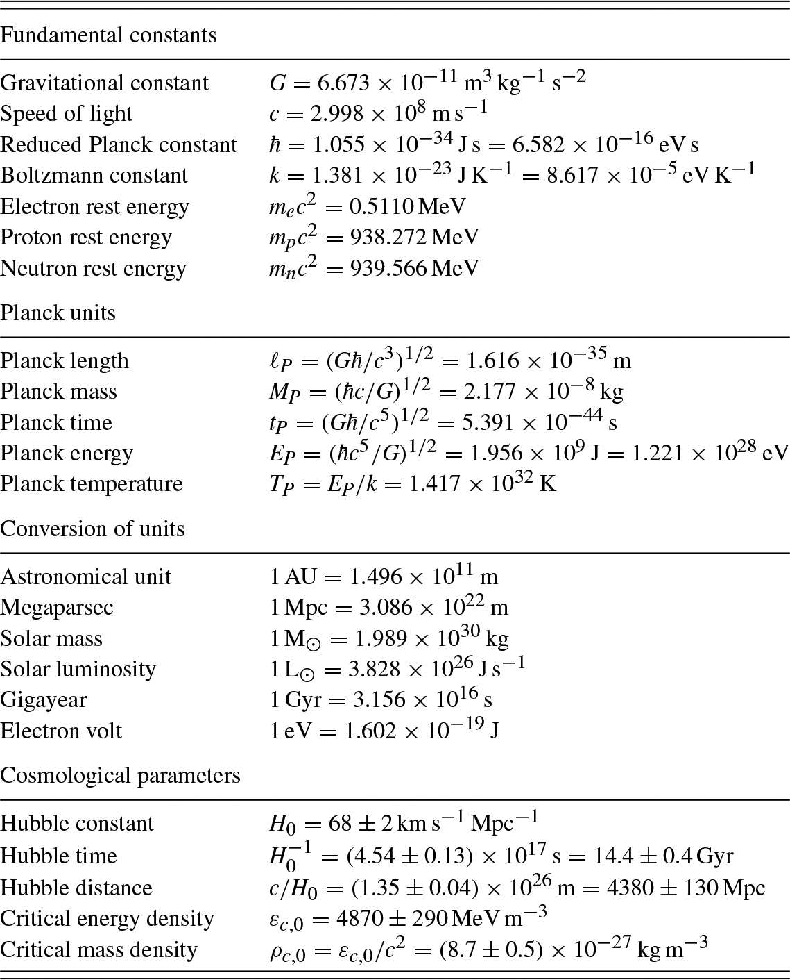
Ryden_Epilogue_UN table-1
© Cambridge University Press 2016

