Slide 1




POLICE DEPLOYMENT AT RECREATIONAL RIOTS: AN AGENT-BASED SIMULATION
Denny Diepgrond
Leon Pater
Rogier de Weert

Slide 2
New focus
Political riots
Food shortage in Venezuela
Racial issues in the US
Student protests during apartheid in South Africa
Two cases:
One party
Project X Haren
Rebellion against police
Two parties
Sports riots
Religious riots
Recreational riots
Hooliganism
Project X Haren
Violent gatherings of young people in working class areas in Belfast

Slide 3
Model
Combination of:
Agent-based model of fighting in two-party crowds
Social research on police deployment during sports riots

Slide 4
Model
Scan frequency different per agent type

Slide 5
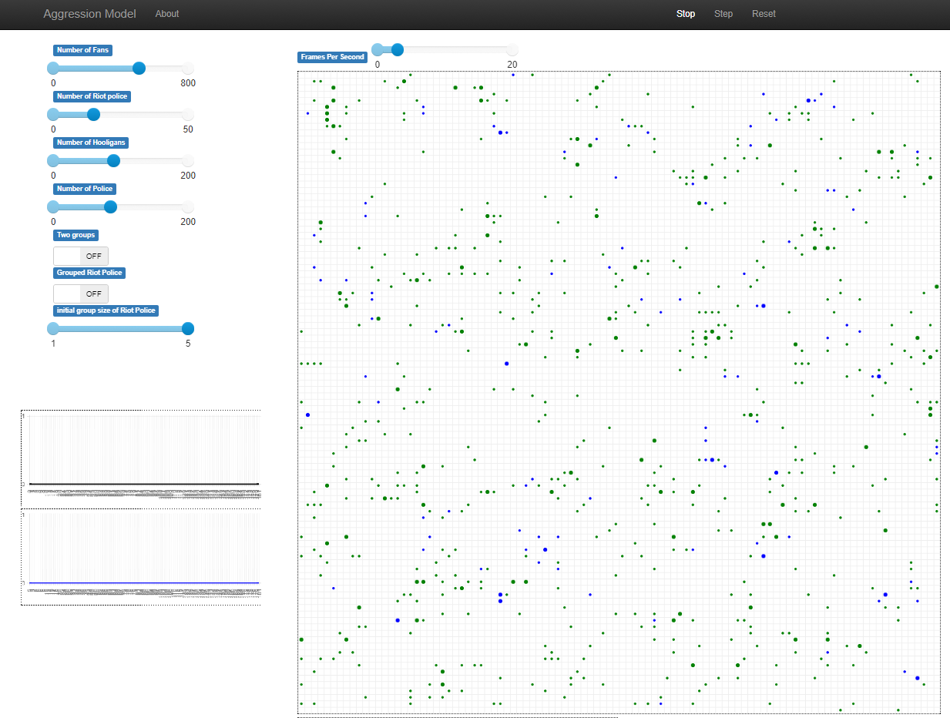
Demo

Slide 6
Experimental set-up
Two models: one party and two parties
For each model we tune the following parameters:
Total number of agents (3 dim.)
Relative ratio of police vs non-police (3 dim.)
Relative ratio of police vs riot police (3 dim.)
Relative ratio of hooligans vs fans (3 dim.)
Initial grouping size of riot agents (5 dim.)
We average 5 runs with 5400 model steps (1:30 in reality) and report number of fights, number of police interventions and mean aggression level of the agents.

Slide 7
Results (preliminary)
6 grafieken – Cases (one or two party) x Variables (interruptions, aggression, fights)
7 lijnen per grafiek (base case en per parameter een lage en een hoge setting = 1 + 3x2)

Slide 8
Discussion
Preliminary conclusions
-
-
To do
-
-
-

Slide 9

THANKS!
ANY QUESTIONS?

