Slide 1




POLICE DEPLOYMENT AT RECREATIONAL RIOTS: AN AGENT-BASED SIMULATION
Denny Diepgrond
Leon Pater
Rogier de Weert

Slide 2
New focus
Political riots
Food shortage in Venezuela
Racial issues in the US
Student protests during apartheid in South Africa
Two cases:
One party
Project X Haren
Rebellion against police
Two parties
Sports riots
Religious riots
Recreational riots
Hooliganism
Project X Haren
Violent gatherings of young people in working class areas in Belfast

Slide 3
Model
Combination of:
Agent-based model of fighting in two-party crowds
Social research on police deployment during sports riots

Slide 4
Model
Scan frequency different per agent type

Slide 5
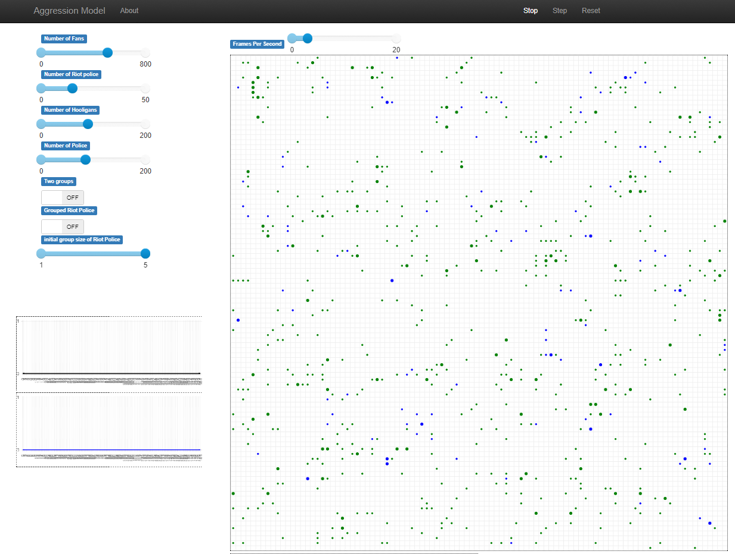
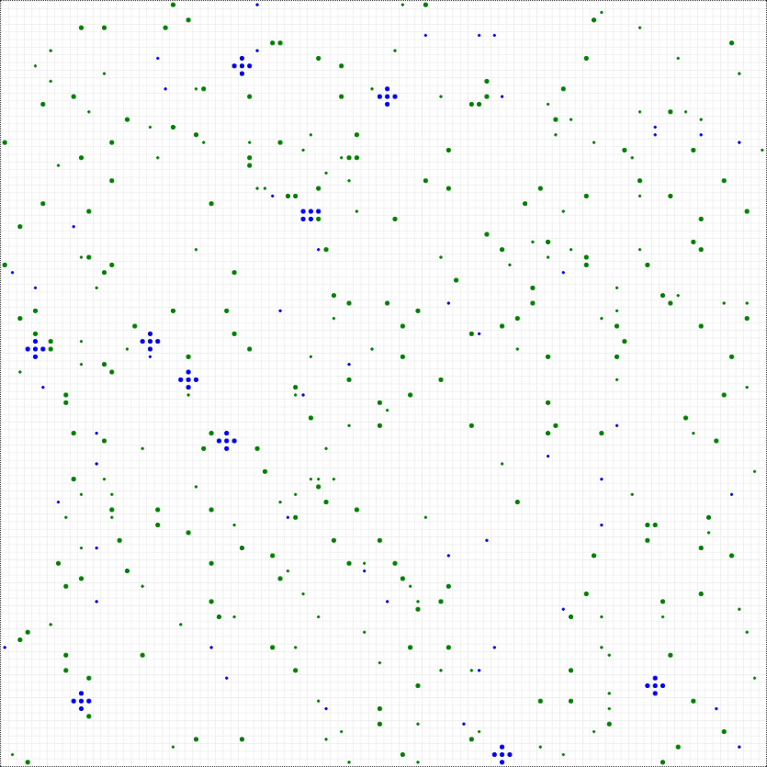
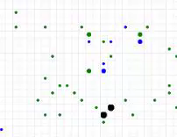
Demo

Slide 6
Experimental set-up
Two models: one party and two parties
For each model we tune the following parameters:
Total number of agents (3 lev.)
Relative ratio of police vs non-police (3 lev.)
Relative ratio of police vs riot police (3 lev.)
Relative ratio of disruptive vs regular agents (3 lev.)
Initial grouping size of riot agents (5 lev.)
We average 5 runs with 5400 model steps each (1:30h in reality) and report number of fights, number of police interventions and mean aggression level of the agents.

Slide 7
Preliminary set-up
Base case:
N regular agents 300
N disruptive agents 100
N police agents 60
N riot police agents 40
We tuned the following parameters individually (3 levels – low, base, high):
Relative ratio of police vs non-police (base=400/100, high=250/250, low=450/50)
Relative ratio of police vs riot police (base=60/40, high=50/50, low=80/20)
Relative ratio of regular vs disruptive (base=300/100, high=200/200, low=350/50)

Slide 8
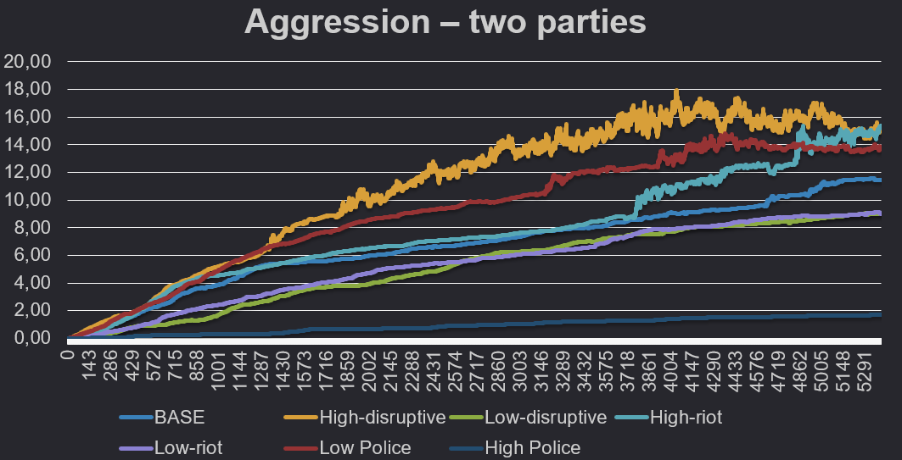
Results (preliminary)

Slide 9
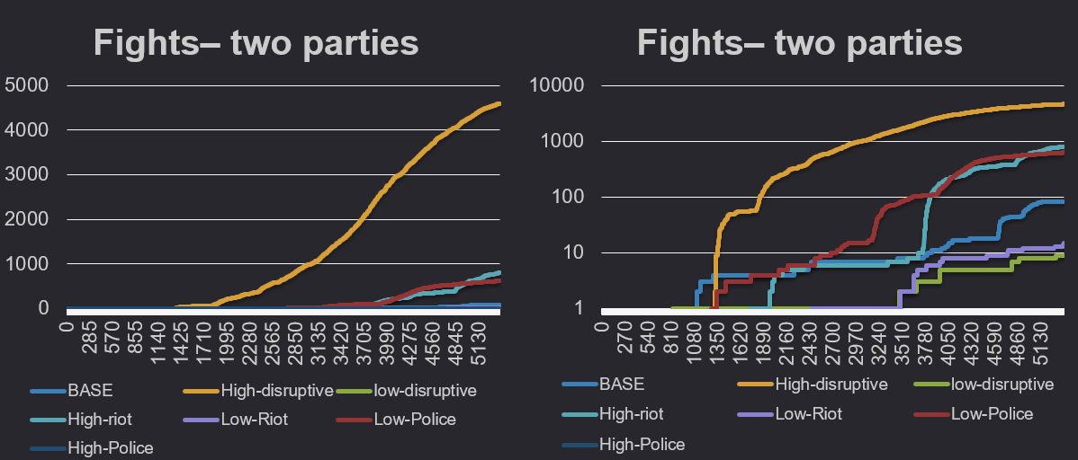
Results (preliminary)

Slide 10
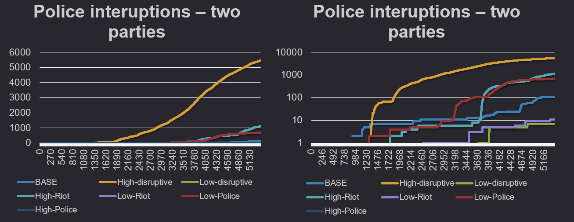
Results (preliminary)

Slide 11
Discussion
Preliminary conclusions
More disruptive agents More fights
More riot police More fights
Frequency of scanning Changes group behavior
To do
- Process results of batchrunner (see experimental set-up)
- Thorough analysis of individual parameters

Slide 12

THANKS!
ANY QUESTIONS?

