Slide 1
AIBLOCK: Blockchain based Lightweight Framework
For Serverless Computing using AI
Muhammed Golec, Deepraj Chowdhury, Shivam Jaglan, Sukhpal Singh Gill and Steve Uhlig

Slide 2
PROBLEM STATEMENT
To design a lightweight framework for IoT-based COVID-19 detection that can handle dynamic scalability and data integrity simultaneously. The framework aims to offer efficient and secure data processing and storage for IoT applications. The challenge is to ensure optimal performance by evaluating various machine learning models, serverless platforms, and blockchain solutions, all while integrating with Google Cloud Platform (GCP)-Cloud Functions.

Slide 3
MOTIVATION
Absence of a solution that could combine dynamic scalability and data integrity for IoT-based COVID-19 detection.
Leading to the development of a unique framework that incorporates serverless computing and blockchain for these dual objectives.
What is the Solution?
Dynamic Scalability can be achieved by Serverless Computing.
Data integrity can be achieved by Block chain.
Combination of these produced solution to the problem.

Slide 4
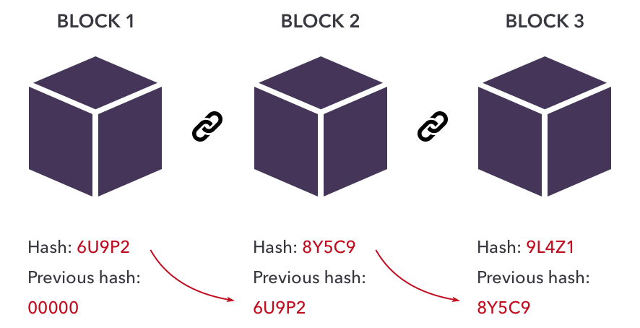
BLOCKCHAIN TECHNOLOGY
Blockchain is like a digital ledger that's not stored in one place but is spread across a network of computers making it very hard for anyone to alter the information forming super secure database.

Slide 5
BLOCKCHAIN TECHNOLOGY
Blockchain essentials
Data Blocks: Information is grouped into blocks.
Digital Signatures: Each block is securely signed.
Chaining: Blocks are linked in a chain with references to previous blocks.
Hashing: Blocks get unique codes based on their content and the previous block's code.
Immutability: If one block is changed, it affects the entire chain.
Consensus: Network agrees on the validity of new blocks.
Decentralization: No single entity controls the network.

Slide 6
BLOCKCHAIN TECHNOLOGY
MERITS
SECURITY and IMMUTABILITY
DECENTRALIZATION
TRANSPARENCY ACCURATE ML PREDICTIONS
DEMERITS
DATA PRIVACY
ENERGY CONSUMPTION
LATENCY

Slide 7
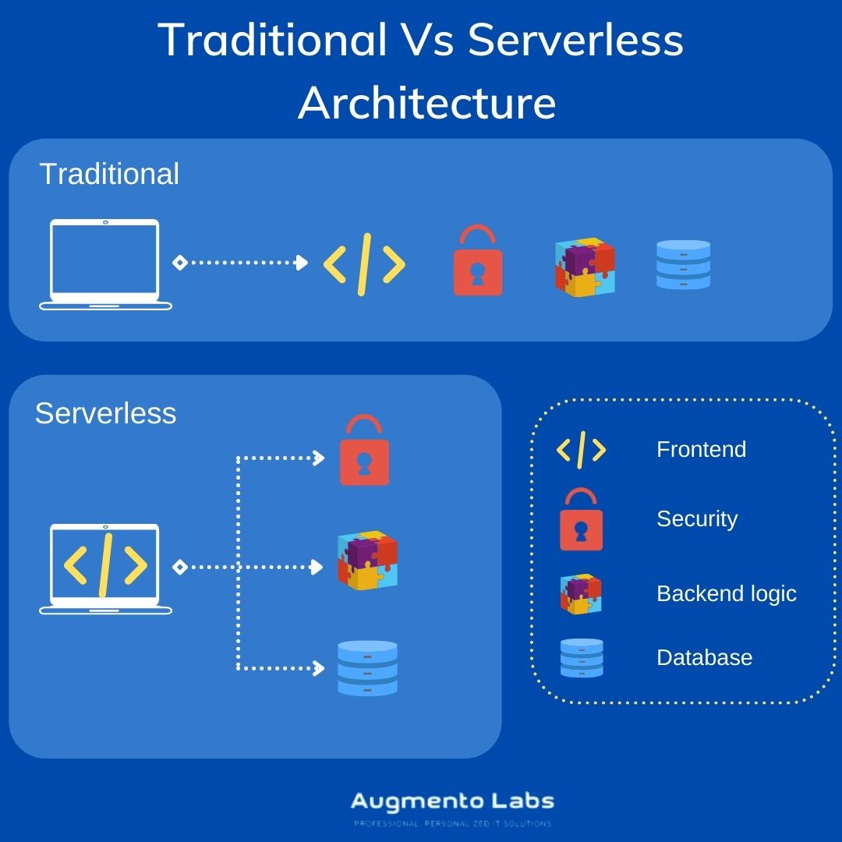
SERVERLESS COMPUTING
A cloud computing model that automatically manages and scales resources, allowing users to run applications and functions without the need to provision or manage servers.

Slide 8
SERVERLESS COMPUTING
ADVANTAGES
DISADVANTAGES
On-Demand Computing
Dynamic Scaling
Pay-as-You-Go
No Server Management
Cold Start Latency
Resource Limits
Vendor Lock-In
Security Concerns

Slide 9
AIBLOCK
AIBLOCK is a framework which combines Machine Learning, Serverless Computing, and Blockchain Technology
Serverless Computing To handle the growing number of users without issues
Machine Learning Suitable ML model that predicts result accurately
Blockchain Technology To ensure security and integrity of data
It's designed to be efficient and adaptable for various applications, like healthcare and online banking, while also using serverless computing for scalability.

Slide 10
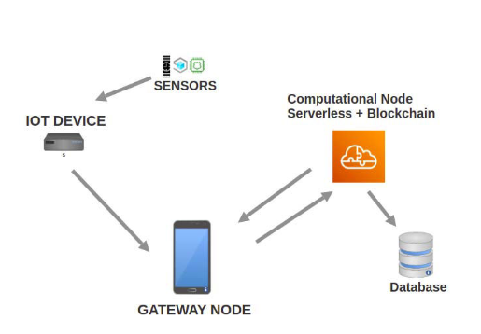
AIBLOCK
Working of AIBLOCK in COVID19 detection :

Slide 11
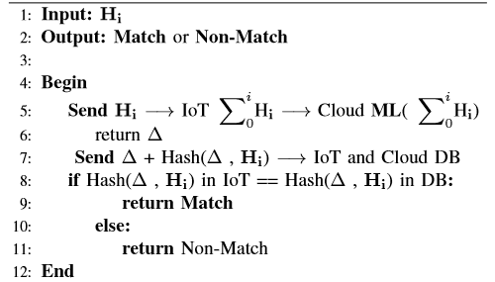
AIBLOCK
Working of AIBLOCK in COVID19 detection :
APPLICATION TO AIBLOCK (COVID19 DETECTION):
In the context of COVID-19, IoT and machine learning to precisely detect COVID from patient data, secures patient data with blockchain, and optimize resources with serverless computing thus AIBLOCK ensured an effective and secure solution for managing patient data during the pandemic.

Slide 12
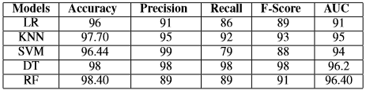
AIBLOCK
Performance evaluation of AIBLOCK in detecting COVID19:
1. Performance of ML model :
After testing collected data with different ML models Random Forest predicted the results with more accuracy.
Hence RF is deployed on GCP to detect COVID19 through the AIBLOCK framework.

Slide 13
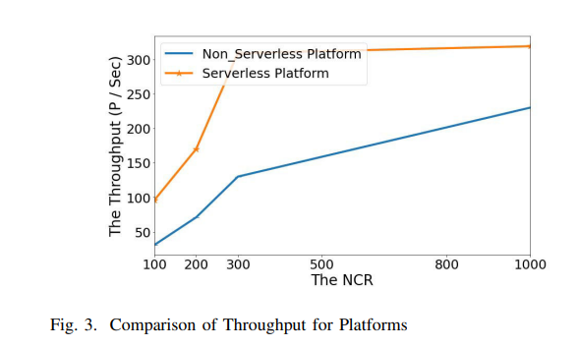
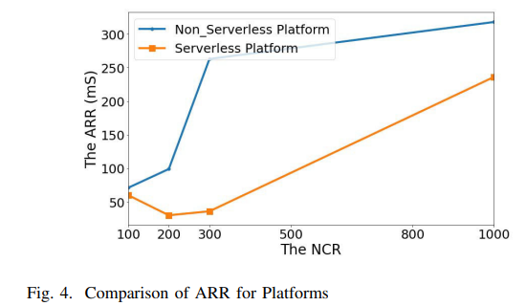
AIBLOCK
2. Server performance :
A server with high processing power, throughput, and low cold start latency shows better performance.
A server that responds quickly to more concurrent requests is the best to prefer

Slide 14
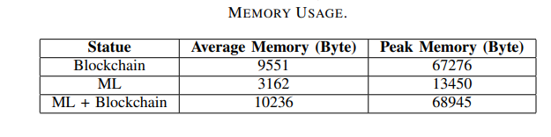
AIBLOCK
3. Performance of Blockchain :
Blockchain guarantees security, integrity, and unchangeable records.
However, it's crucial to plan for memory requirements when creating systems with this technology.

Slide 15
CRITIQUE :
Despite the advantages of scalable resources, security, accuracy, and integrity offered by AIBLOCK, it does come with challenges such as cold start latency and memory requirements.
However, even with these drawbacks, AIBLOCK remains a leading framework in healthcare, finance, and research fields due to its overall effectiveness and reliability.

Slide 16
FUTURE WORKS
Exploring more compute-intensive ML models like Long short-term memory (LSTM) and transfer learning models
Framework could be extended to develop a mobile application for automated data collection from wearable sensors.
Applied to diagnose other diseases such as diabetes, heart disease, or cancer, and can be utilized in various IoT applications like agriculture, traffic management, weather forecasting, or smart cities.
Improvements in reducing cold start latency, inherent to serverless computing, can enhance the performance of this framework for time-sensitive IoT applications.

