Slide 1
AIBLOCK
Blockchain based Lightweight Framework for Serverless Computing using AI
Initially downloaded Covid dataset from Kaggle.
Implemented a ML model Random Forest classifier which predicts the Covid status from the given a patient’s data.
Created a database for storing the patients data and result using blockchain technology in an online database Firebase
Calculating hash values (previous hash, current hash) using a hashlib library in python
https://ieeexplore.ieee.org/document/9826025

Slide 2
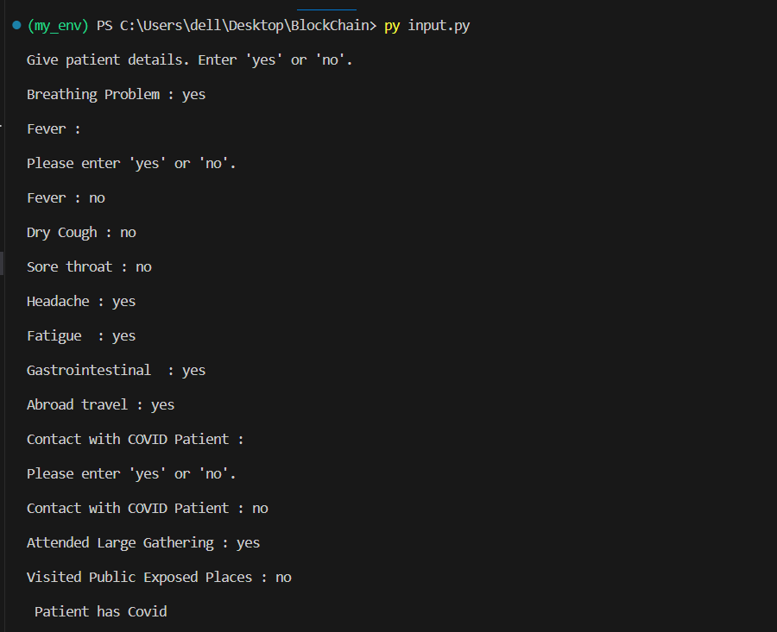
Input:
We collect details of 11 features from the user.
Then we predict the covid status of the patient with pre-trained ml model
After this the patients Data stored in current block of the blockchain which recalculates the new current hash of the block.

Slide 3
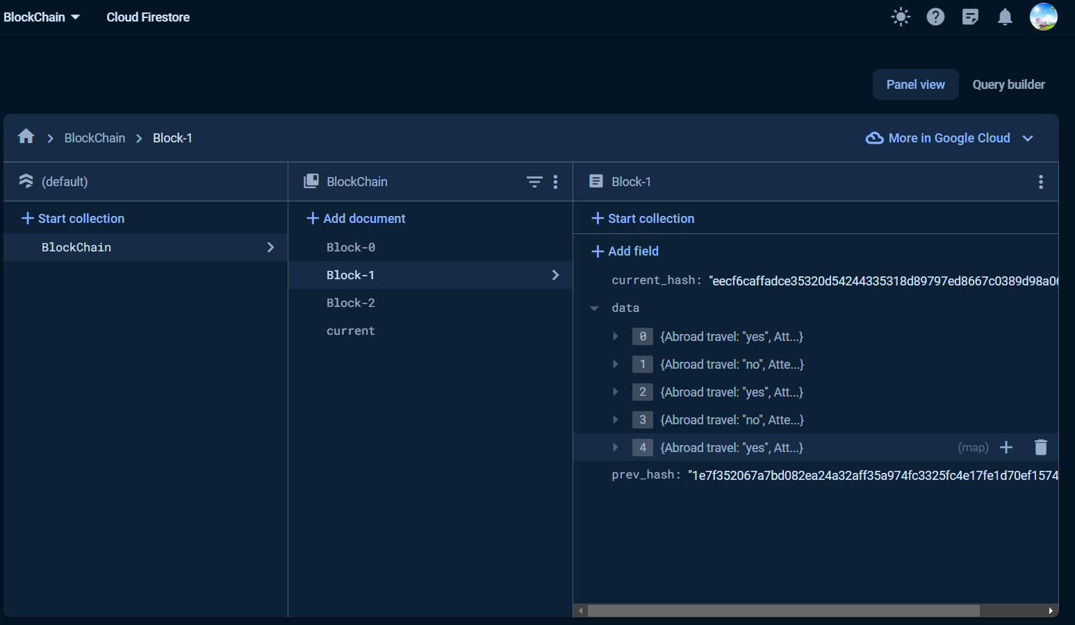
FIREBASE Database
Block -0 indicates the genesis block
Each block contains current_hash, Data(has data of 5 patient's) and prev_hash(indicates the hash value of previous block).

Slide 4
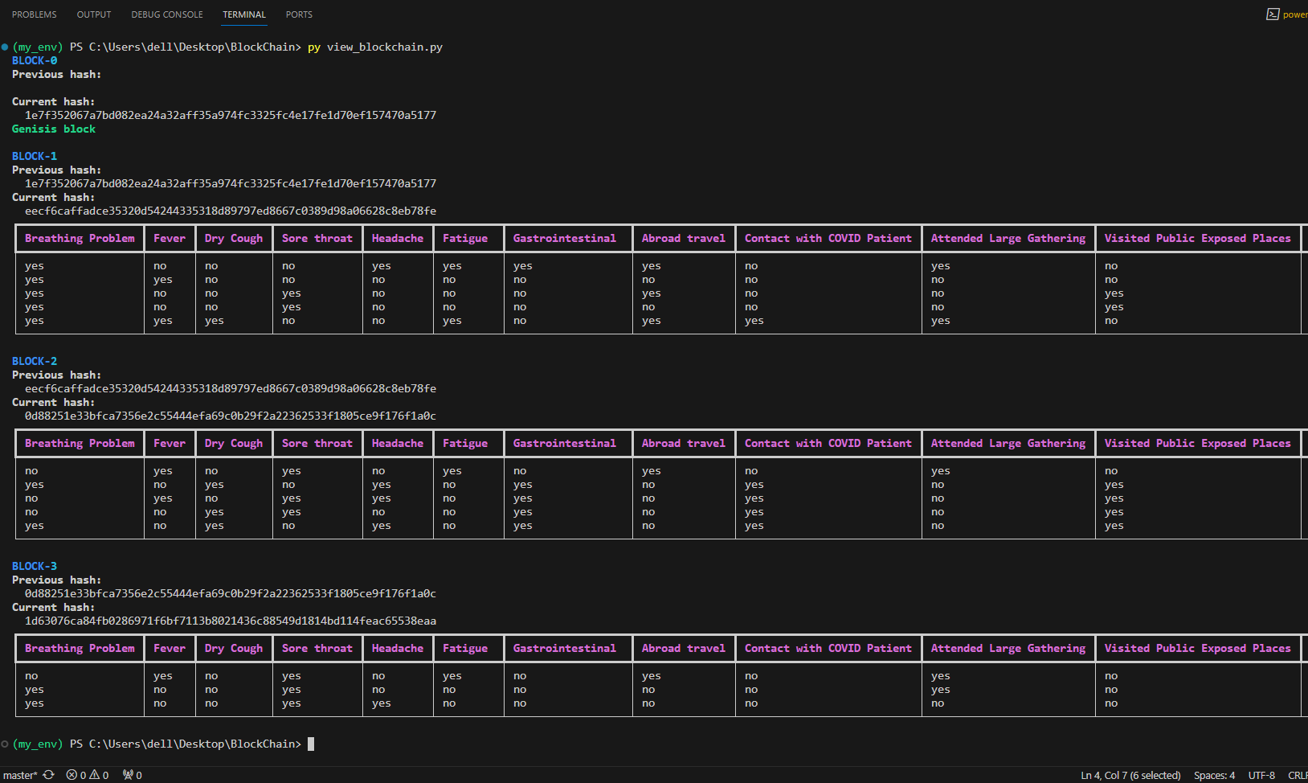

Slide 5
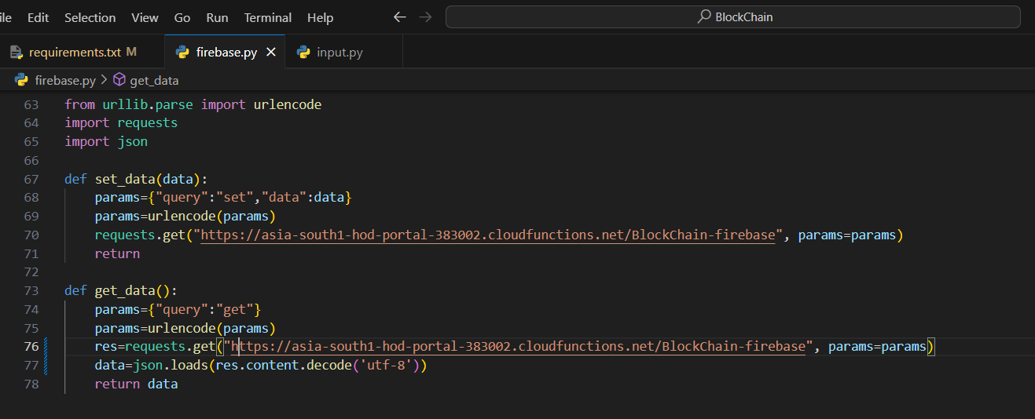
Serverless functions:
Set_data :- Data to keep in database
Get_data :- Data to retrieve from database
These two functions are deployed in serverless platform (GCP)

Slide 6
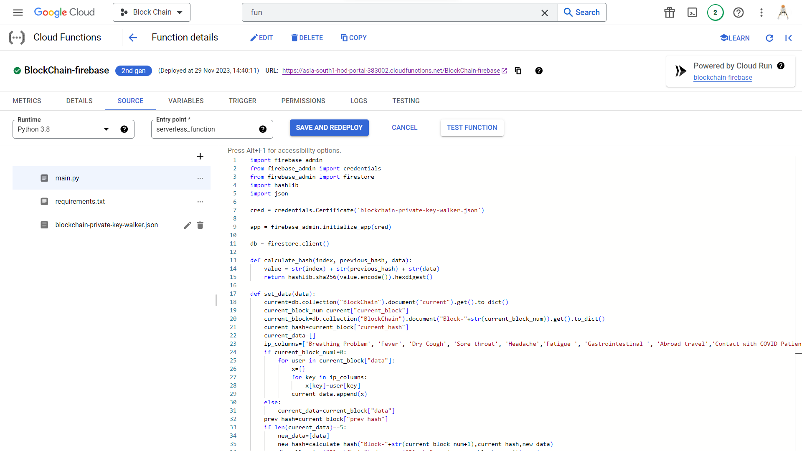

Slide 7
Results:
The covid-19 prediction result using random forest model is nearly 98% accurate
Stored users data in blockchain
Used Serverless get_data and set_data function to keep and retrieve data from blockchain
By using check_blockchain function we can check whether the data in the database is changed or not.
When we call view_blockchain.py it prints the details of the blockchain in the console and it stores in a text-file.

