Slide 1

GESTURE VOLUME CONTROL
Presented By
Lokam Teja Ram – B200793CS
E Krishna Prasad – B200803CS
Abhina Sunny – B200692CS
P Gnana Prakash – B200840CS
Anagha M V – B200762CS

Slide 2
Contents
Problem Statement
Literature Review
Tools and Techniques
Methodology
Evaluation and Results

Slide 3
Problem Statement :
Our project introduces a way to control volume using hand gestures, making technology more intuitive and interactive.
Hand gestures are the most effortless and natural way of communication.
Instead of using the more expensive sensors , a simple web camera can identify the gesture and perform the action
This innovation provides users with a user-friendly, hands-free approach to managing audio volume.

Slide 4
Literature Review
Paper 1:
This study showcases the use of an Artificial Neural Network (ANN) for gesture recognition using an accelerometer, specifically the Wii remote which registers movement along its X, Y, and Z axes.
Paper2:
In this research paper the author discussed a novel method of hands gestures recognition based on the identification of certain shape-based elements. A single camera is used to record the user's gesture and feed it into the system.

Slide 5
Literature Survey :
Paper 3:
In this study the volume control is done using hand gestures and incorporates the use of OpenCV. By utilizing a computer's webcam, the module captures images or videos, processes them to extract relevant data, and adjusts the volume based on recognized gestures.

Slide 6
Tools and Techniques :
OpenCV (cv2): OpenCV (Open Source Computer Vision Library) is a popular library used for computer vision tasks such as image and video manipulation and object detection.
Mediapipe: It is a framework developed by Google that provides tools for building machine learning pipelines for various perception tasks, including body pose estimation, hand tracking, facial recognition.
Pyautogui: PyAutoGUI is a Python library for automating keyboard and mouse interactions.
Image Processing: Techniques such as converting the color space of the image from BGR to RGB and extracting hand landmarks coordinates from the detected hand landmarks are used for processing the webcam frames.

Slide 7
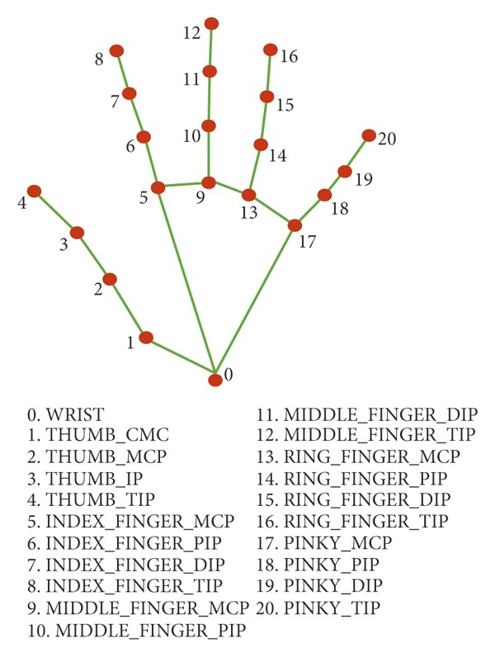
METHODOLOGY
Capture video using OpenCV.
Detect Hands and Hand Tips using Mediapipe.
Identification of tips of the index and thumb finger
Calculate the distance between the fingers
Set volume level accordingly

Slide 8
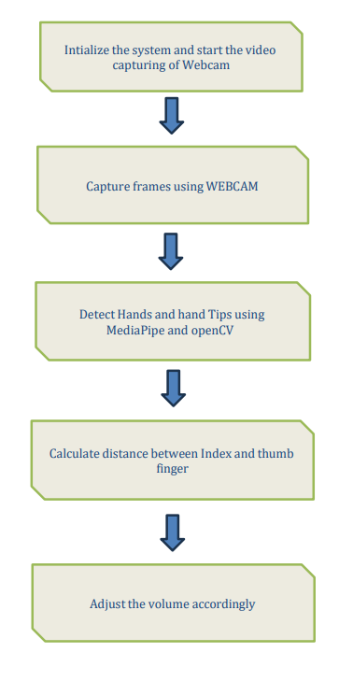
Flow chart

Slide 9
Evaluation :
This project is being evaluated by calculating the distance between the index and thumb finger.
If the Hand detected is right then, distance between index and thumb finger is calculated , if the distance is less than 30 then our code keeps on pressing volume down button and if distance is greater than 30 then our code keeps on pressing volume up button
If the Hand detected is left then, distance between index and thumb finger is calculated and brightness of device is set to that value using SBC(screen_brightness_control ).

Slide 10
Demo

Slide 11
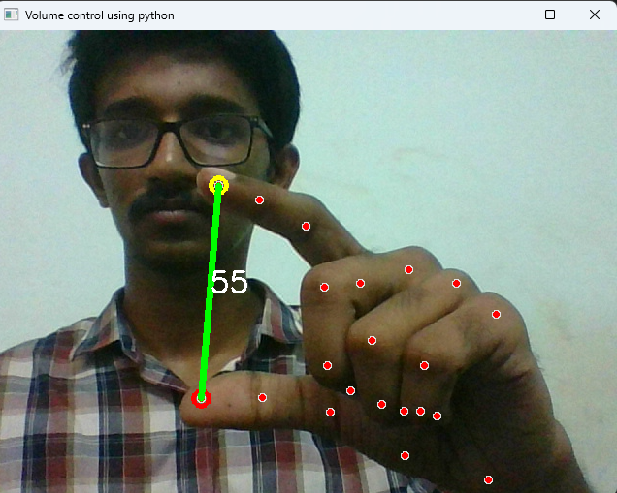
RESULTS
Hand Detected is right and distance is greater than 30 so volume increases.

Slide 12
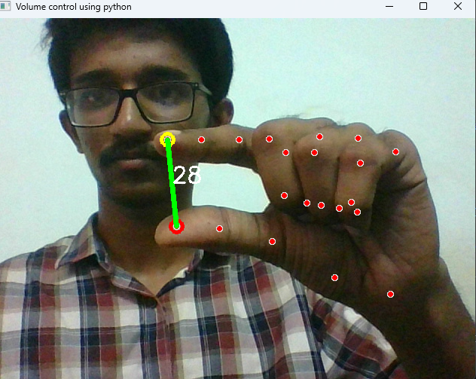
RESULTS
Hand Detected is Right and distance is less than 30 so volume decreases.

Slide 13
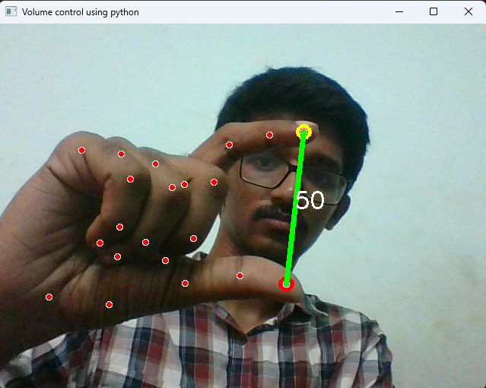
Results
Hand Detected is left and distance is 50 so brightness of device will be set to 50.

Slide 14
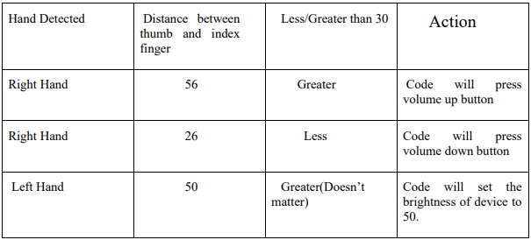
Results

Slide 15
REFERENCES
[1] Gesture volume control using opencv, IRJMETS, 2022 https://www.irjmets.com/uploadedfiles/paper//issue_6_june_2022/27042/final/fin_irjmets1656354635.pd
[2] H.A JALAB "Static hand Gesture recognition for human computer interaction”, 1-72012. JC.MANRESARVARONAR. MASF.
https://developers.google.com/mediapipe
https://opencv.org/
pycaw

Slide 16
THANK YOU

