Slide 1
Rare Event Classification
GROUP 4
Team Members:-
Ans Baby
Jithin G P
T V Nithin
Anagha M V
Abhinave M S
Navaneeth Shanavasan
Mohammed Shaheem C

Slide 2
Problem Summary
The task involves building a classification model to predict paper breaks in a pulp-and-paper manufacturing process using a dataset containing sensor readings and event labels. The dataset is a multivariate time series with anonymized features (x1 to x61) and a target label (y) indicating the occurrence of paper breaks. The training data is provided up to May 21, 1999, and the goal is to achieve high precision and recall metrics on the test data. The approach involves normal classification prediction for accurate paper break prediction based on current sensor readings, alongside early classification prediction to identify patterns preceding paper breaks, enabling proactive interventions and process optimization.

Slide 3
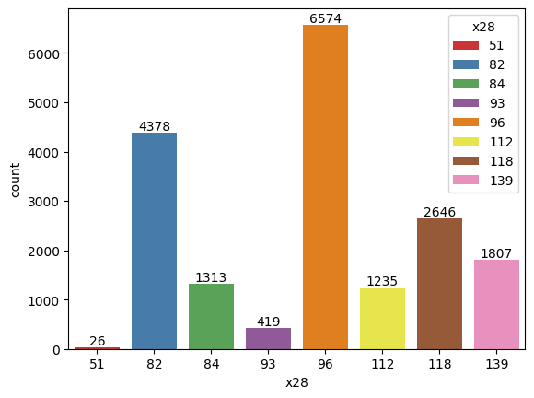
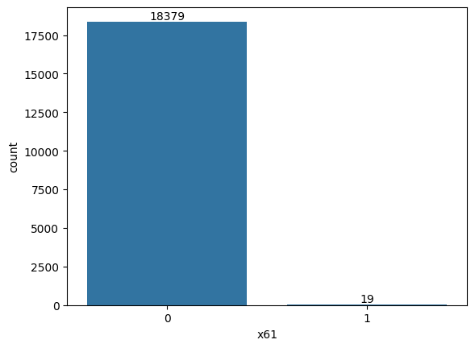
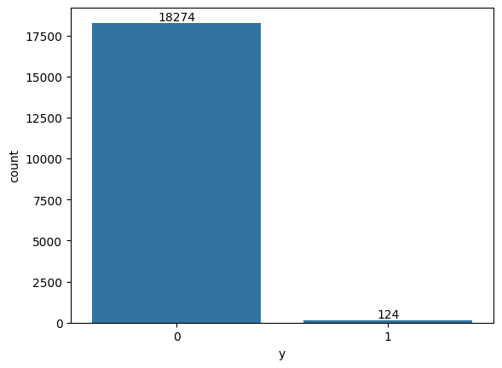
Exploratory Data Analysis

Slide 4
Procedure
01
02
03
04
Feature engineering
Model selection
Explore feature importance, select relevant features, and possibly create new features.
Experiment with various classification algorithms.
Model training
Model evaluation
Train the selected model using the training data.
Evaluate the model's performance using precision and recall metrics on the test dataset.

Slide 5
Feature Engineering
1. Principle Component Analysis
Our intention is to conduct Principle Component Analysis (PCA) on the initial dataset with the aim of reducing its dimensions, while ensuring the retention of 95% of the variance observed in the original dataset.
2. Correlation Analysis
A correlation analysis was performed on all features to assess their relationships with each other. A heatmap visualization was generated to represent the correlations visually. Features showing strong correlations were targeted for potential elimination from the dataset.

Slide 6
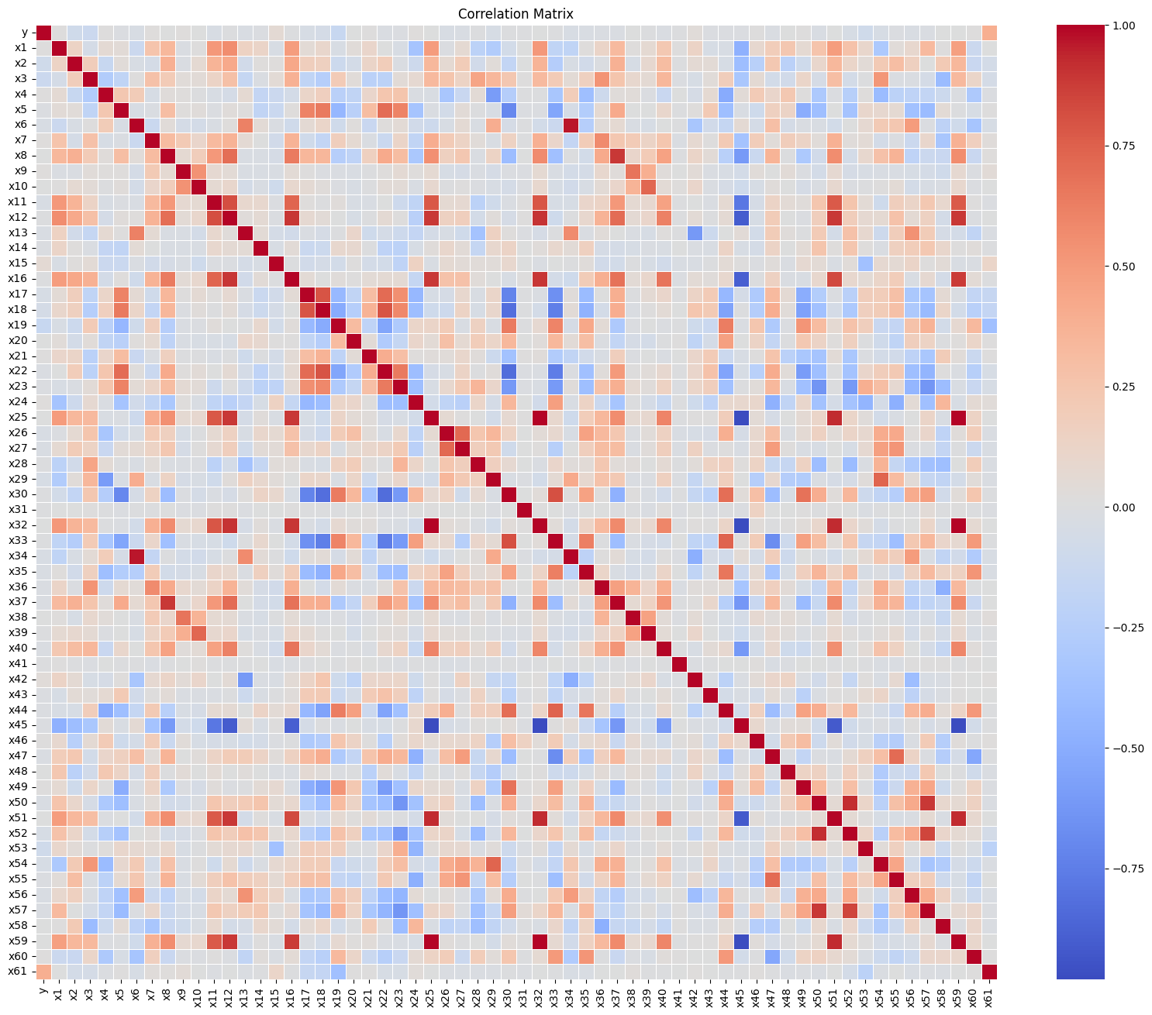
Correlation Analysis

Slide 7
Model Selection
Several models were evaluated, and those that demonstrated favorable results were chosen for further consideration. The selected models include :-
Support Vector Machine
Random Forest
Decision Tree with AdaBoost
In the absence of early detection, most models achieved decent F1 scores. However, when early detection was incorporated, results were less promising, notably with AdaBoost and Random Forest failing to accurately predict any instances labeled as y=1. Conversely, the Support Vector Classifier demonstrated relatively positive outcomes with improved F1 scores.

Slide 8
Thanks!

