Slide 1


Slide 2

WHERE ARE THE MISSING IMAGES?
Rogelio Gracia Otalvaro
Jessica Christa Wira Hadipoernomo
Embry-Riddle Aeronautical University

Slide 3
Preview
2. Approach to each Subproblem
4. Results and Discussion
1
2
3
4
1. Problem Statement
3. Methodology

Slide 4
Problem Statement
1
2
3
4
1
2
3
4

Slide 5
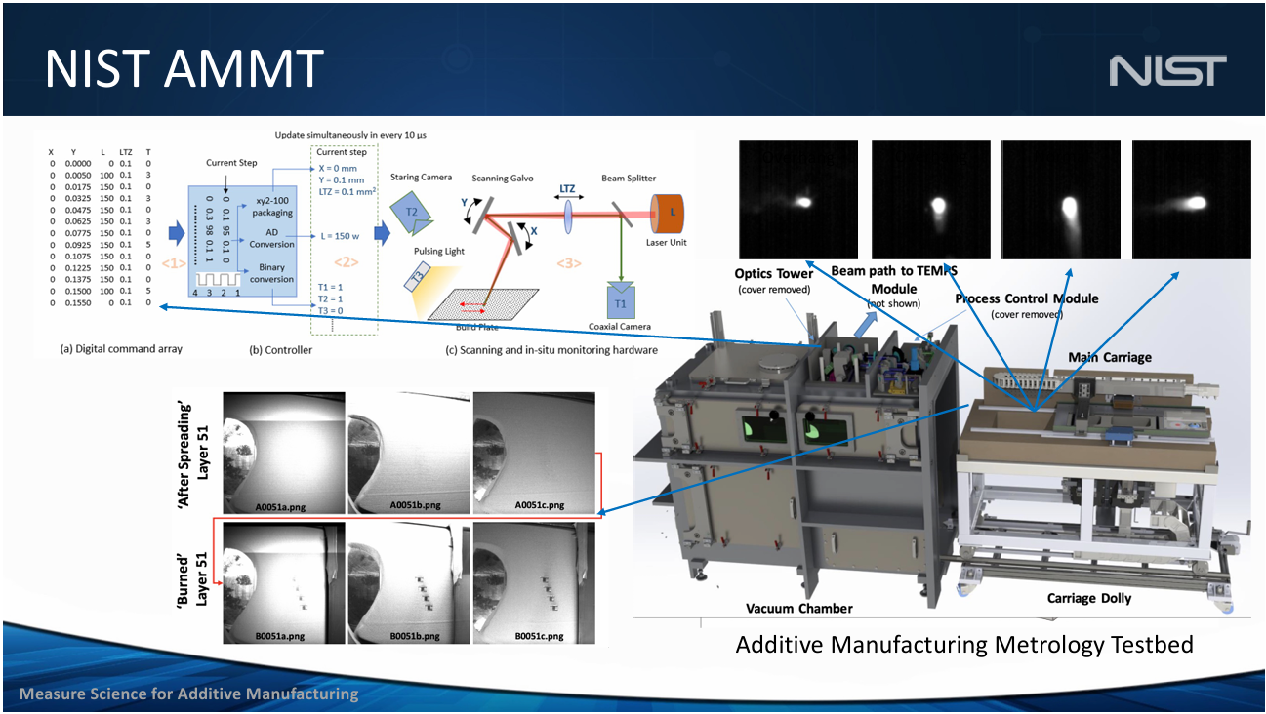
NIST AMMT Control System loses frames over time
Subproblem 1:
• 4581 captured images in part1_given
• 65 missing images in part1_missing
Subproblem 2:
• 2454 captured images in part2_given
1
2
3
4

Slide 6
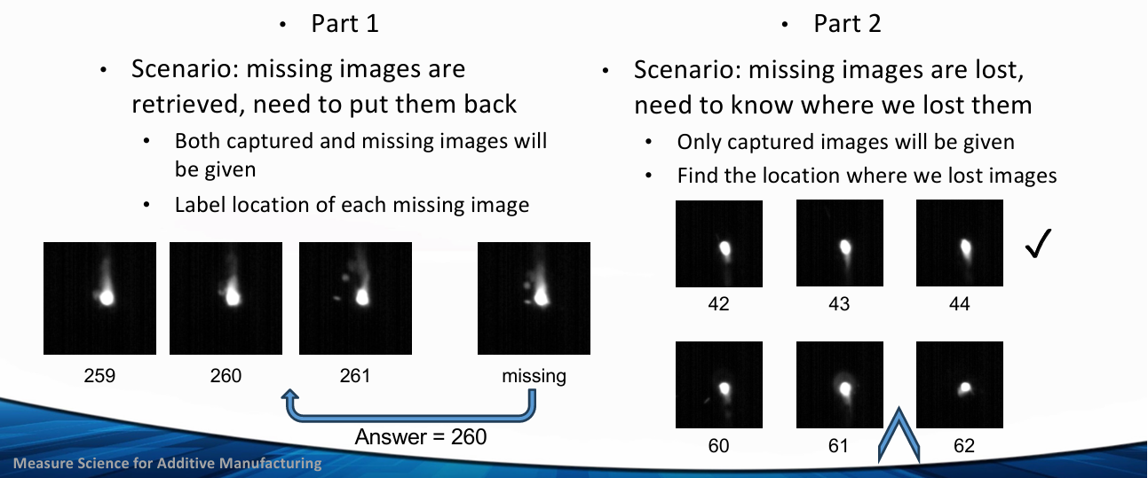
Two different problems to solve: placing images and finding gaps
We know:
No consecutive missing images
Laser power is constant 195W both parts
Part 1 – scan speed is changing
Part 2 – scan speed is constant

Slide 7
Approach to each Subproblem
1
2
3
4

Slide 8
We are looking for reliability
Speed
Accuracy
Robustness

Slide 9
Avoiding complex model training to increase reliability
Speed: The more complex the method, the slower it takes
Accuracy: Even a 99% accuracy will miss 10 frames each 1000 frames… not to much better than the actual problem
Robustness: There is a risk of overfitting

Slide 10
Achieving reliability by combining fast, simpler methods
Speed: Simpler methods take lower times to run
Accuracy: Simpler methods might present different results, so a result selection process will be required to dismiss the most unlikely results
Robustness: Using different techniques will provide a more flexible approach that can still be valid if the conditions of the testbed change

Slide 11
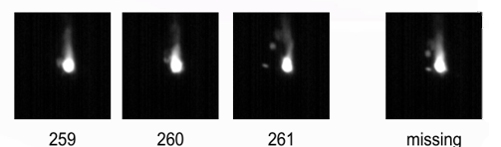
Subproblem 1: Finding the most similar frame to each missing frame
Different speeds might produce more details in the frames
More images to work with than Subproblem 1
Once a matching frame is found for each missing frame, does it go before it or after?

Slide 12
Subproblem 1: Finding the most similar frame to each missing frame
Different speeds might produce more details in the frames
More images to work with than Subproblem 1
Once a matching frame is found for each missing frame, does it go before it or after?

Slide 13
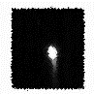
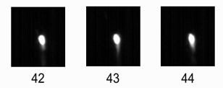
Subproblem 2: Interpolation to find the most unlikely frames to discover gaps
VS

Slide 14
Methodology
1
2
3
4

Slide 15
Simple, Fast methods achieve results in minutes… if not just seconds
Methods Used:
Structural Similarity Index (SSIM)
Mean Squared Error (MSE)
Pixel-by-Pixel Comparison
Edge Detectors: Scharr, Prewitt
Optical Flow
Local Binary Patterns (LBP)
Wavelet Transformation

Slide 16
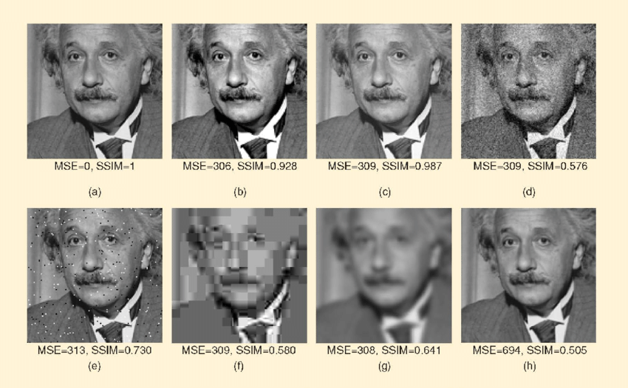
As an example, SSIM and MSE focus on pixel-level similarity and overall image quality

Slide 17
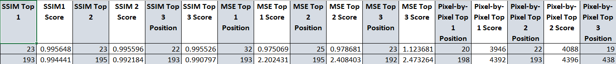
Subproblem 1: Each method will output its 3 best results for each missing frame, to have more matching between results and the final one will be the median of all

Slide 18
Subproblem 2: Each method will output its 75 best results for gap, to have more matching between results and the final one will a normalized score

Slide 19
Results and Discussion
1
2
3
4

Slide 20
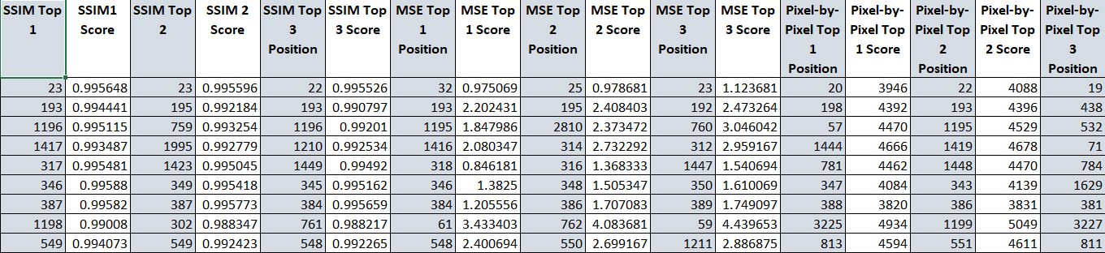
Subproblem 1: Most simple methods were pointing in the same direction, with some clear outliers

Slide 21
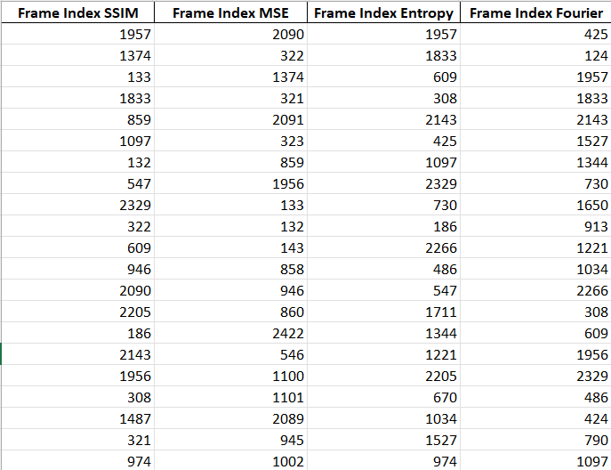
Subproblem 2: Median or modal approaches did not work as the 75 selected results for each method were not always the same

Slide 22
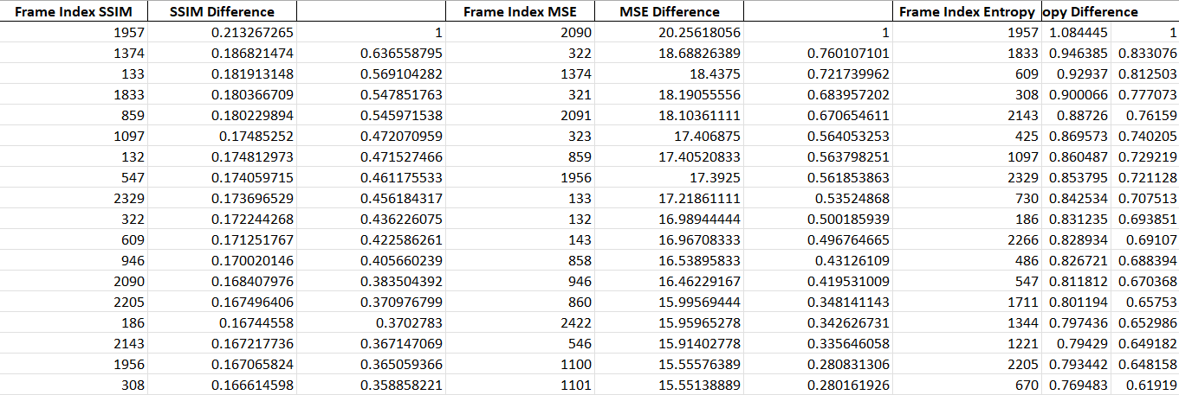
Subproblem 2: Using the score of each result to predict the best 50

Slide 23

Thank you. Any Questions?

Slide 24
Figure 2.5: Comparison of SSIM and MSE performances for "Einstein image. . . (n.d.). ResearchGate. https://www.researchgate.net/figure/Comparison-of-SSIM-and-MSE-performances-for-Einstein-image-altered-with-different_fig5_283461887

