Slide 1
CPE201 Digital Design
By Benjamin Haas
Class 1: Syllabus and Introduction

Slide 2
Syllabus
Available in Canvas
Email: bdhaas@unr.edu
Office hours: T 2:30-4:30pm (by Zoom)
How I Teach
With examples
Fast, even though I try to go slow
With bad handwriting, ask for clarifications

Slide 3
Syllabus
Two lectures per week
Theory
Examples
One lab per week
Hands-on

Slide 4
Syllabus
During the Semester
Come to class, please
Participate
Take Notes
Ask questions (if you are too shy send an email or come to office hours)
How You Take Tests
During class time
On paper
Limited materials

Slide 5

Syllabus
Book: Digital Fundamentals 11th Ed by Floyd

Slide 6
Syllabus
Grading
Homework (20%)
Midterms (15% each)
Final (20%)
Labs (25%)
Instructor Meeting (5%)
Use +/- grading

Slide 7
Syllabus
Homework
10-ish Assignments
Will force you to think, so it will cover ideas that are more complex than the examples from class
Homework is due at the beginning of class, homework turned in after the start of class is considered late. Late homework gets 50% of its normal graded value and is accepted up to 24 hours after the due date.
It has to be a pdf
Put your name and homework number on it
Clearly mark the problem and answer all questions completely. Put a box around the final solution. Show your work.
Attach any computer work for a problem directly behind the other work for the problem.
Midterms
Held on Wednesday February 23rd and Wednesday April 6th. Notify the instructor before the exam takes place to make arrangements for makeup exams, otherwise bring a doctor’s note.

Slide 8
Syllabus
Final
Friday May 6th 9:50 to 11:50am
Labs
Report due the Thursday following the lab
65% in this to pass the class
Instructor Meetings
10 minutes
Whatever you want to talk about

Slide 9
Syllabus
See syllabus for:
Student Safety and Equality
Statement on Academic Dishonesty
Statement of Disability Services
Statement on Audio and Visual Recordings
Statement for Academic Success Services

Slide 10
Syllabus
Mastery Grading:
To aid you in learning the material more deeply by allowing you to prove that you have taken the time to really understand the material.
The grading style for homework, midterms, and labs
You can redo the assignment once to improve the grade
On the first grading, NO partial credit (incorrect things get a zero)
Resubmitted work includes a reflection
Why you missed the problem
The research that you did to solve the problem correctly
Revised solution
The revised submission is also graded for the final grade WITHOUT partial credit
Submission must reasonable (no blank and shows work) to qualify for resubmission

Slide 11
Syllabus
Lee Eason
Email: leasson@nevada.unr.edu Office: SEM323 Office Hours: Wednesdays 3-5pm
Fariha Khondker Hossain
Email: khondkerfarihah@nevada.unr.edu Office Hours: by appointment
Mohammed Farhan
Email: mfarhan@nevada.unr.edu Office: SEM323 Office Hours: Wednesdays 3-5pm

Slide 12
Introduction
Digital vs. Analog
Binary
Digital Systems vs. Microprocessors
Digital Design Example
Reading

Slide 13
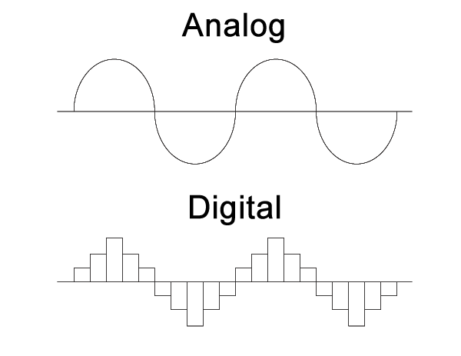
Introduction
Digital vs Analog

Slide 14
Introduction
Binary
On/Off switches to represent states/data
Also a number system

Slide 15
Introduction
Digital Systems
Custom circuits
Gates and iCs
Microprocessors (µCs)
Programmed

Slide 16
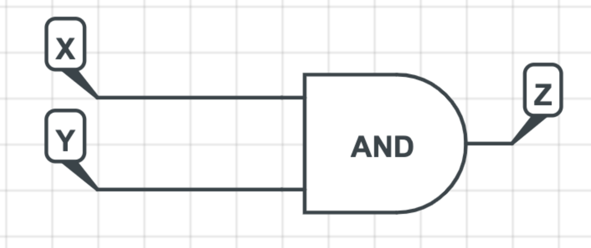
Introduction
Digital Design Example
if (x==1 && y==0) {
z=1;
}

Slide 17
Reading
This lecture
Section 1.1
Next lecture
Sections 2.1-2.3, 2.8-2.9

