Slide 1
CPE201 Digital Design
By Benjamin Haas
Class 3: Arithmetic and Complements

Slide 2
Binary Arithmetic
By hand, it uses all the same rules you know for decimal arithmetic

Slide 3
Binary Addition
4 Rules
0 + 0 = 0
0 + 1 = 1
1 + 0 = 1
1 + 1 = 10 The sum is 0 and the carry is 1

Slide 4
Binary Addition
Carry is the same as for decimal
19 1¹9 Put carry here
+ 1 + 1
0 First col adds to 10 20

Slide 5
Binary Addition Examples
100 + 110
010 + 1
11 + 111
011.1 + 111.01

Slide 6
Binary Multiplication
Easiest multiplication table ever!
0 x 0 = 0
0 x 1 = 0
1 x 0 = 0
1 x 1 = 1

Slide 7
Binary Multiplication
Makes partial products a breeze
100 11.1
x110 x 11
000 111
100 +111
+100 1010.1
11000

Slide 8
Binary Subtraction
The usual rules for positive numbers where you subtract a smaller number from a bigger number
Subtract each column and do a borrow, if necessary

Slide 9
Binary Subtraction
11000 1010
- 100 - 111
10100 0011

Slide 10
Binary Subtraction
The rules work well for a small subset of arithmetic problems
What about negative numbers?
What about subtracting a larger # from a smaller one?
Complements!

Slide 11
Binary Division
Just like decimal, same as the other operators

Slide 12
Unsigned Numbers
The number of bits n used to store the # determine the max value, 2^{n} - 1
For 4 bits, max value = 2⁴ = 15
Not 16 because of including zero
For 8 bits, max value = 255
For 16 bits, max value = 65,535

Slide 13
Complements
Used to express or store negative numbers
Turns subtraction into addition, which is easier
In general, there are 2 types of complements
Diminished radix complement (1’s complement)
Radix complement (2’s complement)

Slide 14
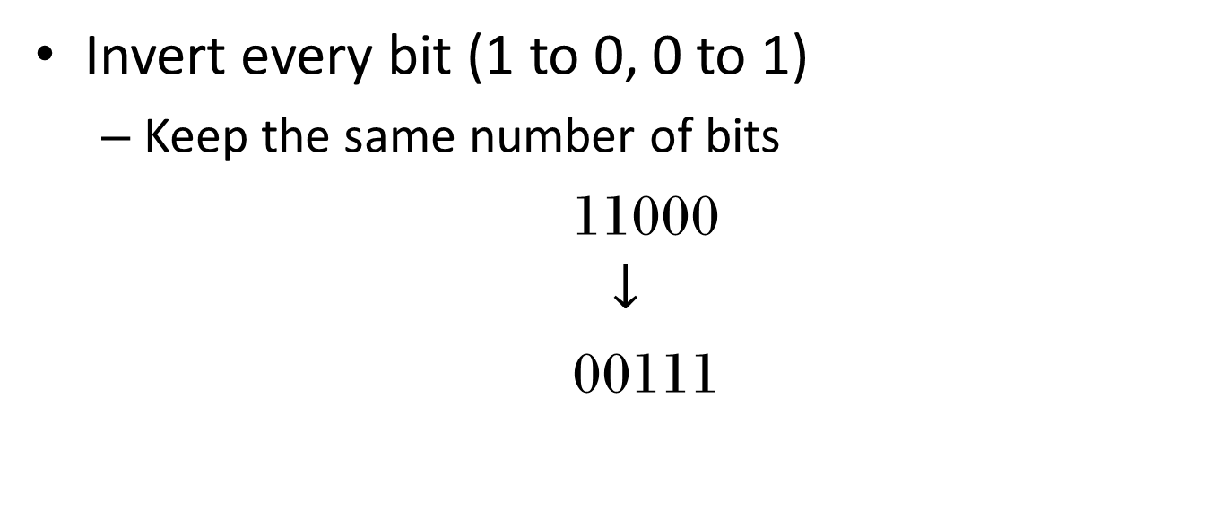
1’s Complement
Invert every bit (1 to 0, 0 to 1)
Keep the same number of bits
11000
$$↓$$
00111

Slide 15
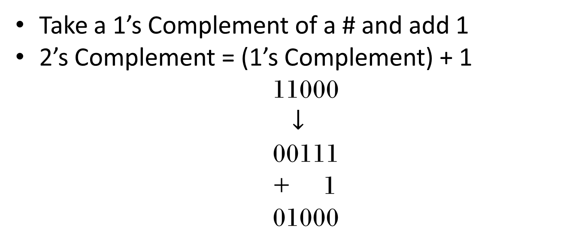
2’s Complement
Take a 1’s Complement of a # and add 1
2’s Complement = (1’s Complement) + 1
11000
$$↓$$
00111
+ 1
01000

Slide 16
2’s Complment
Another way to get it is to start at the LSB and move left
When you get to the first 1, invert all bits to the left of it
Invert 11000 No inversion
01000

Slide 17
2’s Complement Examples
111
10101
10111
100

Slide 18
9’s and 10’s Complement
Like 1’s and 2’s Complement, but for decimal
Feel free to look at it
Not used in this class

Slide 19
Signed Numbers
Splits the value range for neg and pos #’s
Max value = 2^{n-1} - 1
Min value = -(2^{n})
For 4 bits, -8 to 7
For 8 bits, max value = -128 to 127
For 16 bits, max value = -32,768 to 32,767

Slide 20
Signed Numbers
Highest bit (MSB) is a sign bit
0 is positive
1 is negative
Negative #’s are the 2’s complement of the equivalent positive #
-1 = 1 = 0000 0001 = 1111 1110 = 1111 1111 = -1
Pos # 1’s Comp 2’s Comp

Slide 21
Signed Numbers
Weights are slightly modified
MSB is negative
2⁷ 2⁶ 2⁵ 2⁴ 2³ 2² 2¹ 2⁰ for unsigned becomes
-2⁷ 2⁶ 2⁵ 2⁴ 2³ 2² 2¹ 2⁰ for signed
1011 is -2³ + 2¹ + 2⁰ = -8 + 2 + 1 = -5
1111 is -2³ + 2² + 2¹ + 2⁰ = -8 + 4 + 2 + 1 = -1

Slide 22
Signed Number Addition
Pad with leading zeros to fill the bit size
Add the two numbers
Throw away carry
0000 1111 15 0100 1010 74
+1111 0001 +(-15) +1000 1111 +(-113)
1 0000 0000 0 1101 1001 -39

Slide 23
Signed Number Subtraction
Take the 2’s complement of the 2nd #, then add
0000 1111 15 0100 1010 74
- 0000 1111 -15 - 0111 0001 -113
0000 0000 0 1101 1001 -39

Slide 24
Reading
This lecture
Sections 2.4-2.7
Next lecture
Sections 2.10-2.12

